Slide 1



Lessons Learned from Psychiatry: CATIE and STAR*D
Ajay D. Wasan, MD, MSc
Professor and Vice Chair for Pain Medicine
Co-Director, Center for Innovation in Pain Care
Departments of Anesthesiology & Perioperative Medicine; and Psychiatry
University of Pittsburgh School of Medicine
Center for
Innovation
in Pain Care

Slide 2

Agenda
CATIE
  Atypical antipsychotics in Alzheimer’s dementia and schizophrenia; ~50 papers
STAR*D
  Sequential trials of antidepressants in major depression; >100 papers
Key Lessons
  Appreciating the balance points in the trials
  What are the tradeoffs?
“The optimal balance point between the poles of pragmatic and explanatory qualities is where these approaches mutually strengthen each other to create the most robust framework for a clinical trial design.”
“Sweet spot” in Pain Medicine CER which yields most scientifically and clinically impactful findings
Findings that will have the most meaningful impact on the field

Slide 3
Balancing Pragmatic vs. Explanatory
Tool helps make design decisions consistent with the purpose of the trial
80 international trialists, clinicians and policy makers
9 domains
Scale from ‘most explanatory’ to ‘most pragmatic’ (1-5)
Valuable for matching design decisions for how the results of the trial are intended to be used

Slide 4
What to balance? Key issues involving multiple PRECIS domains
Interventions tested in routine clinical delivery settings when possible (generalizability under usual conditions) with attention to minimizing known confounders (best to test causal hypotheses)
  Magnitude of the unknown confounders inherent in this approach is what stymies clinical trialists and evidence-based medicine purists
Inclusion criteria—broad vs. specific
Duration of tracking intervention—signal of effectiveness vs. durability
Specific dose of intervention—1 for all subjects vs. a range
  Introduces confounders as well
Randomization—several issues, crossover, cluster randomization etc.
Outcomes assessment—rigorous vs. global health outcomes
Data analysis—intention to treat vs. only in those completing treatment

Slide 5
CATIE: Clinical Antipsychotic Trials of Intervention Effectiveness
CATIE trial for chronic schizophrenia as well.
The study design was similar but there was no placebo arm and it was only a CER trial of 5 different antipsychotics (olanzapine superior)
CATIE-ALZ olanzapine, quetiapine, risperidone in lower doses, or placebo (N=450/421 data analysis)
Double blinded, randomized & low and high med. doses
2 Primary outcomes
  Time from initiation treatment to discontinuation of any treatment (proxy for treatment failure for effectiveness, adverse effects or both)
  Minimal improvement benchmark on the clinical Global Impression of Change Scale (CGIC) at 12 weeks

Slide 6
Enrollment criteria: DSM DX for Alzheimer’s + deficits in mini mental exam Rigorous
Psychosis, aggression, and agitation sympts determined by judgement of treating MD. Had to have for 4 weeks (Pragmatic)
Prescribing reflected clinical practice
If subject not responsive to med could be discontinued in 2 weeks and move to Phase 2
??Focus on Phase 1: Our field may or may not be ready for multiphase adaptive trials—the future!

Slide 7
All 3 comparisons to placebo <.01
CGIC minimal improvement metric: 32% OlZ, 29% RIS, 26% QUET, 21% PLAC (p=.22)
Key Lesson: Combined primary outcome of efficacy + adverse effects pragmatic but must distinguish between efficacy vs. AE’s.
Key Lesson: Would assay sensitivity be improved if the primary outcomes were continuous?
Key Lesson: In effectiveness studies re-randomizing treatment failures important (adaptive component) A version of a S.M.A.R.T. design

Slide 8
STAR*D: Sequenced Treatment Alternatives to Relieve Depression
Much more complicated study, general overview is what is more important
Designed to assess effectiveness of treatments in generalizable samples and ensure the delivery of adequate treatments.
The study aimed to define the symptomatic outcomes for outpatients with nonpsychotic major depressive disorder treated initially with citalopram, an (SSRI).
The question is what do you do next if a patient fails 1 SSRI?
  Establish TX remitters vs. nonremitters and identify treatment resistant subgroup (treatment resistant depression (TRD)= fail 2 TXs)
Level 1 Citalopram: Adequate doses of citalopram were given for an adequate treatment trial and assess efficacy in representative practice settings and to identify those failing treatment
Primary outcome was remission of depression symptoms (absence) vs. response (50% improvement in symptoms)
In RCTs of antidepressants typically 20-30% remission rate and 35-45% response rates
  KEY LESSON: For an adaptive trial consider a different pain primary outcome?

Slide 9
STAR*D Key Features
N=4000 outpatients,
Entry criteria broad
  18-75 yrs, non-psychotic MDD, DX with DSM criteria, high symptom scores on HAMD
  Many of the subjects would not have qualified for FDA phase 3 AD trials (generalizability)
Dosing flexible but rigorous
  Citalopram (example) 20-60 mgs, can increase every 2-4 weeks
Treatments unblinded, prescribed by a psychiatrist or PCP
Measurement based care
  Symptom checklist used to determine treatment responses (QIDS-C16)
Some degree of patient choice for which treatments they would receive
  KEY LESSON—particularly important for multimodal pain TX trials
12-14 weeks per treatment per treatment level, 1 year follow up
For Level 2 only small # randomized to/ or chose cognitive therapy over meds (could not compare to other treatments)

Slide 10
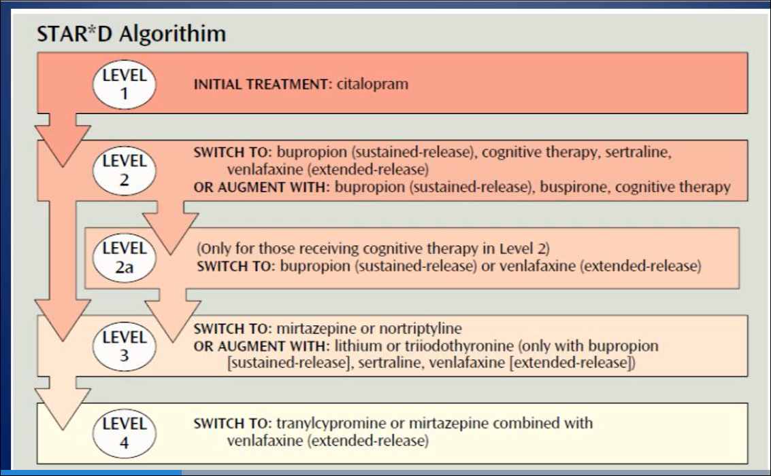

Slide 12
Important study take-aways
Level 1 (citalopram) 33% achieved remission
Levels 1-4: If there is partial benefit at 6 weeks raise the dose
Level 2: Outcomes of switching or augmentation are no different between treatments
  25% remission rate each
With persistent and vigorous treatment, most patients will enter remission: about 33% after one step, 57% after two steps, 63% after three steps, and 67% after four steps (assuming patients stay in treatment).
  Key Lesson: Pay attention to attrition in different phases and relapse rates (next slide)
Remission Rates By Level: 1st=33%, 2nd=25%, 3rd=20%, 4th=15%
7 weeks was the average time needed to achieve remission
Level 2: More of the partial responders to citalopram preferred augmentation vs. switching agents—so augmentation vs. AD med switch strategy could not be directly compared
  Key Lesson: In multiphase study make sure that all treatments can be directly compared with each other

Slide 13
Subject attrition and relapse rates:
Key Lesson: Think about pain flares! Outcome vs. confounder

Slide 14
Lessons from Downstream Studies
Key lesson: Understand characteristics of patients likely to remit. Advances in machine learning make this more possible
  Characteristics of early responders key—lower symptom severity score at 2 weeks into treatment important, higher physical health ratings at baseline, lower anxiety at baseline, fewer episodes of MDD.
  In pain trials consider re-randomizing at 2 weeks if no response?
Key lesson: Are subjects treated in different settings the same (psychiatry vs. primary care) and is the treatment delivered the same?
  ?unmeasured confounders due to treatment clinical site

Slide 15

Thanks to You!
I have been blessed with terrific colleagues!
  Jeong Jong
University of Pittsburgh
  Andrea Gillman
  Ben Alter
  Jim Ibinson
Brigham and Women’s Hospital/
Harvard Medical School
  Robert Edwards
  Srdj Nedeljkovic
  Robert Jamison
  Jeff Katz
MGH Martinos Center/HMS
  Marco Loggia
  Vitaly Napadow
  Randy Gollub
  Jian Kong
Notes:
9:27

Slide 16


Thank You!

