Slide 1
Patient Sources and Eligibility Criteria
The Promis(e) and Perils
Prepared for:
IMMPACT-XXV
Research Design Considerations for Pragmatic and Comparative Effectiveness Clinical Trials of Pain Treatments
Session II
Patient Sources and Eligibility Criteria
22 October 2020
John Markman MD FAAN
Professor of Neurosurgery and Neurology
Neuromedicine Pain Management Center I Translational Pain Research
University of Rochester School of Medicine

Slide 2
Disclosures
Research:
NIH
Consultant:
Flexion Therapeutics, Esteve Pharmaceuticals, Merck, Tremeau, Trigemina, Clexio Bioscience, Quark, Quartet, Collegium, Purdue, Biogen, Novartis, Aptinyx, Nektar, Plasmasurgical, Allergan, Grunenthal , Lilly, Depomed, Kempharm, Jansen, Teva, Kempharm, Abbott, Plasmasurgical, Chromocell, Convergence, Sophren, Inspirion, Pfizer, Diacchi Sankyo, Trevena, SK lifescience, Regenacy (DSMB)
Equity:
YellowBlack; Flowonix
Employee:
Food and Drug Administration (FDA) Special Government Employee (2009-2015)

Slide 3
What do the electronic health record and your junk drawer have in common?

Slide 4
Overview
The Promise
The Perils

Slide 5
Take Home Maximizing External Validity
Include the entire population to which the results will be generalized
The eligibility criteria of your CER/pragmatic study should identify a group that reflects that population

Slide 6
The Formula
CER = PRO + EHR

Slide 7
Types of information in EHR
Encounter Information
Medications ordered
Procedures ordered
Medical and Surgical History
Medical problem list
Billing records

Slide 8
Filter to Identify Chronic Pain Pain scores+ Dx Code+ Meds
ICD9 Diagnosis +
Analgesic (SAO)Medication +
Pain Score>
ICD9 score alone
Tian et al J Am Med Inform Assoc

Slide 9
Chronic Overlapping Pain Conditions
These COPCs overlap at a rate that exceeds other chronic medical conditions with comparable duration and medical encounters.
The study of COPCs collectively, rather than index conditions in isolation is in its infancy but . . .

Slide 10
Strategies for Prescribing Analgesics Comparative Effectiveness (SPACE) Trial
Compares opioid and non-opioid analgesics over 12 months

Slide 11
The trial’s pragmatic design has several advantages. First, enrolled patients had characteristics similar to those of patients receiving opioids in VA primary care, including patients with depression and PTSD.

Slide 12
The Promise
Excellent for hypothesis generating studies using cross-sectional path modeling
fatigue as measured by PROMIS is a mediator of physical function and pain interference
social role satisfaction mediates pain, anger etc.
Well suited for highly regimented care in acute settings –a tweak in your ERAS protocol after knee arthroscopy--as opposed to highly variable care in dispersed settings (i.e. chronic pain)
Sturgeon JA et al PAIN 2015

Slide 13
Collaborative Health Outcomes Information Registry
Sturgeon JA PAIN 2016

Slide 14
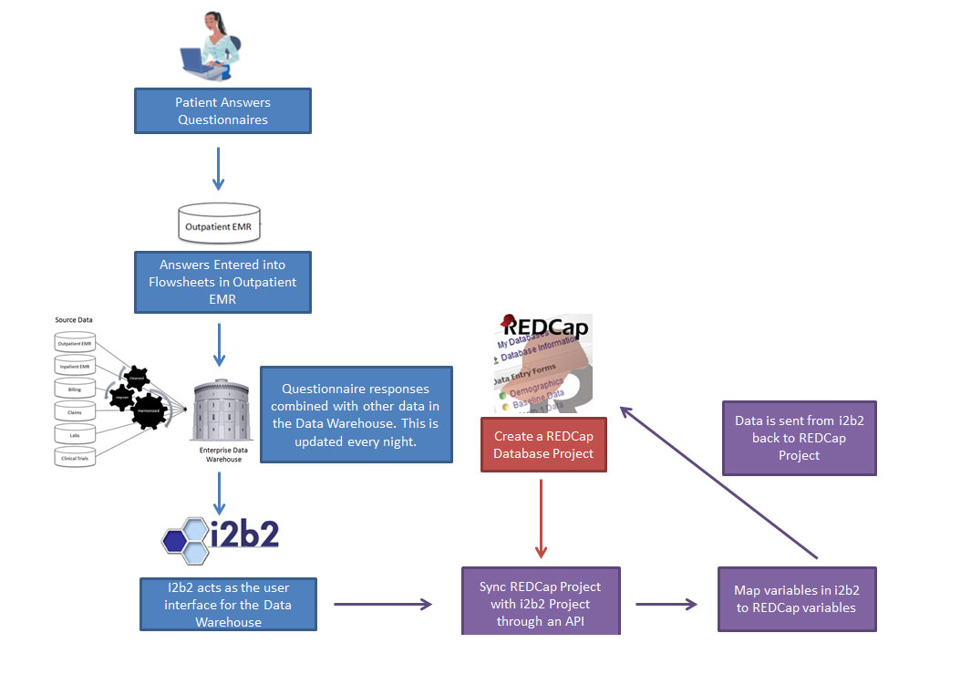
CER 1.0

Slide 15
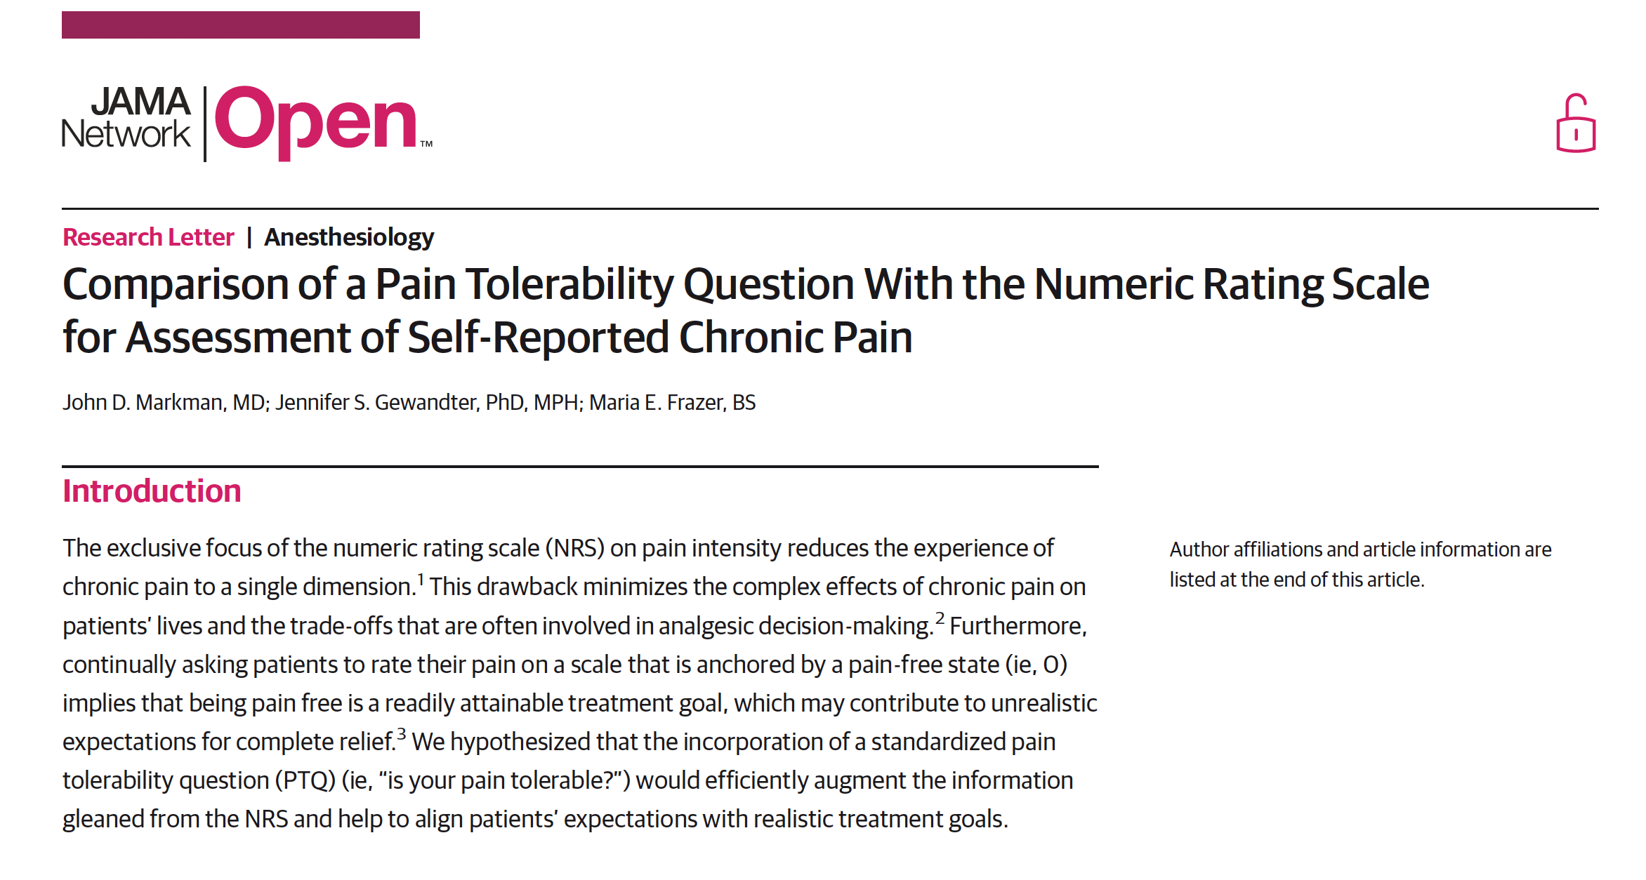
Validation of the PTQ (pain tolerability question)
cohort study 157 practices of GR PCN
n=537

Slide 16
What does a clinical coordinator look like for a pragmatic trial conducted in the EHR
It is probably not a former nurse . . .
Screening for entry is totally different
The quality of study “visit” data collection from patient sources is challenging to track and (nearly) impossible to do in real time.

Slide 17
Implicit Eligibility Criteria
Patient has a computer and/or a smartphone, knows how to download the app, an internet connection, is signed up for the institutional portal, signers the user agreement/waiver of consent, uses the portal, is willing to go to the portal and answer your questions again and again,
and
low back pain on half the days in the past six months

Slide 19
The overarching goal of pain treatment is to make pain tolerable rather than obtain a target numeric rating.

Slide 20
Overview
The Promise
The Perils

Slide 21
EHR Incomplete, inaccurate, inconsistent
Inconsistent use/interaction with EHR functions (e.g. portal)
Patients are increasingly wary of providing “extraneous” information
Documentation to accentuate complexity or maximize revenue or other non-CER related agendas
Is the EHR the real world or its own world?

Slide 22
EHR Distortions

Slide 23
Surveillance capitalism unilaterally claims human experience as free raw material for translation into behavioral data . . . Some of these data are applied to service improvement, the rest are declared behavioral surplus and fabricated into prediction products that anticipate what you will do now, soon, and later.
Notes:
ETHICS O CER
There are 300 promise measures available as full item banks, with CATs

Slide 24
Patient Sources and Eligibility Criteria
The Promis(e) and Perils
Prepared for:
IMMPACT-XXV
Research Design Considerations for Pragmatic and Comparative Effectiveness Clinical Trials of Pain Treatments
Session II
Patient Sources and Eligibility Criteria
22 October 2020
John Markman MD FAAN
Professor of Neurosurgery and Neurology
Neuromedicine Pain Management Center I Translational Pain Research
University of Rochester School of Medicine

