Slide 1
United States National Institutes of Health-Department of Defense-Department of Veterans Affairs Pain Management Collaboratory:
Pragmatic Clinical Trials of Nonpharmacologic Pain Management Approaches
Robert D. Kerns, Ph.D. (Yale University) Cynthia Brandt, M.D., MPH (Yale University)
Peter Peduzzi, Ph.D. (Yale University)
www.painmanagementcollaboratory.org

Slide 2
Gap between evidence and practice
Growing evidence to support integrated, coordinated, multimodal and interdisciplinary models of pain care that support patient activation and pain self-management
Significant organizational/systems, provider and patient-level barriers to timely and equitable access to these approaches
Veteran and military health systems are ideally positioned to address this gap
Notes:
The bottom line is that there is growing evidence to support the delivery of integrated care, but numerous organizational, provider and patient level barriers undermine timely and equitable access to these approaches. These challenges are no doubt greatest in the private, fee for service environment, and the National Pain Strategy section on Service Delivery and Reimbursement emphasized recommendations for percolating innovation in addressing these barriers, particularly reimbursement challenges and financial incentives. In the meantime, integrated learning healthcare systems such as the VA may serve as a proving ground for studying these models of care.

Slide 3
NIH-DoD-VA Pain Management Collaboratory
Approximately $81 Million investment over six years
Sponsors:
NIH: National Center for Complementary and Integrative Health, National Institute for Neurological Disorders and Stroke, National Institute of Drug Abuse, National Institute of Alcohol Abuse and Alcoholism, National Institute of Child Health and Human Development, National Institute of Nursing Research, Office of Behavioral and Social Sciences Research, Office of Research on Women’s Health
DoD: Clinical Rehabilitative Medicine Research Program, Military Operational Medicine Research Program
VA: Health Services Research & Development Service, Office of Research and Development

Slide 4
NIH-DOD-VA Pain Management Collaboratory Key Objective
Conduct pragmatic clinical trials to evaluate whether nonpharmacological approaches for management of pain and multimorbidities are effective when delivered in the Veteran Health Administration (VHA) and/or the Defense Health Agency (DHA)
Why pragmatic studies?
Emphasize generalizability of results and protect rigor
Answer questions that inform VHA and DHA about what services to make available to patients with pain throughout their systems
Results may inform other health care systems about nonpharmacological treatments for pain management

Slide 5
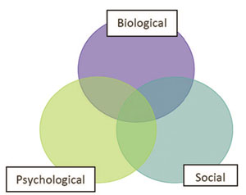
Evidence-based nonpharmacological approaches
Kligler, B. et al. (2018). Clinical policy recommendations from the VHA State-Of-The-Art Conference on Non-pharmacological Approaches to Chronic Musculoskeletal Pain. JGIM, 33 (Supplement), 16-23.
Manual therapies
Manipulation
Acupuncture
Cognitive Behavioral Therapy
Massage
Yoga
Aerobic exercise
Acceptance & Commitment Therapy
Mindfulness Based Stress Reduction
Tai chi
Coordination/ stabilization exercise
Behavioral/
Psychological therapies
Exercise/
movement therapies
Resistance exercise
Notes:
SOTA consensus was that multiple nonpharmacological approaches had adequate RCT evidence of efficacy. Some conventional, some CIH, none an answer for all pts.

Slide 6
VA (and DOD) Models of Integrated Pain Care
Whole Health

Slide 7
Pragmatic Clinical Trials
Phased cooperative agreement research applications to conduct large-scale, pragmatic clinical trials
2 year planning phase
4 year implementation phase
Transition to the implementation phase dependent upon completing milestones in the planning phase
During the implementation phase, the Pragmatic Clinical Trial teams worked with their respective funding agency, and the PMC Coordinating Center to coordinate resource needs and monitor progress
Notes:
The Pragmatic Trial Demonstration Projects are phased cooperative agreement research applications. The projects a 2 year planning phase (UG3), which project are in their second year of funding, and will be looking to transition to 2-4 year implementation phase (UH3) at the end of this fiscal year or sometime in in Early to mid FY20.
All projects will be milestone-driven, and transition to the implementation phase (UH3) will be dependent upon the successful progress made during the planning phase
During the implementation phase the Demonstration Project teams, in cooperation with their respective funding agency rep and the PMC Coordinating Center, will determine resource needs and monitor progress towards the negotiated milestones.

Slide 8
11 Pragmatic Clinical Trials
J. Fritz/D. Rhon: SMART Stepped Care Management for Low Back Pain in Military Health System (NIH)
S. George/S.N. Hastings: Improving Veteran Access To Integrated Management of Chronic Back Pain (NIH)
C. Goertz/C. Long: Chiropractic Care for Veterans: A Pragmatic Randomized Trial Addressing Dose Effects for cLBP (NIH)
A. Heapy: Cooperative Pain Education and Self-management: Expanding Treatment for Real-world Access (COPES ExTRA) (NIH)
M. Rosen/S. Martino:
Engaging Veterans Seeking Service-Connection Payments in Pain Treatment (NIH)
S. Taylor/S. Zeliadt: Complementary and Integrative Health for Pain in the VA: A National Demonstration Project (VA)
S. Farrokhi/C. Dearth/E. Esposito Russell: Resolving the Burden of Low Back Pain in Military Service Members and Veterans (RESOLVE Trial) (DoD)
K. Seal/W. Becker: Implementation of a Pragmatic Trial of Whole Health Team vs. Primary Care Group Education to Promote Non-Pharmacological Strategies to Improve Pain, Functioning, and Quality of Life in Veterans (NIH)
B. Ilfeld: Ultrasound-Guided Percutaneous Peripheral Nerve Stimulation: A Non-Pharmacological Alternative for the Treatment of Postoperative Pain (DoD)
D. McGeary/J. Goodie: Targeting Chronic Pain in Primary Care Settings Using Internal Behavioral Health Consultants (DoD)

Slide 9
Pragmatic Clinical Trials Pragmatic Explanatory Continuum Indicator Summary (PRECIS-2) Domains Loudon Kirsty, Treweek Shaun, Sullivan Frank, Donnan Peter, Thorpe Kevin E, Zwarenstein Merrick et al. The PRECIS-2 tool: designing trials that are fit for purpose BMJ 2015; 350 :h2147
Eligibility: Minimal exclusion criteria (e.g., persons with significant alcohol use/abuse included)
Recruitment: In the flow of routine clinical care
Setting: Clinical care settings (e.g., primary care, PT, surgery)
Organization: Limited additional resources or training (e.g., clinical staff deliver interventions)
Flexibility (in intervention delivery): Patient-centered; flexible; adaptations consistent with optimized clinical care (e.g., COVID related adaptations)
Flexibility (in intervention receipt/adherence): Minimal enhancements beyond those embedded in the interventions
Follow-up: Consistent with routine clinical follow-up
Primary outcomes: Patient-centered (i.e., pain and pain reduction, ability to function in daily life, quality of life, and medication usage/reduction/discontinuation)
Primary analyses: Intent to treat approach

Slide 10
Chiropractic Care for Veterans: A Pragmatic Randomized Trial Addressing Dose Effects for cLBP (Goertz and Long)
Evaluate the comparative effectiveness of a low dose (1-5 visits) of standard chiropractic care against a higher dose (8-12 visits) in Veterans with cLBP.
Evaluate the comparative effectiveness of chiropractic chronic pain management (CCPM; one scheduled chiropractic visit per month x 10 months), compared to usual care, following the initial treatment described in Aim 1.
Evaluate the impact of CCPM on health services outcomes compared to usual care.
Evaluate patient and clinician perceptions of non-specific treatment factors, effectiveness of study interventions, and impact of the varying doses of standard chiropractic care and the CCPM on clinical outcomes across 3 VA facilities using a mixed method, process evaluation approach.
Notes:
Four VHA sites, 766 Veterans

Slide 11
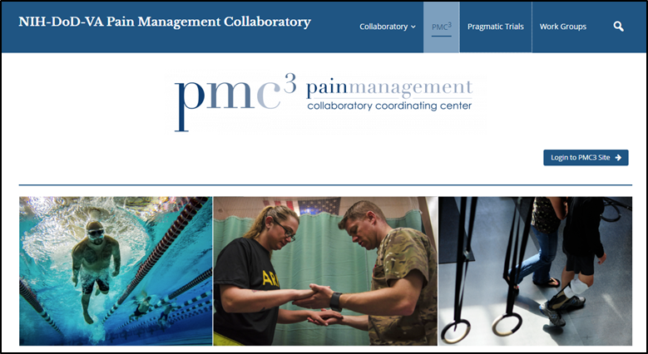
Pain Management Collaboratory Coordinating Center (PMC³)
Robert Kerns, Cynthia Brandt, and Peter Peduzzi Yale University and VA Connecticut
Works with PCT teams to develop, initiate and implement a research protocol;
Coordinates and convenes Steering Committee of all PIs and federal partner representatives;
Supports PCTs via PMC³ Work Groups
Disseminates best research practices within the Veterans Health Administration and Defense Health Agency
Notes:
The purpose of the Coordinating Center is to provide national leadership for the PMC program for internal and external stakeholders. The PMC provides assistance and to the 11 projects to enable them to conduct efficient, large-scale pragmatic clinical trials. During this initial 2 year planning phase, the Coordinating Center has been an important resource for he 11 demonstration projects in helping them prepare for all facets of the implementation phase.

Slide 12
PMC Work Groups
Biostatistics and Study Design
Phenotypes and Outcomes
Electronic Health Record
Data Sharing
Ethical and Regulatory Issues
Stakeholder Engagement
Implementation Science
Membership:
Chairs from Coordinating Center
Investigators from pragmatic clinical trials
Representatives from NIH, DoD, and VA
Purpose:
Guide, support and facilitate decisions regarding pragmatic clinical trials
Disseminate knowledge

Slide 13
PMC Progress
Project Milestones
All projects have either transitioned to implementation phase
Data Harmonization
All projects agreed to include the PEG3 as an outcome measure
All projects agreed on a common definition of opioid use as either an outcome (to examine potential opioid sparing effects) or as a covariate
All projects agreed to use the AUDIT-C and PHQ-2 for phenotyping alcohol use and depressive symptom severity (or affective distress, more generally), respectively
Additional Inclusion criteria and phenotyping harmonization, as appropriate to individual trials
Agreed to use a common definition of “high impact chronic pain” to identify a subpopulation of interest
Developed standardized approach to measuring self-reported use of nonpharmacological/complementary and integrative health approaches

Slide 14
PMC Progress
Site Overlap
Projects that planned to recruit or perform interventions at the same locations made plans to address and minimize competition for subjects and possible contamination (Manuscript under review)
Biostatistics advice
Project specific consultation
Missing Data, ICC and Covariates addressed and “White papers” developed
Regulatory Challenges
Shared learning and identification of best practices
Subgroup developed to discuss principles of justice and health equity (Manuscript in development)
In this context, we’ve seen an opportunity for engaging patients as stakeholders and resources

Slide 15
PMC Progress
Stakeholder Engagement
Shared learning and best practices
Qualitative data from pilot phase shared
Manuscript in press
Letters encouraging support sent to MTF commanders signed by Lt Gen (Ret) Schoomaker; similar letter to VA facility leaders signed by Dr. Carolyn Clancy (senior leader in VHA)
Established Patient Resource Group
Established External Board (Chaired by Lt Gen (Ret) Schoomaker)
Data Sharing
Projects may contribute data to the HEAL Repository
Website Development
Check it out: www.painmanagementcollaboratory.org

Slide 16
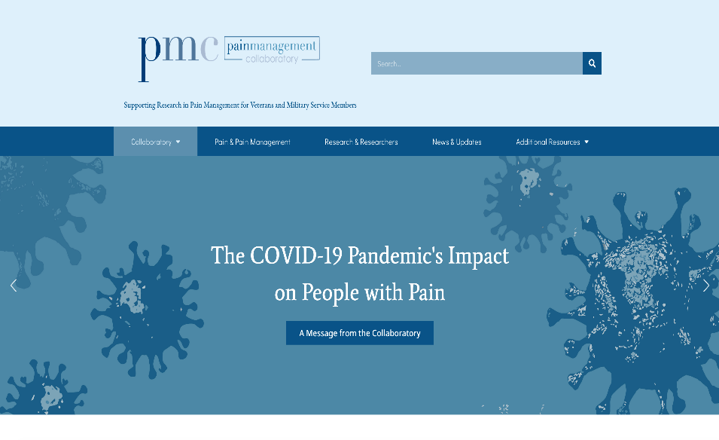
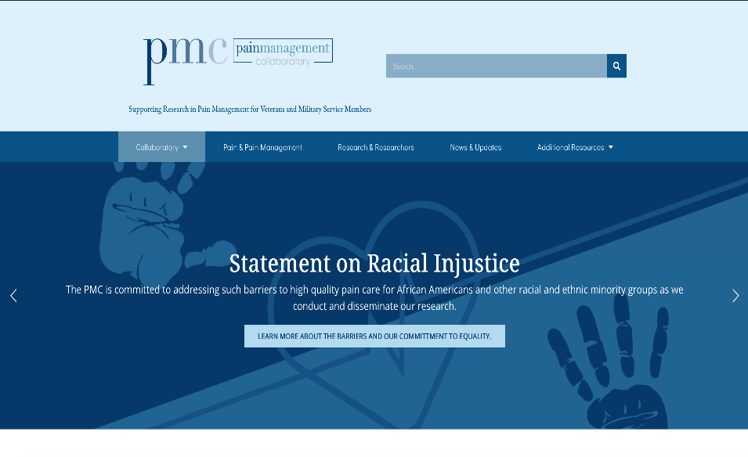
Responses to recent events affecting people with pain
Developed written response to COVID-19 pandemic on PMC website and coordinated and supported unified measures to account for COVID-19 impact across all 11 trials. (Manuscript published)
(
Crafted written and video responses to “Black Lives Matter” and disparities in pain care, leveraging PMC PCT PI expertise.

Slide 17
Response to COVID 19
Building a supportive community, drawing on the strengths of the PMC, VA and DoD as learning healthcare systems.
Coordinated effort to identify significant changes to PCT protocols (sampling and recruitment plans, assessments, interventions) as a function of COVID. (Manuscript on shift to virtual delivery of pain interventions under review)
Developing additional survey questions regarding impact of COVID for study participants.
Developing collaboration with NIH Health Systems Research Collaboratory to identify solutions and best practices, and to develop recommendations for appropriate analytic approaches to address protocol adaptations.
Encouraging ongoing communication between PCT PIs and sponsoring agency program officers and relevant IRBs and DSMBs regarding potential protocol changes.

Slide 18
Testimonials
“I love being part of the Pain Management Collaboratory because I get to work closely with pain experts in the field regularly in real time…. For instance, when the COVID-19 crisis emerged, we had to scramble to determine the impact on our trials, but we were able to work rapidly in real time to come up with measures that everybody was going to add to their battery of baseline measures, and potentially measures throughout the trial, to factor in the impact of COVID.” - Diana Burgess, Ph.D.
“I appreciate this type of camaraderie at a high level.”
-Steven George, PT, Ph.D.
[The Collaboratory] allows us to all be in tune with one another and benefit from the addition of all our projects together, rather than just from the individual project alone. - Brian Ilfeld, M.D., M.S.
www.painmanagementcollaboratory.org

Slide 19
Thanks
Robert.kerns@yale.edu
www.painmanagementcollaboratory.org
Twitter: @Drbob52; @painmc3
Kerns, R.D., Brandt, C.A., Peduzzi, P. and the NIH-DoD-VA Pain Management Collaboratory. (2019). The NIH-DoD-VA Pain Management Collaboratory. Pain Medicine, 20, 2336–2345. doi.org/10.1093/pm/pnz186
Forthcoming Pain Medicine supplement

