Slide 1
Pragmatic and Comparative Effectiveness Trials of Pain Treatments Choosing Study Sites and Investigators
John T. Farrar, MD, PhD
Departments of Epidemiology
Anesthesia (Secondary)
and Neurology (Secondary)
University of Pennsylvania

Slide 2
Conflict of Interest Considerations
Industry Support
Grant Support
Analgesic Solutions
Aptinyx
Biogen
Campbell Alliance
Cara Therapeutics (DSMB)
Daiichi Sankyo
GW Pharma
Novartis
Pfizer/Lilly
International Pelvic Pain Assoc
J PharmacoEpi and Safety (Associate Editor)
IMMPACT/ ACTTION - University of Rochester
NIH and FDA

Slide 3
Outline
Define the issues and problems
Site selection criteria
Other consideration and conclusions

Slide 4
RCT Assay Sensitivity
Definition: A property of a clinical trial defined as the ability to distinguish an effective treatment from a less effective or ineffective intervention*
Primary focus:
Reduction of unintentional variability and bias in all aspects of the trial
Response of subjects in the placebo treated or other control group
* International Conference on Harmonization. E10: Choice of control groups and related issues in clinical trials. http://www.fda.gov/downloads/RegulatoryInformation/Guidances/ucm125912.pdf; 2001

Slide 5
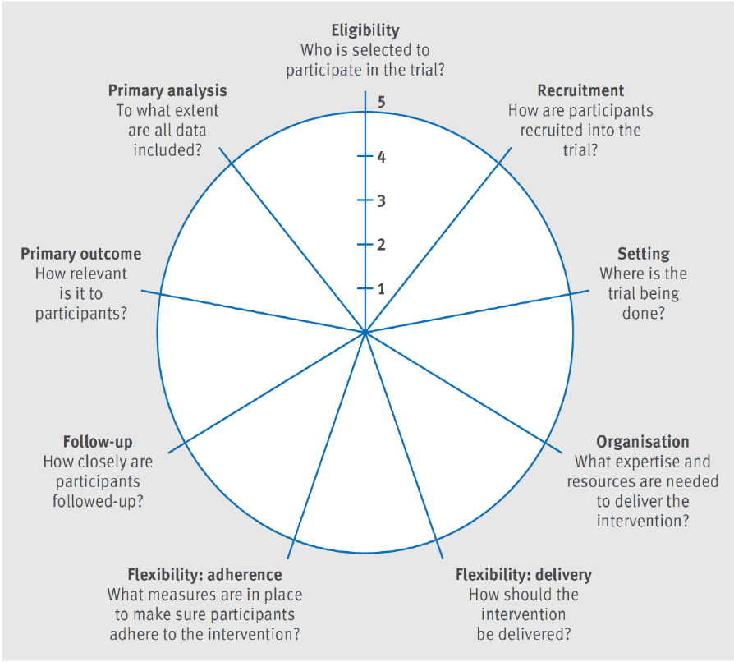
Definition of Pragmatic Trials PRECIS-2
Pragmatic trials are focused on testing of therapies in “real world” clinical practice but there is a broad range of different trial designs for both pragmatic and explanatory trials
*
* Loudon, Kirsty, et al. "The PRECIS-2 tool: designing trials that are fit for purpose." bmj 350 (2015): h2147.
Another definition: https://www.nia.nih.gov/research/blog/2017/06/ pragmatic-clinical-trials-testing-treatments-real-world

Slide 6
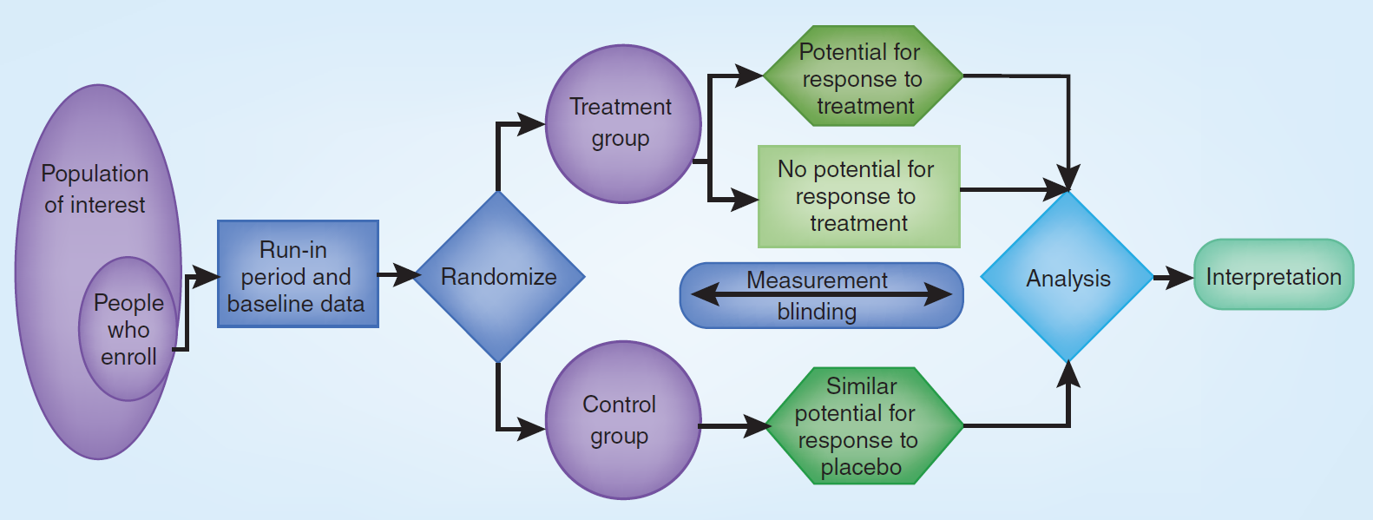
Clinical Trial Design Components
Central enrollment and randomization
Sites and investigators
Farrar JT. Advances in clinical research methodology for pain clinical trials. Nature Medicine. 2010;16(11):1284-93.

Slide 7
Population/ Patient Characteristics Homogeneity vs Heterogeneity
Accuracy of diagnosis vs broad population
Phenotype definition – requires baseline data collection that may not be available in some CER studies
Disease duration
Baseline disease level
Prior treatments and failures
Reason for patient’s participating
Psychological issues
Likelihood of study completion and subject followup

Slide 8
ASCO Statement: Attributes of Exemplary Clinical Trial Sites
Diversification of the clinical trial mix
High accrual activity
Participation in the clinical trial development process
Maintenance of high educational standards
Quality assurance
Multidisciplinary involvement in the clinical trial process
Clinical trial awareness programs.
Baer, Allison R., et al. "Implementing clinical trials: A review of the attributes of exemplary clinical trial sites." Journal of oncology practice 6.6 (2010): 328.

Slide 9
Survey of Attitudes Towards Trial Sites in Europe
Gehring M, et al. Factors influencing clinical trial site selection in Europe: the Survey of Attitudes (SAT-EU Study). BMJ Open 2013; 3:e002957.

Slide 10
Pragmatic Trials Site and Investigator Selection
Worsley, Sally D., et al. Series: Pragmatic trials and real world evidence: Paper 2. Setting, sites, and investigator selection." Journal of Clinical Epidemiology 88 (2017): 14-20.

Slide 11
Site and Investigator Considerations All Designs
Academic vs private practice*
For depression academic sites provided larger separation of placebo and treatment effects
Role of financial incentive is important
Higher vs lower recruitment sites**
Higher recruitment sites => higher placebo rates
*Dunlop, B., et al. A Meta-analysis of Factors Impacting Detection of Antidepressant Efficacy in Clinical Trials: The Importance of Academic Sites. Neuropsychopharmacol 37, 2830–2836
**Irving, G. (2010). The Placebo Response. Clinical drug investigation, 30(11), 739-748.

Slide 12
Components Related to Site and Investigator Characteristics
Financial incentive for screening, enrollment, and completion of study
Accuracy of diagnosis – skills of investigators
Accuracy of previous treatment history
Accurate and honest assessment of baseline pain intensity or other symptoms
Accurate and honest assessment of willingness to participate
Actual involvement of investigators versus staff in patient enrollment and study progress
Notes:
Screening – EHR vs soliciting patients

Slide 13
Site Selection Considerations
Population-wide prevalence of the target pain condition should determine the number of sites
Include sites with a track record of producing high quality data
Highly experienced clinical investigators and staff
Requisite resources
Site visits to confirm the experience and quality are worth-while
Be cautious about implementing strategies to accelerate recruitment or adding less experienced sites. Participants enrolled toward the end of trials demonstrate a smaller treatment effect
*Gewandter, et al (2019). Improving study conduct and data quality in clinical trials of chronic pain treatments: IMMPACT recommendations. The Journal of Pain, in Press.

Slide 14
Assessment of Sites and Investigators
Interest in the clinical trial topic
Number of subjects previously recruited
Record of subject completion of study (dropout rates)
Record of study data completeness
Any recent changes in investigators or staff
Any previous problems (citations) of the investigators
Willingness to attend orientation meeting and undergo specific training

Slide 15
Selection of Sites Depends on Design Consider an Example – Control Group
If control group is “usual care’ then randomization is often by site. Blinding is more difficult
If comparison of treatment is to a placebo then randomization by subject may be more appropriate. Blinding is more important
This choice affects site selection process.

Slide 16
Randomization by Site (e.g. treatment versus usual care)
Relative similarity of sites should be carefully considered (matching?)
Determining what constitutes “usual care”. Must be carefully evaluated in matching as treatment can differ significantly by site.
Will different patient populations agree to trials in treated vs non-treated sites
Methods for maintaining patient involvement (especially without intervention) are needed for the pertinent outcome measures
Notes:
Another is to influence care at participating sites.

Slide 17
Assessment of Sites – Placebo Studies Factors in Placebo Group Rates
A larger placebo group response rate may result from:
Encouraged or overstated patient baseline?
Overly enthusiastic coordinators or presentation of study?
Poor control for “professional” patients?
A lower placebo group response rate may result from:
Recruiting only more severe cases
Look at active treatment group rates as well
Lower recruiting sites also may only recruit more severe disease

Slide 18
Things to Consider to Minimizing Inter-site Variability
Staff training to standardize interaction
Centralized process for enrollment decision and randomization
Consider direct upload of screening data such as the 7 day daily pain diary
Pre-study run in using all forms
Require complete data from subjects and site
Set appropriate incentive for screening, enrollment, and completion of study
Ongoing monitoring for validity of data

Slide 19
Statistical Issues in Site Selection
Homogeneity of patients within site
SES, Race, Sex
Treatment approach to disease of interest
Location factors
Design approaches to mitigate effect of differences on analysis
Block randomization by site
Statistical approaches to site differences
ignore them
model them as fixed effects
model them as random effects

Slide 20
A Few Additional References of Interest
Worsley, Sally D., et al. "Series: Pragmatic trials and real world evidence: Paper 2. Setting, sites, and investigator selection." Journal of Clinical Epidemiology 88 (2017): 14-20.
Hurtado-Chong, A. et.al. (2017). Improving site selection in clinical studies: a standardized, objective, multistep method and first experience results. BMJ open, 7(7), e014796.
Gligorijevic, J., et.al. (2019). Optimizing clinical trials recruitment via deep learning. Journal of the American Medical Informatics Association, 26(11), 1195-1202.
van den Bor, R. M., et.al. (2017). Predicting enrollment performance of investigational centers in phase III multi-center clinical trials. Contemporary clinical trials communications, 7, 208-216.
Dombernowsky, T. et.al. (2019). Criteria for site selection in industry-sponsored clinical trials: a survey among decision-makers in biopharmaceutical companies and clinical research organizations. Trials, 20(1), 708.

Slide 21
Thank you: To the organizers and staff, as well as all the other expert contributors and attendes
Questions?

