Slide 1
Pragmatism:
Finding and Answering the Important Question
Scott Evans, PhD, MS
Director, The Biostatistics Center
Professor and Chair, Department of Biostatistics and Bioinformatics
George Washington University
IMMPACT-XXIV
October 22, 2020

Slide 2
A Leaky Roof…
Created a water bubble in my wall
In addition to a new roof, I had to re-paper the wall
I asked my neighbor, who recently papered a similar-sized room in his house:
“How much paper did you buy?”
He replied: “Six rolls.”

Slide 3
Upon finishing the papering of the wall…
I had only used only 4 rolls
I told my neighbor that I had 2 rolls left
He replied:
“Oh. That happened to you too?”
Notes:
Moral of the story: Spend time carefully thinking about how to frame the question. Right answer to the wrong question.

Slide 4
Two Things I’ve Learned about Traditional Clinical Trials
They are rigorously conducted by experts closely adhering to the highest standards and fundamental principles of randomized clinical trials
They are essentially useless for helping clinicians make treatment decisions

Slide 5
Most clinical trials fail to provide the evidence needed to inform medical decision-making. However, the serious implications of this deficit are largely absent from public discourse.
DeMets and Califf, JAMA, 2011

Slide 6
Outline

Slide 7
Pragmatism ≠ RWE
Real world evidence (RWE) concerns the data source i.e., evidence acquired using non-traditional sources e.g., EHR
Pragmatism concerns the question
One does not necessarily imply the other
  Studies can be pragmatic study without using RWD
  Studies may use RWD and not be very pragmatic
To answer important questions for clinical practice, conduct pragmatic studies
To gain the cost and resource efficiencies of existing data, then consider utilizing RWD

Slide 8
Efficacy Clinical Trials
Typical trial setting involves control over many factors
  Enhances sensitivity for detecting effects
  Faster answers
E.g.,
  Selective enrollment criteria
  Surrogate endpoints instead of clinical outcomes
  Limited use of concomitant therapies
May limit relevancy to clinical practice

Slide 9
Pragmatic / Effectiveness Trials
Purpose to inform decisions about clinical practice and policy
Evaluates “strategies” of intervention application for treating patients in practice
  Distinct from questions of biology / mechanisms of action
Evaluation under usual (vs. ideal) conditions
Extraneous variation and perceived imperfections in clinical practice are not to be controlled but part of the way in which the world works and are thus allowed to happen naturally

Slide 10
Characteristics
Diverse and representative populations (generalizability)
Heterogeneous real-world settings
  Everyday care (community clinics, hospitals, and health systems)
Flexible protocols with respect e.g., adherence, treatment application
Important patient-centered outcomes

Slide 11
Explanatory / Efficacy vs.
Pragmatic / Effectiveness Trials

Slide 12
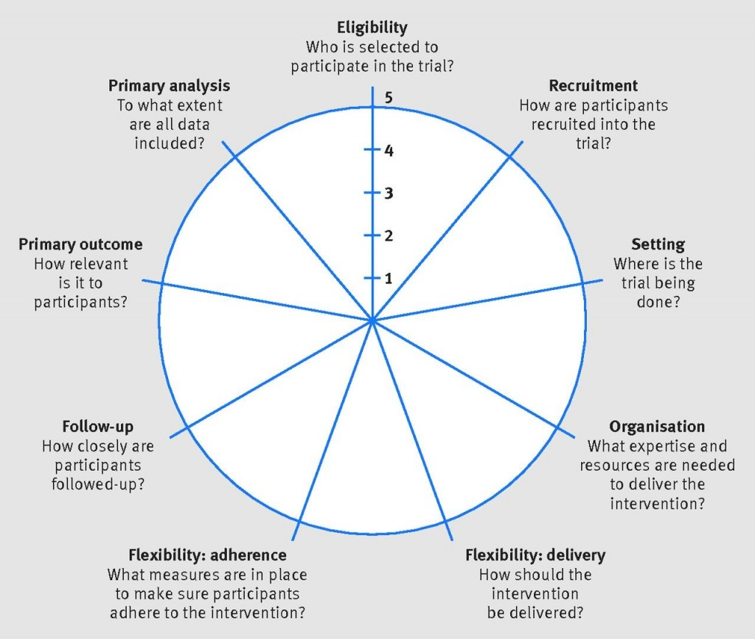
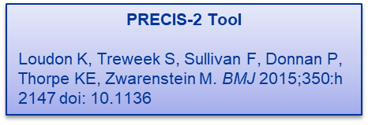
Not a Dichotomy. A Continuum.
A trial may be pragmatic in some respects but not others.

Slide 13
Challenging Issues for Pragmatic Pain Trials
No blinding?
Limited control of concomitant medications?
Flexible application of intervention?
Quality and completeness of RWD for use in trials?

Slide 14
Concern: Lack of Blinding
The most extreme pragmatic designs avoid blinding and placebos
  Would avoid placebo effects
Pain is a patient-centered subjective outcome that could be affected by knowledge of treatment
  Adherence
  Treatment crossover
  Drop-out

Slide 15
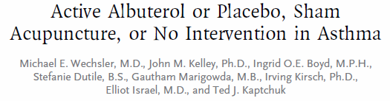
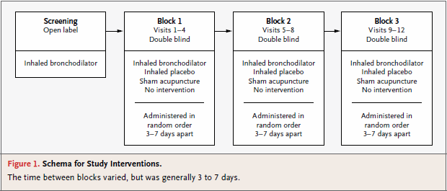
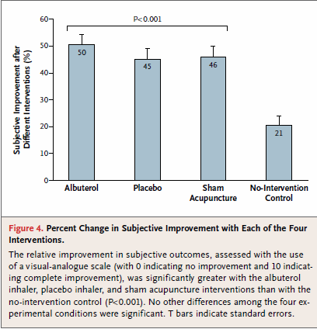
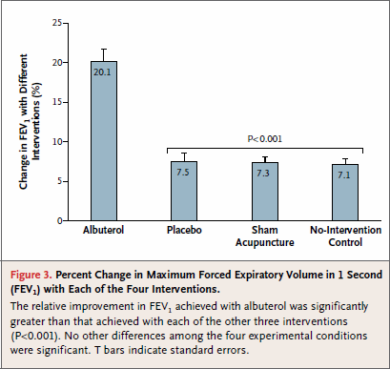
Partially Blinded Trial

Slide 16
Concerns: Concomitant Medication Use
Pain trials often places strict rules on concomitant therapy use e.g., OTC pain medications
  Primary reason: sensitivity
Extreme pragmatic trials place very limited restrictions on concomitant medications
  OTC medications are commonly used in practice

Slide 17
Using RWD?
Very challenging to use RWD for measuring pain outcomes
  Data quality and completeness
  Lack of standardization of methods and measurement instruments
Clinical Trials Transformation Initiative publication forthcoming
  Real-World Data for Planning Eligibility Criteria and Enhancing Recruitment: Recommendations from the Clinical Trials Transformation Initiative (low risk / high reward)
  Data quality and completeness is insufficient for endpoint (high risk)

Slide 18
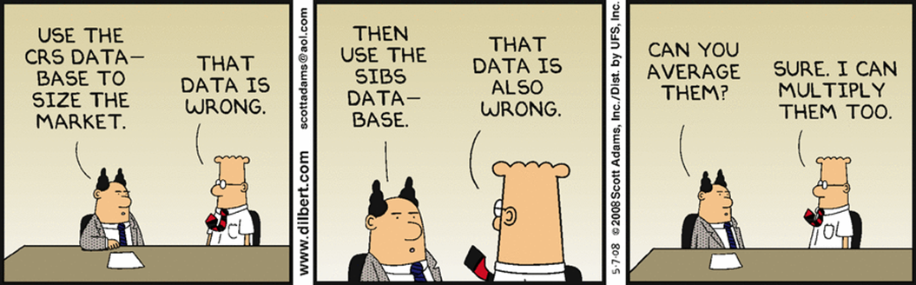
General Concerns
Extraneous variation that is not controlled (e.g., from limited restrictions on entry criteria or the use of concomitant therapies) in pragmatic trials may result in the dilution of treatment effects
  Mixed reviews
Large numbers from RWD don’t eliminate biases & confounding

Slide 19
Opportunity
Getting data through personal devices

Slide 20
Typical approaches to analyses are not pragmatic.
This has essentially gone unrecognized.

Slide 21
Question 1
We define analysis populations
  Efficacy: ITT population
  Safety: safety population
Efficacy population ≠ safety population
We combine these analyses into benefit:risk analyses. To whom does this analysis apply? What is the estimand?
How do we do personalized medicine if we do not evaluate associations between outcomes?

Slide 22
Question 2
Pain: symptom of underlying disease
Effectiveness of pain management can affect underlying disease outcome
  E.g., failure of chemotherapy may be a down-stream consequence to failure of PN management
Change in chemo affects PN…
Difficult problem of competing risks, circularity, etc.

Slide 23
Question 2
Suppose you measure the duration of chemotherapy-associated peripheral neuropathy
Shorter duration is better … or is it?
The faster that a patient withdraws chemo, the shorter the duration. The faster the patient dies, the shorter the duration.
Interpretation needs clinical context of other outcomes for the same patient

Slide 24
Question 3
Great work on estimands…we finally get people to recognize that different analysis populations address difference questions…
Suppose an RCT is conducted comparing A vs. B
Trial participant assigned to A, discontinues A, and begins a new intervention C
The participant then experiences an SAE, adjudicated as related to C but not A
Leads to the belief that safety is not an issue for A. It is C’s fault.

Slide 25
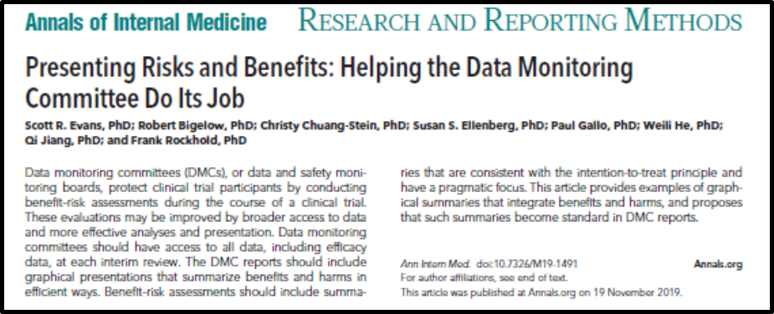
Question 3
Suppose ten additional trial participants discontinue A, begin C, and experience the SAE
Adjudication again links the relationship to C but not A
No such events in Arm B
Would you volunteer to be randomized into this trial?
If you were on the DMC, can you allow continued randomization?
Adjudication is not the relevant question. The strategy of application is. This is ITT.

Slide 26
Question 4
Suppose a loved one is diagnosed with a serious disease
You are selecting treatment
3 treatment options: A, B, and C
2 outcomes, equally important
  Treatment success: yes/no
  Safety event: yes/no

Slide 27
RCT Comparing A, B, and C
Analysis of Outcomes
A (N=100)
B (N=100)
C (N=100)

Slide 28
RCT Comparing A, B, and C
Analysis of Outcomes
A (N=100)
Success: 50%
B (N=100)
Success: 50%
C (N=100)
Success: 50%

Slide 29
RCT Comparing A, B, and C
Analysis of Outcomes
A (N=100)
Success: 50%
Safety event: 30%
B (N=100)
Success: 50%
Safety event: 50%
C (N=100)
Success: 50%
Safety event: 50%

Slide 30
RCT Comparing A, B, and C
Analysis of Outcomes
A (N=100)
Success: 50%
Safety event: 30%
B (N=100)
Success: 50%
Safety event: 50%
C (N=100)
Success: 50%
Safety event: 50%
Which treatment would you choose?

Slide 31
RCT Comparing A, B, and C
Analysis of Outcomes
A (N=100)
Success: 50%
Safety event: 30%
B (N=100)
Success: 50%
Safety event: 50%
C (N=100)
Success: 50%
Safety event: 50%
Which treatment would you choose?
They all have the same success rate.

Slide 32
RCT Comparing A, B, and C
Analysis of Outcomes
A (N=100)
Success: 50%
Safety event: 30%
B (N=100)
Success: 50%
Safety event: 50%
C (N=100)
Success: 50%
Safety event: 50%
Which treatment would you choose?
They all have the same success rate.
A has the lowest safety event rate.

Slide 33
RCT Comparing A, B, and C
Analysis of Outcomes
A (N=100)
Success: 50%
Safety event: 30%
B (N=100)
Success: 50%
Safety event: 50%
C (N=100)
Success: 50%
Safety event: 50%
Which treatment would you choose?
They all have the same success rate.
A has the lowest safety event rate.
B and C are indistinguishable.

Slide 34
RCT Comparing A, B, and C
Analysis of Outcomes
A (N=100)
Success: 50%
Safety event: 30%
B (N=100)
Success: 50%
Safety event: 50%
C (N=100)
Success: 50%
Safety event: 50%
Which treatment would you choose?
They all have the same success rate.
A has the lowest safety event rate.
B and C are indistinguishable.
Choose A…right?

Slide 35
Our culture is to use patients
to analyze the outcomes.
Shouldn’t we use outcomes
to analyze the patients?

Slide 36
Analysis of Patients: 4 Possible Outcomes
A (N=100)
Success: 50%
Safety event: 30%
B (N=100)
Success: 50%
Safety event: 50%
C (N=100)
Success: 50%
Safety event: 50%
Success
+ -
Success
+ -
Success
+ -
SE +
-
15 | 15
35 | 35
50 | 0
0 | 50
0 | 50
50 | 0

Slide 37
Analysis of Patients: 4 Possible Outcomes
A (N=100)
Success: 50%
Safety event: 30%
B (N=100)
Success: 50%
Safety event: 50%
C (N=100)
Success: 50%
Safety event: 50%
Success
+ -
Success
+ -
Success
+ -
SE +
-
15 | 15
35 | 35
50 | 0
0 | 50
0 | 50
50 | 0

Slide 38
Analysis of Patients: 4 Possible Outcomes
A (N=100)
Success: 50%
Safety event: 30%
B (N=100)
Success: 50%
Safety event: 50%
C (N=100)
Success: 50%
Safety event: 50%
Success
+ -
Success
+ -
Success
+ -
SE +
-
15 | 15
35 | 35
50 | 0
0 | 50
0 | 50
50 | 0

Slide 39

Analysis of Patients: 4 Possible Outcomes
A (N=100)
Success: 50%
Safety event: 30%
B (N=100)
Success: 50%
Safety event: 50%
C (N=100)
Success: 50%
Safety event: 50%
Success
+ -
Success
+ -
Success
+ -
SE +
-
15 | 15
35 | 35
50 | 0
0 | 50
0 | 50
50 | 0

Slide 40
Question 5
A negative trial may not mean the treatment is no good for anyone
A positive trial does not mean it works for everyone
How do we identify the subgroup of patients we want to treat?

Slide 41
Identifying Subgroups?
A (N=100)
Success: 50%
Safety event: 30%
B (N=100)
Success: 50%
Safety event: 50%
C (N=100)
Success: 50%
Safety event: 50%
Success
+ -
Success
+ -
Success
+ -
SE +
-
15 | 15
35 | 35
50 | 0
0 | 50
0 | 50
50 | 0
Predictive markers for efficacy identifies …

Slide 42
Identifying Subgroups?
A (N=100)
Success: 50%
Safety event: 30%
B (N=100)
Success: 50%
Safety event: 50%
C (N=100)
Success: 50%
Safety event: 50%
Success
+ -
Success
+ -
Success
+ -
SE +
-
15 | 15
35 | 35
50 | 0
0 | 50
0 | 50
50 | 0
Predictive markers for safety identifies …
Neither approach identifies the patients we want to treat.
Shouldn’t “personalized medicine” be based on analysis of the patient?

Slide 43
Clinical Trial Arithmetic: 1 + 2 × 3 ≠ 9
Compare and combine ≠ combine and compare
Compare and combine is what we do.
Combine and compare is most relevant for evaluating effects on patients.
Scott’s father (a math teacher) to his confused son many years ago:
“The order of operations is important…”

Slide 44
NBA Coach Frank Layden
Had a player that was not producing.
Layden asked the player:
“Son, what is it with you? Is it ignorance or apathy?”
The player looked at Layden and said:
“Coach, I don't know and I don't care.”

Slide 45
If they don’t know, then we should educate them.
If they don’t care, then we should motivate them.

Slide 46
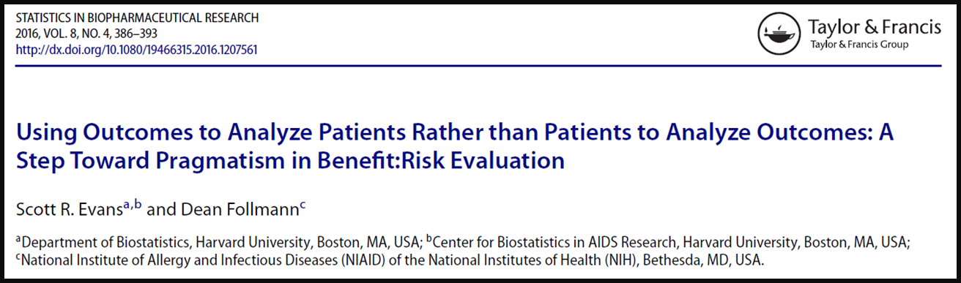
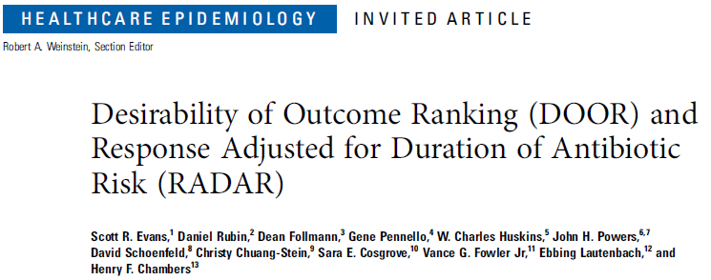
Before we analyze several hundred patients,
we must understand how to analyze one.
The patient journey: synthesis of benefits, harms, QOL

Slide 47
The Map to Pragmatism
Number of outcomes
Now
Progress via composition;
Characterize disease burden
Progress via personalized medicine
Pragmatism
0
Number of Effect Estimates
Then incorporate patient preferences.

Slide 48
DOOR STEPP

Slide 49
PROVIDE
Prospective multi-center observational evaluation among adult hospitalized patients with MRSA bloodstream infections
Research Question
  What is the vancomycin pharmacodynamic exposure target associated with optimal treatment outcome?
N=265

Slide 50

DOOR
Better outcome
 | Treatment success without AKI
 | Treatment success with AKI
 | Treatment failure (persistent bacteremia) without AKI
 | Treatment failure with AKI
 | Death
Worse outcome
Notes:
This slide would make more sense with Better at the top and Worse at the bottom – next time!

Slide 51
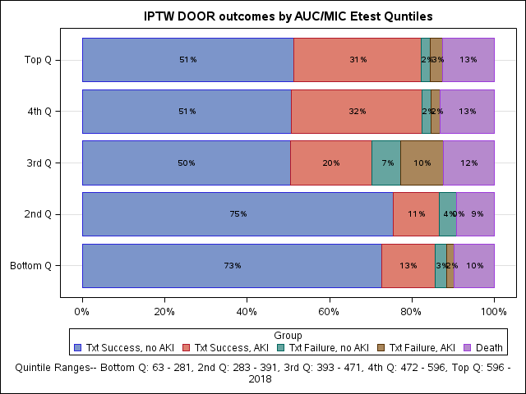
DOOR Outcomes by Dosing Quintiles

Slide 52
Pain trials?
 | Arm A | Control | Score
Pain control; no toxicity | # | # | 100
Pain control w/ toxicity or no pain control w/o toxicity | # | # | Partial credit
No pain control w/ toxicity | # | # | Partial credit
Death | # | # | 0
Looking for northward migration of patients in these categories
DOOR probability: probability of a more desirable global outcome when assigned to the new vs. the control treatment
Partial credit approach can be used to account for:
  Unequal steps between categories
  Varying perspectives among patients / clinicians regarding the desirability of the categories
  For transparency and pre-specification, partial credit can be surveyed from experts or obtained from patients via QOL

Slide 53
My Suggestions
Address pragmatic questions; evaluate “strategies” of application
  A better reflection of the value to society
Pragmatic approaches
  Analysis populations (ITT)
  Flexibility in treatment application
  Allowing concomitant medications
  Analyze benefit:risk e.g., DOOR; rather than outcomes
  RWD for recruitment and defining eligibility criteria
But retain rigor
  Randomization and blinding
  RWD: care needed if assessing endpoints

Slide 54
Two Renown Doctors
What people think of as the discovery is really discovery of the question.
Jonas Salk
Sometimes the questions are complicated and the answers are simple.
Dr. Seuss

Slide 55
Significant Contributors (p<0.001)
Dean Follmann
Dan Rubin
Toshi Hamasaki
Chip Chambers
The Antibacterial Resistance Leadership Group

Slide 56

I have no doubt that you will enthusiastically applaud now …
because you are so relieved that it is over.
Thank you.

