Slide 1
Outcome domains, measures, and sources of data
Matthew J. Bair, MD, MS
VA HSR&D Center for Health Information and Communication, Regenstrief Institute, Inc, and
Indiana University School of Medicine

Slide 2
Outline
PRECIS-2 tool
Outcome domains
Measures
Data considerations

Slide 3
the bmj | BMJ 2015;350:h2147 | doi: 10.1136/bmj.h2147

Slide 4
PRECIS-2 tool
PRECIS (2009) original tool with 10 domains to design clinical trials on a continuum (Thorpe et al. J Clin Epi 2009)
Explanatory attitude (ideal situation) to more pragmatic attitude (usual care)
PRECIS-2—a validated, improved version of the tool

Slide 5
PRECIS-2 tool
PRECIS-2 has 9 domains
Each domain scored on a 5-point Likert continuum (from 1=very explanatory “ideal conditions” to 5=very pragmatic “usual care conditions”)
Trialists can more easily consider whether design decisions match their intended purpose

Slide 6
The Pragmatic-Explanatory Continuum Indicator Summary 2 (PRECIS-2) wheel

Slide 8
Experience with PRECIS
We used PRECIS to:
Organize discussion regarding study design of a planned trial
Determine the extent of consensus among the study investigators
Study Design and Setting
Descriptive; Investigators meeting at VCU
Read and reviewed the PRECIS criteria
Team made judgments of the planned study regarding each PRECIS criteria to reflect initial, ideal and final study design perceptions.

Slide 9
Experience with PRECIS
Results:
Final study design was more explanatory than the preliminary plan
Consensus achieved
Conclusions and findings:
Applying PRECIS principles were useful for (1) detailing points of discussion related to trial design, (2) making revisions to the design to be consistent with the project goals and (3) achieving consensus.
May prove valuable for trial researchers
Riddle et al. J Clinical Epidemiology 2010

Slide 10
Primary trial outcome
Explanatory
Pragmatic
Direct consequence of intervention
More disease-oriented
Underlying mechanism
Objectively measured
Clinically meaningful
More patient-important

Slide 11
Pragmatic outcomes & follow-up
Outcomes are long-term for trials of chronic pain conditions
Clinically meaningful to study participants
Follow-up is low-intensity
Outcomes from existing data without patient contact

Slide 12
Selecting pain outcomes
Pain trial general considerations
Subjective/patient-reported outcomes
Multiple important outcome domains
General considerations
Responsiveness
Respondent burden
Integration in clinical workflow

Slide 13
Key outcome domains
Pain intensity
Pain interference
Physical function
Pain-related change

Slide 14
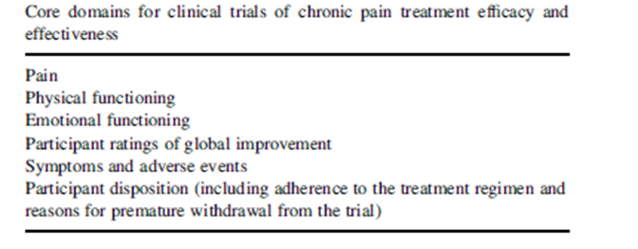
IMMPACT guideline for pain trials
Pain, physical function, emotional function
Condition-specific or generic pain measures
General health-related QOL measures
Adverse effects & symptoms, participant disposition
http://www.immpact.org/publications.html
Turk DC et al. Pain 2003;106: 337–345

Slide 15
Patient relevant pain outcomes
Turk DC et al. Pain 2008;137:276–285
Notes:
4 focus groups conducted to determine 19 aspects of life affected by pain; f/u survey--chronic pain patients asked to rate importance of pain impact on each outcome. All items were rated higher than 6—these are the top rated items. Patients expect pain treatment to reduce pain and improve a variety of domains

Slide 16
Other relevant outcome domains
Depression
Anxiety
Sleep

Slide 17
Other relevant outcome domains
Work disability
Medication/health care use
Health-related quality of life
well-being
Other domains
Catastrophizing
Self-efficacy
Pain coping

Slide 18
Measures – pain intensity
Numeric rating scale (NRS)
Brief Pain Inventory – intensity subscale
Multidimensional Pain Inventory (MPI)

Slide 19
Measures – pain interference
Patient-Reported Outcomes Measurement Information System (PROMIS)
BPI pain interference subscale (7)
PEG
Multidimensional Pain Inventory (MPI)
Graded Chronic Pain Scale

Slide 20
Krebs EE et al. J Gen Intern Med 2009;24:733–8

Slide 21
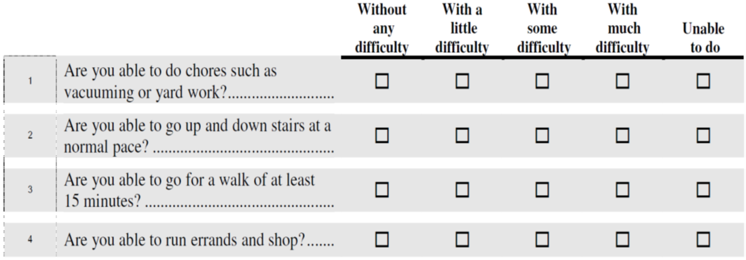
Measures – physical function
PROMIS Physical Function 4-item

Slide 22
Measures – physical function
Roland Morris Disability Questionnaire
Oswestry Disability Index
Medical Outcomes Study SF-36 Bodily Pain Subscale
Western Ontario McMasters Osteoarthritis Index

Slide 23
Measures – pain-related change
Patient-reported Global Impression of Change (PGIC)
Since the start of the study (treatment), my overall pain is …. 1. Much better 2. Moderately better 3. A little better 4. No change 5. A little worse 6. Moderately worse 7. Much worse

Slide 24
Measures – depression
PROMIS
Patient Health Questionnaire-9 (PHQ-9)
PHQ-2
Beck Depression Inventory (BDI)
Profile of Mood States (POMS)
Hospital Anxiety and Depression Scale (HADS)

Slide 25
Measures – anxiety
Generalized anxiety disorder-7 (GAD-7)
GAD-2
Hospital Anxiety and Depression Scale (HADS)

Slide 26
PHQ-2 and GAD-2
Over the last 2 weeks, how often have you been bothered by any of the following problems? Use a check (✓) to indicate your answer for each item | Not at all | Several days | More than half the days | Nearly every day
 | (0) | (1) | (2) | (3)
1. Feeling nervous anxiety or on edge
2. Not being able to stop or control worrying
3. Little interest or pleasure in doing things
4. Feeling down, depressed, or hopeless

Slide 27
Measures – sleep
PROMIS Sleep 4-item

Slide 29
CONSORT extension: pragmatic trials
Recommended extending 8 checklist items for reporting pragmatic trials
The background
Participants
Interventions
Outcomes
Sample size
Blinding
Participant flow
Generalizability of findings
Zwarenstein et al. BMJ 2008

Slide 30
Checklist of items for reporting pragmatic trials
Section | Item | Standard CONSORT description | Extension for pragmatic trials
Outcomes | 6 | Clearly defined primary and secondary outcome measures and, when applicable, any methods used to enhance the quality of measurements (eg, multiple observations, training of assessors) | Explain why the chosen outcomes and, when relevant, the length of follow-up are considered important to those who will use the results of the trial

Slide 31
Data considerations
Quality and completeness of clinical data for research
Availability of data
Gaps in the data – “missing”
Consistency of measurement
Heterogeneity of data across EHR/health systems

Slide 32
Data considerations
Origin of the data
Why and how the data were collected
Information on reliability and meaningful use for research

Slide 33
Data considerations
Important in the early planning stages of a trial
Feasibility
Can data collection be repurposed for research

Slide 34
Data sources
Patient-reported outcomes
Patient-generated data
Clinical data
Administrative or claims data
Registry data

Slide 35
Selecting data sources
Is data source suitable to answer specific trial questions?
A single source may not be sufficient
“Hybrid” data sources?
Use of multiple sources requires more planning, expense

Slide 36
Data quality and completeness
Embedded electronic data capture (EDC) in electronic health record (EHR)
Brief electronic case report forms (CRFs) automatically collected

Slide 37
Potential benefits
May improve costs/efficiency
May reduce patient and provider burden
Greater degree of pragmatism

Slide 38
Potential challenges
Require early strategic agreements w/ sites and health care systems
Different EHR platforms
Interruption of clinical workflow
Security risks of EDC platforms

Slide 39
Best practices for data quality
Begin with minimal set of core data elements
Answer primary/secondary questions
Plan how additional data elements affect clinical workflow

Slide 40
Best practices for data quality
Integrate EDCs into clinical workflows
Manage security risks

Slide 41
Best practices for data quality- Study Design Issues
Designs close to standard of care may reduce gaps in data
Limit # of assessments
Identify what is needed to capture the primary outcome

Slide 42
Best practices for data quality- data collection issues
Minimize participant burden for data collection
Minimize provider burden
Identify collection device or mode most desirable to participants (computer, hard-copy, mobile device)
Consider multiple collection modes (if budget allows)

Slide 43
Study monitoring
Variability in data quality, data gaps, and availability delays
Important implications for trials with safety outcomes (e.g. adverse events related to opioids)

Slide 44
Study monitoring
Centralized monitoring
Risk-based monitoring
Predefined indicators of risk to participant safety, data integrity, trial conduct
“Trigger” in-depth evaluation

Slide 45
Data summary
Good design of the trial upfront
Data capture should focus on primary endpoints
Innovate and iterate on data capture strategies
Evolve to more technology-based data capture

Slide 46
Overall summary points
Pain trialists can use the PRECIS-2 tool to consider whether design decisions match their intended purpose
Key outcome domains (pain intensity, interference, physical functioning, and pain-related change)
Other relevant outcomes to consider

Slide 47
Overall summary points
Highlighted briefer measures for outcome domains
Multiple considerations for data quality and completeness
Several best practices for data quality

Slide 48
Thank you

