Slide 1
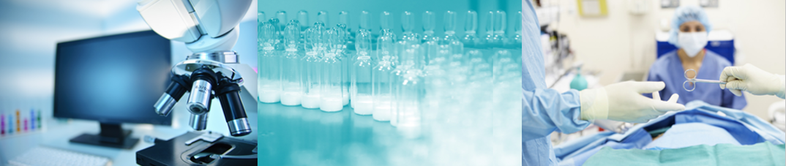
Evidence standards for device approval: Regulatory perspectives
Dr Rahul Singh
Clinical advisor & Orthopaedic surgeon

Slide 2
Objectives: Journey of a medical device
Innovation office/ General Advice
Device development
Compliance
CI approval
Post Market Surveillance
MHRA
Clinical Evaluation
Vigilance
CE Mark
Notified Bodies

Slide 3
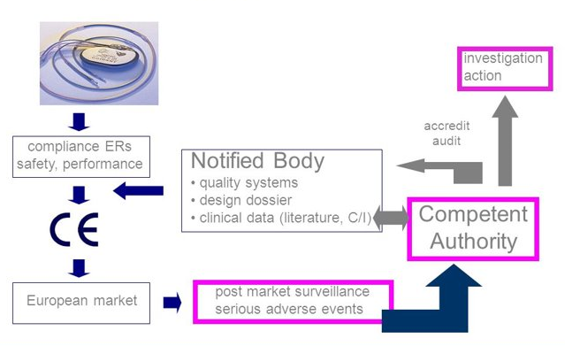
Objectives: Regulatory role

Slide 4
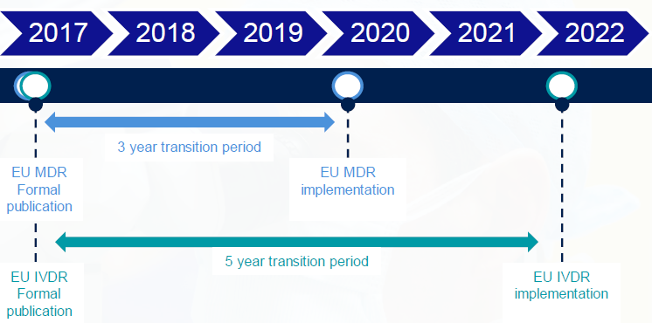
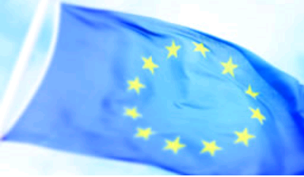
Objectives: New Medical Device Regulation (MDR)

Slide 5
Terminology
Regulation- binding legal force, immediately applicable on set date in all Member States
Directive- is a legislative act that sets out a goal that all EU countries must achieve. Individual countries –can adapt to implement
MEDDEVs promote a common approach to be followed by manufacturers and Notified Bodies that are involved in conformity assessment procedures. Not legally binding.
International Organization for Standardization-ISO creates documents that provide requirements, specifications, guidelines or characteristics that can be used consistently to ensure that materials, products, processes and services are fit for their purpose

Slide 6
Medical Device
Medical Devices Directive, MDD (Directive 93/42/EEC)
Article 1
Any instrument, apparatus, appliance, software, material or other article, whether used alone or in combination, including the software intended by its manufacturer to be used specifically for diagnostic and/or therapeutic purposes and necessary for its proper application, intended by the manufacturer to be used for human beings for the purpose of:
  diagnosis, prevention, monitoring, treatment or alleviation of disease
  diagnosis, monitoring, treatment, alleviation of or compensation for an injury or handicap,
  investigation, replacement or modification of the anatomy or of a physiological process,
  control of conception, and which does not achieve its principal intended action in or on the human body by pharmacological, immunological or metabolic means, but which may be assisted in its function by such means

Slide 7
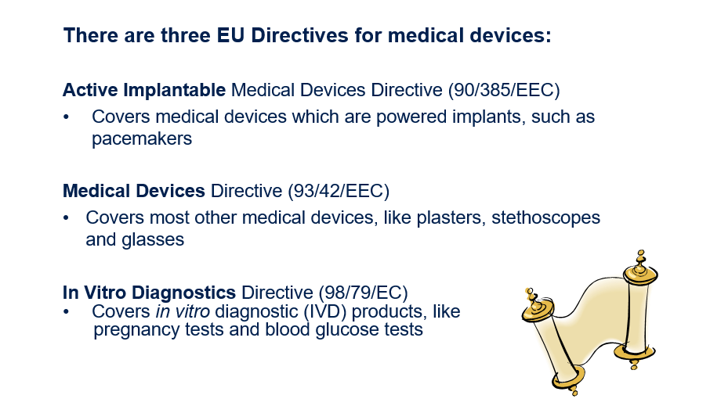
EU Directive for Medical Devices

Slide 8
When to notify MHRA
When
- non-CE marked device
- a CE-marked device being used outside of its intended use
Where possible please give MHRA prior warning of an application
Application: complete IRAS form and submit to MHRA along with the relevant documents – a checklist online

Slide 9
What are we expecting?
Annex X 2.1. of MDD
Demonstration of Safety and Performance.
The objectives of clinical investigation are:
to verify that, under normal conditions of use, the performance of the devices conform to those referred to in Section 3 of Annex I, and
to determine any undesirable side-effects, under normal conditions of use, and assess whether they constitute risks when weighed against the intended performance of the device

Slide 10
Clinical Data - MEDDEV 2.7/1 rev.4
A stepping stone, published 2016
Addresses concerns about clinical evidence
Manufacturers expected to meet the requirements
A clear move towards the expectations of the new medical device regulations.

Slide 11
Stages of clinical evaluation - MEDDEV 2.7/1 rev.4
1
Define the scope, plan the clinical evaluation Section 7, App A3
4
5
2
3
Identify pertinent data Section 8, App. A4-A5
Appraise each individual data set, in terms of its scientific validity, relevance and weighting Section 9, App A6
Analyse the data – conclusions on compliance with ERs on performance and safety, contents of the information materials and residual risks and uncertainties Section 10, App A7-A8
Finalise the clinical evaluation report Section 11, App. A9-A10

Slide 12
Pertinent Data – Section 8
Data generated by the manufacturer
  All pre-market clinical investigations
  All clinical data generated from risk management activities (incl. PMCF, PMS reports, vigilance reports, complaints, analysis of explanted devices, FSCAs, use as a custom made device, exceptional use)
  Relevant pre clinical studies (e.g., bench test reports including verification and validation data)

Slide 13
Data retrieved from literature
Clinical data relevant to the device under evaluation, which are data that relate either to the device under evaluation or to the equivalent device (if equivalence is claimed)
Reasons for using literature:
Describe clinical background/current knowledge/level of evidence
Identify potential clinical hazards (including hazards due to substances and technologies, manufacturing procedures and impurity profiles)
If equivalence is claimed justify/validate criteria used
If surrogate endpoints are used-justify & validate them

Slide 14
Clinical Data- ISO 14155
Addresses GCP, design, conduct, recording, reporting of Clinical investigations
Demonstration of conformity with the relevant general safety & performance requirements
Evaluation of undesirable side-effects & acceptability of the benefit-risk ratio
The manufacturer shall decide on and justify the level of clinical evidence necessary, appropriate for device and its intended use

Slide 15
Biological Evaluation Process- ISO 10993
Chemical constituents, physical properties, additives, residues, degradation products, metabolites, etc.
Establish the safety profile of the materials and characterize risks associated with the device
Data on toxicity of components and prior use
Develop test programme to address uncertainties
Gap analysis
Assessment of toxicological risks and biocompatibility
Prepare biological evaluation report

Slide 16
Framework Matrix from ISO 10993

Slide 17
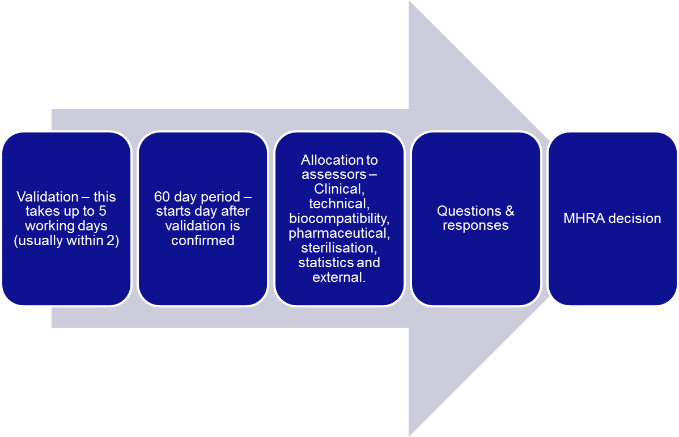
MHRA: Review process

Slide 18
Grounds for objection <10%
Patient safety & risks out weight benefits
Lack relevant clinical end points
Statistical issues
Inadequate pre-clinical testing/ assessment i.e. Tox/bio
Inadequate electrical/software testing

Slide 19

MHRA approval: Clinical investigation

Slide 20
Process: During a clinical investigation
MHRA
Approve study amendments​
Review serious adverse events​
Review protocol deviations​
Review the final study report
​Suspend or terminate CI

Slide 21
Notified Body- CE marking
Before a device is placed on the market :​
Assessment of devices against the particular Annex(es) for the Specified Product Range​
Issues Annex Approval(s)​
Performs Batch Review of highest risk IVD devices​
Post Market :​
Continues ongoing surveillance activities (if QA Annex)​
Approves any changes to the device such as design changes or stating new medical claims or a new intended purpose ​-Co-regulator for devices​

Slide 22
Post Market Surveillance (PMS)
A system to monitor clinical performance & safety of device
Appropriate for the device intended use
Evaluate data which may impact risk analysis.
Clinical evaluation & clinical evaluation report (CER) must
be actively updated with PMS

Slide 23
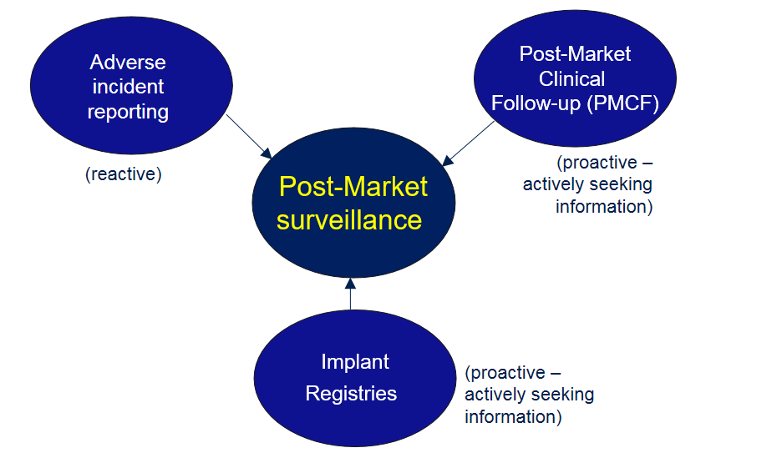
Post Market Surveillance (PMS)
A system to monitor clinical performance & safety of device

Slide 24
Post Market Clinical Follow-up (PMCF)
MEDDEV 2.12/2 rev 2
Following a proper premarket clinical evaluation, the decision to conduct PMCF studies must be based on the identification of possible residual risks and/or unclarity on long term clinical performance that may impact the benefit/risk ratio.
PMCF studies can review issues such as long-term performance and/or safety, the occurrence of clinical events (e.g. delayed hypersensitivity reactions, thrombosis), events specific to defined patient populations, or the performance and/or safety of the device in a more representative population of users and patients

Slide 25
PMCF studies can follow several methodologies:
the extended follow-up of patients enrolled in premarket investigations
a new clinical investigation
a review of data derived from a device registry
a review of relevant retrospective data from patients previously exposed to the device.

Slide 26
Notified Body Review
Class III and class IIb implantable -review by in house clinician
Sampling of IIa & IIb is also done by NBs – this are not routinely audited by MHRA.
Clinical and regulatory affairs manager should sign off on all reviews
NB report – live document with Q&As embedded within it.
    Ensure CER satisfies the requirements
    Verify PMCF is conducted in accordance with relevant provisions. Monitoring.
Auditing the review

Slide 27
Summary: Journey of a medical device
Innovation office/ General Advice
Device development
Compliance
CI approval
Post Market Surveillance
MHRA
Clinical Evaluation
Vigilance
CE Mark
Notified Bodies

Slide 28
Summary: Regulatory role

Slide 29
Summary :New Medical Device Regulation (MDR)

Slide 30
Thank you for listening !

