Slide 1
Sources of Bias in Randomized Controlled Trials of Spinal Cord Stimulation
Nathaniel Katz, MD, MS
Analgesic Solutions, Natick, MA
Tufts University School of Medicine, Boston, MA
IMMPACT Meeting
November 2018 Washington, DC
Notes:
Good afternoon everyone
I started implanting devices for pain in the mid 1990s, and left practice in early 2000s to focus on clinical trial design and execution.
It’s exciting to see all the progress made in this filed since then and I congratulate all of you on that progress.
My goal for today is to in turn get you excited about what we have been learning on the clinical trial design side,
And hope it helps you think more about the design and execution of clinical trials of neuromodulation therapies.

Slide 2

Disclosures
I run a research and consulting firm (Analgesic Solutions) that works with companies developing treatments for pain, and provides tools to improve the conduct of clinical trials
No specific conflicts for this presentation
www.analgesicsolutions.com

Slide 3
Types of bias
PERFECT TRIAL
POSITIVE BIAS
(away from null)
NEGATIVE BIAS
(towards null)
Treatment
Control
Treatment
Control
Treatment
Control
Allocation bias
Expectation bias
Observer bias
Asymmetric non-specific factors
High placebo effect
Rescue medication
Concomitant medication
Poor adherence
Measurement error
Extreme variability

Slide 4
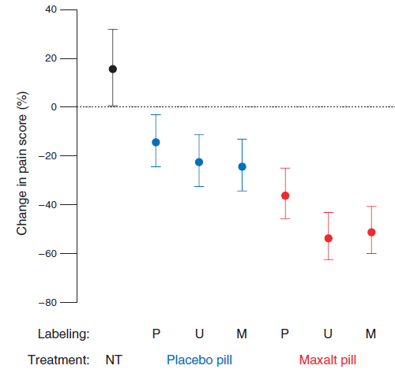
POSITIVE INFORMATION Increases Placebo Effect
Telling participants Placebo was Maxalt increased the placebo response
Your words may be as POWERFUL as the drug
NT = No Treatment; P = Placebo; U = Placebo or Maxalt; M = Maxalt
Kam-Hansen S, Sci Transl Med, 2014

Slide 5
“Enhanced Materials” Increase the Placebo Response
Asthma, n=601
Glossy print, TV ads, brand name vs. “neutral” materials
Led to increased placebo effect compared to same drug with neutral materials
Wise RA, J Clin Allerg Immunol, 2009

Slide 6
Investigator expectation is transmitted unconsciously by investigators to subjects
Placebo patients in the
“Placebo or Naloxone” group
Placebo patients in the
“Placebo, Naloxone, or Fentanyl” group
Single-blind = no blind

Slide 7
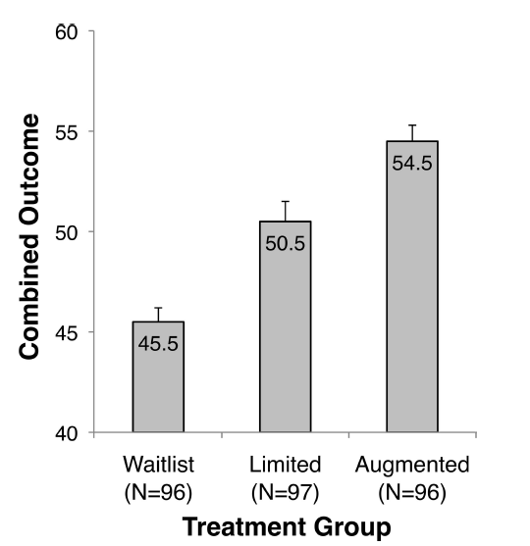
Warmth And Empathy Enhance Placebo Response
Warm and empathic acupuncture providers
Neutral and business-like acupuncture providers
(p < 0.001)
Kelley, Psychosomatic Medicine, 2009

Slide 8
Expectation bias
Subject expectation comes from:
  Research staff expectation
  Words
  Printed and on-line information
  Other subjects, word of mouth
Expectation bias can:
  If uniformly high → bias studies to the null
  If asymmetric → bias one treatment over another

Slide 9
Concomitant and Rescue Treatments
The more concomitant treatments patients are allowed, the harder it is to discriminate one treatment from another
Patients are poorly adherent to prescribed medications and at documenting actual use
Concomitant treatments should be minimized, standardized, monitored, and quantified
Katz N, Neurology, 2005; Mou J, Pain, 2013

Slide 10
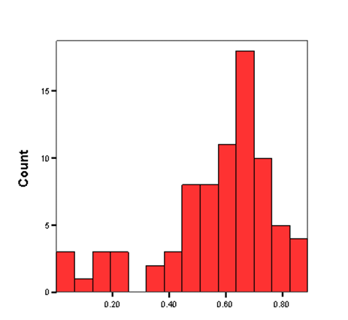
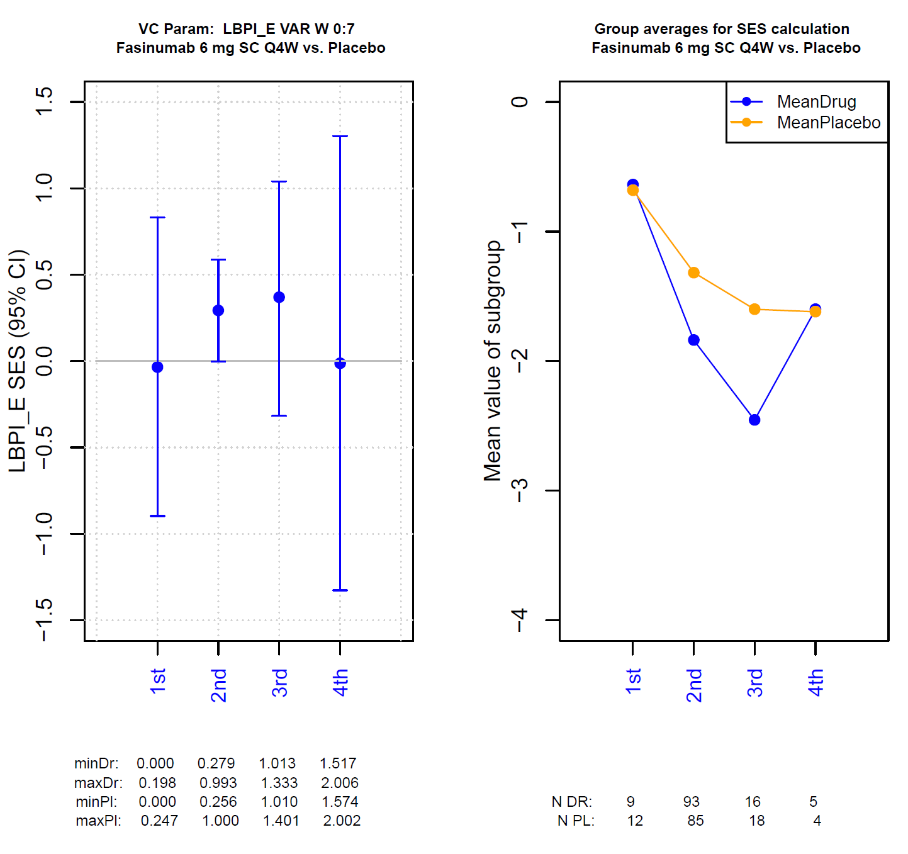
Accurate Pain Reporting and Extreme Variability
About 1/3 of patients cannot report experimental (thermal or mechanical) pain accurately
Very Low Variability
Very High Variability
This predicts how well they discriminate treatments in clinical trials
Treister R, PLOS One, 2018; Mayorga AJ, Scand J Pain, 2017; Treister R, J Pain Res, 2017

Slide 11
Non-inferiority studies are uninterpretable
Both treatments work!
What’s the interpretation?
Treatment A
Treatment B
Sham
Treatment A
Treatment B
Neither treatment works!
Measurement error biases non-inferiority studies to a finding of non-inferiority
Treatment A
Treatment B
Sham

Slide 12
Mitigation
Double-blinding and sham controls when possible
Document and quantify non-specific influences of outcome
  Ancillary staff interactions, time, frequency
  Medications
  Physical modalities
  Printed and on-line materials including ICF
Documentation of patient perceptions of treatment context
Keep expectation neutral (not too high or low) and balanced (similar between groups)
Minimize sources of measurement error

Slide 13
Levels of Evidence
LEVEL | DESCRIPTION | PERSUASIVE?
I | Randomized controlled trial
II-1 | Controlled trials without randomization
II-2 | Cohort or case-control studies
II-3 | Time series designs with or without the intervention
III | Expert opinion, descriptive studies
Randomized, double-blind, placebo/sham-controlled trial with measures to minimize bias and maximize assay sensitivity
0
YES
NO
NO
NO
NO
NO
United States Preventive Services Task Force, 1989

Slide 14
Conclusions
Firm conclusions about efficacy can only be reached by randomized, double-blind, placebo/sham-controlled trials, with strict attention to minimizing bias and maximizing assay sensitivity
  This is not clearly represented in evidence hierarchies
In circumstances where blinding is not possible:
  Control observer bias with blinded assessors
  Control expectation bias with rigorous and transparent attention to non-specific factors that bias expectation
Avoid non-inferiority studies without an internal demonstration of assay sensitivity

