Slide 1

Special issues in RCTs of SCS
Programming comparisons
Sham stimulation
Sam Eldabe
Consultant Anaesthetist
The James Cook University Hospital
Middlesbrough
UK

Slide 2
General Classification of SCS RCTs
  Effectiveness of SCS in Pain indications.
  Device Comparison Studies.
  Investigations of modes/parameter of stimulation.
  Sham controlled RCT.

Slide 3
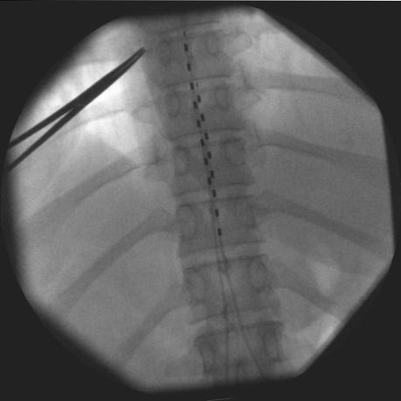
Device Programming
Under the bonnet of Programming
Why does programming matter ?
  Outcomes of SCS dependent on appropriate programming.
  No consensus on what constitutes appropriate programming.
    No standard programming for conventional SCS
    Partial Standard Programming for HF10 reported
    Partial Standard programming for Burst reported
    Partial Standard for HD/ subparaesthesia
SCS programming parameters
  Frequency (Hz)
  Pulse Width (mcsec)
  Amplitude (mAmp)
  Cathode location /Lead tip location
-
+

Slide 4
Under the Bonnet of Device Programming:

Slide 5
Placebo in Neuropathic Pain
THE SUMMARY
Large Placebo response in Neuropathic Pain
Participants with highest intervention response also tend to have the highest placebo response
Predictors of a higher placebo response
  Higher baseline pain
  Opioid trials
  Higher number of face to face visits
  Age
  Long washout Periods
  Discontinuation due to adverse events
Vase, L., et al. (2016). "Placebo, nocebo, and neuropathic pain." Pain 157 Suppl 1: S98-S105

Slide 6
Device Programming in Neurmodulation RCT
A Pragmatic Approach?
  Personnel (industry, clinical or combination)
  Frequency
  Duration
  Setting
  Scripted programming ?
Notes:
Head to head RCT always make this type of statement, which is pragmatic approach very much similar to real life or is it ?
Experience of an industry rep who locked himself in a room for programming for hours, bought patients coffee, trial results nosedived after he left !!

Slide 7
Device Programming
Under the bonnet of Programming
  Usually delegated to industry representative operating in isolation from clinical/research staff.
  Impact on reporting of SCS failure/explant within RCT.
  No reporting of frequency of programming across groups
  Frequent visits and perceived focussed attention can impact pain scores and satisfaction.
  Programming reporting in Methods and Results sections ?
  Cost ?

Slide 8
Approaches to reporting programming methods
Variable Often confusing information in different part of the manuscript
Extract from Methods section
Kapural, L., et al. (2015). "Novel 10-kHz High-frequency Therapy (HF10 Therapy) Is Superior to Traditional Low-frequency Spinal Cord Stimulation for the Treatment of Chronic Back and Leg Pain: The SENZA-RCT Randomized Controlled Trial." Anesthesiology 123(4): 851-860.

Slide 9
Approaches to reporting programming methods
De Andres et al 2017 A clearer approach ?
Specific algorithm description for conventional SCS intraoperative stimulation and subsequent adjustment during trial
  Start with central bipole.
  if high impedance use double bipole.
  Amplitude and PW settings aim to reduce consumption
  Start with PW of 300mcsec and increase amplitude to 4.5-5.0 V
  If no threshold at 5.0 V increase PW to 390 mcsec .
  If no threshold at 8.0 V increase PW to 450 mcsec.
  If no threshold move leads longitudinally.
  Set frequency at lowest value to maintain comfort (initial 40Hz)
-
+
De Andres, J., et al. (2017). "Prospective, Randomized Blind Effect-on-Outcome Study of Conventional vs High-Frequency Spinal Cord Stimulation in Patients with Pain and Disability Due to Failed Back Surgery Syndrome." Pain Med.

Slide 10
Approaches to reporting programming methods
De Andres et al 2017 A clearer approach ?
Programming sessions run by staff physician and industry rep
System reviewed at 5 study assessment points
And if the patient reported changes in paraesthesias
Report Frequency of prn programming sessions ?
De Andres, J., et al. (2017). "Prospective, Randomized Blind Effect-on-Outcome Study of Conventional vs High-Frequency Spinal Cord Stimulation in Patients with Pain and Disability Due to Failed Back Surgery Syndrome." Pain Med.

Slide 11
Programming Reporting in Effectiveness studies
RCT | Population | Programing Method | Surgical Procedure | Programming Results | Frequency of Programming | Personnel
Klomp 1995 Spincemaille 2000 | CLI | Yes | Yes | Yes full detail in technical publication | No | No
Kemler (2001) | CRPS I [36] | Rate 85 Hz PW 201usec Amp variable (0-10V) | Yes | No | No | No
North (2005) | FBSS [50] | No | Yes | No | No | No
Kumar (2007) | FBSS [100] | No | Yes | Mean and (SD) (appendix ) | No | No
Slangen (2014) | PDPN [36] | No | Yes | No | No | No
de Vos (2014) | PDPN [60] | No | Yes | Adjust Amp | No | No
Eldabe et al 2016 | RA (29) | No | Yes | No | No | No
Notes:
This table shows takes the example of SCS for NeuP and shows the current portfolio of RCTs in this space. [make comment that focusing on RCTs in this presentation but of course there is value of nonRCT/obervational evidence too]
Only including SCS vs alternative therapy (not comparisons of technical differences – surgical vs percut leads) and also excluded RCTs in patients with previous exposure to SCS

Slide 12
SCS Effectiveness Studies: Conclusions
Effectiveness studies:
  Rarely report on programming
  No Reports on personnel
  Reporting is variably presented in the methods or results section.
  Quality and Reproducibility of RCT findings.
  Generalizability of Findings?

Slide 13
SCS Studies: Impact of programming on Sample Size
SCS is a complex intervention
Success of SCS is reliant on a combination of
  Competence of Implanter
  Competence of Programmer
  Instructions
  Adherence
Despite the complexity few studies account for variability of the intervention across sites
None aim to quality control the intervention

Slide 14
Device Comparison RCTs
RCT | Population | Programing Method | Programming Results | Frequency of Programming | Personnel
SENZA (2015) HF10 Conv Stim | FBSS [198] | Conv SCS adjusted to overlap | Mean (SD) Min & max values | No | No
 |  | HF: 10,000 Hz, 30usec amplitude variable | Mean (SD) min & max amp
ACCURATE DRG Conv Stim (2016) | CRPS I & II [152] | DRG Conv Stim | Table of all values Mean (SD) Range | No | Separate technicians
SUNBURST (2017) Burst Conv Stim | NeuP limb/trunk [121] | Conv (ranges) Burst DR described | No | As needed | No
De Andres (2017) HF10 Conv Stim | FBSS [60] | SCS Conv algorithm HF10 detailed | No | Yes | Industry + staff
Tjepkema- Cloostremans (2016) | NeuP | Conv Stim Burst Low Burst (sham) | Broad Range of parameters Multiple programs (some ranges) | No | No
Notes:
This table shows takes the example of SCS for NeuP and shows the current portfolio of RCTs in this space. [make comment that focusing on RCTs in this presentation but of course there is value of nonRCT/obervational evidence too]
Only including SCS vs alternative therapy (not comparisons of technical differences – surgical vs percut leads) and also excluded RCTs in patients with previous exposure to SCS

Slide 15
Conclusions
Device comparison studies:
  Marginally better reporting of methods.
  Result section reporting is rare.
  Results report various formats of data
    Commonest report is Mean (SD) and ranges of Freq, PW and Amp.
  No/rare reporting of cathode position.
  None report full programming parameters
  Few report on programming personnel or setting.
  None report on number of programming sessions, intensity or cost

Slide 16
Parameter studies
Study | Methods | N= | Results | Personnel | Number of Visits
Schu (2014) | Burst DR (subsensory) SCS at 500Hz (subsensory) No PW report | 20 | Amp Mean (SD) PW no report | No | No
Van Havenbergh (2014) | Two types of Burst 500Hz and 1000Hz | 15 | Amp reported as Mean (SD) | No | No
Perruchoud (2014) | 5000 Hz, 60mcsec, PT | 37 | Amp not reported | Clinical | No
Sweet (2016) | 1200Hz, 200mcsec, 90% PT | 4/15 | Amp not reported | No | No
North (2016) | 1KHz sub perception Conv SCS | 22 | No | No | No
Al-Kaisy (2018) | Full report (Amp adjusted) | 24 | Full report | Clinical | No
Thomson (2018) | 1, 4, 7 and 10 KHz Optimal PW and Amp | 20 | No report | Industry | No

Slide 17
Conclusions
Frequency comparison studies:
  Better programming method reporting.
  Result section reporting remains poor.
  Commonest report is Mean (SD) and ranges.
  Majority do not report all programming parameters
  Few directly report on personnel carrying out programming
  None provide a record of number of programming sessions, intensity.

Slide 18
Potential Recommendations for programming in future RCT
In an RCT programming is an integral part of the intervention and should be quality controlled
  Personnel programming SCS in an RCT should be provided with study specific training
  Industry should provide investigators with ”best practice algorithms”
  Best Practice algorithms are currently applied for HF10, Burst and HD/subparaethesia
  Scripted program for conv stim has been described
  Investigators should make every attempt to script programming where possible
  Investigators should ensure site staff training on the programming script
  Where site staff training is not feasible , industry representatives may program according to study algorithm in the presence of site staff
  Who, where , how often and for how long

Slide 19
Potential Recommendations for reporting programming
Investigators should describe programming algorithm in the methods section including:
  Intended programming script or ranges of Amp, Freq, PW settings
  Intended Cathode position/Lead tip position
  Personnel
  Intended frequency and setting
Investigators report on programming in the results section to include
  Mean (SD) and ranges of Amp , PW and Frequency
  Cathode position/Lead tip position
  Personnel
  Frequency and intensity of programming
  Setting
  Outcome ?

Slide 20
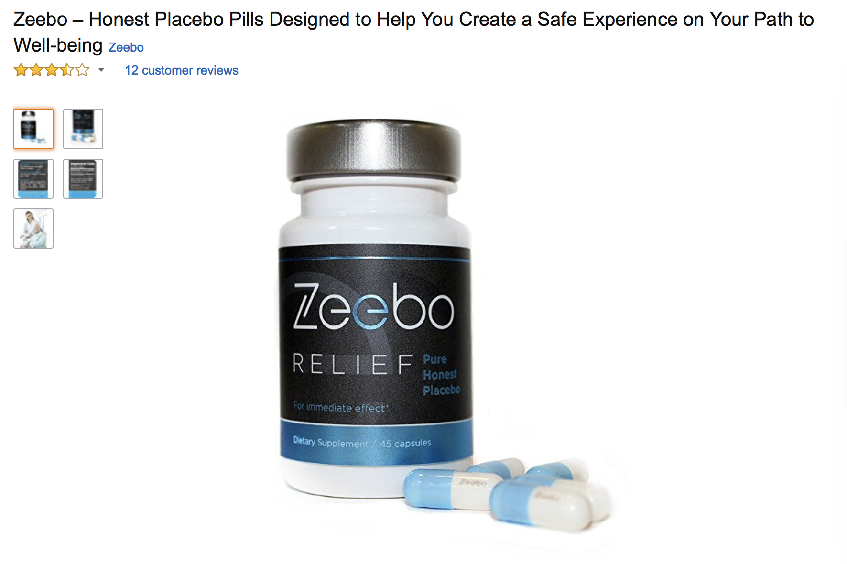
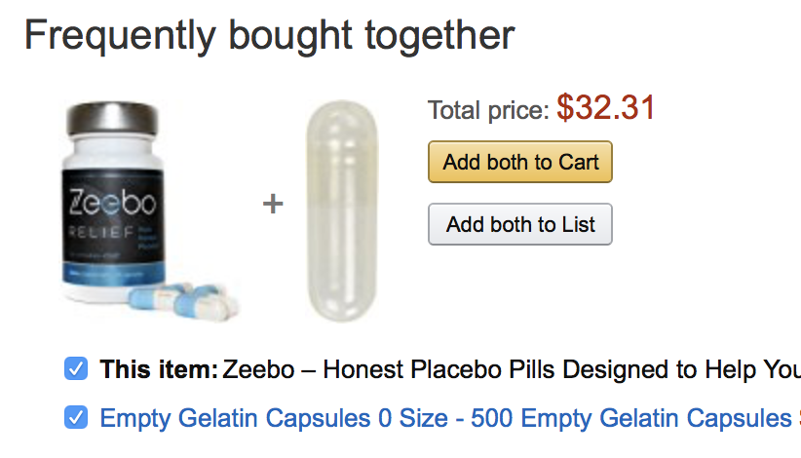
Placebo controlled studies in Spinal Cord Stimulation

Slide 21
Barriers to Placebo Controlled Trials in SCS
Paraesthesias
Subjects Handheld SCS programmer
Recharging
Consent issues
Device Programming

Slide 22
Placebo Controlled Trials in Spinal Cord Stimulation
Study | N | Condition Population | Test | Placebo | Comment
Eddicks et al. (2007) | 12 | RA Existing | Conv SCS ST | 0.1V | Patient Programmer ?
Lanza et al. (2011) | 25 | RA New | SCS, ST 75-80% of T | 0.05 V 1 hour/ day | Patient Programmer ? Position of patient for ST
Zipes et al. (2012) | 68 | RA New | HS Conv SCS with programmer | LS Suprathreshold stim 1min/day | Position ? Programmer
Wolter et 2011 | 10 | NeuP Existing | Subthreshold | OFF | PT in all positions Programmer in sealed
De Ridder (2013) | 15 | FBSS During trial period | Burst | Switch off | Non sterile EON IPG Supine
Perruchoud et al. (2013) | 37 | FBSS Existing | HFSCS (5KHz) Rechargeable | Sham Discharging IPG | No patient programmer PT supine
Schu et al. (2014) | 20 | FBSS Existing | Burst | Device switched off | No patient programmer Position ?
Youn et al 2015 | 20 | NeuP existing | HF, conv and OFF | OFF | HF 200-1200HZ No OFF details
Tjepkema-C. et al (2016) | 41 | FBSS Existing | Burst | Burst at 0.1mA | Position ?
Kreik et al (2017) | 89 | CRPS (new) 3 months stabilization | 40 Hz, 500Hz, 1200Hz, Burst | Device off | Sitting and Supine Recharge as needed
Al-Kaisy et al (2018) | 24 | FBSS New | 1,3 and 6KHz | Sham Discharging IPG | No patient programmer PT supine

Slide 23
Sham Control Conclusions & Recommendations
Sham SCS is a variable entity across studies.
Paraesthesia stim sham can consist of
  Very Low amplitude continuous verum stimulation
  Short duration supratheshold stimulation
  No stimulation
  All carry an inherent risk
Sham complexity increases with use rechargeable systems.
Sham SCS for rechargeable devices needs to account for risk of unblinding through recharging frequency
Self discharging IPG needs to consider current use in active arm (crossover studies)
Patient Programmer status should be reported in sham studies
Sham controlled Studies need to confirm adequacy of blinding.
Studies using Perception Thresholds (PT) should report PT measurement position

Slide 24

Thank You
Notes:
Slide 11 “just appears” with no bridge from the previous conclusion. The flow is as follows, and I think this could all be done with 4 slides (one for each point).
Back pain is a big problem.
Disrupted MF control is one cause.
Specific exercises targeting the MF can help, but not everyone.
An alternative way of activating the MF is with electrical stimulation.
The slides on the Feasibility study are pretty detailed and repetitive.
Slide 16 is an eye chart.
Slide 17 could be removed – not relevant to the talk.
Slide 20 – the last bullet is unclear. I thought we were talking about >50% had >50% improvement (mean = 70%)
Slides 21 and 22 could be combined to make it more punchy. Don’t need to make all the points in the conclusion.

