Slide 1
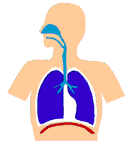
Sparing of opioid-related respiratory depression: assessment and analysis
Denham S Ward, MD, PhD
Emeritus Professor and Chair,
University of Rochester School of Medicine and Dentistry
Professor, Tufts University School of Medicine
Maine Medical Center
Notes:
Please put your right arm in the air, now exhale and hold your breath. Put your arm down when you need to breath again. Ok everyone breathe again. Now this isn’t a contest but here is an obvious illustration of the interaction of voluntary and autonomic control of breathing.
OK now everyone close your eyes, take a deep breath through your nose and exhale slowly through your mouth. The relaxation you feel is an illustration of a voluntary maneuver of the autonomic breathing system in turn affecting the limbic emotional system, in turn with cortical effects

Slide 2
Disclosures
Past and current consulting with:
Galleon Pharmaceuticals (p)
Cara Therapeutics (p)
Imprimis (c)

Slide 3
Measuring the respiratory depression caused by opioids
  Laboratory - ↑ P_{ET}CO₂ , ↓Ventilation , HCVR, HVR
  Clinical – desaturation, P_{ET}CO₂, Ventilatory arrhythmias
Complexity of study design
  Concurrent Pain
  Sleep / sedation
Examples of study design in the literature
  Opioids + peripheral analgesics (e.g., ketorolac)
  Opioids + central sedatives (e.g., promethazine,)
  Opioids + central analgesics (e.g., ketamine, dexmedetomidine, pregabalin)
Recommendations
  Laboratory studies (volunteers)
  Clinical studies (patients)
    Acute procedural pain
    Post-operative pain

Slide 4
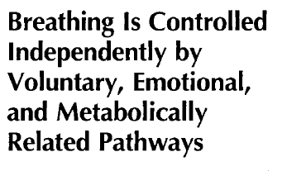
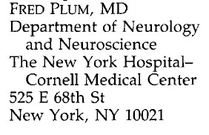
“Breathing is the only coordinated skeletal muscle act that continuously fulfills and seamlessly integrates continuous metabolic and intermittent behavioral functions without normally disrupting the efficiency of either in the process.”
Arch Neurol 49: 441, 1992
Notes:
Professor Plum also nicely described the actual complexity. These pathways are not additive but rather interact in profound and complex ways. As we have seen, it even works in reverse with slow breathing having an influence on the limbic system.

Slide 5
Brainstem respiratory centers
CCR
Phrenic N
CSN N
Vagus N
Diaphragm
Lung ventilation (gas exchange)
P_{a}CO₂
Carotid bodies
P_{a}O₂
Metabolic Rate

Slide 6
Cortex (motor & premotor)
Subcortical
limbic system
Brainstem respiratory centers
CCR
Spinal / hypoglossal motoneurons
CSN N
Vagus N
Chest wall
Upper airway
P_{a}CO₂
Lung ventilation (gas exchange)
Carotid bodies
P_{a}O₂
Metabolic Rate
Notes:
So the COB system is much more complex and interesting than my first conceptions and all of these effects are evident in the abstracts in this session. Particularly when we are concerned with the clinical effects of pharmacological interventions, disease and surgery, all of these elements (and probably more) have to be considered.
So besides the experiments we just did, what is the evidence for the involvement of the supra brainstem regions of the brain in the autonomic control of breathing?

Slide 7
“Behavioral”,
Wakefulness
Control
(Pain?)
“Metabolic” Control
(CO₂ / O₂
chemoreceptors)
“Voluntary”
Control
(Pain?)
Normal resting (“Mixed” Control)
Notes:
Rather than an anatomical diagram model, I prefer to think of a functional model. But one in which we will be able to make neuro anatomical connections

Slide 8
 | Metabolic Control (O₂, CO₂, H⁺ ) | Behavioral (“Wakefulness”) Control | Voluntary Control
Normal Resting | + | +++ | +
Anaerobic Exercise | ++++ | - | ----
REM Sleep | - | +++ | ----
Non-REM Sleep | ++++ | ---- | ----
Singing, Talking | - | + | ++++
Pain, Arousal | ++ | ++++ | ++++
Ondine’s Curse | ---- | +++ | +++
Locked-in Syndrome | ++ | +++ | ----
Opioids | -- | - | +

Slide 9
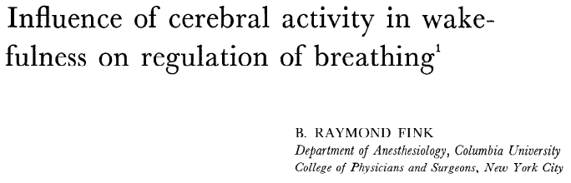
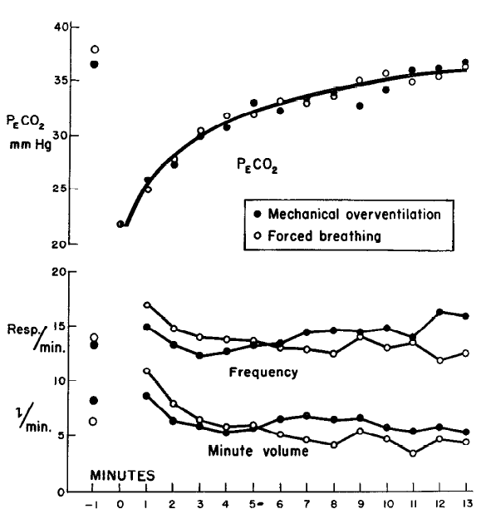
“...cerebral activity associated with wakefulness probably plays an important part in the maintenance of the resting respiratory rhythm. …carbon dioxide appears to play a subsidiary part and the main respiratory drive appears to be of neural origin.”
J Appl Physiol 16: 15-20, 1961

Slide 10
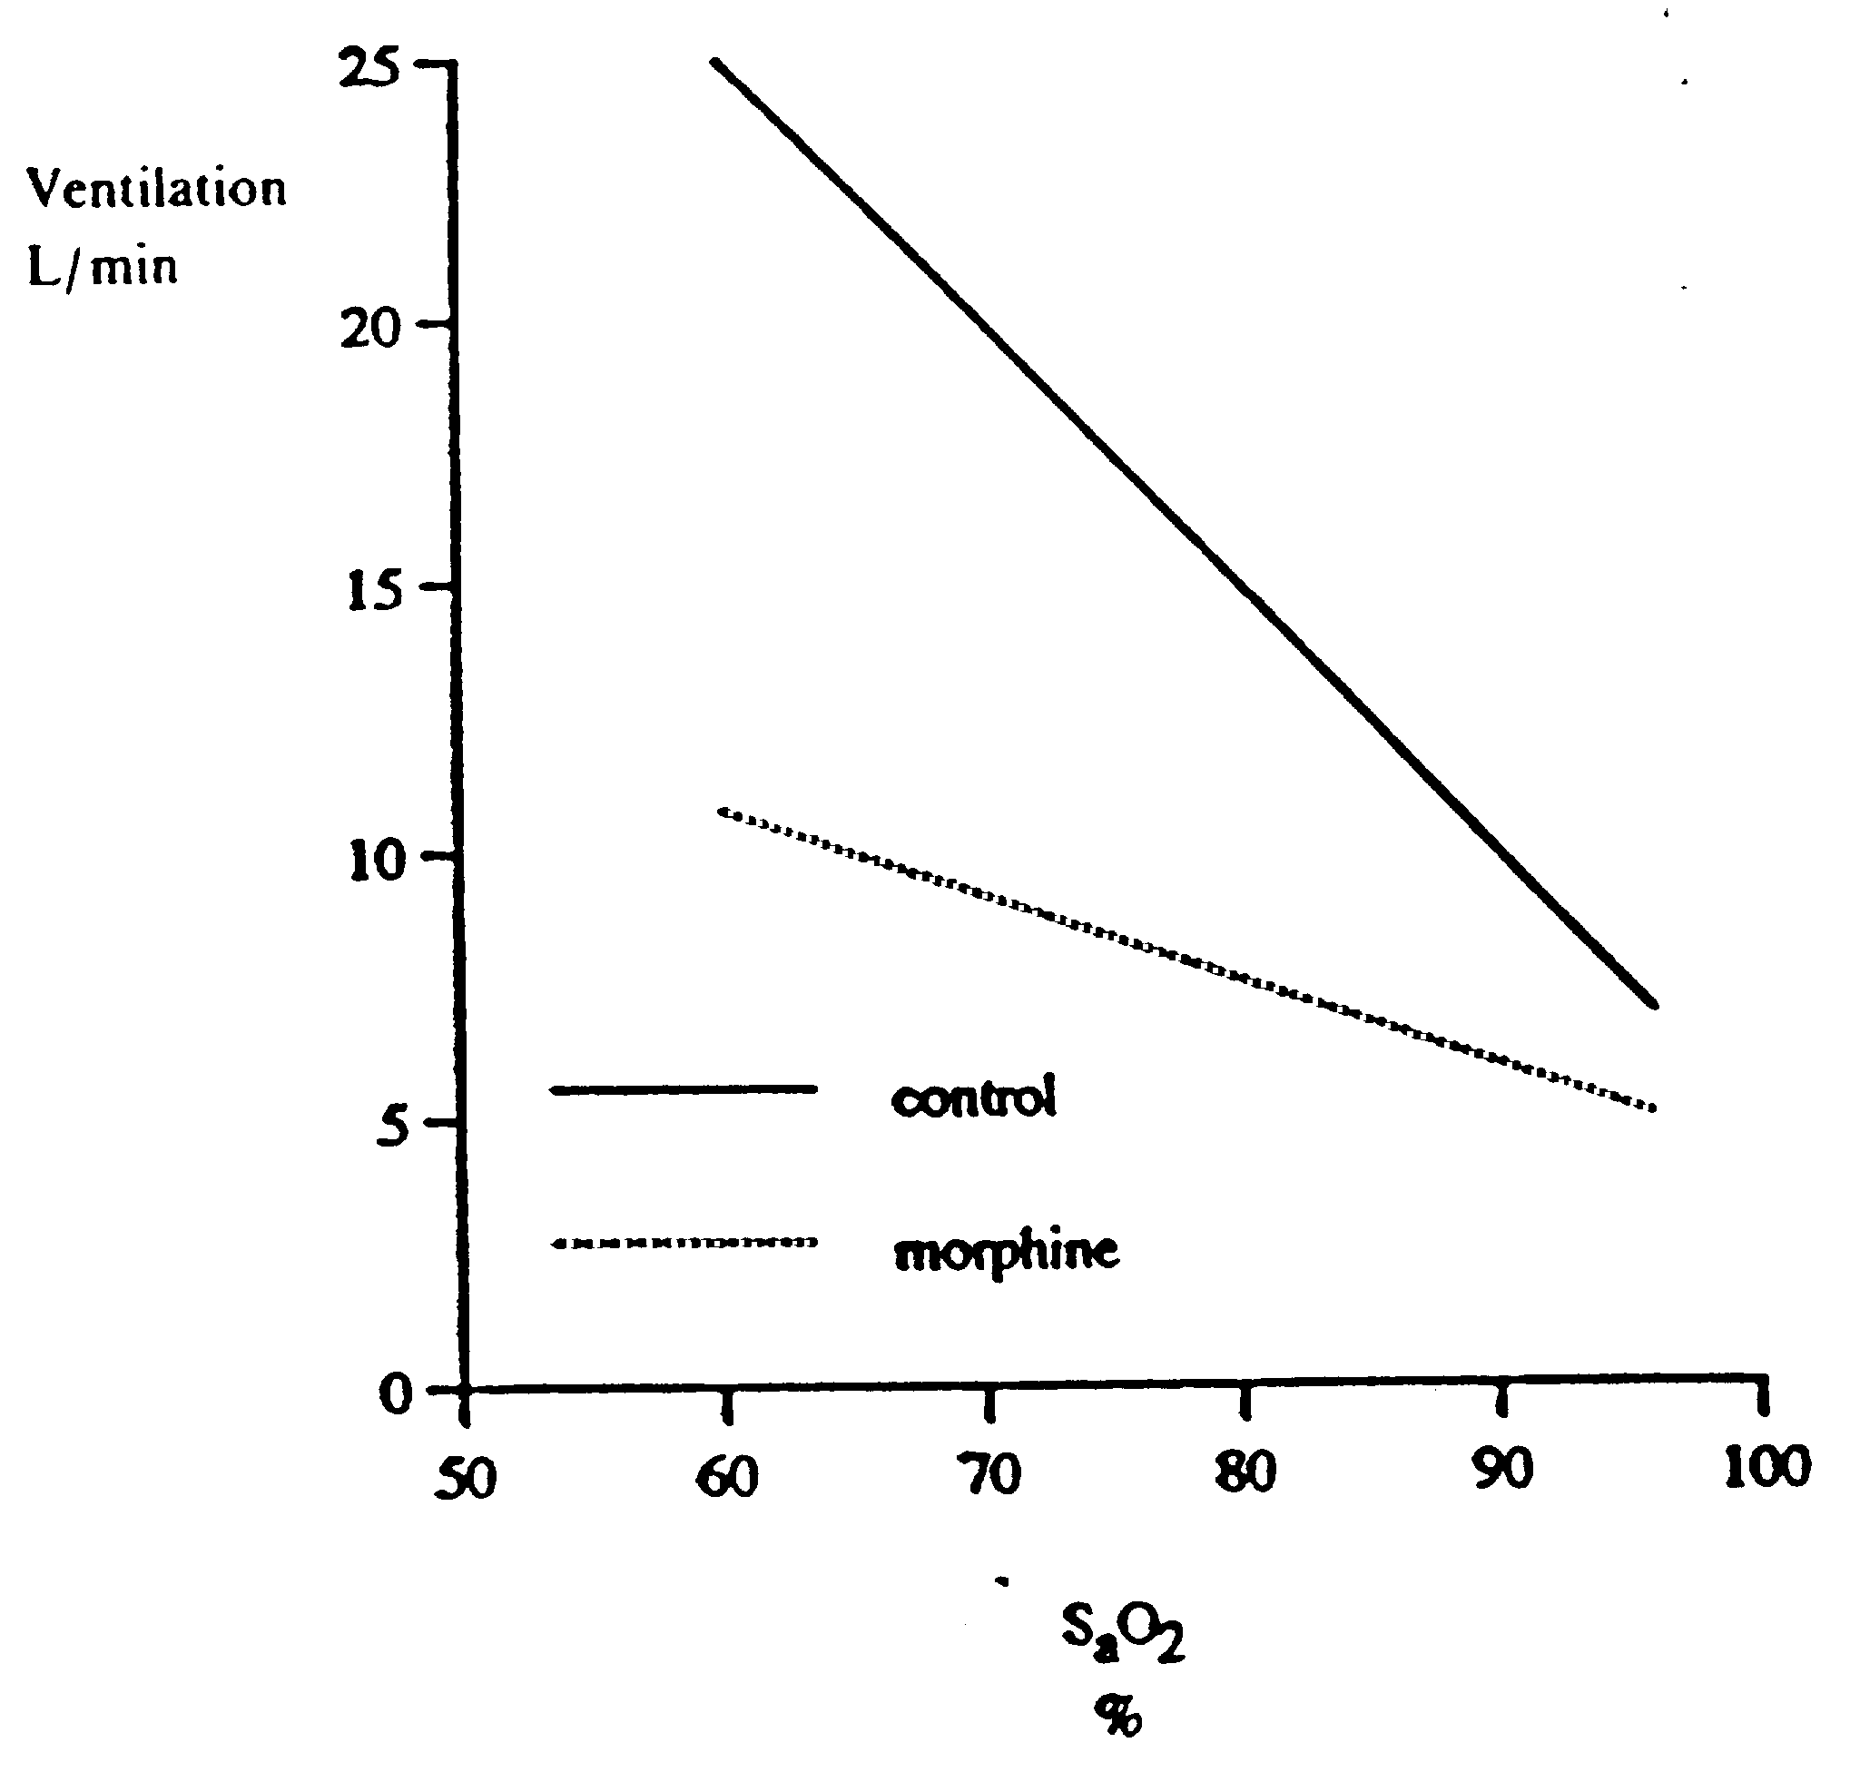
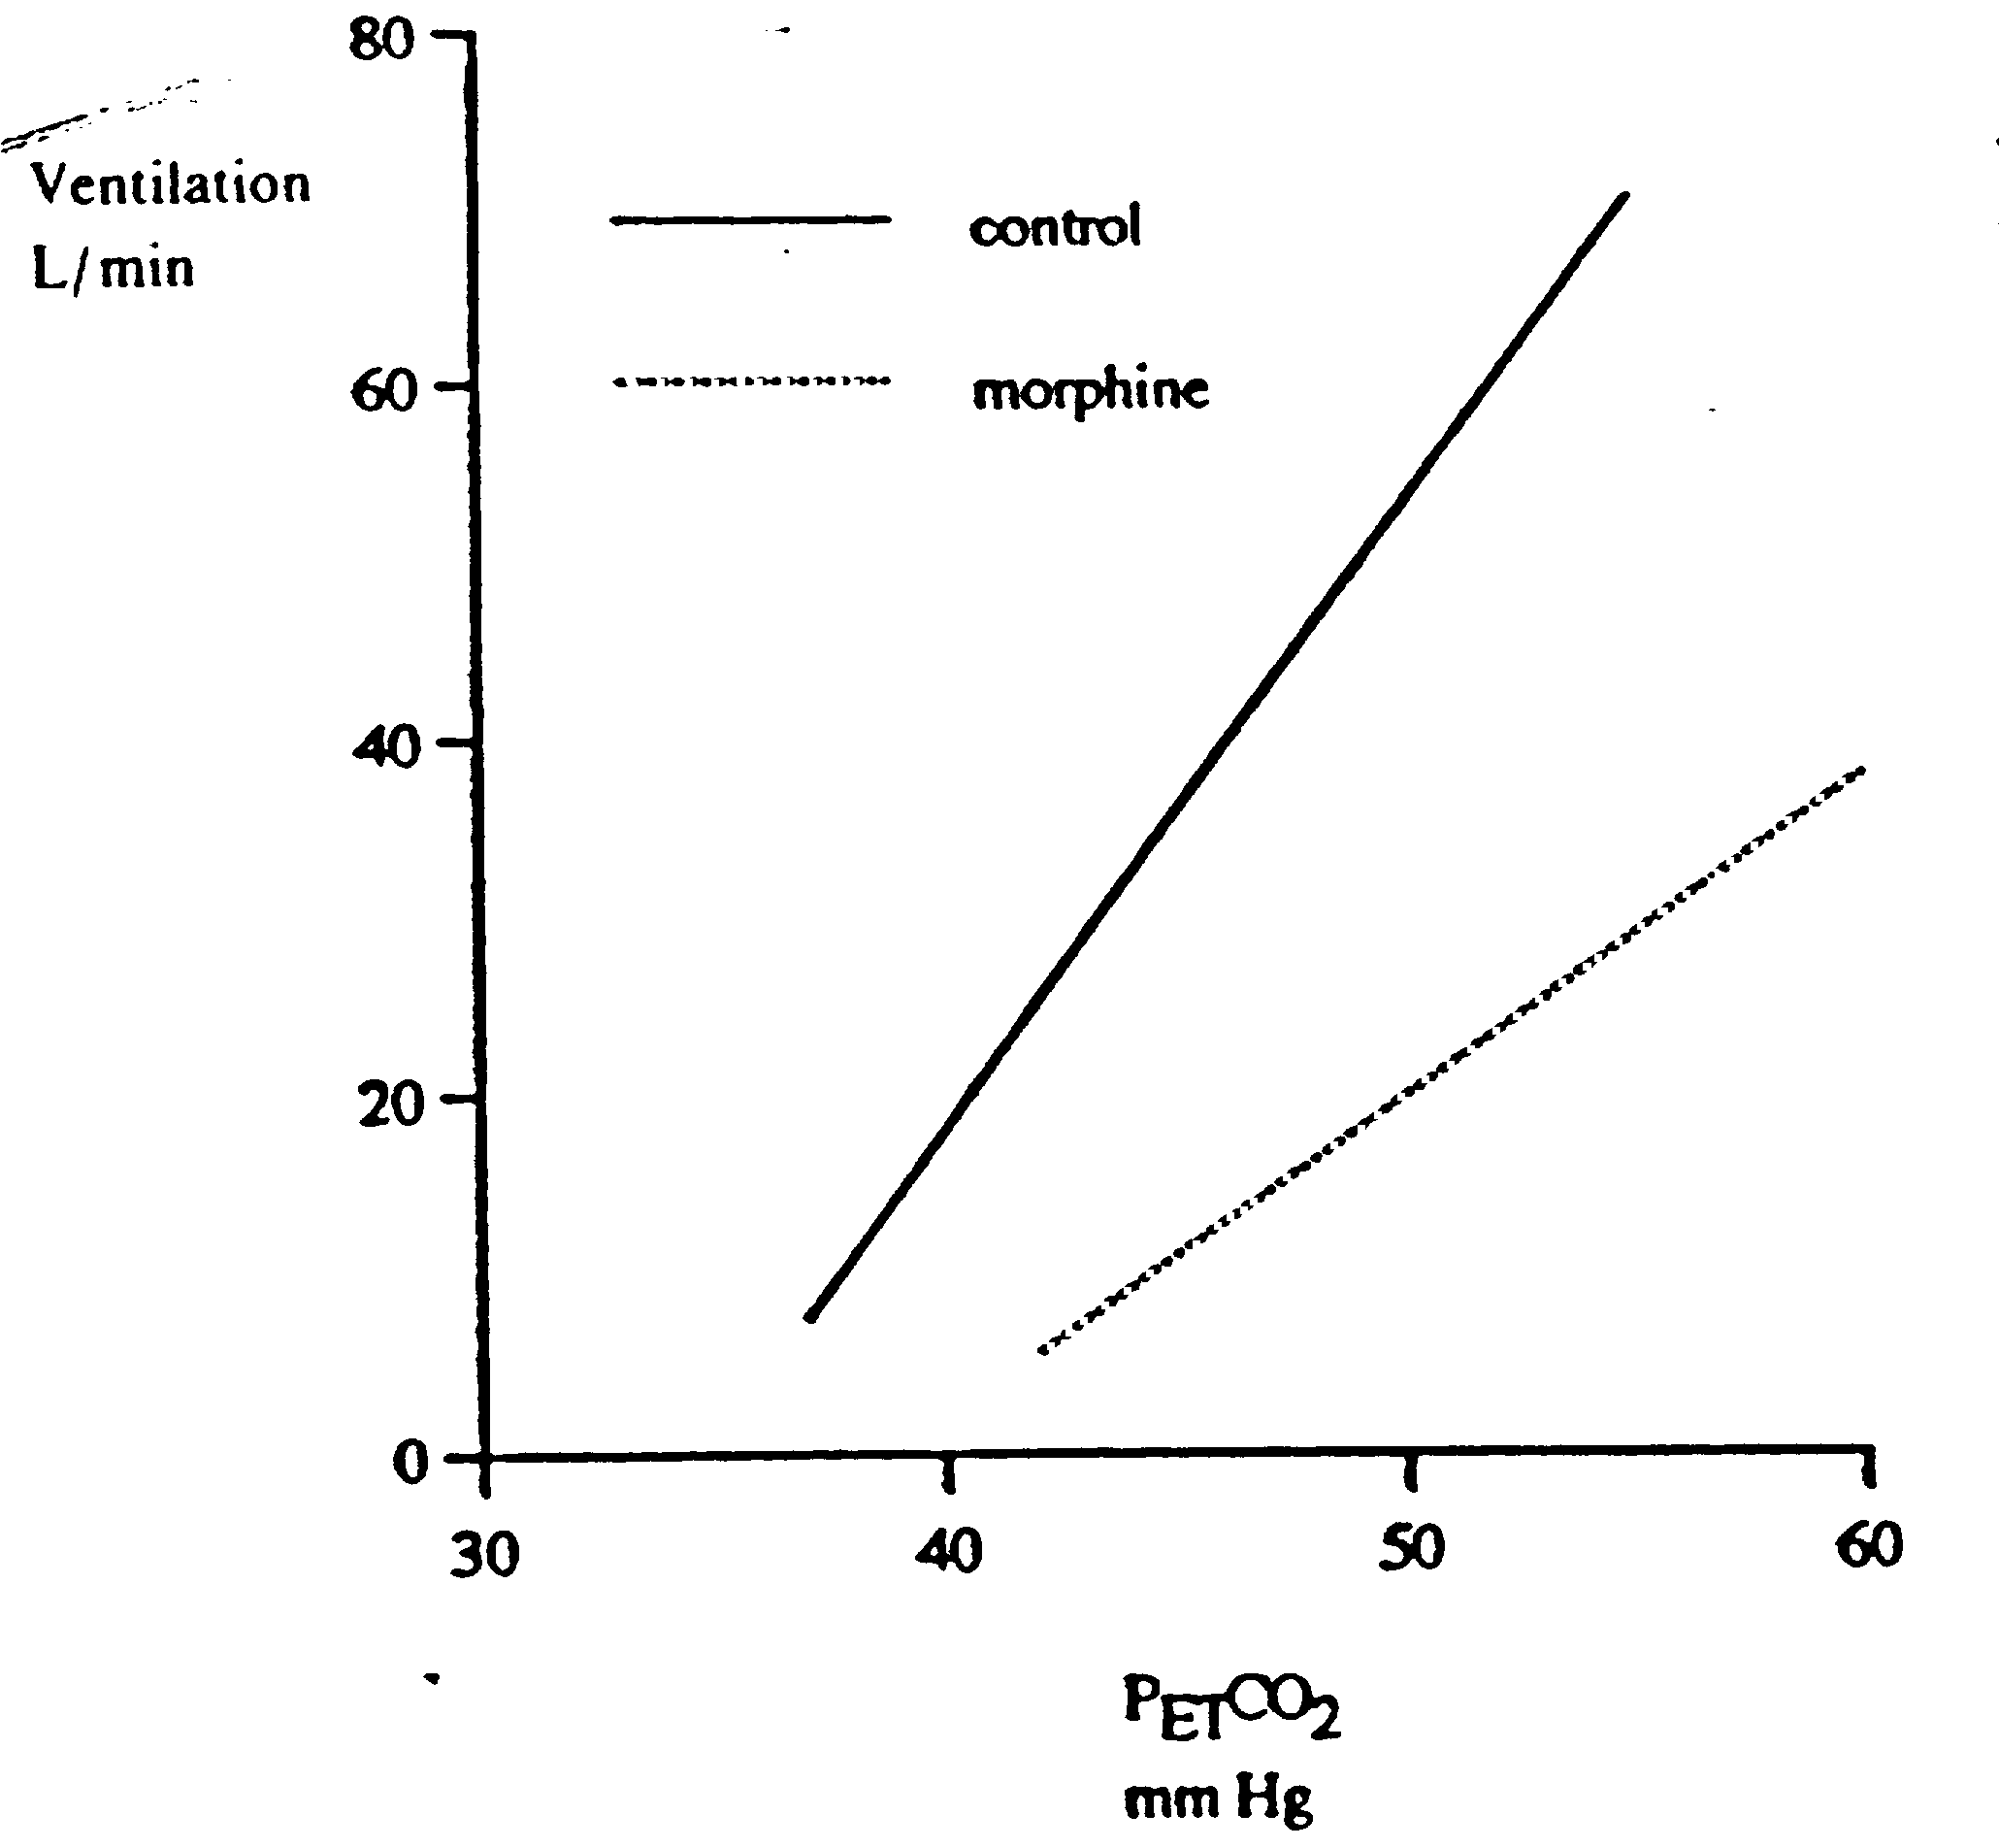
Effects of 0.2 mg.kg⁻¹ IM morphine.
Ventilation 6.8 5.1 l/m
Tidal Vol 0.7 0.5 l
Rate 11.5 11.0 br/min
Santiago et al. J Appl Physiol. 1979
3.5 l/min/mmHg
0.5 l/min/% sat decrease
1.8
0.16

Slide 11
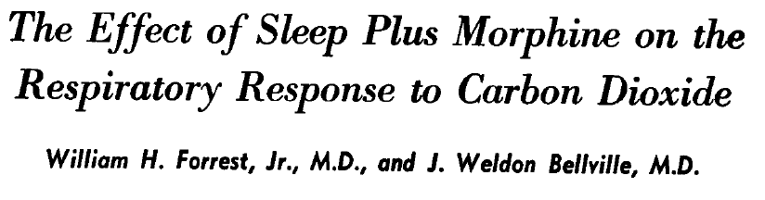
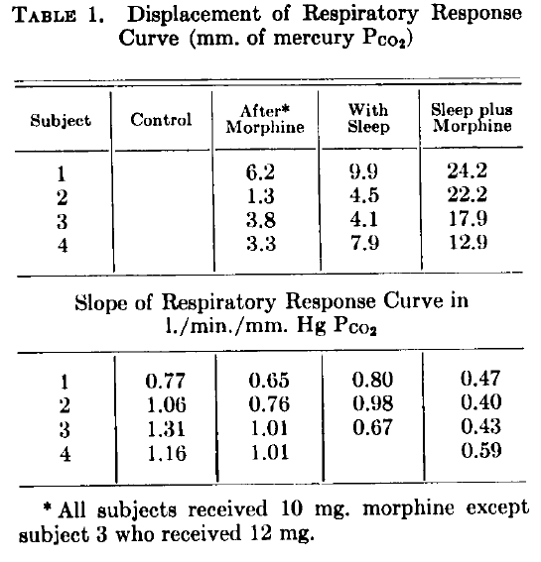
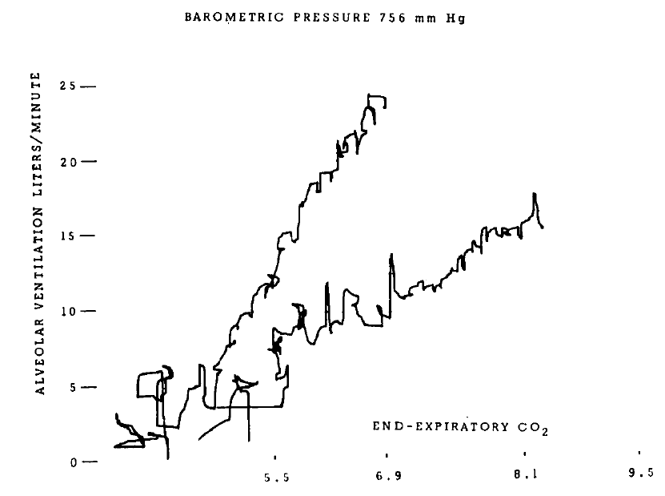
Anesthesiology 25:137-141, 1964
“…how much of the very substantial respiratory depression seen during anesthesia is related to the altered state of consciousness and how much is due to the drug per se? Certainly this study poses many problems concerning the interaction of sleep, altered states of consciousness and drug effects.”

Slide 12
Opioids + Peripheral Analgesics
Moren et al. Anesth Analg 1997
  Volunteer: double-blind, randomized, cross-over.
  Ketoprofen (1.5 mg/kg), MS (0.1 mg/kg), K+MS (same doses)
  Less ↓ HCVR with K+M
  than M
  No analgesia assessment

Slide 13
Liu et al. Anesth Analg 1993
  Post-op patients: double-blind, placebo controlled. Saline vs 60 mg Ketorolac given pre-op
  K ↓ pain in the PACU and needed less fentanyl
  No measurements of COB (lung mechanics only)
Jain & Shah. Respiratory depression following combination of epidural buprenorphine and intramuscular ketorolac. Anaesthesia, 1993

Slide 14
Opioids + Central Sedatives
Keats et al. Anesthesiology, 1960
  Post-op patients: Not randomized or blinded, Meperidine 50 mg vs Promethazine 50 mg + M
  Volunteers: Randomized, M 50mg, M 100 mg, vs M 50 + P 50 mg,. HCVR
“… the addition of promethazine to meperidine did not increase the respiratory depression … ,but markedly increased the sedative effects…”

Slide 15
Olson et al. Am Rev Resp Dis 1986
  Volunteers: Not blinded, MS 0.15 mg/kg then randomized prochlorperazine (12.5 mg) vs saline.
  MS ↓ HCVR by ≈ 40% and the HVR by ≈ 50%
  P had no effect on HCVR but HVR ↑ significantly
  No analgesic measurements.

Slide 16
Opioids + Central Analgesics
Bailey et al. Anesthesiology 1991
  Volunteers: Randomized, cross-over, single-blind, clonidine (PO, 0.35 mg), MS (IM, 0.21 m/kg), C+MS (same doses)
  No analgesia assessment

Slide 17
Lin et al. Brit J Anaesth. 2009
  Post-op clinical: double-blind, randomized. MS or MS + Dexmedetomidine via PCA for post-op pain
  “There was no report of somnolence or respiratory depression in tis study.”

Slide 18
Mildh et al. Anaesth. 1998
  Volunteers: double-blind cross-over randomized, Fentanyl (2 μg/kg) vs F + Ketamine (0.25mg/kg) IV
  S_{p}O₂ ↓ to ≈ 90% in both groups. P_{a}CO₂ ↑ 10 mmHg for F and ↑ 6 mmHg for F+K
  No analgesia measurement

Slide 19
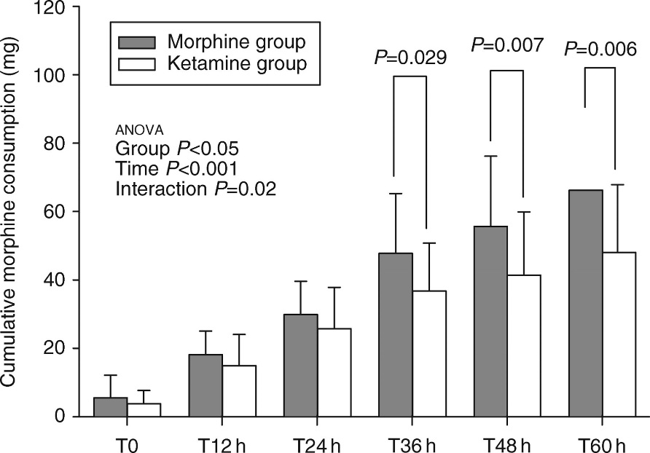
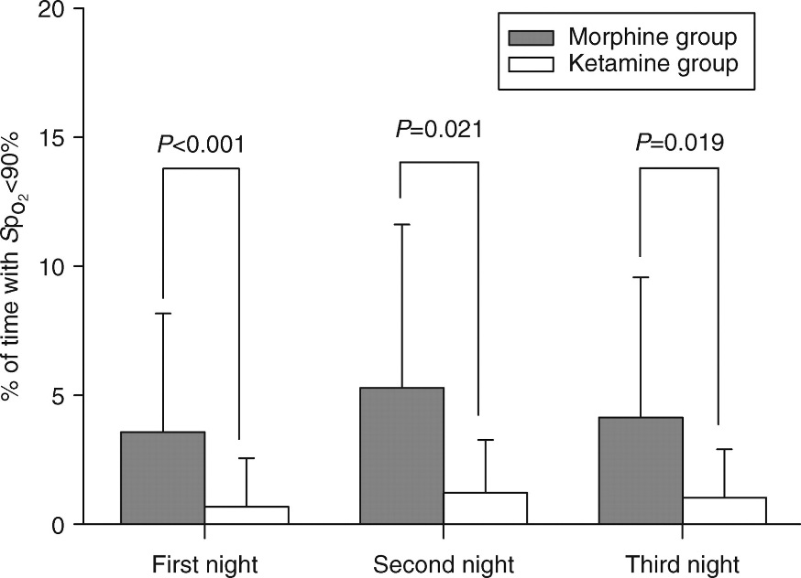
Michelet et al. Brit J Anaesth. 2007
  Post-thoracotomy clinical: randomized, double-blinded. MS vs MS + ketamine PCA

Slide 20
Myhre et al Anesthesiology 2016
  Volunteers: randomized, double-blinded, cross-over. Remifentanil (TCI – 0.6, 1.2, 2.4 ng/ml) vs R + Pregabalin (150 mg po)
  Cold pressor test

Slide 21
Recommendations
Early studies done with volunteers (laboratory studies) should include HCVR, HVR, assessment of analgesia.
  Dose response data
Acute pain: Late clinical trials (efficacy) should include continuous S_{p}O₂ and P_{a}CO₂
  Overnight monitoring important in special populations, e.g., OSAS
Chronic pain: No accepted methodology; home sleep S_{p}O₂ monitoring; formal sleep studies

Slide 22
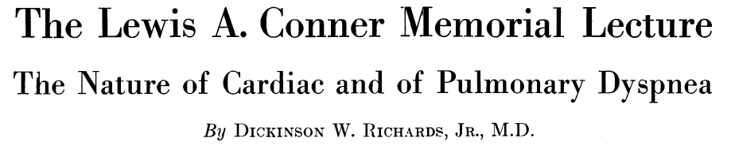
“Breathing is truly a strange phenomenon of life, caught between the conscious and the unconscious, and peculiarly sensitive to both”
Circulation 7:15-29, 1953
Notes:
Dr Richards summed this up succinctly in his lecture in 1953

Slide 23
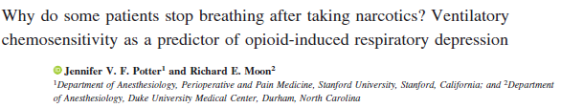
“Behavioral” Control
(wakefulness)
“Metabolic” Control
(CO₂ / O₂
chemoreceptors)
“Voluntary”
Control
“Normal resting &
? Light Exercise
(“Mixed” Control)

Slide 24
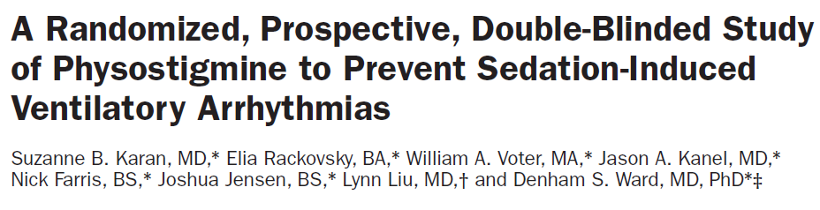
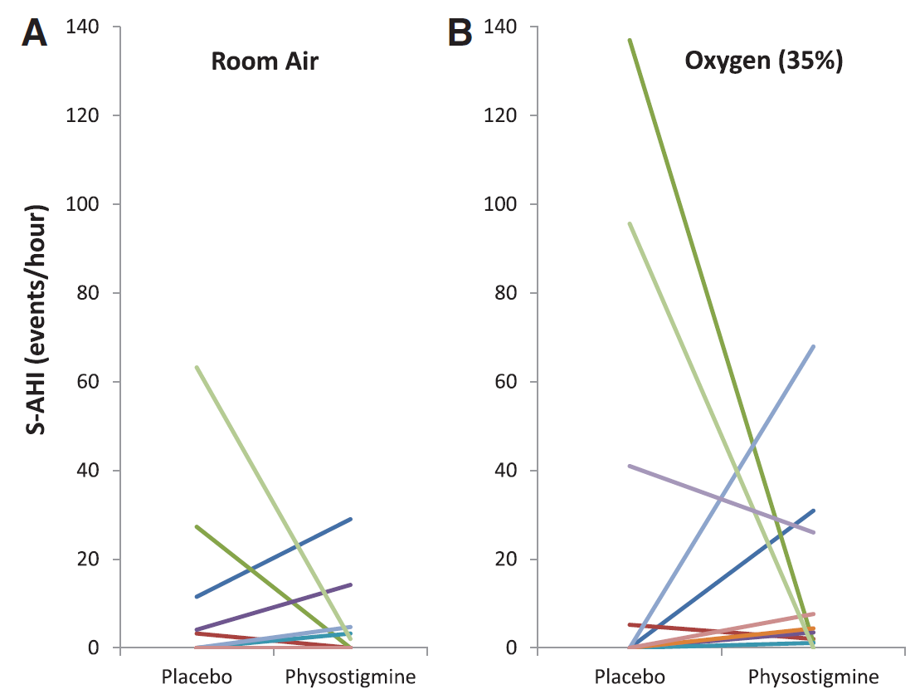
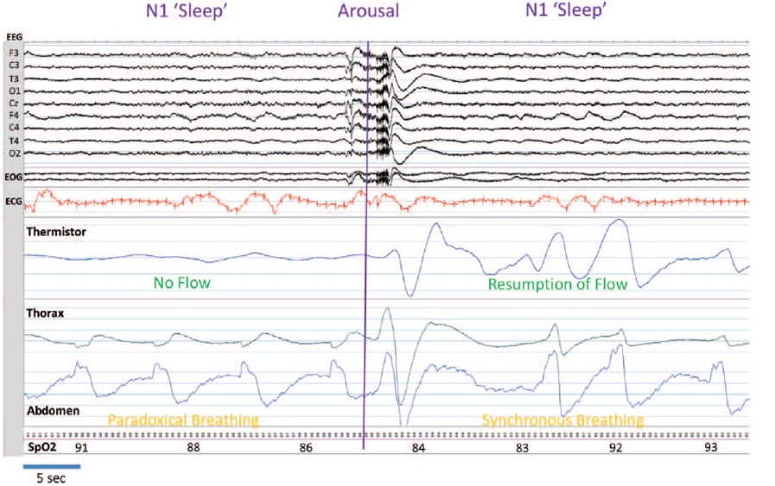

Slide 25
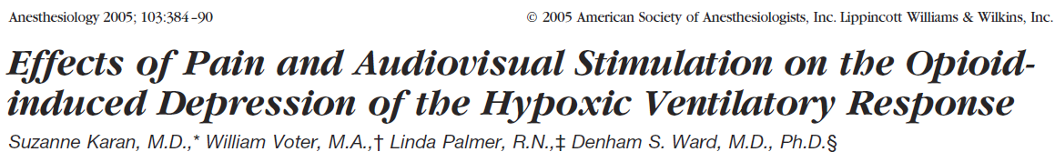
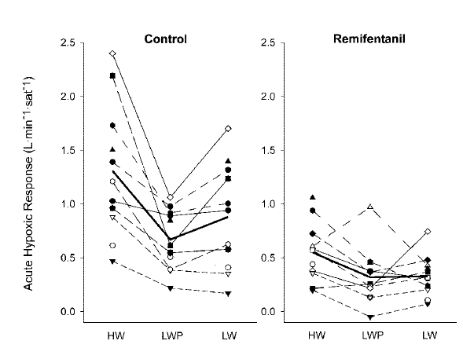
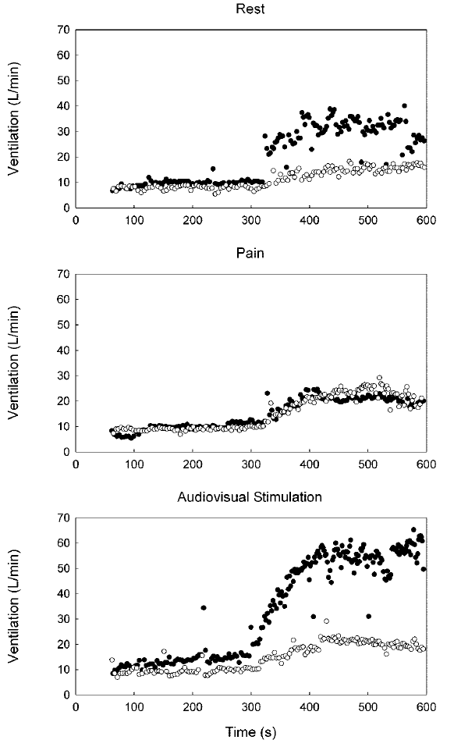
Control
Remifentanil
“Clinically, these results could indicate that a specific audiovisual stimulation requiring a volitional patient reaction may be more effective than pain in restoring adequate ventilation in responsive narcotized patients.”

