Slide 1

Opioid(-)Sparing: Assessing opioid use and opioid outcomes in clinical trials
Brett R. Stacey, MD
Medical Director, UW Center for Pain Relief
Professor, Anesthesiology & Pain Medicine

Slide 2
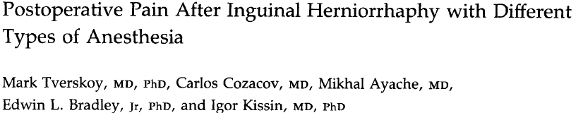
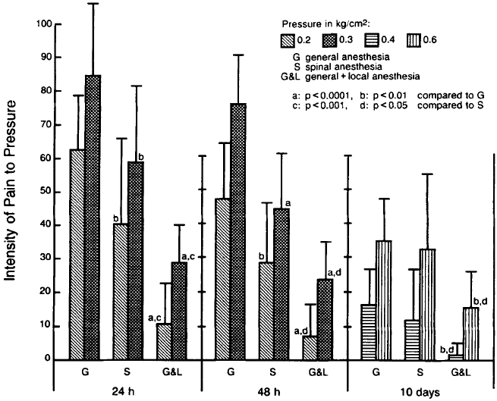
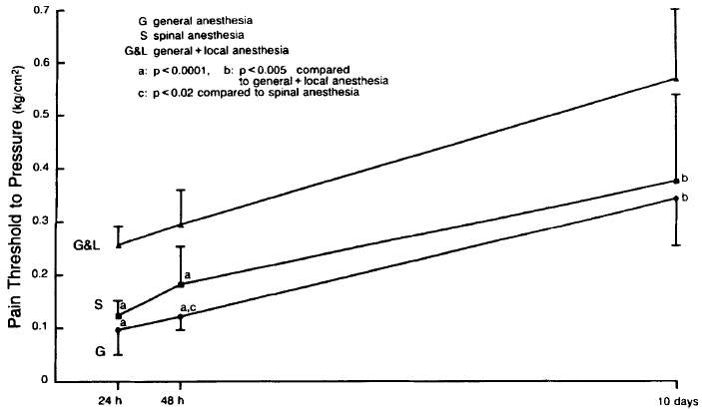
DBRT: general, general + local infiltration, spinal
The main focus of the paper was pain at rest, pain with pressure, pain with movement up to 10 days
Tverskoy, M., et al. (1990). "Postoperative pain after inguinal herniorrhaphy with different types of anesthesia." Anesthesia & Analgesia 70(1): 29-35.
Notes:
Tverskoy, M., et al. (1990). "Postoperative pain after inguinal herniorrhaphy with different types of anesthesia." Anesthesia & Analgesia 70(1): 29-35.
In a randomized, double-blind study, postoperative pain was assessed in 36 patients undergoing inguinal herniorrhaphy with three types of anesthesia: general (thiopental-nitrous oxide-halothane); general with the addition of local (infiltration of the abdominal wall with 0.25% bupivacaine along the line of the proposed incision); and spinal (0.5% bupivacaine). The severity of constant incisional pain, movement-associated incisional pain, and pain upon pressure applied to the surgical wound using an algometer was assessed with a visual analogue self-rating method at 24 h, 48 h, and 10 days after surgery. The addition of local anesthesia significantly decreased the intensity of all types of postoperative pain. This effect was especially evident with constant incisional pain that disappeared almost completely 24 h after surgery. With pain caused by pressure on the site of the surgical incision, the pain score difference between general and general plus local anesthesia was obvious even 10 days after the surgery (with 0.4-kg/cm2 pressure, the pain scores were 16 +/- 3 vs 2 +/- 1, P less than 0.01). The difference in postoperative pain scores between spinal and general anesthesia groups indicated that spinal anesthesia also decreases the pain intensity. However, this decrease is less pronounced than that seen with the addition of local anesthesia: movement-associated pain scores 24 h after surgery were 72 +/- 5 in the general anesthesia group, 40 +/- 6 in the spinal anesthesia group, and 16 +/- 3 in the general plus local anesthesia group (with P less than 0.002 between the groups). Our results indicate that postoperative pain after inguinal herniorrhaphy can be significantly decreased if the surgery is performed with the use of local or spinal anesthesia. We hypothesize that neural blockade, by preventing nociceptive impulses from entering the central nervous
system during and immediately after surgery, suppresses the formation of the sustained hyperexcitable state in the central nervous system that is responsible for the maintenance
of postoperative pain.

Slide 3
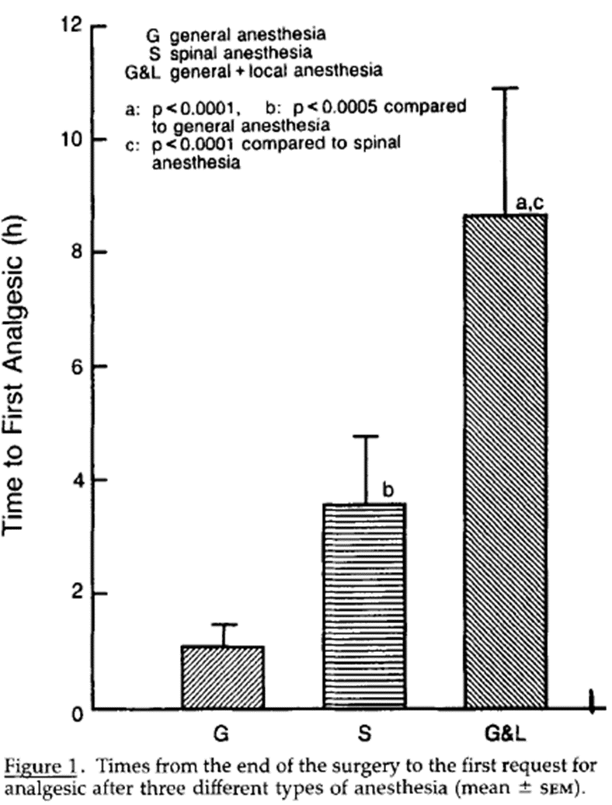
As a marker for duration of analgesia time to first opioid dose recorded
However: no data presented about overall opioid dosing
Tverskoy, M., et al. (1990). "Postoperative pain after inguinal herniorrhaphy with different types of anesthesia." Anesthesia & Analgesia 70(1): 29-35.
Notes:
Meperidine was the opioid

Slide 4

It May Be Obvious
Opioid reduction often not the focus of the study = the data can be buried
Opioid reduction is meaningless if pain is worse
For acute pain = no standard for how to assess opioid use, dose reduction, or opioid specific outcomes, but there are many studies reporting “opioid-sparing”
For chronic pain = even less consistent data

Slide 5
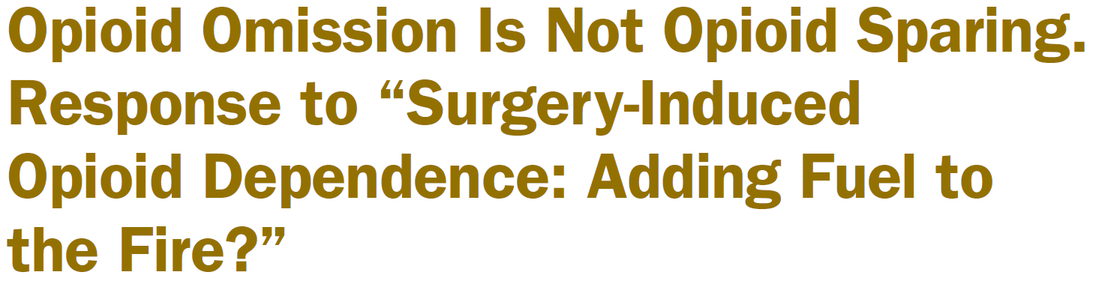
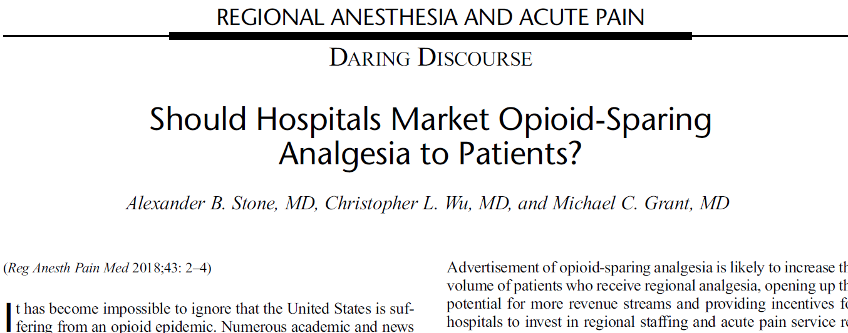
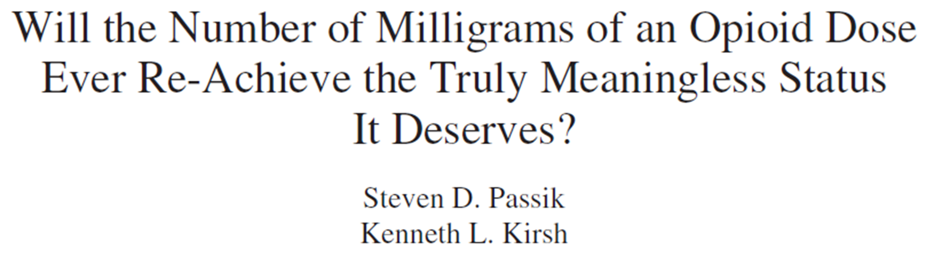
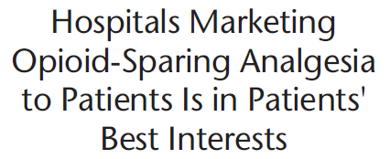
Lack of data is no barrier to lots of discussion
Notes:
Stone, A. B., et al. (2018). "Should Hospitals Market Opioid-Sparing Analgesia to Patients?" Regional Anesthesia & Pain Medicine 43(1): 2-4.
Passik, S. D. and K. L. Kirsh (2007). "Will the number of milligrams of an opioid dose ever re-achieve the truly meaningless status it deserves?" J Pain Palliat Care Pharmacother 21(1): 39-41.
There is a notion that tolerance is an inevitable complication when patients are maintained on opioid analgesic regimens for an extended period of time. Whether this is true or not, it is important to remember that, in spite of growing regulatory scrutiny and spreading fear around these medications, defining "ceiling doses" of opioids has more to do with clinician comfort and much less to do with reality and patient requirements. This commentary posits that clinicians must return to the principles of balancing efficacy with toxicity as the dose-limiting factor once again, contextualized by outcomes in the areas of function and compliant drug-taking.

Slide 6
How to assess opioid use in clinical trials?
Time to first dose/ Use of rescue
Dose prescribed
  # of pills/doses prescribed per event or time period
  # of pills/doses taken
MME/MED or cumulative/daily dose
Duration of opioid therapy
Opioid refills
Dose escalation
Dose of zero
Pain Outcomes (see other IMMPACT info):
  Pain rating = universal in some form
  Function = variable
  Satisfaction = variable
Pain, function, side effects, satisfaction:
  Not worsened
  Unchanged or improved
  Multiple assessment options

Slide 7
Time to first dose/ Use of rescue
Commonly used in Acute Pain trials to assess an intervention’s initial effect or duration of effect.
With less intense pain stimulus or more effective intervention rescue may be avoided.
  What is clinically significant?
  Is it meaningful as a stand alone assessment?
  How does it translate to clinical practice?
  Does it lead to decreased overall opioid dosing?

Slide 8
MME/MED
MME = morphine milligram equivalents
MED = morphine equivalent dose
Risk for opioid-related serious harms are dose-dependent
Both Acute and Chronic pain studies
  In acute pain studies: often 24-48 hours only
Clinical utility as well
Prominent in public policy and guidelines
Reported per time period (commonly daily) or totaled over the study period

Slide 9
Prescribed Dose/# of Pills
Opioids often prescribed/consumed in defined increments either scheduled or “as needed”
Most prescription opioid consumption for both acute and chronic pain occurs outside of the supervised medical setting
Higher doses = more risk, more adverse effects
More pills = more available for diversion/misuse

Slide 10
Acute Pain

Slide 11
Acute Pain: Opioid-Sparing Review
Review of studies demonstrating “opioid-sparing:” adjuvant medications, regional anesthesia, nerve blocks
Reduced opioid consumption first 24 - 48 hours = most commonly reported opioid-sparing effect
“While individual pieces of optimal postoperative pain management plans have been studied, long-term outcome data are lacking, as well as data regarding rebound pain…. there is much work to be done.
Kumar, K., et al. (2017). "A Review of Opioid-Sparing Modalities in Perioperative Pain Management: Methods to Decrease Opioid Use Postoperatively." Anesthesia & Analgesia 125(5): 1749-1760.
Notes:
Kumar, K., et al. (2017). "A Review of Opioid-Sparing Modalities in Perioperative Pain Management: Methods to Decrease Opioid Use Postoperatively." Anesthesia & Analgesia 125(5): 1749-1760.
There is an epidemic of opioid use, abuse, and misuse in the United States, which results in significant morbidity and mortality. It may be difficult to reduce perioperative opioid use given known acute surgical trauma and resultant pain; however, the discrete and often limited nature of postoperative pain also may make management easier in part by utilizing nonopioid modalities, such as regional anesthesia/analgesia, and multimodal analgesia, which may decrease the need for powerful opioids. This article reviews the relevant literature describing the use of adjunct medications, regional anesthesia and analgesic techniques, and regional block additives in the context of providing adequate pain control while lessening opioid use.

Slide 12
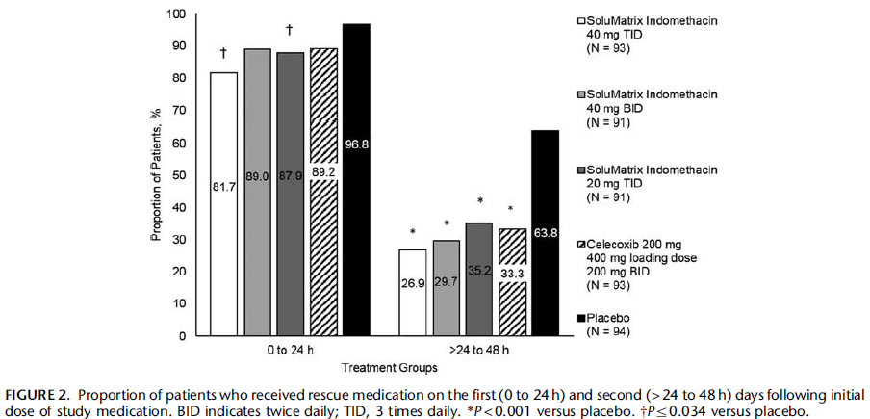
Traditional PCRT Drug Study:
Phase 3, multicenter DBPCRT SoluMatrix indomethacin, 462 subjects, bunionectomy
All subjects: popliteal sciatic block + 1st metatarsal block, continued till POD #1, study medication given on POD #1 for 48 hours
Randomized to 3 different doses of SoluMatrix indomethacin, celecoxib, or placebo.
Outcome measures: Pain Intensity Difference treatment groups vs Placebo, proportion of patients who used rescue (hydrocodone/apap), time to first use of rescue, number of tablets
Results: active treatment resulted in reductions that were most pronounced after 24 hours
Notes:
  Given the delay, starting early may have led to greater separation between groups
  What happens after the 48 hour study period?
Gharibo, C. G., et al. (2018). "Opioid-sparing Effects of SoluMatrix Indomethacin in a Phase 3 Study in Patients With Acute Postoperative Pain." Clinical Journal of Pain 34(2): 138-144(Clinicaltrials.gov identifier NCT01543685)
Notes:
Gharibo, C. G., et al. (2018). "Opioid-sparing Effects of SoluMatrix Indomethacin in a Phase 3 Study in Patients With Acute Postoperative Pain." Clinical Journal of Pain 34(2): 138-144.
OBJECTIVES: To report the opioid-sparing effects of SoluMatrix indomethacin, developed using SoluMatrix Fine Particle Technology, in a phase 3 study in patients with acute pain following bunionectomy. METHODS: This phase 3, placebo-controlled study randomized 462 patients with moderate-to-severe pain following bunionectomy surgery to receive SoluMatrix indomethacin 40 mg 3 times daily, SoluMatrix indomethacin 40 mg twice daily, SoluMatrix indomethacin 20 mg 3 times daily, celecoxib 400-mg loading dose followed by 200 mg twice daily, or placebo. Patients were permitted to receive opioid-containing rescue medication throughout the study. The proportion of patients who used rescue medication and the amount of rescue medication used on the first (0 to 24 h) and second (>24 to 48 h) days following initial dose of study medication, as well as time to first rescue medication use, were assessed. RESULTS: Significantly fewer patients who received SoluMatrix indomethacin 40 or 20 mg 3 times daily used opioid-containing rescue medication on day 1 compared with those receiving placebo (P</=0.034), and fewer patients in all active treatment groups used rescue medication during the second day compared with those in the placebo group (P<0.001). All active treatment groups used significantly fewer rescue medication tablets on days 1 and 2 following randomization compared with placebo (P<0.001). The most common adverse events were nausea, postprocedural edema, and headache. DISCUSSION: SoluMatrix indomethacin was associated with opioid-sparing effects in patients with acute postoperative pain.

Slide 13
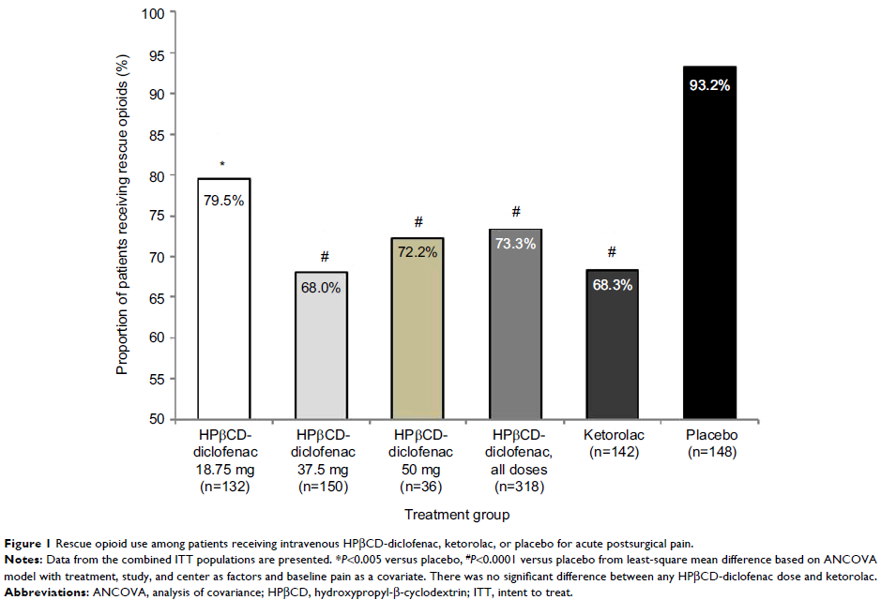
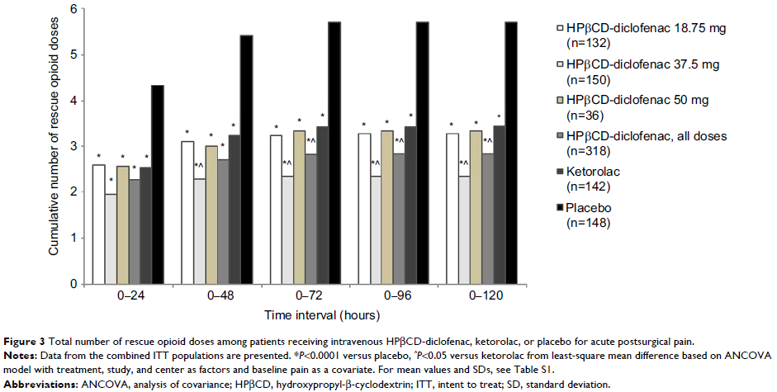
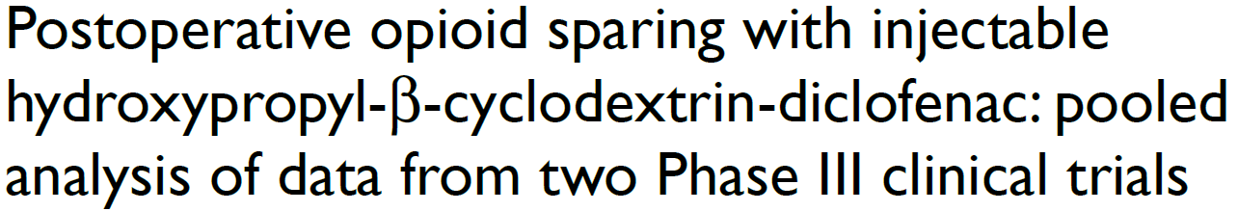
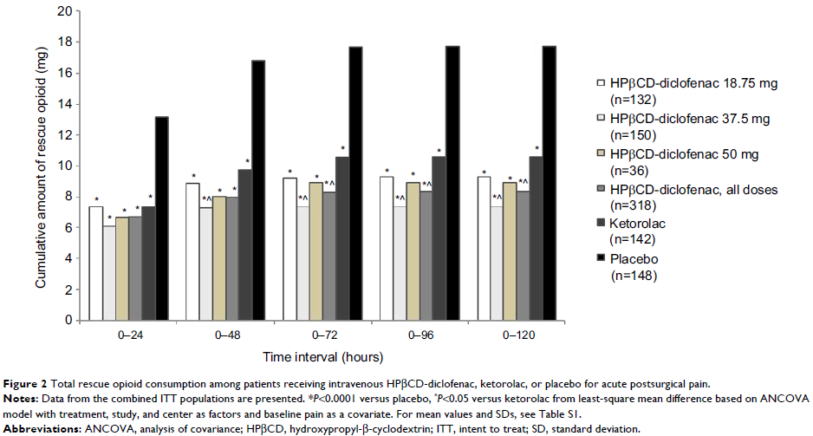
Acute Pain Opioid Sparing Phase III
Two DBPCRTs abdominal/pelvic or orthopedic surgery, hydroxypropyl-β-cyclodextrin (HPβCD)-diclofenac, ketorolac, or placebo, 608 subjects.
Intervention: IV NSAID or placebo. Dose adjusted by non-pain factors (wt, risks, age)
Opioid assessments: IV Morphine bolus. Proportion of patient requiring opioids, cumulative opioid dose and number of doses over 5 days.
Results: treatment groups were less likely to use opioids, used fewer doses, fewer mg
Notes: not the primary outcomes of the studies, this is a combined secondary paper focused on opioids with varied patient population
Gan, T. J., et al. (2017). "Postoperative opioid sparing with injectable hydroxypropyl-beta-cyclodextrin-diclofenac: pooled analysis of data from two Phase III clinical trials." J Pain Res 10: 15-29. (NCT00448110, NCT00507026)
Notes:
Gan, T. J., et al. (2017). "Postoperative opioid sparing with injectable hydroxypropyl-beta-cyclodextrin-diclofenac: pooled analysis of data from two Phase III clinical trials." J Pain Res 10: 15-29. (NCT00448110, NCT00507026)
PURPOSE: Use of nonopioid analgesics (including nonsteroidal anti-inflammatory drugs) for postoperative pain management can reduce opioid consumption and potentially prevent opioid-related adverse events. This study examined the postoperative opioid-sparing effect of repeated-dose injectable diclofenac formulated with hydroxypropyl-beta-cyclodextrin (HPbetaCD)-diclofenac. PATIENTS AND METHODS: Pooled data from two double-blind, randomized, placebo- and active comparator-controlled Phase III trials were analyzed. Patients received HPbetaCD-diclofenac, placebo, or ketorolac by intravenous injection every 6 hours for up to 5 days following abdominal/pelvic or orthopedic surgery. Rescue opioid use was evaluated from the time of first study drug administration to up to 120 hours following the first dose in the overall study population and in subgroups defined by baseline pain severity, age, and HPbetaCD-diclofenac dose. RESULTS: Overall, 608 patients received >/=1 dose of study medication and were included in the analysis. While 93.2% of patients receiving placebo required opioids, the proportion of patients requiring opioids was significantly lower for patients receiving HPbetaCD-diclofenac (18.75, 37.5, or 50 mg) or ketorolac (P<0.005 for all comparisons). Mean cumulative opioid dose and number of doses were significantly lower among patients receiving HPbetaCD-diclofenac versus placebo for the 0-24 through 0-120 hour time periods (P<0.0001), as well as versus ketorolac for the 0-72 through 0-120 hour time periods (P<0.05). HPbetaCD-diclofenac significantly reduced opioid consumption versus placebo in subgroups based on baseline pain severity (moderate, severe) and age (<65 years, >/=65 years) from the 0-24 hour period onward. When compared to ketorolac, HPbetaCD-diclofenac also significantly reduced cumulative opioid consumption among patients with moderate baseline pain (0-72 through 0-120 hours) and opioid dose number among patients >/=65 years old (0-24 through 0-120 hours). CONCLUSION: HPbetaCD-diclofenac can reduce postoperative opioid requirements. As this analysis was not powered to compare opioid-related adverse event rates, follow-up studies examining the clinical impact of HPbetaCD-diclofenac's opioid sparing are warranted.

Slide 14
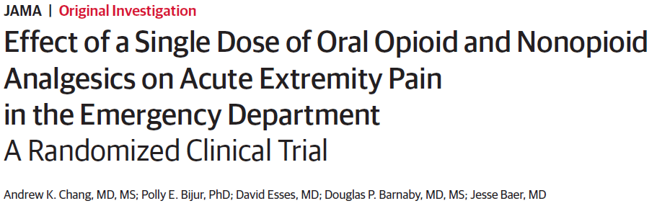
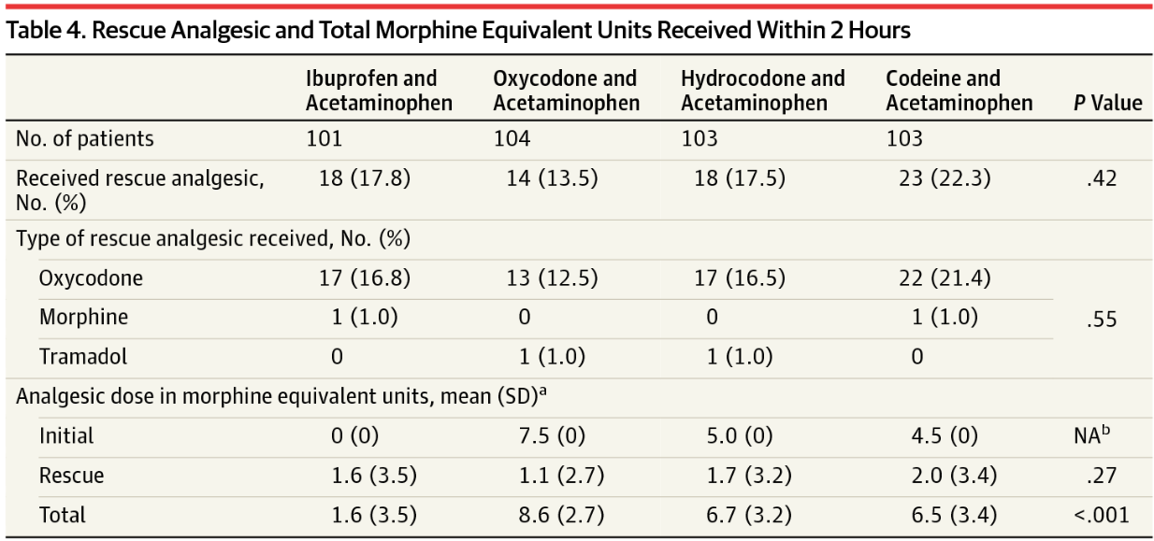
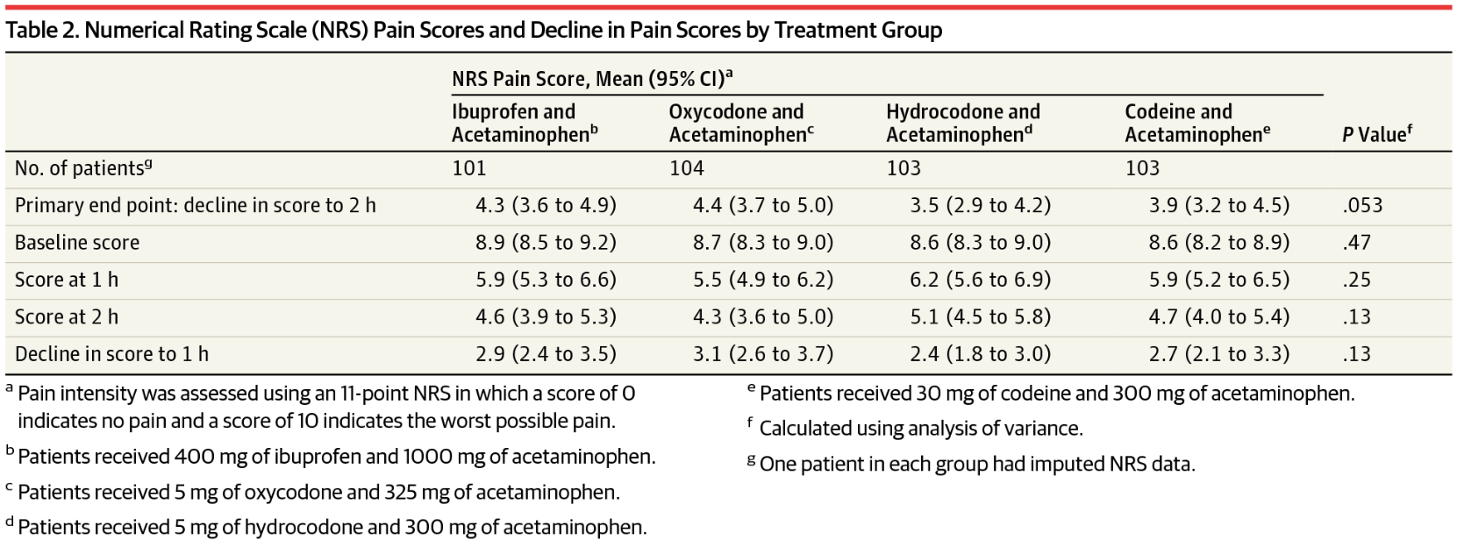
416 patients with acute moderate to severe extremity pain, randomized
Outcomes assessed after 2 hours (remember, it is an ED study)
Chang, A. K., et al. (2017). "Effect of a Single Dose of Oral Opioid and Nonopioid Analgesics on Acute Extremity Pain in the Emergency Department: A Randomized Clinical Trial." JAMA 318(17): 1661-1667.
Notes:
Chang, A. K., et al. (2017). "Effect of a Single Dose of Oral Opioid and Nonopioid Analgesics on Acute Extremity Pain in the Emergency Department: A Randomized Clinical Trial." JAMA 318(17): 1661-1667.
Importance: The choice of analgesic to treat acute pain in the emergency department (ED) lacks a clear evidence base. The combination of ibuprofen and acetaminophen (paracetamol) may represent a viable nonopioid alternative. Objectives: To compare the efficacy of 4 oral analgesics. Design, Settings, and Participants: Randomized clinical trial conducted at 2 urban EDs in the Bronx, New York, that included 416 patients aged 21 to 64 years with moderate to severe acute extremity pain enrolled from July 2015 to August 2016. Interventions: Participants (104 per each combination analgesic group) received 400 mg of ibuprofen and 1000 mg of acetaminophen; 5 mg of oxycodone and 325 mg of acetaminophen; 5 mg of hydrocodone and 300 mg of acetaminophen; or 30 mg of codeine and 300 mg of acetaminophen. Main Outcomes and Measures: The primary outcome was the between-group difference in decline in pain 2 hours after ingestion. Pain intensity was assessed using an 11-point numerical rating scale (NRS), in which 0 indicates no pain and 10 indicates the worst possible pain. The predefined minimum clinically important difference was 1.3 on the NRS. Analysis of variance was used to test the overall between-group difference at P = .05 and 99.2% CIs adjusted for multiple pairwise comparisons. Results: Of 416 patients randomized, 411 were analyzed (mean [SD] age, 37 [12] years; 199 [48%] women; 247 [60%] Latino). The baseline mean NRS pain score was 8.7 (SD, 1.3). At 2 hours, the mean NRS pain score decreased by 4.3 (95% CI, 3.6 to 4.9) in the ibuprofen and acetaminophen group; by 4.4 (95% CI, 3.7 to 5.0) in the oxycodone and acetaminophen group; by 3.5 (95% CI, 2.9 to 4.2) in the hydrocodone and acetaminophen group; and by 3.9 (95% CI, 3.2 to 4.5) in the codeine and acetaminophen group (P = .053). The largest difference in decline in the NRS pain score from baseline to 2 hours was between the oxycodone and acetaminophen group and the hydrocodone and acetaminophen group (0.9; 99.2% CI, -0.1 to 1.8), which was less than the minimum clinically important difference in NRS pain score of 1.3. Adverse events were not assessed. Conclusions and Relevance: For patients presenting to the ED with acute extremity pain, there were no statistically significant or clinically important differences in pain reduction at 2 hours among single-dose treatment with ibuprofen and acetaminophen or with 3 different opioid and acetaminophen combination analgesics. Further research to assess adverse events and other dosing may be warranted. Trial Registration: clinicaltrials.gov Identifier: NCT02455518.

Slide 15
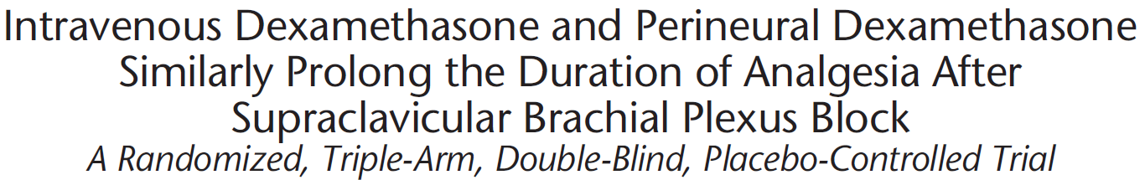
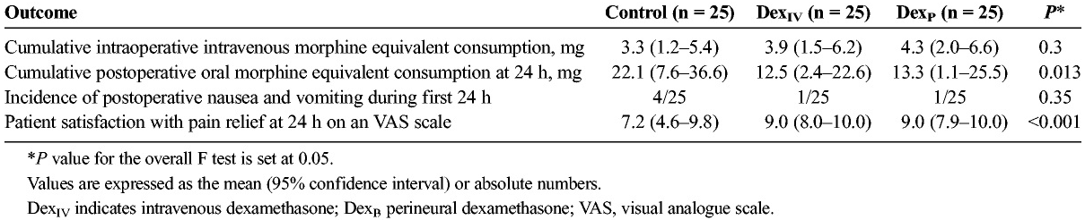
Acute Pain: Duration of Analgesia
Often assessed as time to first request for analgesia
This study had opioid dosing and presumed opioid side effects as outcome measures
Abdallah, F. W., et al. (2015). "Intravenous Dexamethasone and Perineural Dexamethasone Similarly Prolong the Duration of Analgesia After Supraclavicular Brachial Plexus Block: A Randomized, Triple-Arm, Double-Blind, Placebo-Controlled Trial." Regional Anesthesia and Pain Medicine 40(2): 125-132.
Notes:
Abdallah, F. W., et al. (2015). "Intravenous Dexamethasone and Perineural Dexamethasone Similarly Prolong the Duration of Analgesia After Supraclavicular Brachial Plexus Block: A Randomized, Triple-Arm, Double-Blind, Placebo-Controlled Trial." Regional Anesthesia and Pain Medicine 40(2): 125-132.
Background and Objectives Perineural dexamethasone prolongs the duration of single-injection peripheral nerve block when added to the local anesthetic solution. Postulated systemic mechanisms of action along with theoretical safety concerns have prompted the investigation of intravenous dexamethasone as an alternative, with decidedly mixed results. We aimed to confirm that addition of intravenous dexamethasone will prolong the duration of analgesia after single-injection supraclavicular block compared with conventional long-acting local anesthetic alone or in combination with perineural dexamethasone for ambulatory upper extremity surgery. Methods Seventy-five patients were randomized to receive supraclavicular block using 30-mL bupivacaine 0.5% alone (Control), with concomitant intravenous dexamethasone 8 mg (DexIV), or with perineural dexamethasone 8 mg (DexP). Duration of analgesia was designated as the primary outcome. To test our hypothesis, the superiority of DexIV was first compared with Control and then with DexP. Motor block duration, pain scores, opioid consumption, opioid-related side effects, patient satisfaction, and block-related complications were also analyzed. Results Twenty-five patients per group were analyzed. The duration of analgesia (mean [95% confidence interval]) was prolonged in the DexIV group (25 hours [17.6–23.6]) compared with Control (13.2 hours [11.5–15.0]; P < 0.001) but similar to the DexP group (25 hours [19.5–27.4]; P = 1). The DexIV group experienced longer motor block (30.1 hours) compared with DexP (25.5 hours) and Control (19.7 hours) groups. Both DexIV and DexP had reduced pain scores, reduced postoperative opioid consumption, and improved satisfaction compared with Control. Conclusions In a single-injection supraclavicular block with long-acting local anesthetic, the effectiveness of intravenous dexamethasone in prolonging the duration of analgesia seems similar to perineural dexamethasone.

Slide 16
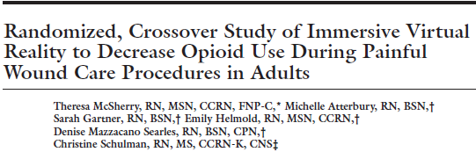

Hospitalized patients undergoing painful wound care, standard treatment = IV Fentanyl
Within-subject RCT IVR vs no IVR; 18 subjects
Intervention: VR goggles, headset, use of mouse in SnowWorld (www.vrpain.com)
Outcome measures: fentanyl total dose, # of doses, 0-10 verbal numeric scale
Results: Statistically fewer requests for opioid, total dose of fentanyl reduced from 103.1 to 91.7 mcg, pain no different.
Notes: novel intervention. Standardized pretreatment with 1 mcg/kg fentanyl decreased the possibility of a larger dose reduction.
McSherry, T., et al. (2018). "Randomized, Crossover Study of Immersive Virtual Reality to Decrease Opioid Use During Painful Wound Care Procedures in Adults." J Burn Care Res 39(2): 278-285.
Notes:
SnowWorld
McSherry, T., et al. (2018). "Randomized, Crossover Study of Immersive Virtual Reality to Decrease Opioid Use During Painful Wound Care Procedures in Adults." J Burn Care Res 39(2): 278-285.
The objective of this study was to evaluate the effect of immersive virtual reality (IVR) distraction therapy during painful wound care procedures in adults on the amount of opioid medications required to manage pain. A convenience sample of consenting, adult inpatients requiring recurrent painful wound care procedures was studied. Using a within-subject, randomized controlled trial study design, 2 sequential wound procedures were compared, 1 with IVR distraction therapy and 1 without IVR. Total opioid medications administered before and during the wound procedures were recorded and pain and anxiety were rated before and after the 2 wound procedures. The IVR intervention included the wearing of virtual reality goggles and participation in an immersive, computer generated, interactive, 3-dimensional virtual world program. Data were analyzed with Student's t test and chi-square analysis, with P < 0.05 considered significant. A total of 18 patients were studied, with 12 completing both study wound procedures and 6 completing a single wound procedure. The amount of opioid administered before each of the 2 wound procedures was similar with and without IVR. Total opioid administration during the dressing procedures with IVR was significantly less than when no IVR was used, 17.9 +/- 6.0 and 29.2 +/- 4.5 mcg/kg fentanyl, respectively (t = -2.7; df = 14; P = 0.02). Two of 15 patients (11%) requested more than 1 opioid rescue dose with IVR and 9 of 15 patients (60%) requested more than 1 rescue dose without IVR. Seventy-five percentage of participants stated that they would want to use IVR with future dressing changes. Pain and anxiety scores were similar for the wound procedures with and without IVR (P > 0.05). IVR significantly reduced the amount of opioid medication administered during painful wound care procedures when IVR was used compared with no IVR. Since pain scores were similar before and after the wound procedures with IVR and without IVR, the 39% reduction in opioid medication during IVR supports its use as a pain distraction therapy during painful procedures.

Slide 17
ERAS
Pre-emptive analgesia, preventive analgesia: a focus on delaying/minimizing pain, often with one single intervention
Multimodal analgesia: mainly anesthesia interventions, analgesia in the title
Enhanced Recovery After Surgery: (ERAS): many interventions, systematic multifaceted team approach spanning periop period, multiple objectives, improved pain control not the sole focus.
One of the commonly reported benefits of ERAS protocols is reduced reliance on opioids
How that is reported is variable:
  Meta-analysis #1: Lau & Chamberlain 2016: 42 RCTs reviewed, mainly reported LOS, readmission, costs, complications, GI function, etc. DID NOT REPORT OPIOID DOSING/OPIOID REDUCTION
  Review #2: Wick et al 2017: prominent focus on opioids, overview, specific measures not reported
Lau, C. S. and R. S. Chamberlain (2017). "Enhanced Recovery After Surgery Programs Improve Patient Outcomes and Recovery: A Meta-analysis." World J Surg 41(4): 899-913.
Wick, E. C., et al. (2017). "Postoperative Multimodal Analgesia Pain Management With Nonopioid Analgesics and Techniques: A Review." JAMA Surg 152(7): 691-697.
Notes:
Lau, C. S. and R. S. Chamberlain (2017). "Enhanced Recovery After Surgery Programs Improve Patient Outcomes and Recovery: A Meta-analysis." World J Surg 41(4): 899-913.
INTRODUCTION: Enhanced recovery after surgery (ERAS) programs have been developed to improve patient outcomes, accelerate recovery after surgery, and reduce healthcare costs. ERAS programs are a multimodal approach, with interventions during all stages of care. This meta-analysis examines the impact of ERAS programs on patient outcomes and recovery. METHODS: A comprehensive search of all published randomized control trials (RCTs) assessing the use of ERAS programs in surgical patients was conducted. Outcomes analyzed were length of stay (LOS), overall mortality, 30-day readmission rates, total costs, total complications, time to first flatus, and time to first bowel movement. RESULTS: Forty-two RCTs involving 5241 patients were analyzed. ERAS programs significantly reduced LOS, total complications, and total costs across all types of surgeries (p < 0.001). Return of gastrointestinal (GI) function was also significantly improved, as measured by earlier time to first flatus and time to first bowel movement, p < 0.001. There was no overall difference in mortality or 30-day readmission rates; however, 30-day readmission rates after upper GI surgeries nearly doubled with the use of ERAS programs (RR = 1.922; p = 0.019). CONCLUSIONS: ERAS programs are associated with a significant reduction in LOS, total complications, total costs, as well as earlier return of GI function. Overall mortality and readmission rates remained similar, but there was a significant increase in 30-day readmission rates after upper GI surgeries. ERAS programs are effective and a valuable part in improving patient outcomes and accelerating recovery after surgery.

Slide 18

Prescribed opioids for surgery
Across multiple procedures: 42-71% opioids unused and typically available for unmonitored use
Persistent opioid use just as likely after minor surgery
Prescribing less
  Patients just as satisfied
  Don’t have more pain
  Use fewer pills (lower doses) for shorter duration
  Not more likely to get refills
Bicket, M. C., et al. (2017). "Prescription Opioid Analgesics Commonly Unused After Surgery: A Systematic Review." JAMA Surg.
Brummett, C. M., et al. (2017). "New Persistent Opioid Use After Minor and Major Surgical Procedures in US Adults." JAMA Surg 152(6): e170504.
Sekhri, S., et al. (2017). "Probability of Opioid Prescription Refilling After Surgery: Does Initial Prescription Dose Matter?" Ann Surg.
Waljee, J. F., et al. (2017). "Iatrogenic Opioid Dependence in the United States: Are Surgeons the Gatekeepers?" Ann Surg 265(4): 728-730.
Lee, J. S., et al. (2017). "Postoperative Opioid Prescribing and the Pain Scores on Hospital Consumer Assessment of Healthcare Providers and Systems Survey." Jama 317(19): 2013-2015.

Slide 19
Chronic Pain

Slide 20
Chronic Pain Opioid Reduction
Cochrane Review, 2017
Examining interventions to reduce prescribed opioid use in chronic pain
Heterogeneous populations, interventions. and outcomes. 5 studies identified
They decided what a responder was:
  “at least a 50% reduction in opioid consumption”
  Or: Complete opioid withdrawal
  Or: reduction below “high” dose = 120 MED
  AND: “A responder also had to have, at worst, no increase in pain as a result of the intervention. Both aspects of improvement had to be maintained for at least three months post intervention.”
OPIOID USE: no consistent assessment within the 5 studies. MED in only one, dose/week in another, vague in the other three.
All other outcomes: AEs, Mood, Physical Function, Pain inconsistently reported.
Eccleston, C., et al. (2017). "Interventions for the reduction of prescribed opioid use in chronic non-cancer pain." Cochrane Database of Systematic Reviews 11: Cd010323.
Notes:
Eccleston, C., et al. (2017). "Interventions for the reduction of prescribed opioid use in chronic non-cancer pain." Cochrane Database of Systematic Reviews 11: Cd010323.
BACKGROUND: This is the first update of the original Cochrane Review published in 2013. The conclusions of this review have not changed from the 2013 publication. People with chronic non-cancer pain who are prescribed and are taking opioids can have a history of long-term, high-dose opioid use without effective pain relief. In those without good pain relief, reduction of prescribed opioid dose may be the desired and shared goal of both patient and clinician. Simple, unsupervised reduction of opioid use is clinically challenging, and very difficult to achieve and maintain.
OBJECTIVES: To investigate the effectiveness of different methods designed to achieve reduction or cessation of prescribed opioid use for the management of chronic non-cancer pain in adults compared to controls. SEARCH METHODS: For this update we searched CENTRAL, MEDLINE, and Embase in January 2017, as well as bibliographies and citation searches of included studies. We also searched one trial registry for ongoing trials. SELECTION CRITERIA: Included studies had to be randomised controlled trials comparing opioid users receiving an intervention with a control group receiving treatment as usual, active control, or placebo. The aim of the study had to include a treatment goal of dose reduction or cessation of opioid medication. DATA COLLECTION AND ANALYSIS: Two review authors independently extracted data and assessed risk of bias. We sought data relating to prescribed opioid use, adverse events of opioid reduction, pain, and psychological and physical function. We planned to assess the certainty of the evidence using the GRADE approach, however, due to the heterogeneity of studies, we were unable to combine outcomes in a meta-analysis and therefore we did not assess the evidence with GRADE. MAIN RESULTS: Three studies are new to this update, resulting in five included studies in total (278 participants). Participants were primarily women (mean age 49.63 years, SD = 11.74) with different chronic pain conditions. We judged the studies too heterogeneous to pool data in a meta-analysis, so we have summarised the results from each study qualitatively. The studies included acupuncture, mindfulness, and cognitive behavioral therapy interventions aimed at reducing opioid consumption, misuse of opioids, or maintenance of chronic pain management treatments. We found mixed results from the studies. Three of the five studies reported opioid consumption at post-treatment and follow-up. Two studies that delivered 'Mindfulness-Oriented Recovery Enhancement' or 'Therapeutic Interactive Voice Response' found a significant difference between groups at post-treatment and follow-up in opioid consumption. The remaining study found reduction in opioid consumption in both treatment and control groups, and between-group differences were not significant. Three studies reported adverse events related to the study and two studies did not have study-related adverse events. We also found mixed findings for pain intensity and physical functioning. The interventions did not show between-group differences for psychological functioning across all studies. Overall, the risk of bias was mixed across studies. All studies included sample sizes of fewer than 100 and so we judged all studies as high risk of bias for that category. AUTHORS' CONCLUSIONS: There is no evidence for the efficacy or safety of methods for reducing prescribed opioid use in chronic pain. There is a small number of randomised controlled trials investigating opioid reduction, which means our conclusions are limited regarding the benefit of psychological, pharmacological, or other types of interventions for people with chronic pain trying to reduce their opioid consumption. The findings to date are mixed: there were reductions in opioid consumption after intervention, and often in control groups too.

Slide 21
Chronic Pain Opioid Reduction
Cochrane Review, 2017
My CONCLUSION: nothing really helpful here!
50% reduction is a high bar, isn’t any reduction meaningful?
Studies should use IMMPACT guidelines for reporting outcomes in multiple domains
They note: “More work is needed to agree the best endpoints for treatments of medication reduction. Measures of the type of opioid and the median daily opioid dose in morphine equivalents consumed in a particular time period are critical to report. In addition, measures of patient-relevant outcomes such as mood, social functioning, and personal role functioning are also important to assess.”
Eccleston, C., et al. (2017). "Interventions for the reduction of prescribed opioid use in chronic non-cancer pain." Cochrane Database of Systematic Reviews 11: Cd010323.
Notes:
Eccleston, C., et al. (2017). "Interventions for the reduction of prescribed opioid use in chronic non-cancer pain." Cochrane Database of Systematic Reviews 11: Cd010323.
BACKGROUND: This is the first update of the original Cochrane Review published in 2013. The conclusions of this review have not changed from the 2013 publication. People with chronic non-cancer pain who are prescribed and are taking opioids can have a history of long-term, high-dose opioid use without effective pain relief. In those without good pain relief, reduction of prescribed opioid dose may be the desired and shared goal of both patient and clinician. Simple, unsupervised reduction of opioid use is clinically challenging, and very difficult to achieve and maintain.
OBJECTIVES: To investigate the effectiveness of different methods designed to achieve reduction or cessation of prescribed opioid use for the management of chronic non-cancer pain in adults compared to controls. SEARCH METHODS: For this update we searched CENTRAL, MEDLINE, and Embase in January 2017, as well as bibliographies and citation searches of included studies. We also searched one trial registry for ongoing trials. SELECTION CRITERIA: Included studies had to be randomised controlled trials comparing opioid users receiving an intervention with a control group receiving treatment as usual, active control, or placebo. The aim of the study had to include a treatment goal of dose reduction or cessation of opioid medication. DATA COLLECTION AND ANALYSIS: Two review authors independently extracted data and assessed risk of bias. We sought data relating to prescribed opioid use, adverse events of opioid reduction, pain, and psychological and physical function. We planned to assess the certainty of the evidence using the GRADE approach, however, due to the heterogeneity of studies, we were unable to combine outcomes in a meta-analysis and therefore we did not assess the evidence with GRADE. MAIN RESULTS: Three studies are new to this update, resulting in five included studies in total (278 participants). Participants were primarily women (mean age 49.63 years, SD = 11.74) with different chronic pain conditions. We judged the studies too heterogeneous to pool data in a meta-analysis, so we have summarised the results from each study qualitatively. The studies included acupuncture, mindfulness, and cognitive behavioral therapy interventions aimed at reducing opioid consumption, misuse of opioids, or maintenance of chronic pain management treatments. We found mixed results from the studies. Three of the five studies reported opioid consumption at post-treatment and follow-up. Two studies that delivered 'Mindfulness-Oriented Recovery Enhancement' or 'Therapeutic Interactive Voice Response' found a significant difference between groups at post-treatment and follow-up in opioid consumption. The remaining study found reduction in opioid consumption in both treatment and control groups, and between-group differences were not significant. Three studies reported adverse events related to the study and two studies did not have study-related adverse events. We also found mixed findings for pain intensity and physical functioning. The interventions did not show between-group differences for psychological functioning across all studies. Overall, the risk of bias was mixed across studies. All studies included sample sizes of fewer than 100 and so we judged all studies as high risk of bias for that category. AUTHORS' CONCLUSIONS: There is no evidence for the efficacy or safety of methods for reducing prescribed opioid use in chronic pain. There is a small number of randomised controlled trials investigating opioid reduction, which means our conclusions are limited regarding the benefit of psychological, pharmacological, or other types of interventions for people with chronic pain trying to reduce their opioid consumption. The findings to date are mixed: there were reductions in opioid consumption after intervention, and often in control groups too.

Slide 22
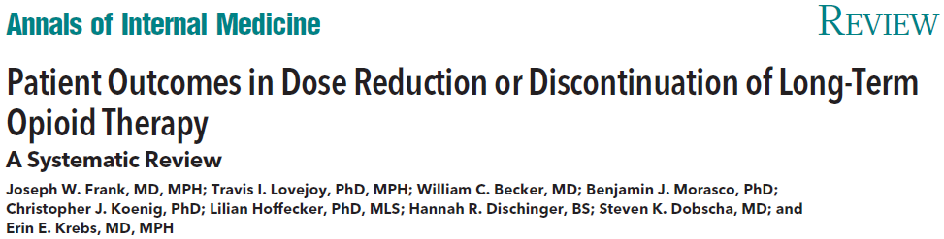
Equally Revealing of Deficiencies:
Identified 61 studies. Quality: good = 3, fair = 13, poor = 51.
One of the “good” studies did not have opioid reduction as a primary objective
Limitation: Heterogeneous interventions and outcome measures; poor-quality studies with uncontrolled designs.
Conclusion: “Very low quality evidence suggests that several types of interventions may be effective to reduce or discontinue LTOT and that pain, function, and quality of life may improve with opioid dose reduction.”
Frank, J. W., et al. (2017). "Patient Outcomes in Dose Reduction or Discontinuation of Long-Term Opioid Therapy: A Systematic Review." Annals of Internal Medicine 167(3): 181-191
Notes:
Frank, J. W., et al. (2017). "Patient Outcomes in Dose Reduction or Discontinuation of Long-Term Opioid Therapy: A Systematic Review." Annals of Internal Medicine 167(3): 181-191.
GOOD STUDIES: NAYLOR 2010, SULLIVAN 2017, ZGIERSKA 2016
Background: Expert guidelines recommend reducing or discontinuing long-term opioid therapy (LTOT) when risks outweigh benefits, but evidence on the effect of dose reduction on patient outcomes has not been systematically reviewed. Purpose: To synthesize studies of the effectiveness of strategies to reduce or discontinue LTOT and patient outcomes after dose reduction among adults prescribed LTOT for chronic pain. Data Sources: MEDLINE, EMBASE, PsycINFO, CINAHL, and the Cochrane Library from inception through April 2017; reference lists; and expert contacts. Study Selection: Original research published in English that addressed dose reduction or discontinuation of LTOT for chronic pain. Data Extraction: Two independent reviewers extracted data and assessed study quality using the U.S. Preventive Services Task Force quality rating criteria. All authors assessed evidence quality using the GRADE (Grading of Recommendations Assessment, Development and Evaluation) system. Prespecified patient outcomes were pain severity, function, quality of life, opioid withdrawal symptoms, substance use, and adverse events. Data Synthesis: Sixty-seven studies (11 randomized trials and 56 observational studies) examining 8 intervention categories, including interdisciplinary pain programs, buprenorphine-assisted dose reduction, and behavioral interventions, were found. Study quality was good for 3 studies, fair for 13 studies, and poor for 51 studies. Many studies reported dose reduction, but rates of opioid discontinuation ranged widely across interventions and the overall quality of evidence was very low. Among 40 studies examining patient outcomes after dose reduction (very low overall quality of evidence), improvement was reported in pain severity (8 of 8 fair-quality studies), function (5 of 5 fair-quality studies), and quality of life (3 of 3 fair-quality studies). Limitation: Heterogeneous interventions and outcome measures; poor-quality studies with uncontrolled designs. Conclusion: Very low quality evidence suggests that several types of interventions may be effective to reduce or discontinue LTOT and that pain, function, and quality of life may improve with opioid dose reduction. Primary Funding Source: Veterans Health Administration. (PROSPERO: CRD42015020347).

Slide 23
Education & Policies: A double dose is better
Washington state guidelines regarding limiting high dose opioids published 2007, law in 2010
Group Health added initiatives/education for their providers, but not contracted providers.
Comparison of those exposed to just the state regs vs the double dose of intervention, 5,552 COT patients (contracted providers) vs 16,653 COT patients (group practice)
Study Measures: MED, > 120 MED, More than 20 excess days supply
Interrupted time series analyses
Reductions were substantially greater in the group practice setting that implemented additional initiatives to alter shared physician expectations regarding appropriate COT prescribing, compared with the contracted physicians’ patients.
Von Korff, M., et al. (2016). "The Impact of Opioid Risk Reduction Initiatives on High-Dose Opioid Prescribing for Patients on Chronic Opioid Therapy." Journal of Pain 17(1): 101-110.
Notes:
Von Korff, M., et al. (2016). "The Impact of Opioid Risk Reduction Initiatives on High-Dose Opioid Prescribing for Patients on Chronic Opioid Therapy." Journal of Pain 17(1): 101-110.
UNLABELLED: Avoiding high opioid doses may reduce chronic opioid therapy (COT) risks, but the feasibility of reducing opioid doses in community practice is unknown. Washington State and a health plan's group practice implemented initiatives to reduce high-dose COT prescribing. The group practice physicians were exposed to both initiatives, whereas contracted physicians were exposed only to statewide changes. Using interrupted time series analyses, we assessed whether these initiatives reduced opioid doses among COT patients in group practice (n = 16,653) and contracted care settings (n = 5,552). From 2006 to June 2014, the percentage of COT patients receiving >/=120 mg morphine equivalent dose declined from 16.8% to 6.3% in the group practice versus 20.6 to 13.6% among COT patients of contracted physicians. The proportion receiving excess opioid days supplied declined from 24.0 to 10.4% among group practice COT patients and from 20.1 to 14.7% among COT patients of contracted physicians. Reductions in prescribing of high opioid dose and excess opioid days supplied followed state and health plan initiatives to change opioid prescribing. Reductions were substantially greater in the group practice setting that implemented additional initiatives to alter shared physician expectations regarding appropriate COT prescribing, compared with the contracted physicians' patients. PERSPECTIVE: Washington State and a health plan's group practice implemented initiatives to reduce high-dose COT prescribing. Group practice physicians were exposed to both initiatives, whereas the health plan's contracted physicians were exposed to only the statewide changes. Reductions in prescribing of high opioid dose, average daily dose, and excess opioid days supplied followed state and health plan initiatives to change opioid prescribing. Reductions were substantially greater in the group practice setting that implemented additional initiatives to alter shared physician expectations regarding appropriate COT prescribing, compared with the contracted physicians' patients.

Slide 24
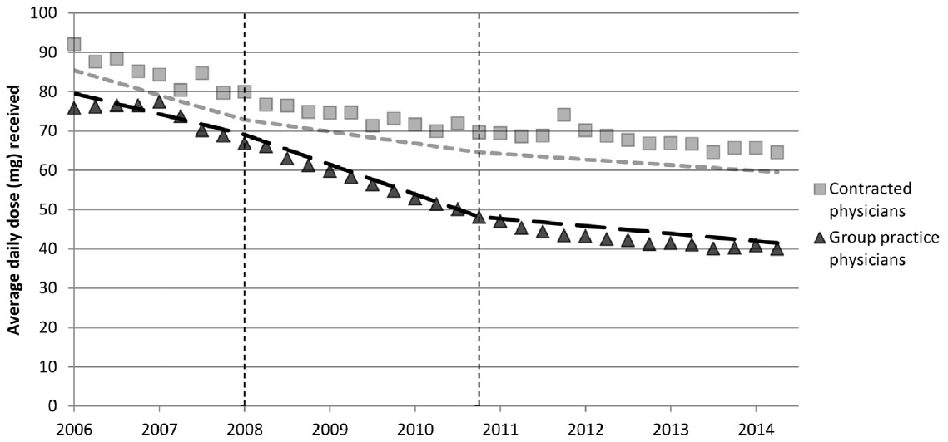
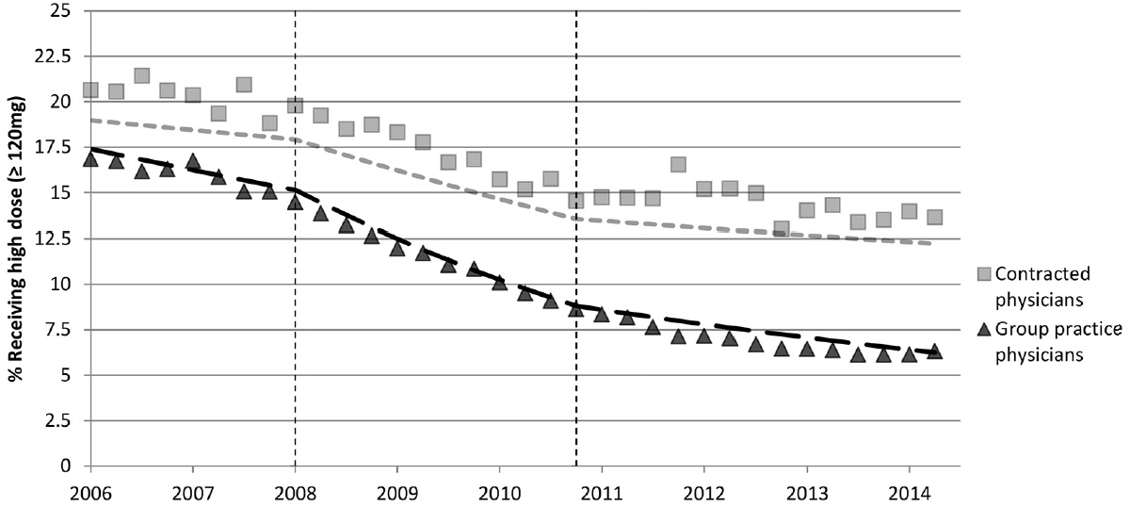
Opioid Reduction: Two is Better than one
Von Korff, M., et al. (2016). "The Impact of Opioid Risk Reduction Initiatives on High-Dose Opioid Prescribing for Patients on Chronic Opioid Therapy." Journal of Pain 17(1): 101-110.

Slide 25
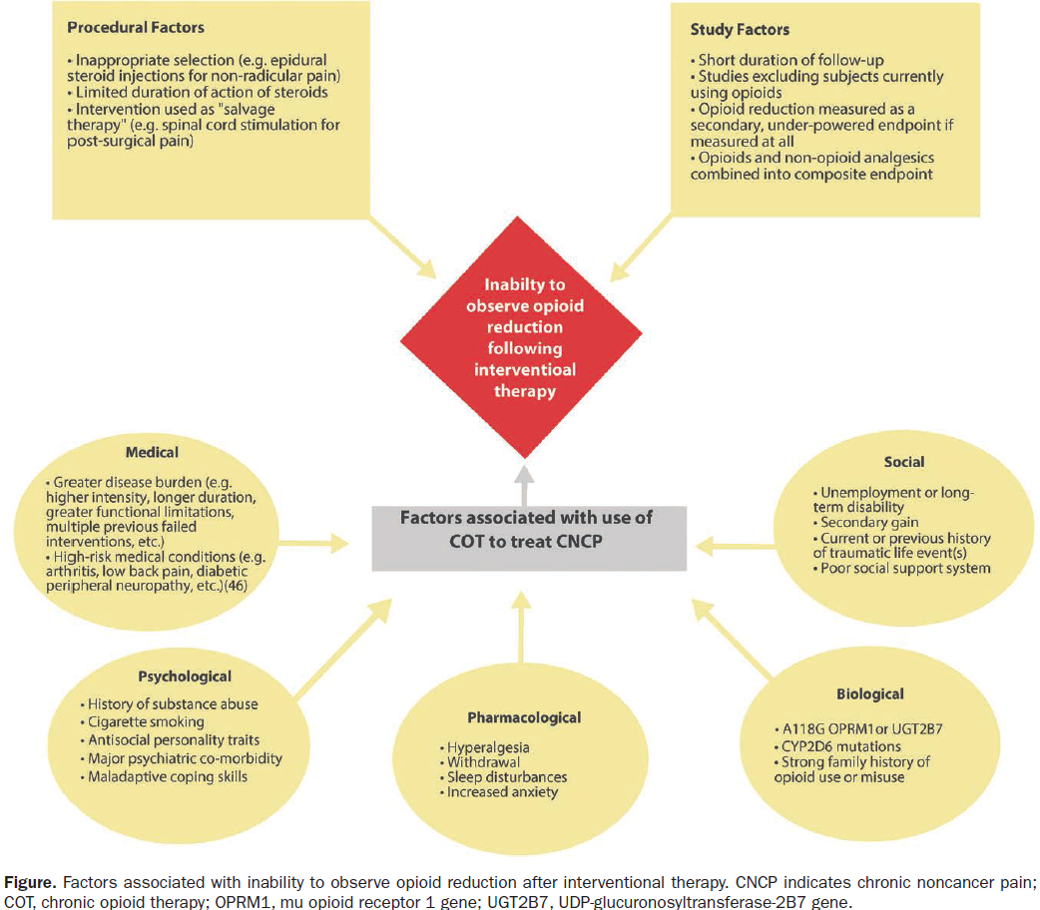
Chronic pain intervention, not much data for opioid reduction
Maher & Cohen review
Opioid reduction not a primary outcome
Data to support opioid reduction very limited
Maher, D. P. and S. P. Cohen (2017). "Opioid Reduction Following Interventional Procedures for Chronic Pain: A Synthesis of the Evidence." Anesthesia & Analgesia 125(5): 1658-1666.
Notes:
Maher, D. P. and S. P. Cohen (2017). "Opioid Reduction Following Interventional Procedures for Chronic Pain: A Synthesis of the Evidence." Anesthesia & Analgesia 125(5): 1658-1666.
The past decade has witnessed the tremendous growth of procedures to treat chronic pain, which has resulted in increased third-party scrutiny. Although most of these procedures appear to be associated with significant pain relief, at least in the short and intermediate term, their ability to improve secondary outcome measures, including function and work status is less clear-cut. One of these secondary outcome measures that has garnered substantial interest in the pain and general medical communities is whether interventions can reduce opioid intake, which is associated with significant risks that in most cases outweigh the benefits in the long term. In the article, we examine whether procedural interventions for chronic pain can reduce opioid intake. Most studies that have examined analgesic reduction as a secondary outcome measure have not separated opioid and nonopioid analgesics, and, among those studies that have, few have demonstrated between-group differences. Reasons for failure to demonstrate opioid reduction can be broadly classified into procedural, design-related, clinical, psychosocial, biological, and pharmacological categories, all of which are discussed. In the future, clinical trials in which this outcome is examined should be designed to evaluate this, at least on a preliminary basis.

Slide 26
Conclusions
ACUTE PAIN
Pain, satisfaction, function outcomes discussed elsewhere
Acute pain studies report many outcomes
Many opioid dosing outcomes can have meaning, those that extend beyond the immediate postoperative period are rarely reported
CHRONIC PAIN
MED is the most common reported variable
High dose patients: using MED often reported as an additional outcome point
Many challenges

Slide 27
THE unanswered central question
What opioid dose outcome(s) is/are sufficient to claim/support a meaningful “opioid-sparing” effect?

Slide 28

Thank You!
Notes:
Harstine Island, WA

