Slide 1
Chronic pain opioid sparing trials:
Research designs, methods, and study execution
Michael C. Rowbotham, MD
Chief Research Officer, Sutter Health
Adjunct Professor, UCSF Anesthesia
Professor Emeritus, UCSF Neurology

Slide 2
What does ‘opioid sparing’ mean and what are the outcomes to measure?
Lower doses of opioids
Can also mean sparing the need for opioids
Could even mean ‘sparing’ or reducing the frequency of OUD or reducing risk of overdose severe outcomes like hospitalization and death
Could be reinterpreted to mean opioid dose optimization (per HLF comment)
Lack of agreement on goals and outcome measures

Slide 3
What I learned about opioid tapering before my residency in Neurology….......
Chiang Mai, Thailand, UCSF Medical Student 1979
SFGH Methadone Clinic Medical Director 1981-83
  Hard to reduce dose, dose escalation can be surprisingly rapid

Slide 4
Cowan study (UK)
Cowan DT, et al, Pain Medicine 2003; 4:340-51.
N=104 prescribed opioids for mean of 14 months
2.8% ‘addiction’ rate (but use could still be managed)
90 of 104 reported stopping opioids at some point - only 13 reported withdrawal sx
  31 stopped temporarily; 59 stopped permanently
  Temporary cessation due to ‘fear of addiction’ in 22%
  Permanent cessation due to ‘fear of addiction’ in 10%, neuropsych AEs 23%, tx failure 18%

Slide 5
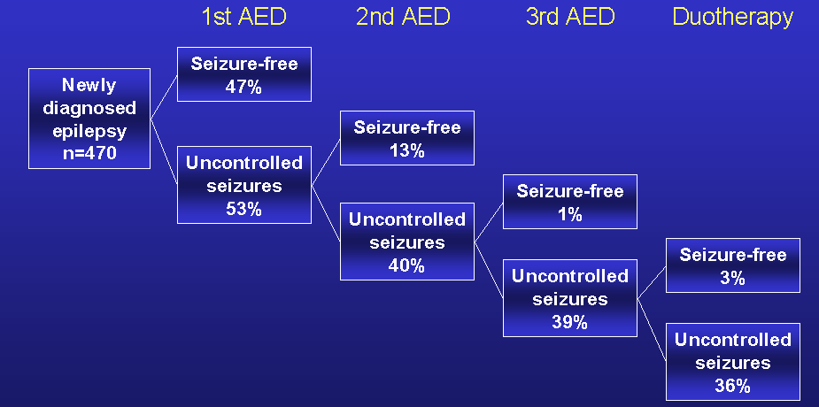
Are patients treated with opioids inherently different? Yes, if opioids always a ‘last resort’
Response to sequential treatment trials and duotherapy in epilepsy
Kwan and Brodie, NEJM 2000; 342:314-319
Likelihood of success no different if first drug ‘old’ vs ‘new’
Thank you to Ken Laxer
Notes:
Kwan and Brodie conducted a study to identify the factors associated with inadequate seizure control by AEDs, which is the outcome in about 30% of epilepsy patients. This slide shows the diminishing control rates with successive trials of different drugs when patients did not respond to the first AED.
Kwan P, Brodie MJ. Early identification of refractory epilepsy. N Engl J Med. 2000;342(5):314-319.

Slide 6
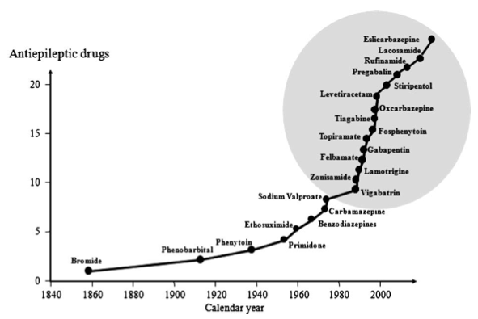
Response to sequential treatment trials and duotherapy in epilepsy
2011 update from the Glasgow group
N > 1,000 subjects
Failure rate reduced from 36% to 32%
Brodie and Sills, Seizure 2011; 20:369-375
Notes:
Kwan and Brodie conducted a study to identify the factors associated with inadequate seizure control by AEDs, which is the outcome in about 30% of epilepsy patients. This slide shows the diminishing control rates with successive trials of different drugs when patients did not respond to the first AED.
Kwan P, Brodie MJ. Early identification of refractory epilepsy. N Engl J Med. 2000;342(5):314-319.

Slide 7
What could a device accomplish?
Pain relief and symptom control
The device prevents the need to initiate opioids
  A direct pain-relieving effect
The device plus opioids is associated with equivalent pain relief at a lower opioid dosage than opioids alone
  Either directly relieves pain or synergistic with opioids
The device makes it possible to taper down to a lower dosage – or even completely discontinue -- in patients already on opioids
  Either directly pain relieving, or synergistic with opioids, or targets symptoms of opioid withdrawal
The device makes it possible to receive opioids in a form less prone to abuse
  No requirement of pain relief or synergy
  Could be transdermal absorption, iontophoretic, intraspinal, PCA
Examples would include spinal cord stimulation, deep brain stimulation, spinal drug delivery, withdrawal or craving symptom driven non-opioid drug delivery device, etc.

Slide 8
Prevention of OUD
Monitoring or lock-out
The device prevents the development of OUD in patients on opioids
  Not really sparing, but prevents unsanctioned dose escalation
  Tamper-proof system for ensuring dose limits can’t be exceeded (analogous to ambulatory PCA)
  Would need to also ensure patient not taking other opioids or taking same opioid by multiple routes
The device prevents opioid diversion in patients on opioids
  Not really sparing, but relevant to the societal problem
  Device would confirm patient actually taking the prescribed opioid and not diverting it

Slide 9
Would an app qualify?
How about device-delivered behavior modification?
Like a digital friend, AA support member, or family, delivers messages of support to reduce craving and unsanctioned opioid use
  Pear Therapeutics
MIT Media Arts and Sciences Program developing multiple devices to alter attitude and decision making (Pattie Maes)
  Change the ‘valence’ of the situation
  Odor release
  Pairing drug use with negative beliefs of patient’s choosing (aversive conditioning)

Slide 10
Trial design issues: Historical Controls
Not useful or valid
  Society and prescribers have moved from an opioid-promoting to an opioid-averse culture
Is OUD associated with higher opioid doses? Does this mean that lower doses confer lower OUD?
Time delay between post-op pain management and OUD – long and variable – why?
Prescribers are now prescribing significantly lower doses of opioids and being more selective in who receives them
  Not necessarily due to introduction of buprenorphine
  What constitutes a high risk patient is better appreciated by prescribers
  Paradoxical increase in use of illicit opioids with associated increased risk of overdose
    Prescription opioids less easily obtained
Only a prospective study can settle the issue

Slide 11
Trial design issues: prospective RCT
If goal is opioid sparing, depending on outcome measure, trial length could vary dramatically
  Opioid use at 1 month = easy
  Opioid use at 3 months = feasible
  Opioid use at 6 months or longer = very difficult due to drop out rates of 50% or more and difficult recruitment
If goal is reduced incidence of OUD, a traditional RCT is almost impossible without complete control over opioid Rx and perfect monitoring – this is not a short-term outcome
  Entirely dependent on assumptions about what % develop OUD
  Skewing the population towards higher OUD risk (hx of mental illness, stimulant abuse hx, etc) reduces sample size but makes study execution vastly more difficult
Case-Control design as an alternative
  If a device compared to best medical therapy, then only works well if device not otherwise readily available
Cohort designs covered as a form of pragmatic trial

Slide 12
Prospective RCTs - all about recruitment and retention
Costly, hard to recruit subjects
  High OUD risk patients hardest to recruit, usually left out
Opioid trials have the highest drop out rates of all?
Drop outs are almost certainly failures – AEs exceed perceived benefit

Slide 13
Levorphanol for Peripheral and Central Neuropathic Pain:
Low- vs High-Strength Levorphanol Capsules
Randomized, Double-Blind Comparison
Baseline
Week
Tapering
Week 1
Tapering
Week 2
Tapering
Week 3
Tapering
Week 4
Screening
Week 1
Week 2
Week 3
Week 4
Week 5
Week 6
Week 7
Week 8
Maximum,
3
capsules
Maximum,
9
capsules
Maximum,
15
capsules
Maximum,
21
capsules
Titration
Treatment
(maximum,
21 capsules)
Tapering
(up to 4 weeks)
No opioids allowed
Rowbotham et al. N Engl J Med. 2003;348:1223-1232

Slide 14
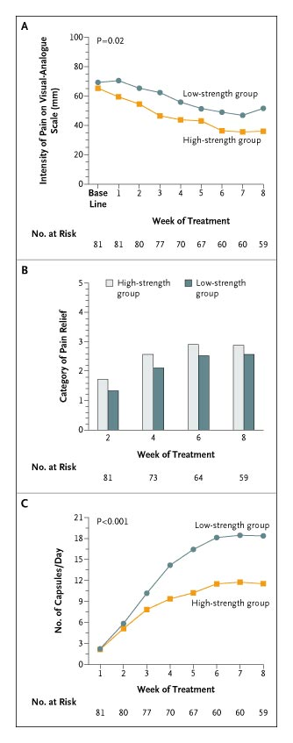
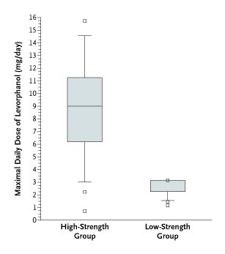
A Closer Look…….
81 subjects randomized, 59 completed
15 drops due to AE’s; agitation in high strength group
Eventual drops fell behind in capsule intake, pain reduction, and pain relief
No significant group difference in relief ratings
Actual daily dose highly variable

Slide 15
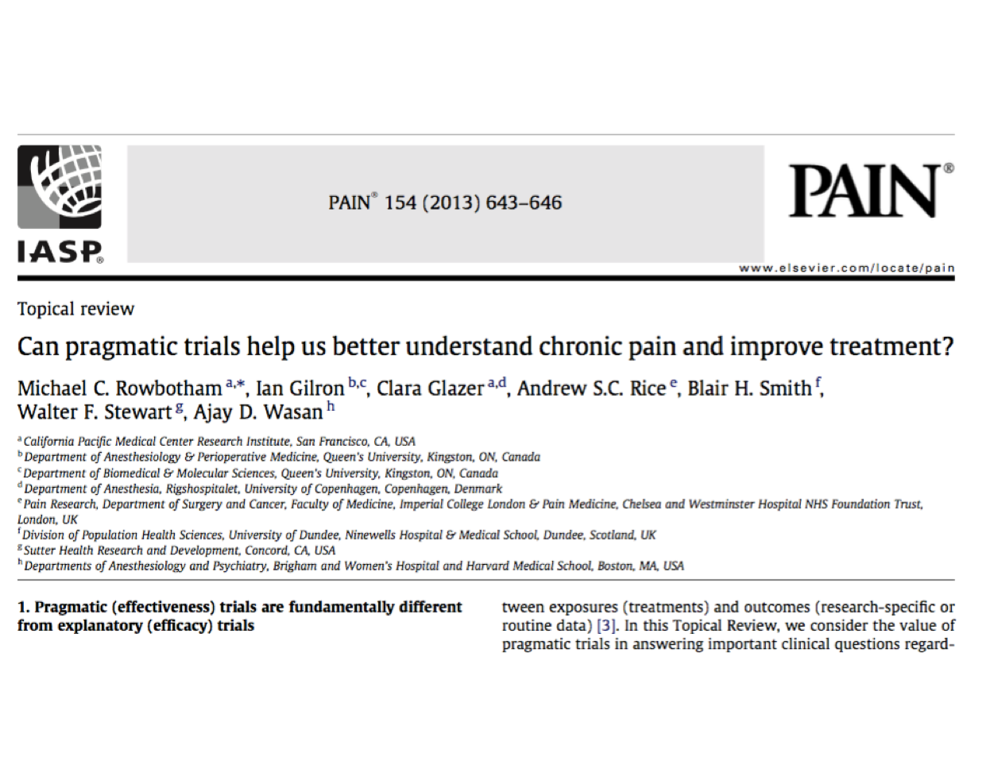

Slide 16
Trial design issues: Pragmatic Trials
Patients stay in their usual care situation
  Outcomes determined from review of EHR
  Correlations straightforward, but proof of causation difficult
  Data collection and correlation issues

Slide 17
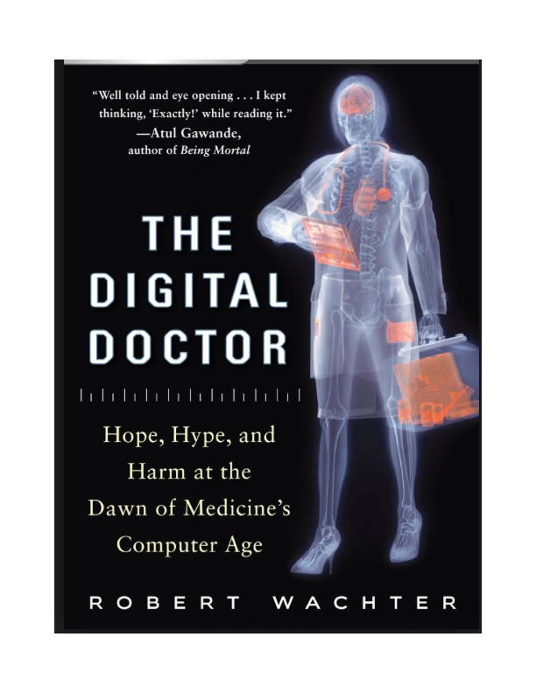
Trial design issues: Pragmatic Trials
EHR use is fraught with problems!
Sutter Health has the world’s largest installation of EPIC
SF Bay Area has CareEverywhere to link multiple sources of care (UCSF, Sutter, Kaiser, others)
Even at CPMC, private practice MDs in outpatient practices don’t use EPIC
Hard to get questionnaires in, even harder to get data back out

Slide 18
Trial design issues: Pragmatic Trials
Cluster randomized design comparing treatment approaches prospectively
  This could be at the level of facility or practice (easy enough in a large integrated health care system like Kaiser or maybe Sutter)
  This could be at the level of state or country if opioids regulated differently, especially access to opioids
  Confounders and bias can be subtle
    Devices especially susceptible – who gets access
    Busy primary care practices are different than dedicated pain management programs
  Outcome measures can be built into the electronic record
    Telemedicine and sensors would help
    Regular urine screening and other compliance measures too

