Slide 1
Opioid-Sparing Clinical Trial Objectives and Outcomes:
Acute Pain
T. J. Gan, M.D., F.R.C.A., M.H.S.
Professor and Chairman
Department of Anesthesiology
Stony Brook Medicine, NY
Founding President, American Society for Enhanced Recovery (ASER) aserhq.org | enhancedrecovery.org

Slide 2
Outline
Opioid related adverse events
Strategies for opioid sparing
  Multimodal analgesia
  Enhanced recovery strategy
Assessment for the reduction of opioid related adverse events
  Objective
  Subjective

Slide 3
Side Effects Postsurgery
Up to Two Weeks
Apfelbaum, Gan et al. Anesth Analg 2003; 97:534-40

Slide 4
Unrelieved Pain: Connections and Consequences
Increased Sympathetic Activity
Fear, Anxiety
Splinting, Shallow Breathing
Tachycardia, Hypertension
Sleeplessness,
Helplessness
Atelectasis,
Hypocarbia, Hypoxia
Decreased
Regional
Blood Flow
Increased
Oxygen
Consumption
Impaired Rehabilitation
Pneumonia
Infection,
Poor Wound
Healing
Myocardial
Ischemia
4
Ghori MK, et al. In: Sinatra RS, et al, eds. Acute Pain Management; 2009:21-32

Slide 5
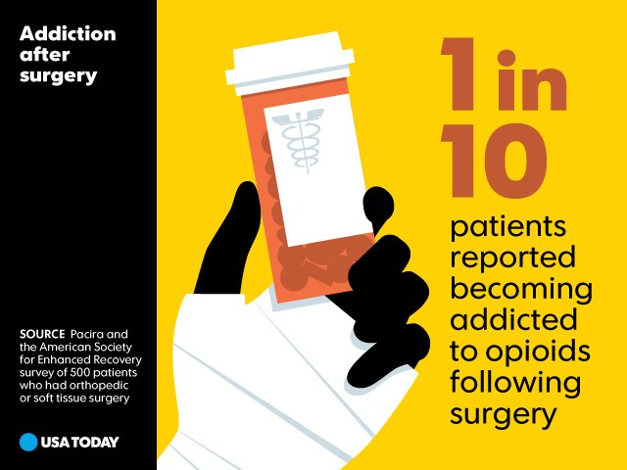
Risk of Opioid Addiction
A new national study of 500 patients who had orthopaedic or soft tissue surgery within the last year, and 200 surgeons who perform those procedures.
Almost all surgeons polled (94%) say they frequently prescribe opioids
  91% admit that they feel pressure to prescribe more opioids than their patients actually need (HCAHPS, formulary options, patient request)
Many patients expressed concerns about the risks of opioid addiction and a vast majority of patients (79%) say they would prefer a non-opioid
  Only 23% of patients say they discussed non-opioid options with their surgeon before their procedure
Key survey finding; reported on the cover of the
Aug 9 print edition of USA Today.

Slide 6
Outcomes: Cost and Length of Stay (LOS) Regional
ADE=adverse drug event.
↑ 56%*
↑ 69%*
Oderda, Gan et al. J Pain & Palliative Care Pharmacotherapy 2012

Slide 7
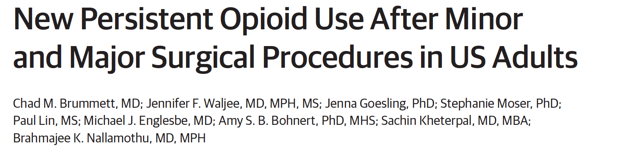
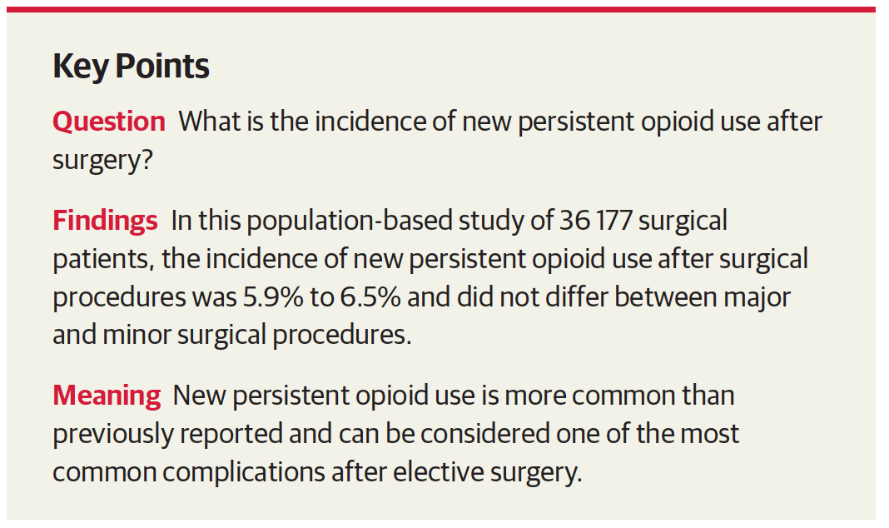
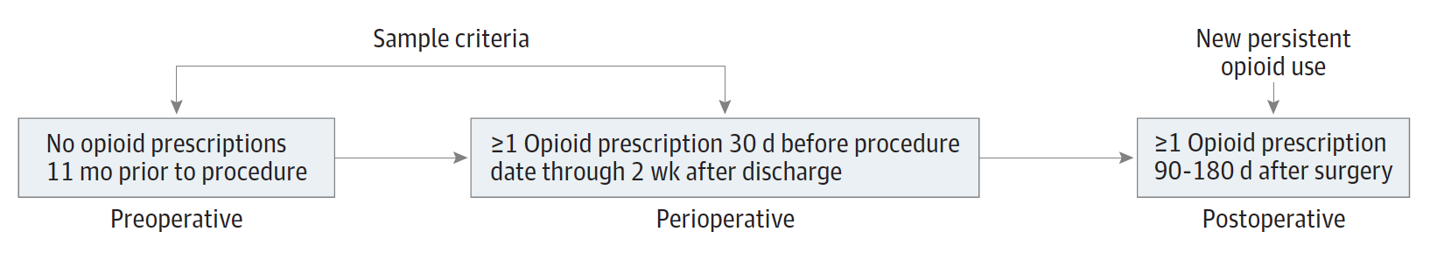
Long-Term Adverse Consequences
Brummett CM, et al. JAMA Surg. 2017;152(6):e170504. doi:10.1001/jamasurg.2017.0504

Slide 8
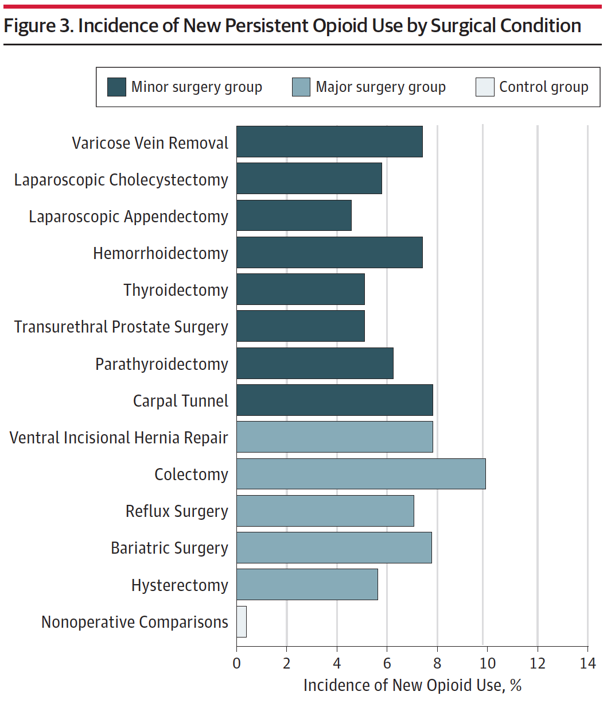
Brummett CM, et al. JAMA Surg. 2017;152(6):e170504. doi:10.1001/jamasurg.2017.0504

Slide 10
Incidence of CPRA - Opioid and Sedatives

Slide 11
Balancing the Imperatives
Effective pain management
Adverse
effects

Slide 12
“Trade-offs” in Pain Management: Patients Have Concerns That May Hinder Treatment
More post-surgical patients chose less pain relief
than increased/more severe side effects
Side Effect: Vomiting (V) Constipation (C) Itchiness (I)
70%
N=50
70
65%
65%
60
50
Patients Reporting Selected Profile (%)
40
35%
35%
30%
30
20
vs
vs
vs
10
0
“Moderate” V +
“good” pain relief
No side effects +
“fair” pain relief
“Severe” C +
“excellent” pain relief
“Mild” C +
“good” pain relief
“Severe” I +
“excellent”
pain relief
“Mild” I +
“good” pain relief
Gan et al. Brit J Anaesthesia. 2004;92:681-688
Notes:
The attitudes and behaviors of patients can also impact optimal management of pain. Gan and colleagues¹ found that patients’ desire to avoid analgesic side effects can be more important than pain control.
In a study of 50 postsurgical patients undergoing major abdominal surgery (mean age 48.4 years; 58% female), Gan and colleagues¹ interviewed patients in an adaptive conjoint analysis. This type of analysis aimed to elicit patient preferences for attributes of analgesia by asking them to trade-off combinations of analgesia features. Patients were interviewed pre-operatively, and then three times postoperatively (within 12 hours of transitioning from patient-controlled to oral anesthesia, 48 hours after the second interview or immediately before discharge, and finally within 14 days postdischarge).
Patients were almost twice as likely to select less pain relief over increased or severe side effects such as vomiting, constipation or itchiness.
12
Gan TJ, Lubarsky DA, Flood EM,et al. Patient preferences for acute pain treatment. Brit J Anaesthesia. 2004;92:681-688.
ref1/Gan/ pg683 /col2/ para 3
ref1/Gan/pg 686/ Table 6
ref1/Gan/pg686/ col2/para 3
New Slide: title, subheads, labels
ref1/Gan/pg686/ Table 6

Slide 13
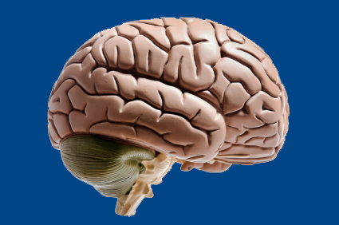
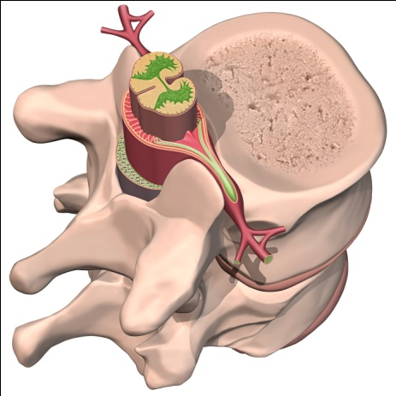
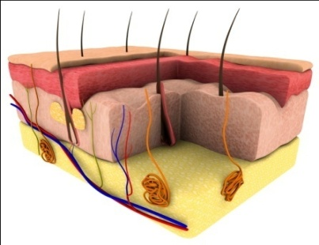
A Multimodal Approach Addresses
the Complex Nature of Pain Transmission
Opioids,
alpha-2 agonists¹
acetaminophen,
NE-reuptake inhibitors
ketamine²
Descending modulation
Ascending input via Spinothalamic tract
Local anesthetics
(epidural),
opioids,
alpha-2 agonists¹
Dorsal horn
Local anesthetics
(peripheral nerve block)¹
Local anesthetics
(field block),
NSAIDs, coxibs¹
Peripheral
nerve
NE=norepinephrine.
NSAIDs=non-steroidal anti-inflammatory drugs.
Pain
Adapted from Gottschalk A & Smith D. Am Fam Physician. 2001;63:1979-84.
Iyengar S et al. J Pharmacol Exp Ther. 2004;311:576-84.
Peripheral nociceptors
Notes:
This figure describes pain transmission pathways as well as key targets for multimodal analgesia.
Due to the complex nature of pain transmission and perception, a balanced or multimodal approach that includes a variety of drugs and multiple sites of analgesic activity may be necessary to achieve optimal pain control.
Surgical trauma activates nociceptor endings which transmit pain signals via peripheral nerves to the dorsal horn of the spinal cord. Noxious signals are then relayed via the spinal thalamic tract to the thalamus and cerebral cortex where pain is perceived. Descending cortical and brainstem inhibitory fibers modulate pain transmission in the spinal cord.
Peripheral acting analgesics including NSAIDs, Cox-2 inhibitors, and infiltration of local anesthetics provide effective pain relief by limiting activation of peripheral nociceptors and reducing inflammation.
Injections and infusions of local anesthetics may be employed to selectively block pain fibers in peripheral nerves.
Neuraxially administered opioids, alpha-2-adrenergic agonists, and local anesthetics may be administered to modulate pain transmission in the spinal cord.
Finally, central acting analgesics including opioids, acetaminophen, tricyclic antidepressants, and alpha-2-agonists activate receptors or increase concentrations of inhibitory neurotransmitters in the brain and brainstem and blunt pain perception.
Monotherapeutic approaches to acute pain management are often ineffectual because of limitations in sites of activity or dose related intolerability. Since multimodal dosing regimens target noxious transmission at multiple sites along the pain pathway, analgesic effectiveness and tolerability may be improved.
1 Adapted from Gottschalk A & Smith D. American Family Physician. 2001;63:1979-84.
2 Iyengar S et al. Journal of Pharmacology and Experimental Therapeutics. 2004;311:576-84.

Slide 14
Non-Opioids Used in
Multimodal Pain Treatment Plans
Acetaminophen | Alpha-2 agonists | Gabapentinoids
acetaminophen | clonidine dexmedetomidine | gabapentin pregabalin
Local anesthetics | NMDA receptor antagonists | NSAIDs/COX-2
bupivacaine lidocaine liposomal bupivacaine | ketamine | celecoxib ibuprofen ketorolac diclofenac
Note: The agents listed above are commonly employed in the perioperative management of acute pain.
This list is not meant to be a comprehensive directory of all available analgesic agents.
NMDA = N-methyl-D-aspartate; NSAIDs = non-steroidal anti-inflammatory drugs
Wu CL, Raja SN. Lancet. 2011; 377: 2215-2225.
Notes:
Please discuss information on slide.
Reference
Wu CL, Raja SN. Treatment of acute postoperative pain. Lancet. 2011; 377: 2215-2225.
14

Slide 15
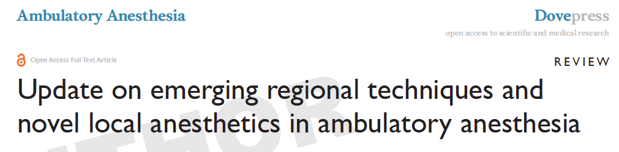
Transversus Abdominis Plane (TAP) Block
  Abdominal procedures, e.g. Lap Chole, Inguinal hernia, GYN laparoscopic surgery, lap hysterectomy
Pectoral Nerves Block
  Breast surgery, pacemaker placement, port placement
Adductor Canal Block
  Lower limb procedures, arthroscopic knee surgeries, ACL, meniscectomy, TKA
Szafran MJ, Abrahams E, Gan TJ. Ambulatory Anesthesia 2015

Slide 16
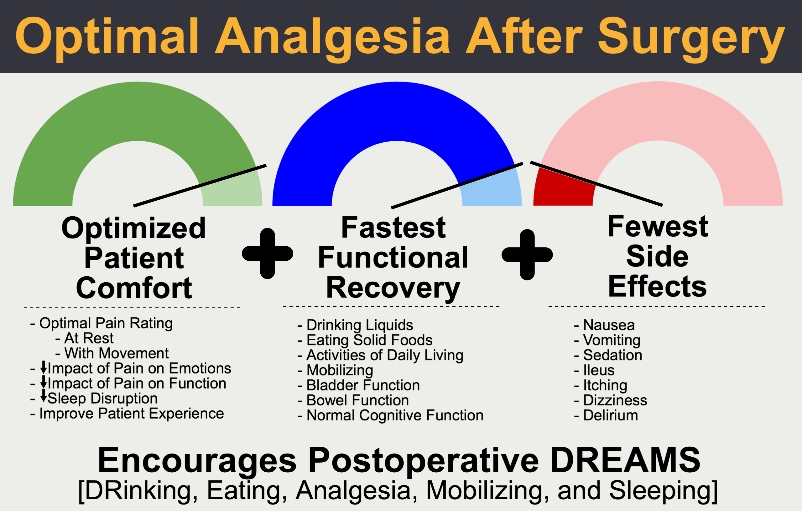
McEvoy et al. Perioperative Medicine (2017) 6:8

Slide 17
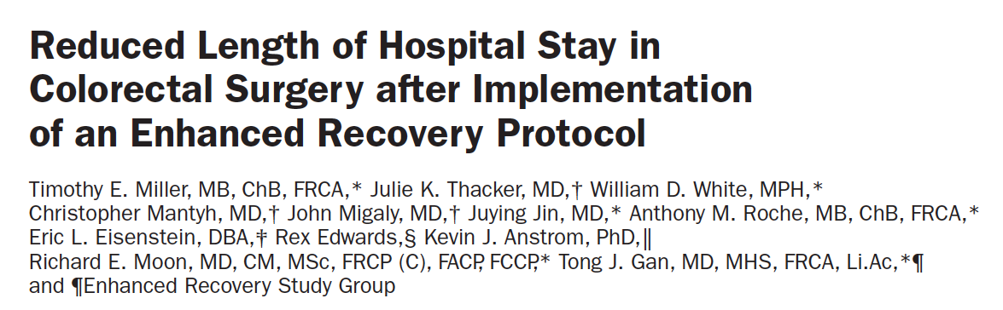
Quality Improvement Research
  2009 – 99 patients (60% open vs. 40% laparoscopic)
  2010 – 142 patients (43% open vs. 57% laparoscopic)
Patients in the two groups did not differ in age, BMI, surgery time or ASA grade.
Thoracic epidural
  92.2% of patients in the ERAS group compared with 18.1% in the traditional group (p<0.0001).
Miller and Gan et al. Anesth Analg 2014;118:1052–61

Slide 18
Multimodal Analgesic and Antiemetic Regimens for ERAS
Analgesic
  Thoracic epidural (open)
  Nerve block or TAP block (laparoscopic)
  Acetaminophen
  NSAID
  Dexamethasone
  Subanesthetic ketamine
  Gabapentin
Antiemetic
  Preoperative
    Transdermal Scopolamine
  Intraoperative
    Dexamethasone
    Ondansetron
    Propofol anesthetic
  Rescue
    Promethazine
    Diphenhydramine
    Droperidol
    Aprepitant
Miller and Gan et al. Anesth Analg 2014;118:1052–61

Slide 19
Length of Stay
Days
*
#
* p<0.0001
# p<0.05
*
Miller and Gan et al. Anesth Analg 2014;118:1052–61

Slide 20
Pain Score and Morphine Consumption
Traditional Care vs. ERAS
mg
*
*
*
*
*p<0.0001
Miller and Gan et al. Anesth Analg 2013 (in press)

Slide 21
ERAS – Perioperative Outcomes
 | Pre ERAS | Post ERAS | P values
Intraoperative
Crystalloid (ml) | 3170 ± 1621 | 2261 ± 1282 | <0.0001
Colloid (ml) | 716 ± 519 | 1072 ± 530 | <0.0001
Estimated blood loss (ml) | 319 ± 314 | 246 ± 430 | 0.0003
Postoperative
POD to first oral liquid | 1.8 ± 1.9 | 0.5 ± 1 | <0.0001
POD to first stool | 3.4 ± 1.7 | 2.4 ± 1.6 | 0.0001
Urinary Tract Infection (%) | 24.2% | 13.4% | 0.03
Readmission (%) | 20.2% | 9.8% | 0.02
Death (%) | 1% | 0% | 0.41
Miller and Gan et al. Anesth Analg 2014;118:1052–61

Slide 22
Assessment for the reduction of opioid related adverse events
Objective:
  Incidence of postoperative vomiting
  Time to gastrointestinal recovery
  Need for rescue
Subjective:
  Opioid-related side-effects
  Opioid-Related Symptom Distress Scale (OR-SDS)
  QoR scales
  StEP Initiative

Slide 23
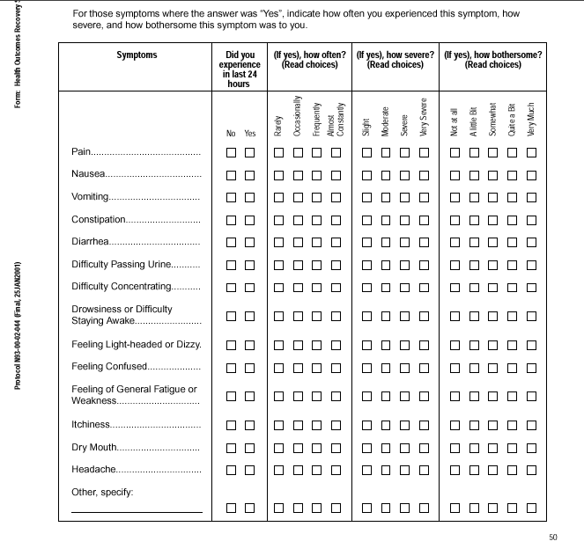
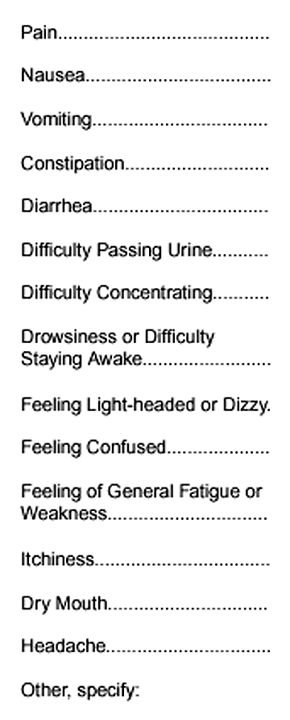
Gan TJ, et al. Acta Anesthesiol Scand 2004;48:1194-207

Slide 24
Gan TJ et al. Acta Anaesthesiol Scand 2004; 48: 1194—1207

Slide 25
Chan KS et al. Qual Life Res (2009) 18:1331–1340

Slide 27
Myles PS et al. Br J Anaesthesia, 2018;120:705-711

Slide 28
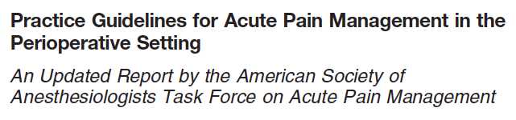
“Whenever possible, anesthesiologists should employ multimodal pain management therapy. Unless contraindicated, all patients should receive an around-the-clock regimen of NSAIDs, coxibs, or acetaminophen.”
ASA Task Force on Acute Pain Management. Anesthesiology. 2012;116:248–73

Slide 29
Questions

