Slide 1


Slide 2

“Doctors have always recognized that every patient is unique, and doctors have always tried to tailor their treatments as best they can to individuals. You can match a blood transfusion to a blood type — that was an important discovery. What if matching a cancer cure to our genetic code was just as easy, just as standard? What if figuring out the right dose of medicine was as simple as taking our temperature?”
- President Obama, January 30, 2015

Slide 3

THE PRECISION PAIN MEDICINE INITIATIVE

Slide 4
Pain Genomics

Slide 8
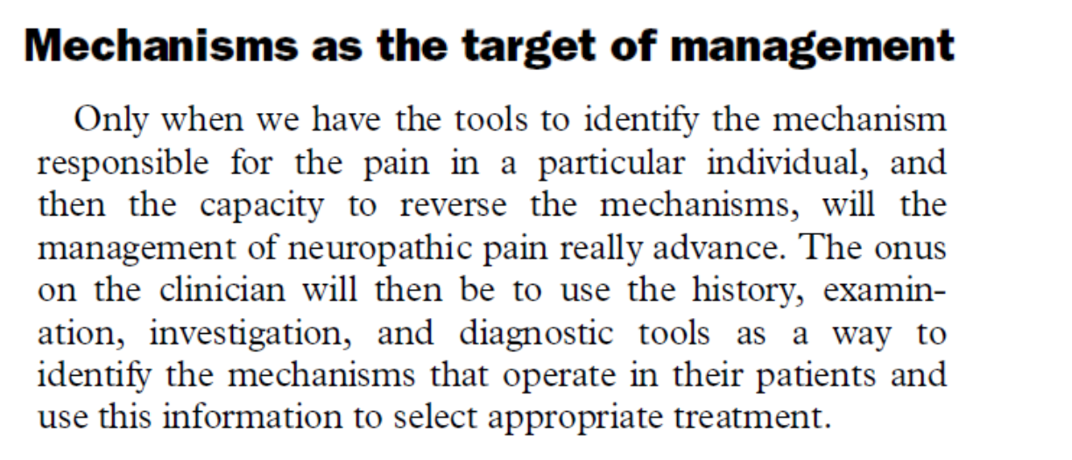

Slide 9
Pain Phenotype
Disease Nature
Duration
Location
Extent
Age
Gender
Genotype
Neurobiological mechanisms
Psychosocial factors
Individual
Family
Culture
Society

Slide 10
Measuring Pain Phenotype
History
Physical examination
Quantitative sensory tests
Clinical Electrophysiology
Imaging

Slide 11
Pain Phenotype
Standardized Interview
Physical examination
Current pain state
Sensory nervous system
Skin and appendages, subcutaneous tissue
Pain location
Skin lesions
Response to punctuate mechanical stimuli
Onset and time course
Temporal characteristics
Swelling
Response to pressure
Change of skin color
Response to a dynamic mechanical stimulus
Pain-evoking stimuli
Quality of the pain
Altered sweating
Pinprick pain
Sense of vibration
Effect of drug therapy and other pain-alleviating conditions
Trophic changes
Response to thermal stimuli
Pressure sensitivity of deep tissues
Non-painful sensations
Temporal summation
Sense of position and response to movement
Sensory deficits
Standardized interview 46 items
Physical examination 39 items
Each individual had 85 tags defining their pain “universe”
Scholz et al PLoS Medicine 2009

Slide 12

April 2009

Slide 13
Enrollment
Postherpetic neuralgia 23
Painful diabetic polyneuropathy 50
Low back pain with signs of nerve root damage rLBP 57
Axial low back pain w/o radicular symptoms or signs aLBP 57
Total 187
Inclusion criteria:
At least 18 years of age
Chronic pain (≥ 3 months)
Average pain intensity rated 6/10 or higher on a numerical rating scale
Scholz et al PLoS Medicine 2009

Slide 14
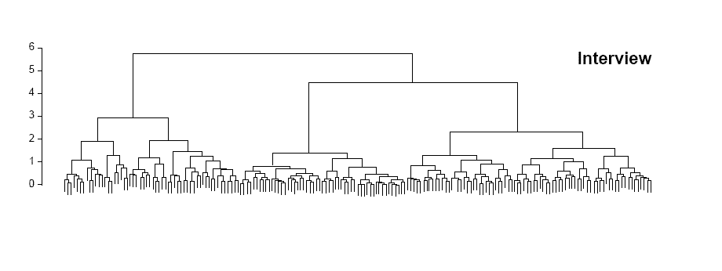
0 187
Standardized interview 46 items
Scholz et al PLoS Medicine 2009

Slide 15
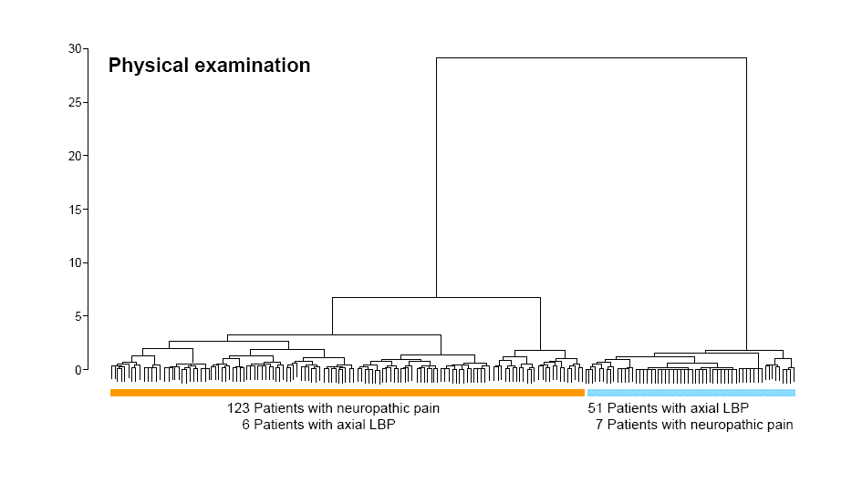
Physical examination 39 items
Scholz et al PLoS Medicine 2009

Slide 16
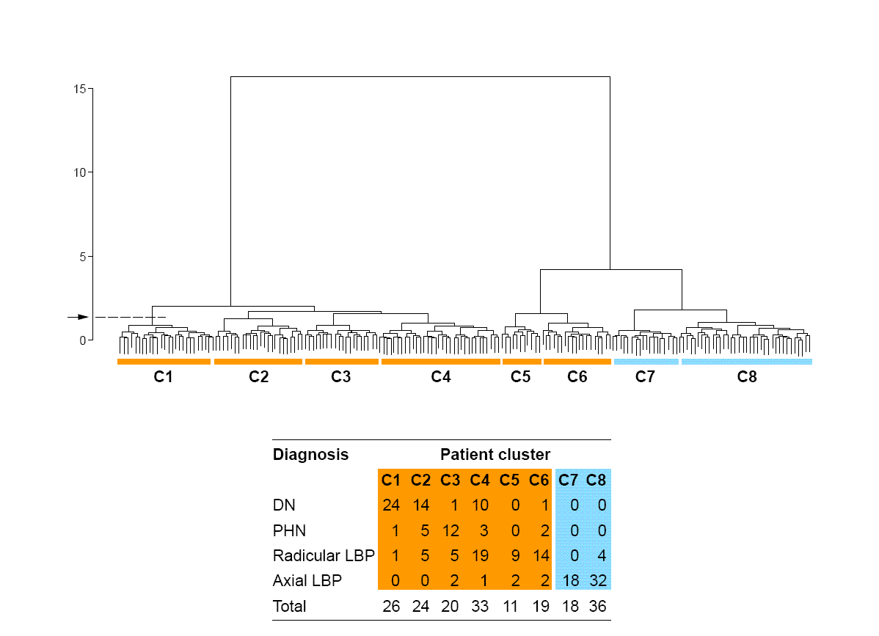
Combined history and examination
Scholz et al PLoS Medicine 2009

Slide 17
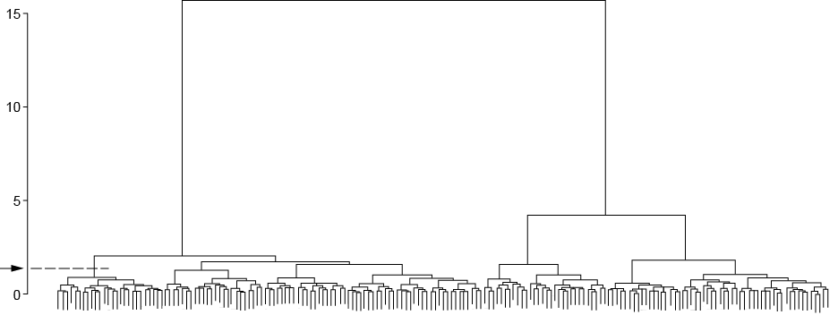
rLBP
aLBP
PHN
PDN
Scholz et al PLoS Medicine 2009

Slide 18
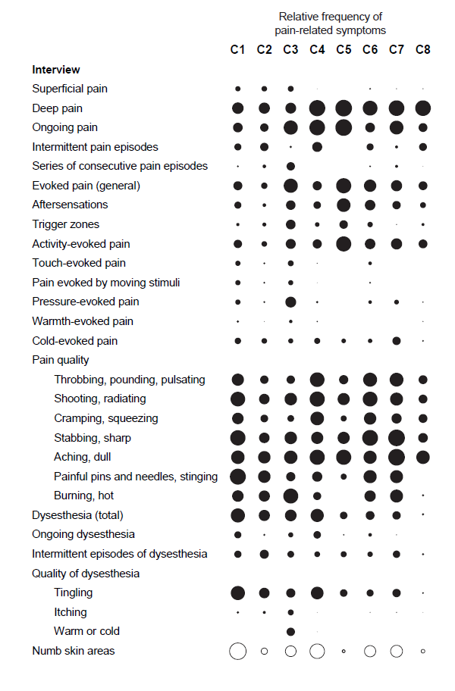
Scholz et al PLoS Medicine 2009

Slide 19
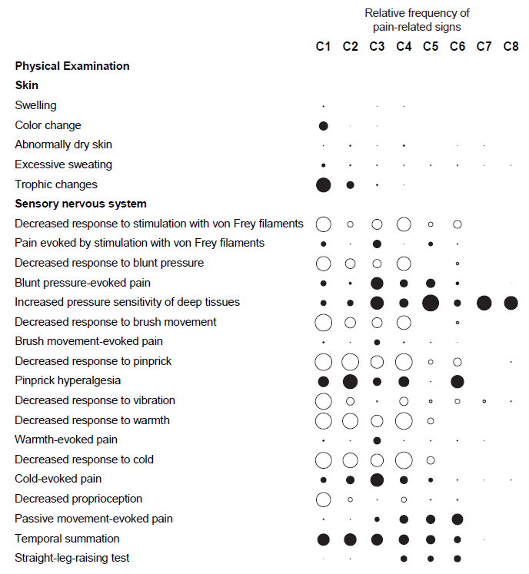
Scholz et al PLoS Medicine 2009

Slide 20
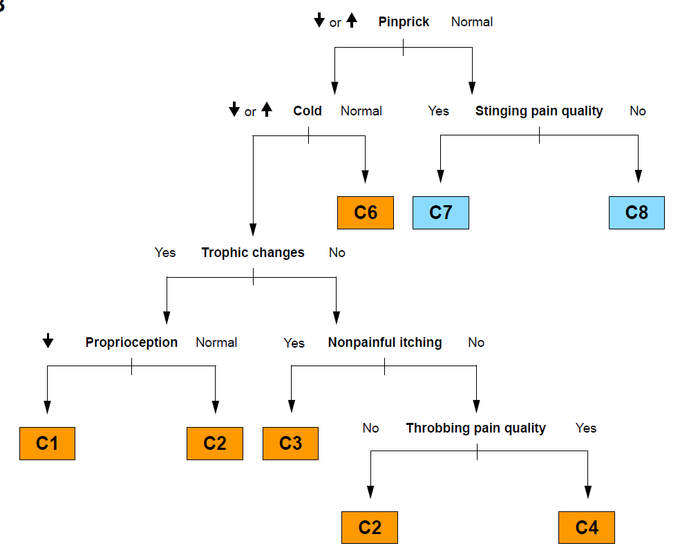
Classification Tree Analysis
StEP = 6 interview & 10 examination items
Scholz et al PLoS Medicine 2009

Slide 21
Classification Tree Analysis
Scholz et al PLoS Medicine 2009

Slide 22
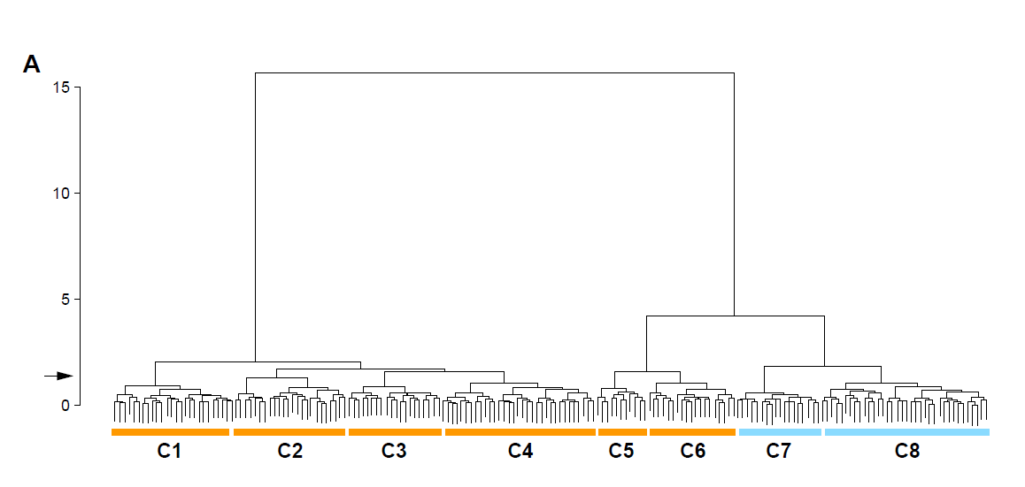
Peripheral sensitization
Central sensitization
?
Disinhibition
Ectopic activity
Scholz et al PLoS Medicine 2009

Slide 30



STATE
Nociceptive
Dysfunctional
MECHANSIM
Peripheral sensitization
TARGET
Inflammatory
Neuropathic
Central disinhibition
Central sensitization
Ectopic activity
Nociceptive transmission
NGF
TrkA
TRPV1
Nav1.7
NMDAR
Vardeh et al, 2016
Notes:
Figure 2

Slide 31
PAIN STATE | CLINICAL DIAGNOSTIC CRITERIA
Nociceptive | Evidence of noxious (mechanical) insult Symptoms: pain localized to area of stimulus/joint damage Signs: imaging - mechanical pathology/altered joint architecture such that normal movements will likely produce excessive forces sufficient to activate nociceptors
Inflammatory | Evidence of inflammation: Sterile infectious Symptoms: redness, warmth, swelling of affected area Signs: imaging (MRI, SPECT ) immune cell and cytokines, detection of pathogens/response to antibiotics
Neuropathic | Evidence of sensory nerve damage Symptoms: burning, tingling or shock-like, spontaneous pain; paresthesias or dysthesias Signs: decreased pinprick or vibration sense, straight leg raise*, mechanical and cold allodynia *lumbar radiculopathy
Dysfunctional | Pain in the absence of detectable pathology No identifiable noxious stimulus, inflammation or neural damage; evidence of increased amplification / reduced inhibition.
Vardeh et al, 2016
Notes:
Table 1

Slide 32
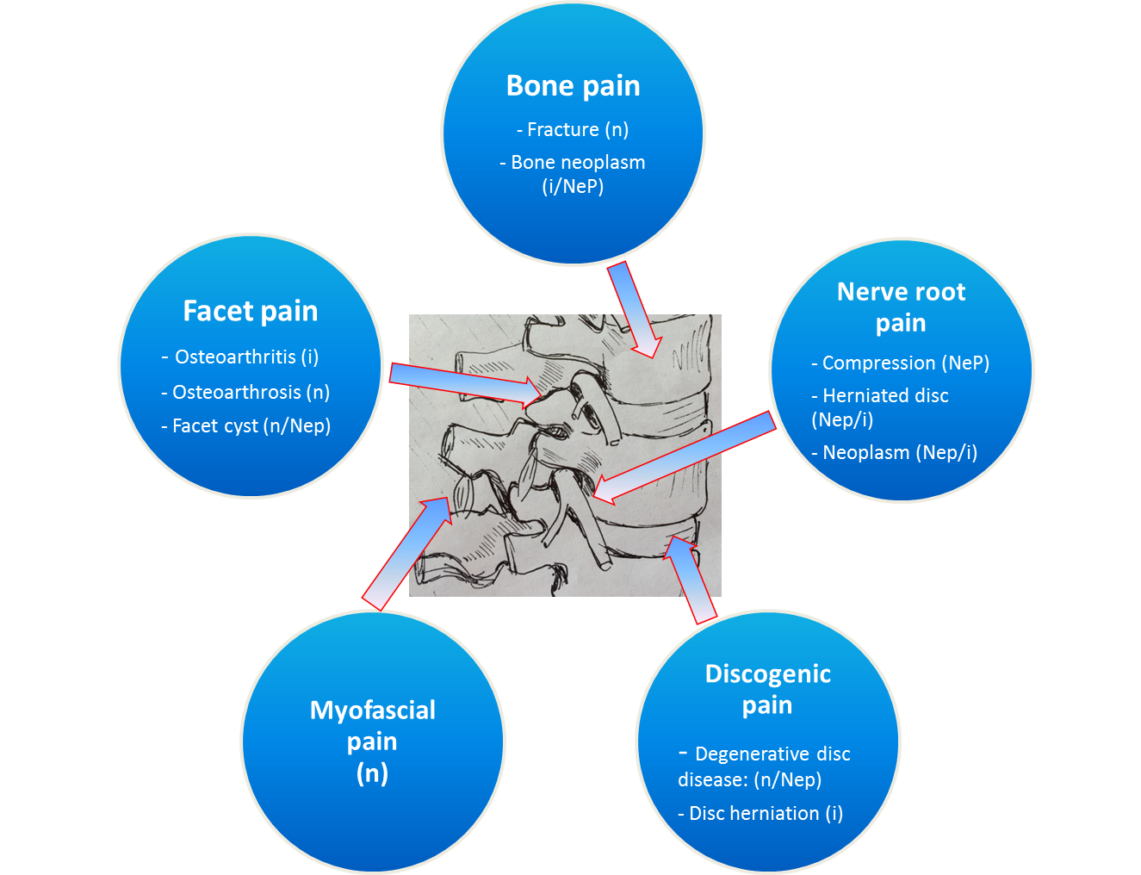
n – nociceptive
i- inflammatory
Nep - neuropathic
Vardeh et al, 2016

Slide 33
GENERAL PAIN MECHANISM | CLINICAL DIAGNOSTIC CRITERIA | SPECIFIC TREATMENT EXAMPLES | NONSPECIFIC TREATMET EXAMPLES
 |  |  | Gaba-pentinoid | AED | AD | Opioid
Nociceptive transduction | Proportionate pain in response to identifiable noxious stimulus | Removing stimulus |  |  |  | X
Peripheral Sensitization | Primary hyperalgesia due to decreased transduction threshold of nociceptor terminals | Anti-inflammatory (e.g. NSAID, Coxibs); Immunosuppressant |  | X | possibly | X
Ectopic Activity | Spontaneous pain in the absence of obvious peripheral trigger; relieved by nerve block | Nav channel blockers | X | X |  | X
Central Sensitization | Secondary hyperalgesia Temporal summation Allodynia | NMDA-Antagonists (e.g. Ketamine) Gabapentanoids | X | Some e.g. VA, TPM | X | X
Central Disinhibition | Secondary hyperalgesia Allodynia | GABA-A alpha 2 subunit agonist Dual amine uptake inhibitors | X | See above | X | X
Vardeh et al, 2016
Notes:
Table 2

Slide 34
SPECIFIC PAIN MECHANMISS (selected) | PRECLINICAL MANIFESTATION | SPECIFIC CLINICAL MANIFESTATION | MOLECULAR TARGET | GENETIC VALIDATION | SPECIFIC TREATMENT
Increased NGF synthesis | Nociceptor activation at lowered heat threshold | Peripheral sensitization No specific diagnostic criteria | NGF, TrkA (NGF receptor); TRPV1 | HSAN IV HSAN V | anti-NGF AB (phase 3); TrkA R antagonist (phase 2)
NMDA receptor phosphorylation | Increased post-synaptic activity | Pain amplification No specific diagnostic criteria | NMDA receptor | no | NMDA receptor antagonist (e.g. Ketamine)
Excitatory transmitter release | Increased post-synaptic activity | Pain amplification No specific diagnostic criteria | Ca(v)α2δ-1 | no | Gabapentinoids
Nav 1.7 | Nociceptor firing | Nociceptive pain No specific diagnostic critria | Nav 1.7 | Paroxysmal extreme pain disorder; primary erythromelalgia | Nav 1.7 antagonist (phase 2)
Spinal inhibitory interneuron dysfunction/degeneration | Decreased inhibitory transmission | Pain amplification No specific diagnostic criteria | Gaba A receptor | no | Gaba A receptor subtype selective agonist
TRPA1 | Nociceptor firing | Nociceptive pain No specific diagnostic criteria | TRPA1 | Familial episodic pain syndrome | TRPA1 antagonist phase 2
Vardeh et al, 2016
Notes:
Table 3

Slide 35
DIAGNOSTIC TEST | INTERPRETATION | LIMITATIONS
HISTORY
Quality and severity of pain | burning/tingling/electric shock like paresthesias = neuropathic pain Dull, aching = nociceptive pain | Poor specificity Coexistence of more than one pain state Different mechanisms can produce same symptoms No gold standard
PHYSCIAL EXAM
Straight leg raise (SLR) test | Lumbar radiculopathy/ sciatic nerve irritation | Low specificity (e.g. many patients have hamstring and gluteal tightness eliciting pain upon SLR). Unable to distinguish between L4, L5, S1 root or sciatic nerve.
Dermatomal sensory loss/ Myotomal deficit | root compression/ damage | Inconsistent finding Significant dermatomal/ myotomal overlap
Musculoskeletal maneuvers, e.g. facet loading, sacroiliac joint and hip maneuvers, low back palpation | Anatomic localization of pain driver | Poor specificity multiple structures are simultaneously stimulated
INVESTIGATIONS
NCS/ EMG | Presence/ absence of neuropathy or radiculopathy | Only evaluates large-diameter fibers (not A-δ and C fibers) Lesions proximal to DRG are not routinely captured
Quantitative Sensory Testing | “sensory fingerprint” indicative of pain mechanism | Time consuming and resource heavy No gold standard Same disease with multiple sensory clusters
MRI imaging | Degenerative changes | Poor specificity. Degree of degenerative changes does not correlate with symptoms Only anatomical changes considered (not functional/inflammation, etc)
Vardeh et al, 2016
Notes:
Table 4

