Slide 1


Non-Pharmacologic Treatments in Precision Pain Medicine: Rationale for Splitting (Stratifying) vs. Lumping
Dennis C. Turk, Ph.D.
Department of Anesthesiology & Pain Research
and
Center for Research on Pain Impact, Measurement, & Effectiveness (C-PRIME)
University of Washington

Slide 2
There are two kinds of people in the world…
those who think there are two kinds of people and those who don’t.
The first group can be labeled splitters, the latter lumpers.

Slide 3
Splitting vs. Lumping –
Criteria for Stratifying Patients
Demographic
Genetics
Biomedical
Mechanisms
Clinical presentation (eg, symptoms)
Etiological (actual or perceived)
Psychological
Response to treatment

Slide 4
Splitting vs. Lumping –
Criteria for Stratifying Patients
Demographic
Genetics
Biomedical
Mechanisms
Clinical presentation (eg, symptoms)
Etiological (actual or perceived)
Psychological
Response to treatment

Slide 5
FM: Attributed Cause of Symptoms
N = 569
Accident at work = 5.9%
Accident at home = 1.7%
Automobile accident = 13.8%
Following surgery = 5.4%
Following an illness = 9.6%
No identifiable cause = 39.5%
Other (eg, stress) = 21.0%
Precipitating
event = 36.4%
Robinson et al. Pain Med 2012;13:1366-76

Slide 6
FM Patients - Background Information
Traumatic (n=46) Idiopathic (n=46)
Age 50.46 (11.97) 48.46 (10.08)
Sex (female) 94% 94%
HS. Education 81% 93%
Married 57% 66%
Duration (mos.) 86.75 (98.23) 98.52 (92.28)
Turk et al. J Rheumatol 1996;23:1255-62

Slide 7
Biomedical and Psychosocial Findings by Onset in FM Patients
Traumatic
Idiopathic
NS
Ps<0.05
Mean MEDICS T-Scores
Mean Scores
Biomedical
Findings
Pain
Severity
Interference
Affective
Distress
0=none, 6 = Extremely
Turk et al. J Rheumatol 1996;23:1255-62

Slide 8
Observed Physical Function and Perceived Disability by Pain Onset
Traumatic
Idiopathic
NS
P<0.05
PDI
Physical Function
Perceived Disability
Turk et al. Pain 1996;68:423-30

Slide 9
Previous Treatments
All Ps<0.05
Percent Prescribed
Nerve Blocks
Physical
Therapy
TENS
Opioids
Turk et al. Pain 1996;68:428-30

Slide 10
Moderate-Severe Sx vs. Mildly Sx in Whiplash Pts:
Differences on Physical Examination, Imagining, & Neuropsychological Tests (n = 108)
Physical Examination
CROM (degrees) (extension, flexion, lt-rt
rotation, lt-rt lateral bend)
Neck strength force in pounds
(flexion, extension, rt-lt lateral bend)
Shoulder range of motion degrees
(abduction, flexion, ext-inter
rotation)
Shoulder strength force in pounds
(abduction, flexion, ext-int rotation)
Elbow (flexion-extension)
Grip strength
Pinch strength
Plain X-rays of cervical spine
No significant
difference on any
Neuropsychological Test
Wechsler Memory Scale
Trails A, B
Robinson et al. Arch Phys Med Rehabil 2007; 88:774-9

Slide 11
Pictorial Fear of Activity Scale (PFActS-C)
78 Photographs of movements + 5 control involving lower body)
  Arm Position: Side, Extended at shoulder, Overhead
  Loading: Loaded, Unloaded
  Movements: Flexion, Extension, Lateral bending (Rt, Lt), Rotation (Rt, Lt)
  Degree: Minimal, Extreme
Turk et al. Pain 2008;139:55-62.

Slide 12

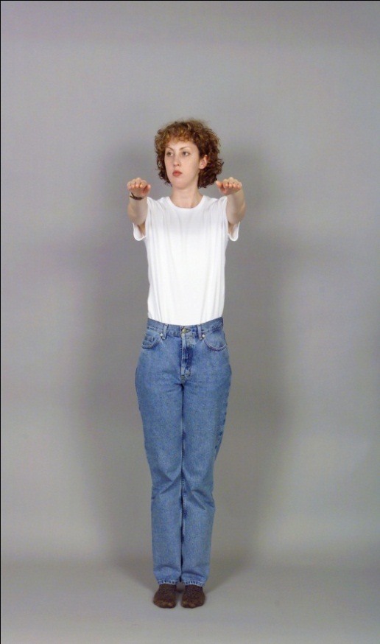
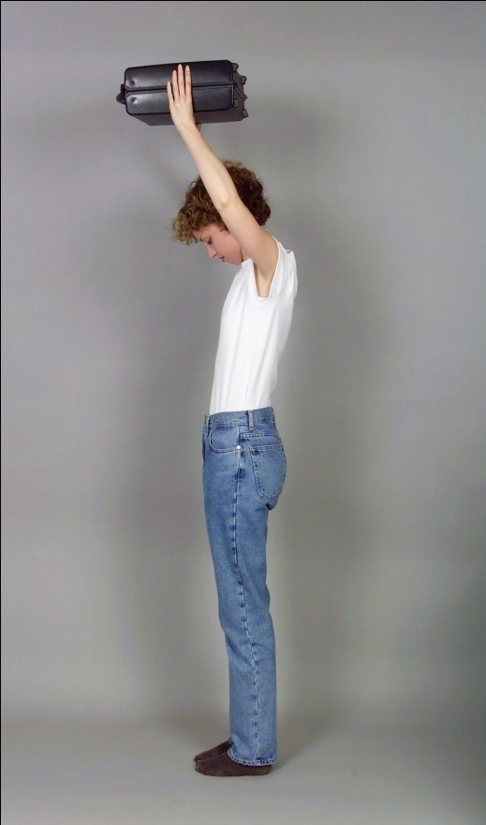
Pictorial Fear of Activity Scale (PFActS-C)
Examples From Set of 78 + 5 controls
Arms at side
Unloaded
Lt rotation
Extreme
Arms extended
Unloaded
Rt rotation
Minimal
Arms overhead
Loaded
Flexion
Extreme

Slide 13
    Hierarchical Multiple Regression of Current Symptoms
Pred Var & Step R2 R2 Change
MPI-PS #Sx NDI MPI-PS #Sx NDI
1. Age .001 .031 .002 .001 .031 .002
2. CROM .004 .035 .011 .002 .003 .009
3. TSK .205 .168 .244 .201** .133* .233**
4. PFActS-C .445 .274 .463 .240*** .106* .219***
5. CESD .461 .300 .545 .017 .025 .082
*P<0.05, **P<0.01, ***P<0.001
CROM, cervical range of motion; TSK, Tampa Scale of Kinesiophobia; PFActS-C, Pictorial Fear of Activity Scale-Cervical; CESD, Center for Epidemiological Studies Depression Scale; MPI-PS, Multidimensional Pain Inventory-Pain Severity; NDI, Neck Disability Index
Turk et al. J Pain 2004;5 (Suppl 1):124

Slide 14
Splitting vs. Lumping –
Criteria for Stratifying Patients
Demographic
Genetics
Biomedical
Mechanisms
Clinical presentation (eg, symptoms)
Etiological (actual or perceived)
Psychological
Response to treatment

Slide 15
Multidimensional Pain Inventory
Part I
Pain Severity
Interference
Life Control
Affective Distress
Support
Part II
Negative Resp.
Solicitious Resp.
Distracting Resp.
Part III
Houshold
Chores
Outdoor Work
Activities Away
from Home
Social Activities
Kerns et al. Pain 1985;23:345‑56

Slide 16
“Psychotyping” -- Unique Characteristics of Subgroups of Chronic Pain Patients Based on Adaptation
Dysfunctional
Hi pain
Hi emot distress
Lo sense control
Lo activity
Interpersonally Distressed
Lo support
Lo solicitous resp
Lo distract resp
Hi negative resp
Adaptive Copers
Lo emot distress
Hi sense control
Hi activity
Turk DC, Rudy TE. J Consult Clin Psychol 1988;56:233-8

Slide 17
MPI Profile Distributions
FM2
26%
39%
35%
CLBP1 HA1 TMD1 SLE3 MetCa4 Local Ca4
DYS
ID
AC
62% 46% 44% 14% 64% 31%
18% 22% 26% 28% 6% 35%
20% 32% 30% 46% 31% 34%
1Turk DC & Rudy TE. Pain 1990;43:27-36;2Turk et al. J Rheumatol 1996;23:1255-62;3Greco et al. Pain Med 2003;4:39-50;4Turk et al. Pain 1998;74:247-56

Slide 18
External Validation of MPI Clusters, TMD – Physical Examination
Variable Cluster Means
DYS ID AC Sig.
Pain Duration (yrs.) 4.74 5.89 5.95 ns
# Sx. / Exam 1.18 1.16 1.38 ns
Max. Intercisal 30.23 30.31 32.09 ns
Open (mm)
Prop. Abn. CTs 0.44 0.52 0.47 ns
Rudy et al. Pain 1989;36:311-20

Slide 19
Observed Physical Functioning of Chronic Pain Patients by MPI Subgroups
DYS
ID
AC
Lumbar
Flexion
Fingertips
to Floor
Straight
Leg Raise
Cervical
ROM
All not statistically significant
Turk et al. Pain 1996;68:423-30

Slide 20
Psychiatric Diagnoses in MPI Subgroups
Thieme et al. Psychosom Med 2004;66:837-44

Slide 21
Splitting vs. Lumping –
Criteria for Stratifying Patients
Demographic
Genetics
Biomedical
Mechanisms
Clinical presentation (eg, symptoms)
Etiological (actual or perceived)
Psychological
Response to treatment

Slide 22
Treatments for FM: Pharmacological
Antidepressants
MAO Inhibitors
Moclobemide
Pirlindole
Tricyclics
Amitriptyline
Cyclobenzaprine
Clomipramine
Dothiepim
Doxepin
Tetracyclic
Maprotiline
Mirtazapine
SSRIs
Citalopram
Fluoxetine
Sertaline
Paroxetine
SNRIs
Duloxetine
Milnacipran
Venlafaxine
Opioids
Morphine
Tramadol + APAP
Sedative/Hypnotics
Sodium Oxybate
Zolpiclone
Zolpidem
Anticonvulsants
Pregbalin
Pramipexole
Ropinirole
5-HT3 Antagonists
Ondanseron
Tropisetron
NMDA Antagonists
Dextromethorphan
Ketamine
Supplements
SAM-e
Ginko Biloba
NSAIDS
Ibuprophen
Naproxen
Muscle relaxants
Cyclobenzaprine
Tizanidine
Carisoprodol +
Parcetamol + Caf
Other
Prednisone
Topical Capsaicin
Malic Acid +
Magnesium Hydrox
Antidiencephalon
Immune Serum
Mexillitine
Myanserine
Chlormezanone
Delta-9-THC
Alprazolam
Bomazepam
Coenzyme Q10
Growth Hormone
Guanethidine
Interferon alpha
5-Hydroxytrptophan
Moclobemide
Lignocaine
Pindolol
Tenoxicam
Tiaprofenic acid
Melatonin
Staph. Toxoid
Tropisetron
Rhus toxicodendron
Gamma-
Hydroxybuturate
Staph toxoid
Calcitonin
Naltrexone
Last count:
N = 57

Slide 23
Comparison of Medications for FM
% pts > 50% reduction pain
Medication N Tx Duration Active Placebo P value
*Duloxetine1 207 12 wks 28% 17% 0.06
*Duloxetine2 354 12 wks 41% 23% 0.003
*Milnacipran3 125 12 wks 37% 14% 0.04
*Pregabalin4 528 8 wks 29% 11% 0.001
Pramipexole5 60 14 wks 42% 14% 0.008
Ropinrole6 30 14 wks 45% 30% 0.31
IArnold et al. Arthritis Rheum 2004;50:2974-84;2Wernicke et al Arthritis Rheum 2004;50(Suppl 9),S1867 (abst); 3Vitton et al. Hum Psychopharmacol Clin Exp 2004;19:S27-35;4Crofford et al Arthritis Rheum 2005;52:1264-73;5Holman A & Myers R. Arthritis Rheum 2005;52:2495-505;6Holman. J Clin Rheum 2003;9:277-9

Slide 24
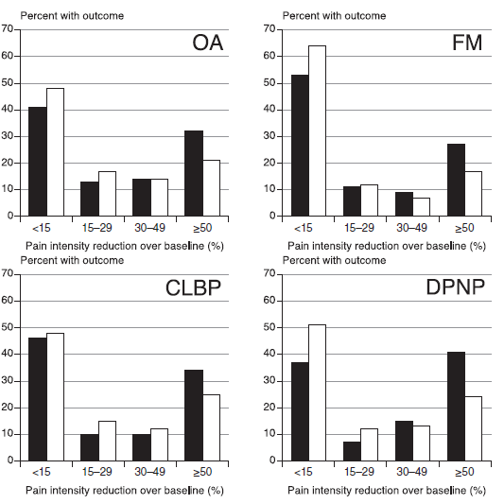
Patterns of Pain Reduction with Duloxetine
Duloxetine
Placebo
Dulox
Placebo
Bimodal distribution,
SD>Mean,
thus
average not appropriate
Moore et al. Eur J Pain, 2013

Slide 25
Treatments for FM: Non-Pharmacological
Acupuncture
Aerobic exercise
Aloe vera
Anthocyanidins
Autogenic training
Balneotherapy
Biofeedback
Bioresonance
therapy
Chorella
CBT
Cryotherapy (whole
body)
Delta wave sleep
interruption
Education
EEG-driven
stimulation
Electroacupuncture
TENS
ECT
Manip + Ultrasound
Feldenkrais
Flexibility exercise
Guided imagery
Homeopathic vellum
Hot Packs
Hyperbaric Oxygen
Hydrogalvanic therapy
Hypnotherapy
Laser therapy
Light therapy
Magnetized mattress
Manual lymph drainage
Marital counseling
Massage, connective tissue
Meditation
Muscle vibration
Neck support
Operant conditioning
Psychomotor therapy
Qigong +
Mindful Meditation
Relaxation
Wool
Stress management
Stretching exercise
Sulphur mud baths
Tender pt injections
Written emotional
expression
Connective tissue
manip. + ultarsound
Amitriptyline +
Stanger bath
Massage
Pool exercise +
education
Aquatic exercise
(deep water running)
Warm water exercise
Transcranial Direct
Current Stimulation
Electromagnetic
Shielding Fabric
Valerian bath
Last count: N = 57

Slide 26
Effects of Nonpharmacological Treatments -
Average Expected Reduction in Pain Intensity
Acupuncture 10⁺%
CBT/Mindfulness 30-50%
Sleep restoration 40%
Physical fitness 60%
Hypnosis, Yoga,
Manipulations “some effect”
Turk et al. Lancet 2011;337:2226-35

Slide 27
Treatment Protocol
Outpatient, 6, 3 hour sessions, once/wk
Medical – educational, reassurance
Physical – aerobics and stretching exercises
Occupational – pacing, body mechanics
Psychological – pain and stress management
Turk et al. Arthritis Care Res 1998;11:397-404

Slide 28
Change in the MPI Profiles
Post-treatment
100
90
80
38
70
62
60
80
Posttreatment Frequency, %
50
40
54
30
15
20
10
23
13
8
7
0
MPI Profiles
Turk et al. Arthritis Care Res 1998;11:397-404

Slide 29
Predictors of Clinically Meaningful Response at 12 mo. Follow-up – Physical Functioning (PF) & Pain Intensity (PI)
Treatments (15 weekly grp sessions)
Operant CBT Attention Control
(n = 43) (n= 42) (n = 40)
High Phys Impair X
Pain X
High Pain Behav X
High Solict Spouse X
Low Phys Funct X
More MD Visits X
High Catas X
% Respond PF/PI 58.1%/53.5% 38.1%/45.2% 5.0%/7.5%
High Affect Dist X
Low Solicit Spouse X
Low Pain Behav X
Low Coping X
High Neg Support X
Thieme et al. Arthritis Care Res 2007;57:830-6

Slide 30
Predisposing/ Precipitating Perpetuating/
Protective Protective & Alleviating
Genetics
Prior stresses
Prior leaning history
Physical trauma
Disease/
Illness
Emotional trauma
Symptoms
Attitudes/Beliefs
Meaning
Coping repertoire
Social support
Financial resources
Behavioral responses
Consequences

Slide 31
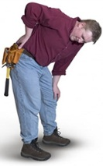
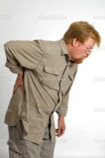
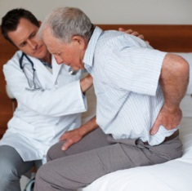
Longitudinal vs. Cross-sectional Perspective
Socioeconomic Context
Life
Expectancy
Change in pathology
Age at pain onset
Pathology
Current age
Change in pathology
Premorbid
characteristics
Genes
Learning Hx
⁰
37
44
76+
Resources
Interpersonal support
Economic

Slide 32
A question that remains to be resolved…
Can we improve clinical outcome by matching treatments to patients’ characteristics?
“Personalized Health Care /
Precision Medicine”

Slide 33
Arguments That Support Splitting or “Typing” (Geno, Pheno, Psycho)
There are large variations in adaptation to disease and response to treatment. Patients with the same diagnosis respond in widely different ways.
The traditional diagnostic classifications are not comprised of homogeneous sets of patients.
Psychosocial factors influence adaptation independent of medical diagnosis and pathophysiology.
Lack of attention to important variations has hindered our understanding and treatment of patients → for these reasons splitting may be essential in chronic pain; however,

Slide 34
How to Split and Lump
May not be a simple dichotomy of lumping or splitting but rather how to split and lump -- by Genotypes, Phenotypes, and Psychotypes vs. traditional biologically-based diagnosis (eg, fibromyalgia, chronic low back pain, depression)

Slide 35
No single treatment eliminates pain for all people with chronic pain….
Thus, we should be considering combinations of treatments for chronic pain patients -- psychological as well as pharmacological and physical.
Sometimes 1 + 1 does = 3
And these should be matched to patients taking into consideration both psychosocial (“psychotyping”) and biological characteristics.
Turk DC. Clin J Pain 2001;17:281-3.

