Slide 1
Descending Inhibition of Pain
Roland Staud, M.D.
Professor of Medicine
University of Florida
Notes:
An important mechanism by which humans and animals process incoming nociceptive information is top–down modulation, either through inhibition or facilitation of the nociceptive input after tissue damage. The net outcome of this endogenous pain modulatory process, in combination with other pain-modulating processes, is a sensory perception that may range from no pain to severe pain

Slide 2
Outline
Endogenous Pain Modulation is Variable in Healthy Individuals and Patients
Genetic and Environmental Factors
Endogenous Pain Inhibitory Function Is Inefficient in Many Chronic Pain Disorders
Endogenous Pain Inhibitory Function May be Predictor for
Analgesic Drug Response (Drug Class)
Individual Treatment Response

Slide 3
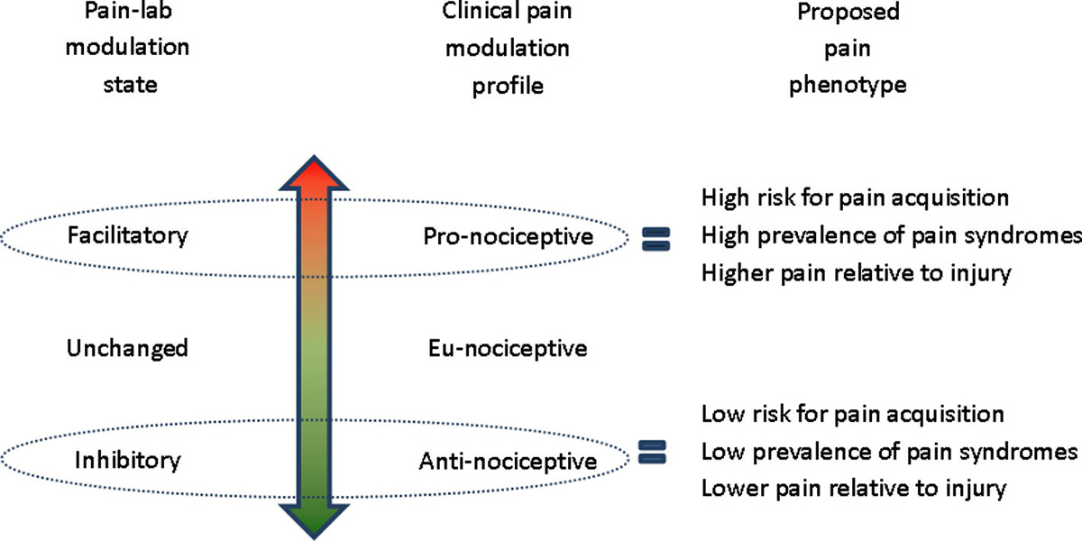
Pain Modulation Phenotypes
Yarnitsky et al. 2014

Slide 4
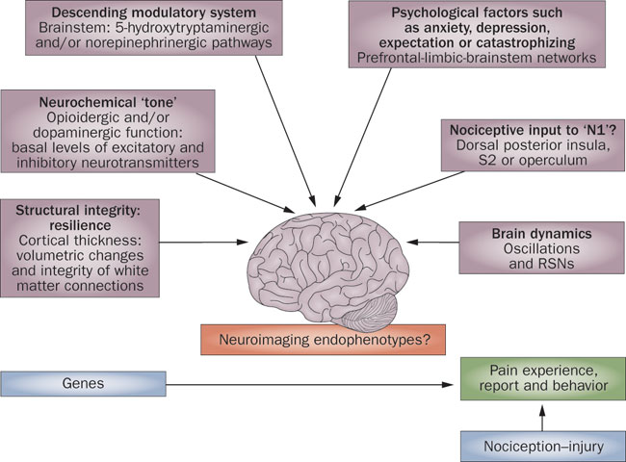
Neuroimaging Endophenotypes
Tracey, I. 2011

Slide 5
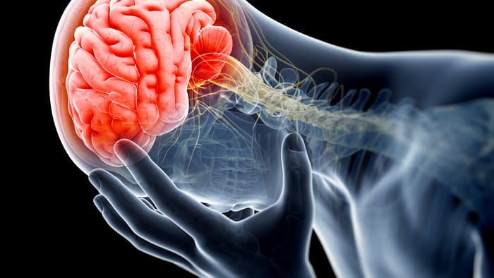
Pain Modulatory Endophenotypes
Temporal
Summation
Context Related Analgesia
(Placebo)
Response to Tonic Pain
Stimuli
Spatial
Summation
Offset
Analgesia
Conditioned Pain
Modulation
Stress Response
(Analgesic – Hyperalgesic)

Slide 6
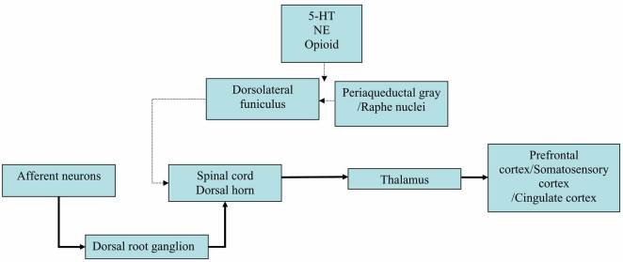
Ascending and Descending Pain Pathways
Marks et al, 2009
Notes:
Circuit of pain modulatory pathway. Abbreviations: 5-HT, serotonin; NE, norepinephrine. Thick arrow indicates ascending pain pathway and thin arrow represents descending inhibitory pain pathway.

Slide 7
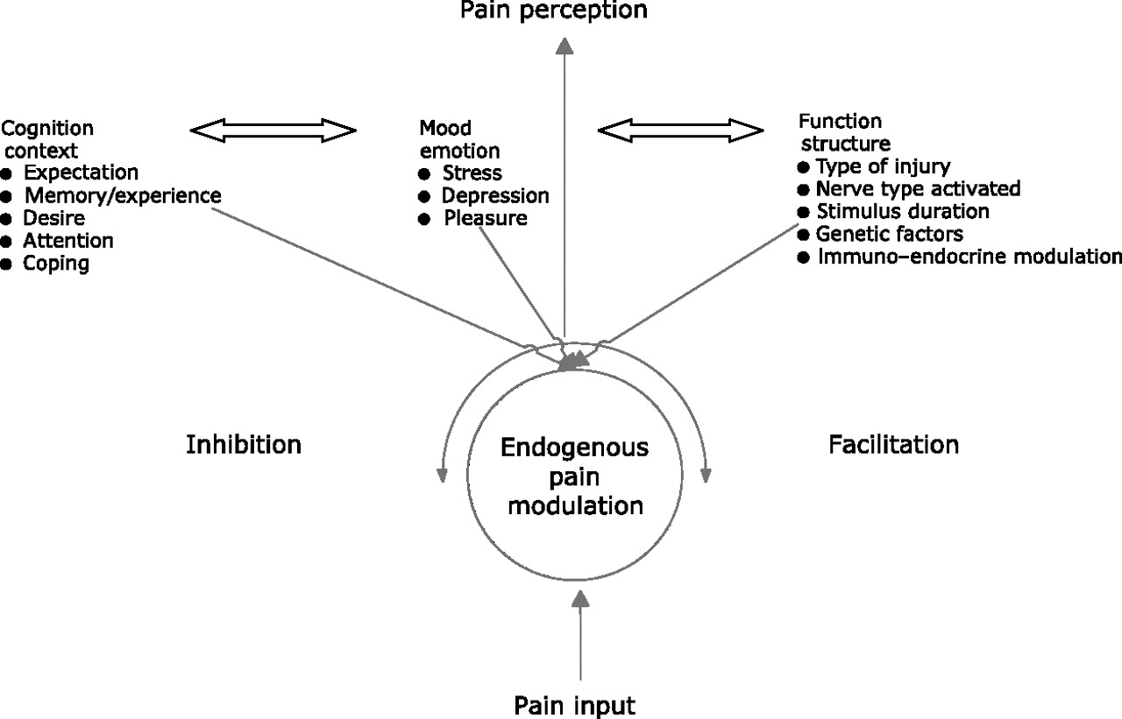
Endogenous Pain Modulation
Wilder-Smith, C. 2011

Slide 8
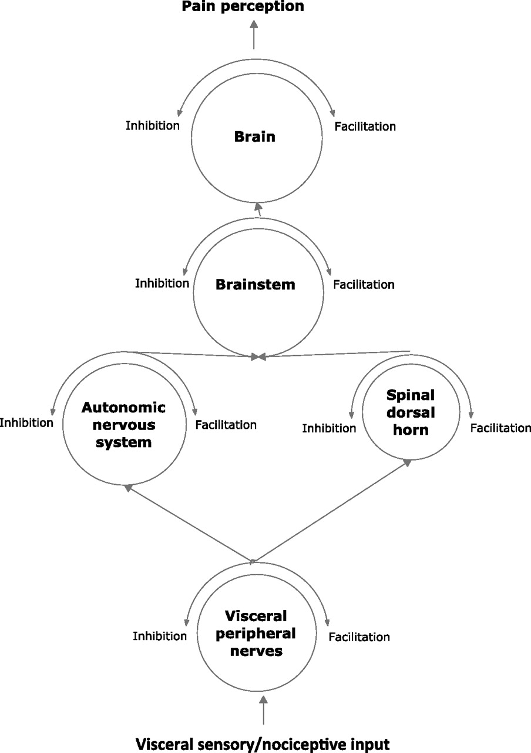
Endogenous Pain modulation
Wilder-Smith, C. 2011

Slide 9
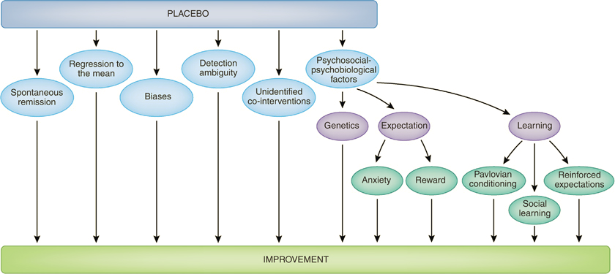
Placebo Analgesia
Benedetti et al. 2011
Notes:
After the administration of a placebo, a clinical improvement may occur for a variety of reasons. Whereas the clinical trialist is interested in any improvement that may take place in a clinical trial, the neurobiologist is only interested in the psychosocial–psychobiological effects after the administration of a placebo. These include a number of mechanisms, such as anxiety, reward, learning, and genetics.

Slide 10
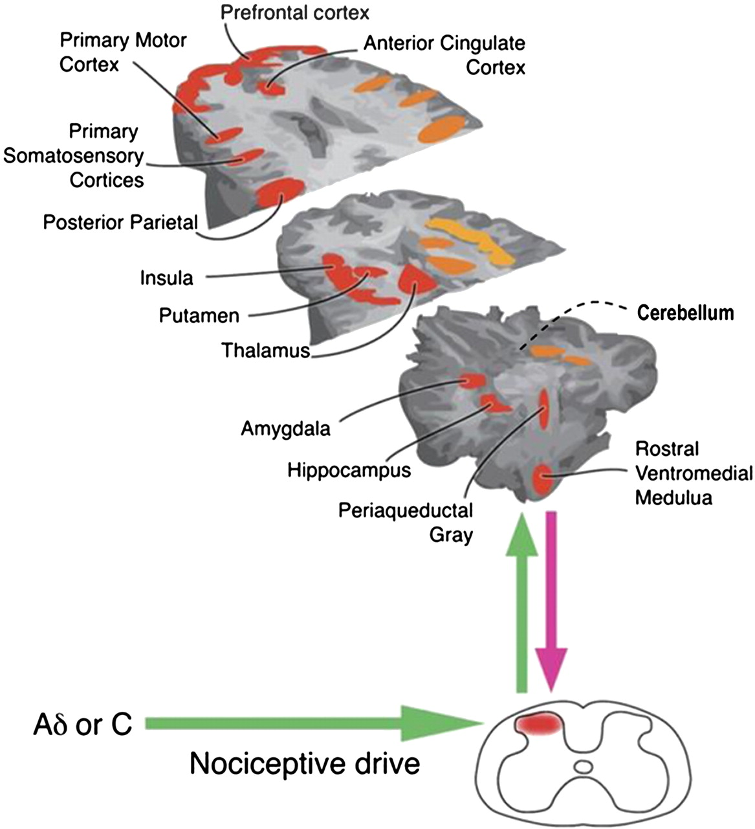
Endogenous Pain Modulation
Wilder-Smith, C. 2011
Notes:
Brain areas consistently shown in imaging studies to be active in the processing and modulation of pain. Adapted from Tracey and Mantyh

Slide 11
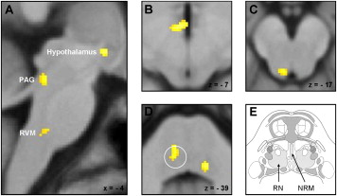
Midbrain and Brainstem Activation Related to Placebo Effect
Eippert et al 2009
Notes:
(A) The sagittal slice (contrast “pain: placebo > control [saline group]”) shows placebo-enhanced responses in the hypothalamus, the PAG, and the RVM, all of which are significantly reduced by naloxone. The three transverse slices show the location of these responses in more detail: (B) hypothalamus, (C) PAG, (D) RVM. The response in the RVM corresponds to the reticular nuclei (RN; approximately indicated by the white circle) adjacent to the nucleus raphe magnus (NRM), which consist of the nucleus reticularis gigantocellularis (more medial) and the nucleus reticularis parvocellularis (more lateral). (E) The anatomical drawing indicates the location of these structures (modified from Naidich et al. [2009]; with permission). The visualization threshold is set to p < 0.01 uncorrected, and the activation maps are displayed on the average structural image over all subjects.

Slide 12
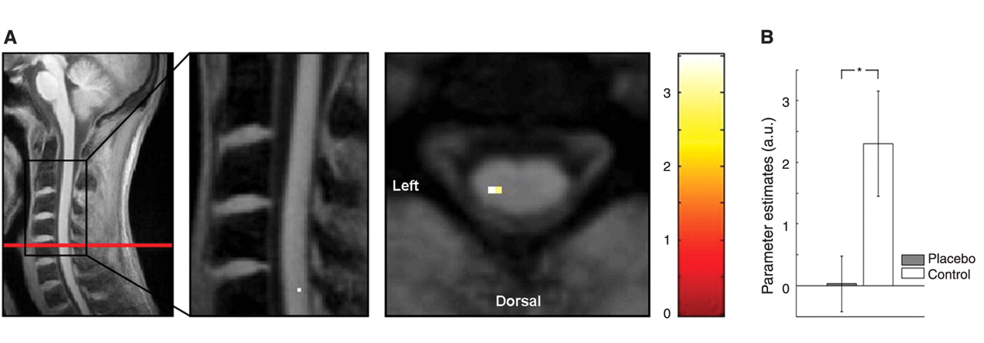
Placebo Effects in Spinal Cord
Eippert et al. 2009
Notes:
Pain-related BOLD responses and their reduction by placebo. (A) (Left) The average structural image with the black box indicating the sagittal section (middle image) and the red line indicating the transverse section (right image). The sagittal and transverse sections show that BOLD responses (main effect of pain; visualization threshold P < 0.01 uncorrected) are present in the dorsal part of the spinal cord, ipsilateral to the side of painful stimulation (left). The location corresponds to segment C6. The color bar indicates t values. (B) Parameter estimates were extracted from the peak voxel for the main effect of pain in the ipsilateral spinal cord. The parameter estimates show that the BOLD response is significantly reduced under placebo (gray bar) in comparison with control (white bar). Error bars indicate standard error; *P 0.05.

Slide 13
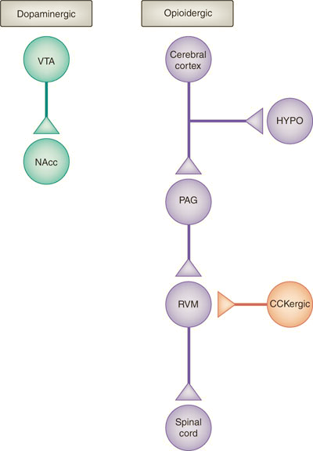
Neural Network of Placebo Analgesia
Benedetti et al. 2011
Notes:
Neural network involved in placebo analgesia and nocebo hyperalgesia. A descending pain inhibitory opioidergic system starts from the cerebral cortex and goes down to the hypothalamus (HYPO), periaqueductal gray (PAG), rostroventromedial medulla (RVM), and spinal cord. The dopaminergic reward system, in which dopaminergic neurons in the ventral tegmental area (VTA) project to the nucleus accumbens (NAcc), is also involved. These opioidergic and dopaminergic networks are antagonized by at least two mechanisms, which are at the basis of nocebo hyperalgesia. On one hand, a cholecystokininergic (CCKergic) system antagonizes the opioidergic circuit at different levels, for example, in the rostroventromedial medulla. On the other hand, deactivations of μ-opioids and D2–D3 dopamine receptors occur in the nucleus accumbens during nocebo hyperalgesia.

Slide 14
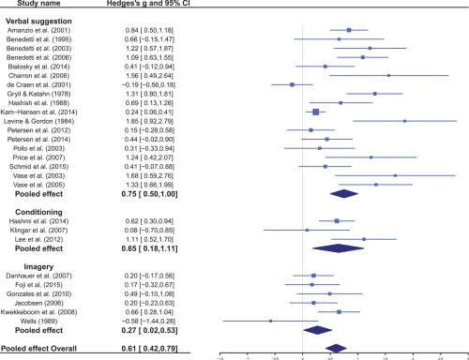
Effect of Placebo Modulations on Pain
Peerdeman et al. 2016
Notes:
Forest plot of the random-effects meta-analysis indicating the effects of the expectation inductions (verbal suggestion, conditioning, and imagery) on pain relief in clinical samples. Positive values for g indicate lower postintervention pain ratings in the intervention condition than in the control condition.
Of the 15,955 studies retrieved, 30 met the inclusion criteria, of which 27 provided sufficient data for quantitative analyses. Overall, a medium-sized effect of the interventions on patients' pain relief was observed (Hedges g = 0.61, I² = 73%), with varying effects of verbal suggestion (k = 18, g = 0.75), conditioning (always paired with verbal suggestion, k = 3, g = 0.65), and imagery (k = 6, g = 0.27). Subset analyses indicated medium to large effects on experimental and acute procedural pain and small effects on chronic pain. In conclusion, patients' pain can be relieved with expectation interventions; particularly, verbal suggestion for acute procedural pain was found to be effective

Slide 15
Placebo Effect and Precision Medicine
The placebo effect is highly reliable and similarly effective if the treatment is applied in the same context (Whalley et al. 2008)
Repetition of effective treatments seems to increase placebo efficacy (Vase et al. 2005)
Identification of placebo responders can inform trial designs and benefit the treatment of such individuals

Slide 16
Temporal and Spatial Filtering of Pain
Offset Analgesia and Conditioned Pain Modulation
Notes:
Several questions regarding the endogenous pain modulation and the CPM model remain. For example, the interplay between the noradrenergic and the serotonergic descending tracts in pain inhibition via the CPM protocol—which of the neurotransmitters is responsible for pain inhibition? Both? If so, what is the relative contribution of each? Another issue, along the noradrenergic line, is what should we target as possible treatment line—should we augment pain inhibition by increasing noradrenergic tone, for example, by the use of noradrenaline reuptake inhibition via agents such as duloxetine, which was found effective for many neuropathic and other pain syndromes, or should we target a decrease in the sympathetic tone, as we do with clonidine, effective in prevention of migraine? Furthermore, should we increase CPM before any expected pain acquisition so that it becomes more efficient and make the patient more resistant to pain? What pharmacological steps should be taken to the end? Maybe the most important point is the lack of ability of clinical studies to isolate the mechanisms of pain inhibition from the many factors involved in the clinical picture of pain

Slide 17
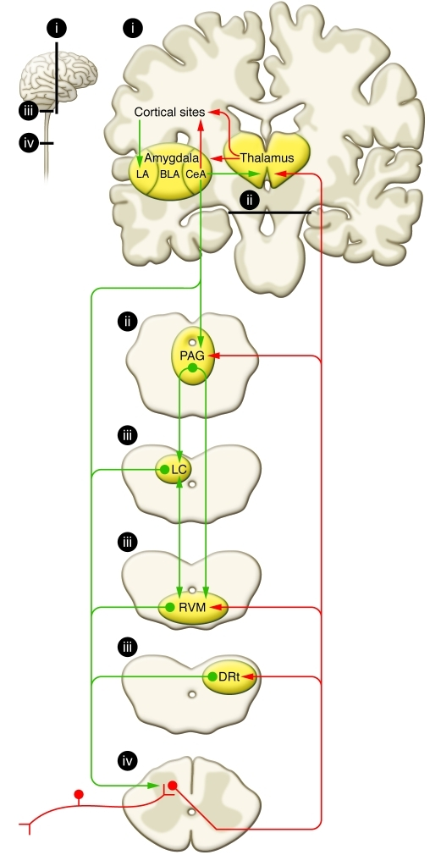
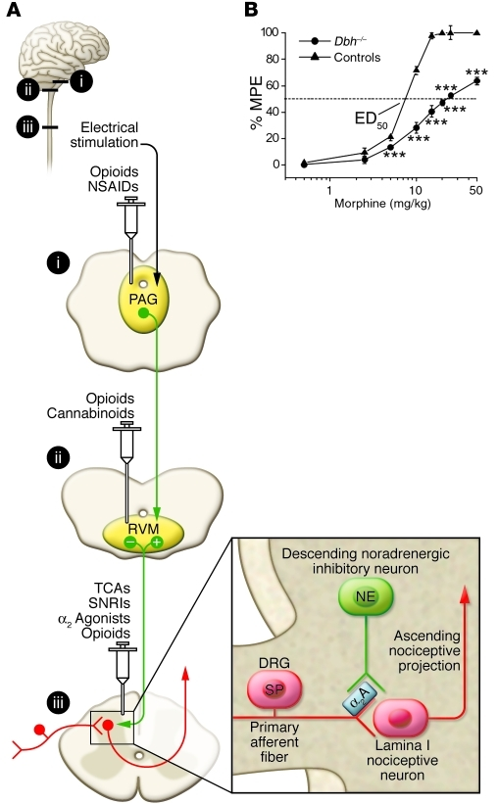
Pain Modulatory Circuits of Brain Stem and Spinal Cord
Ossipov et al. 2010
Notes:
Nociceptive inputs enter the spinal dorsal horn through primary afferent fibers that synapse onto transmission neurons. The projection fibers ascend through the contralateral spinothalamic tract. Ascending projections target the thalamus, and collateral projections also target mesencephalic nuclei, including the DRt, the RVM, and the midbrain PAG. Descending projections from the DRt are a critical component of the DNIC pathway. Rostral projections from the thalamus target areas that include cortical sites and the amygdala. The lateral capsular part of the CeA (“nociceptive amygdala”) receives nociceptive inputs from the brainstem and spinal cord. Inputs from the thalamus and cortex enter through the lateral (LA) and basolateral (BLA) amygdala. The CeA sends outputs to cortical sites and the thalamus, in which cognitive and conscious perceptions of pain are integrated. Descending pain modulation is mediated through projections to the PAG, which also receives inputs from other sites, including the hypothalamus (data not shown), and communicates with the RVM as well as other medullary nuclei that send descending projections to the spinal dorsal horn through the DLF. The noradrenergic locus coeruleus (LC) receives inputs from the PAG, communicates with the RVM, and sends descending noradrenergic inhibitory projections to the spinal cord. Antinociceptive and pronociceptive spinopetal projections from the RVM positively and negatively modulate nociceptive inputs and provide for an endogenous pain regulatory system. Ascending (red) and descending (green) tracts are shown schematically. Areas labeled “i–iv” in the small diagram correspond with labeled details of the larger diagram
(A) Descending pain inhibition from the PAG can be initiated by electrical stimulation or direct microinjection of opioids. Recent evidence also indicates a role for COX inhibitors in the PAG as well. Opioids and cannabinoids inhibit pain by enhancing the baseline firing rate of off-cells and eliminating the off-cell pause in response to nociceptive stimuli. Inhibition of on-cell activity may abolish enhanced pain states. The on-cells and off-cells might correlate with pain facilitatory (+) and inhibitory (–) neurons in the RVM, respectively. At the level of the spinal cord, opioids can inhibit transmitter release from primary afferent terminals as well as activity of pain transmission neurons. Norepinephrine (NE) release from spinopetal noradrenergic fibers from medullary sites also inhibits pain transmission. Tricyclic antidepressants (TCAs) and other norepinephrine reuptake inhibitors enhance the antinociceptive effect of opioids by increasing the availability of spinal norepinephrine (box). Areas labeled “i–iii” in the small diagram correspond with labeled details of the larger diagram. α₂A, α₂-adrenergic receptor; DRG, dorsal root ganglion; SNRI, serotonin/norepinephrine reuptake inhibitor; SP, substance P. (B) Mice deficient in dopamine β-hydroxylase that do not produce norepinephrine show a diminished antinociceptive effect of morphine compared with control animals, suggesting that the presence of norepinephrine, presumably released in the spinal cord, is required for the full expression of morphine antinociception. The dashed line represents the 50% effect, and the corresponding dose is the ED₅₀ (that is the dose producing a 50% effect). % MPE, percentage maximal possible effect. ***P < 0.001 compared with the control group. Error bars represent SEM. Copyright National Academy of Sciences, USA (151).

Slide 18
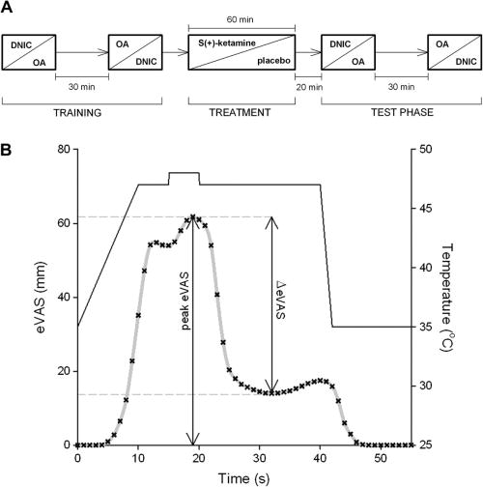
Offset Analgesia
Niesters et al. 2011
Notes:
(A) Schematic diagram of the study protocol. Initially the subjects performed a training session; these data were discarded. After receiving treatment (ketamine or placebo) and a 20-minute rest period, the test phase started with DNIC (diffuse noxious inhibitory control) and OA (offset analgesia) experiments. Each subject received the 2 treatments on separate occasions. OA and DNIC studies were randomized. (B) Calculation of offset analgesia. The visual analogue scale ranging from 0 (no pain) to 100 (worst pain imaginable) (eVAS) response (each cross is a 1-second averaged eVAS value) to a heat pain stimulus (continuous line) is given. The decrease in eVAS from peak eVAS value to its nadir following the 1°C decrease of the heat pain stimulus (at t = 20 seconds) is calculated ([DELTA]eVAS). To correct for the value of the peak eVAS, the [DELTA]eVAS is divided by the peak eVAS giving the “corrected” [DELTA]eVAS or [DELTA]eVAS_{C} (=[DELTA]eVAS/[peak eVAS]).

Slide 19
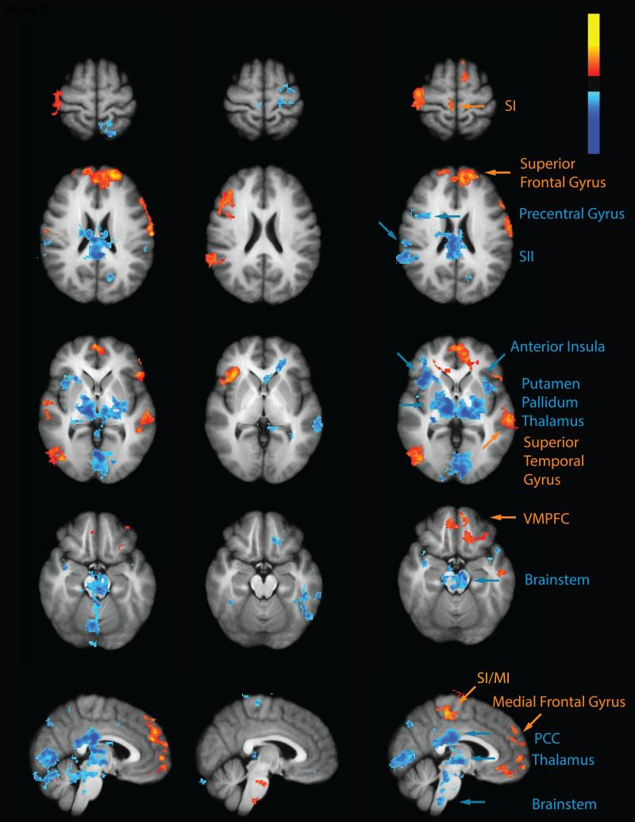
Brain Activity during CPM and Offset Analgesia
Nahman-Averbuch et al. 2014
Notes:
CPM produced markedly different patterns of activity than OA. CPM reduced test stimulus activation (blue) in the brainstem, cerebellum, putamen, posterior INS and SII more than OA (CPM>OA). In contrast, OA reduced test stimulus related activation (red-yellow) more than CPM in SI (CPM>OA). OA was associated with greater activation of the anterior INS, dorso-lateral PFC, intra parietal sulcus, and inferior parietal lobule, while CPM was associated with less deactivation of the both the ventro-medial and dorso-medial PFC, superior temporal gyrus and lateral occipital cortex. INS- insula; PFC- dorsa-lateral prefrontal cortex; SII- secondary somatosensory cortex.

Slide 20
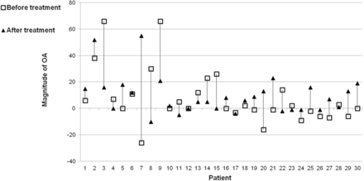
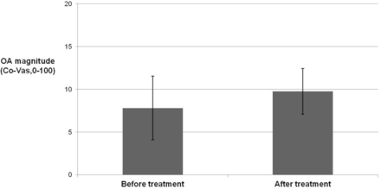
Effects of Hydromorphone on Offset Analgesia
Suzan et al. 2015
Notes:
OA magnitudes prior to and following 4 weeks of hydromorphone treatment in each of the 30 patients. The empty squares represent OA magnitude before treatment and the blackened triangle represent OA magnitude 4 weeks following treatment initiation.
There was no significant difference in the average magnitude of OA for the entire group between both sessions (before vs after treatment) (Wilcoxon signed rank test, P = 0.44; Figure ⇑). McNemar test revealed that even though the percentage of patients who exhibited a change in the direction of their OA was larger than of CPM, it was still not statistically significant (43.3%; P = 0.48; Figure ⇑).
The effect of hydromorphone treatment on OA magnitude (mean ± standard error of the mean; N = 30).

Slide 21
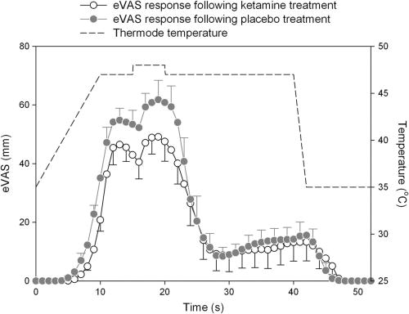
No Effect of Ketamine on Offset Analgesia
Niesters et al. 2011
Notes:
Effect of placebo and ketamine treatment on endogenous pain modulation as determined by the Offset Analgesia paradigm. The [DELTA]eVAS values (decrease in eVAS [visual analogue scale ranging from 0 (no pain) to 100 (worst pain imaginable)] from peak eVAS value to its nadir following the 1°C decrease of the heat pain stimulus [at t = 20 seconds]) corrected for the difference in peak [DELTA]eVAS did not differ between treatments. The data are the population mean of the subjects’ mean eVAS values (SEM).

Slide 22
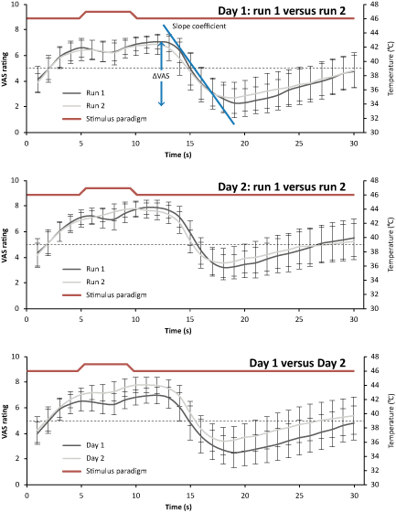
Reliability of Offset Analgesia
ICC .99
ICC .96
ICC .71
Nilsson et al. 2014
Notes:
Psychophysical measures of offset analgesia averaged over all subjects. The red line depicts the temperature in the stimulus paradigm, and a clear effect of offset analgesia can be seen in all graphs following the decrease in temperature. The psychophysical parameters ΔVAS_{Corrected} and slope coefficient are depicted on the top graph. No differences in ΔVAS_{Corrected} or slope coefficient were detected between any runs (all intraclass correlation coefficients > 0.6). The dashed horizontal line denotes the transition from the innocuous sensory range (0–5) to the noxious sensory range (5–10). Note that offset analgesia not only causes complete pain relief, but also extends the effect into the innocuous sensory range.

Slide 23
Offset Analgesia
Lack of Offset Analgesia in Neuropathic Pain Patients (Niesters et al. 2011 and 2014)
Offset Analgesia is easy to perform and thus may become useful for the identification of pain modulatory endophenotypes but more data is needed

Slide 24
Conditioned Pain Modulation (CPM)
Formerly Known As
Diffuse Noxious Inhibitory Controls
Notes:
CPM is abolished by spinal cord section. It appears to depend on the dorsal reticular nucleus which has projections to the RVM, PAG thalamus and amygdala

Slide 25
Bulbo-Spinal Pain Inhibition
Ossipov et al. 2010
Notes:
(A) Descending pain inhibition from the PAG can be initiated by electrical stimulation or direct microinjection of opioids. Recent evidence also indicates a role for COX inhibitors in the PAG as well. Opioids and cannabinoids inhibit pain by enhancing the baseline firing rate of off-cells and eliminating the off-cell pause in response to nociceptive stimuli. Inhibition of on-cell activity may abolish enhanced pain states. The on-cells and off-cells might correlate with pain facilitatory (+) and inhibitory (–) neurons in the RVM, respectively. At the level of the spinal cord, opioids can inhibit transmitter release from primary afferent terminals as well as activity of pain transmission neurons. Norepinephrine (NE) release from spinopetal noradrenergic fibers from medullary sites also inhibits pain transmission. Tricyclic antidepressants (TCAs) and other norepinephrine reuptake inhibitors enhance the antinociceptive effect of opioids by increasing the availability of spinal norepinephrine (box). Areas labeled “i–iii” in the small diagram correspond with labeled details of the larger diagram. α₂A, α₂-adrenergic receptor; DRG, dorsal root ganglion; SNRI, serotonin/norepinephrine reuptake inhibitor; SP, substance P. (B) Mice deficient in dopamine β-hydroxylase that do not produce norepinephrine show a diminished antinociceptive effect of morphine compared with control animals, suggesting that the presence of norepinephrine, presumably released in the spinal cord, is required for the full expression of morphine antinociception. The dashed line represents the 50% effect, and the corresponding dose is the ED₅₀ (that is the dose producing a 50% effect). % MPE, percentage maximal possible effect. ***P < 0.001 compared with the control group. Error bars represent SEM. Copyright National Academy of Sciences, USA (151)

Slide 26
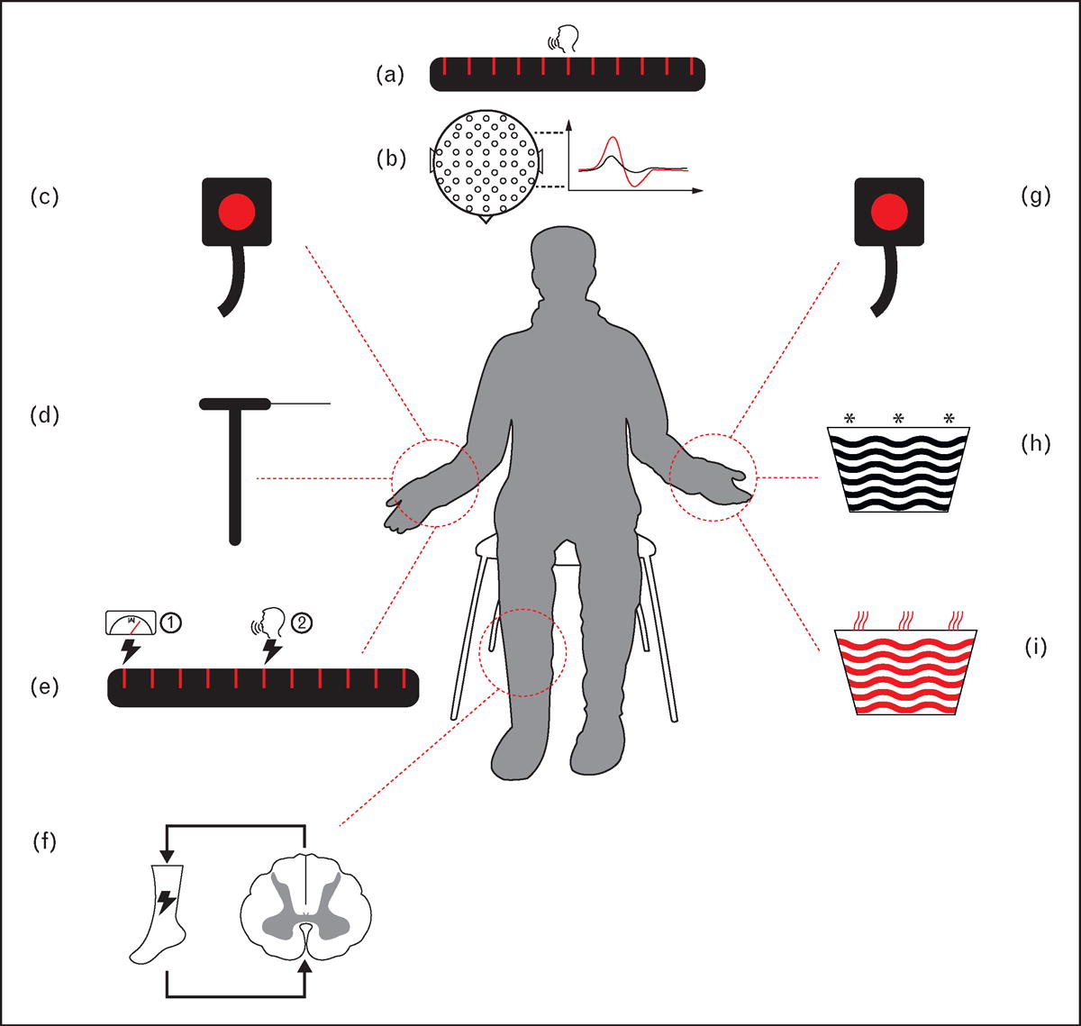
Principles of CPM

Slide 27
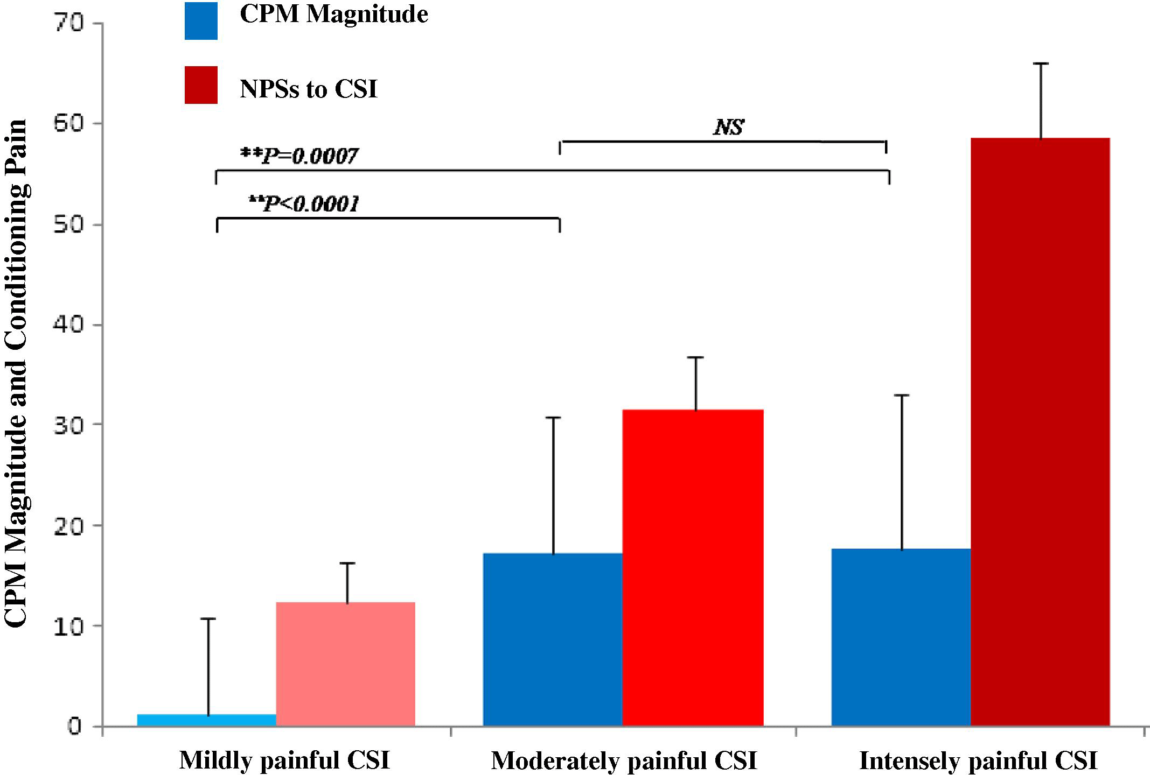
Role of Conditioning Stimulus for CPM Magnitude
Nir et al. 2011

Slide 28
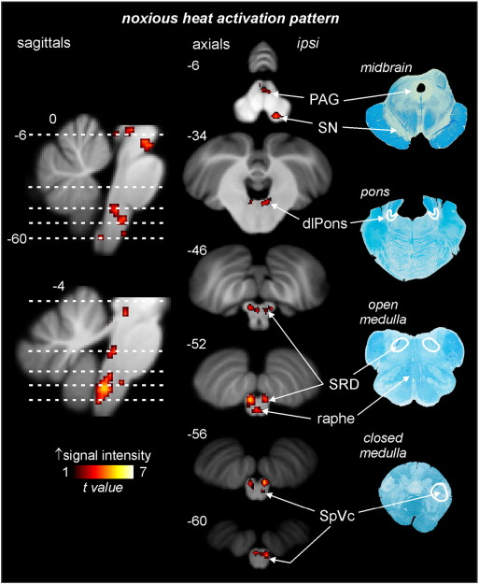
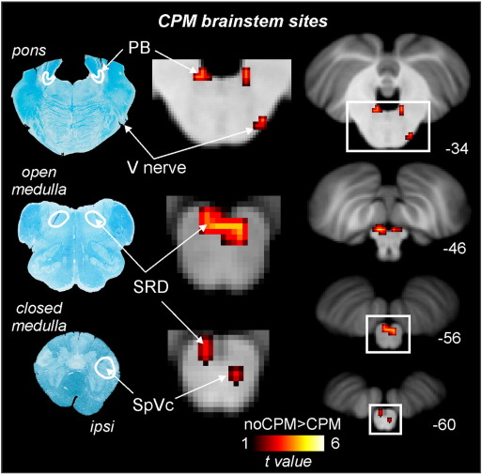
Brain and Brainstem Activation during CPM
Youssef et al. 2015
Notes:
Brainstem activation during 8 brief noxious stimuli (test stimuli) in all 54 subjects overlaid onto a mean T1-weighted anatomical image set. Noxious stimuli applied to the right side of the mouth evoked signal intensity increases (hot color scale; p < 0.05, false discovery rate corrected for multiple comparisons) in the region of the ipsilateral spinal trigeminal nucleus caudalis (SpVc), bilaterally in the region of the subnucleus reticularis dorsalis (SRD) and the medullary raphe, bilaterally in the dorsolateral pons (dlPons), the midbrain periaqueductal gray matter (PAG) and in the region of the ipsilateral substantia nigra (SN). Myelin stained axial sections of a human brainstem from the closed medulla to the midbrain are shown to the right to indicate the location of SpVc, medullary raphe, SRD, dlPons, PAG and SN. The location of each axial slice is represented by hatched horizontal lines on the sagittal slices. In addition, the location of each sagittal and axial slice in Montreal Neurological Institute space is indicated at the upper left of each image.
Effect of conditioned pain modulation (CPM) on brainstem activity. Brainstem regions in which CPM analgesia was associated with a significant reduction in signal intensity increases during test stimuli overlaid onto axial slices of a mean T1-weighted brainstem image set (hot color scale; display thresholdp < 0.001 uncorrected, each cluster p < 0.05 small volume corrected). Myelin stained axial sections of a human brainstem from the closed medulla to the pons are shown to the left and the location of the caudalis subdivision of the spinal trigeminal nucleus (SpVc), subnucleus reticularis dorsalis (SRD) and theparabrachial (PB) nucleus are indicated by white outlines. The three axial slices to the right of the myelin stained sections are enlargements of the regions encompassed by the white boxes shown on the axial sections to the right.

Slide 29
Clinical Syndromes with Abnormal CPM
Fibromyalgia
Irritable Bowel Syndrome
Temporomandibular Disorder
Interstitial Cystitis
Whiplash-Associated Disorders
Osteoarthritis

Slide 30
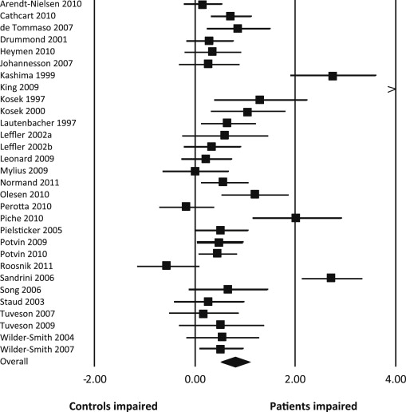
Meta-Analysis of CPM Trials
TMD
IBS
Stroke
Migraine
Lewis et al. 2012
Notes:
Effect size calculations for each study included within the review. Bars indicate the 95% confidence interval of the estimate. An overall summary statistic is also provided (diamond) showing the 95% confidence interval. > = effect size greater than 4.

Slide 31
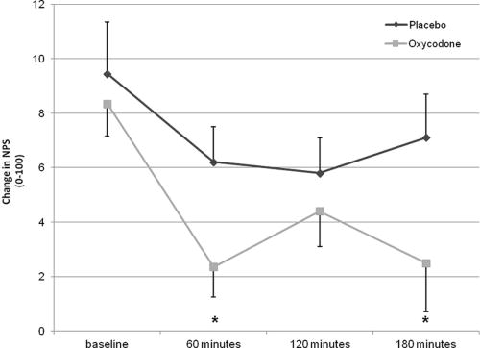
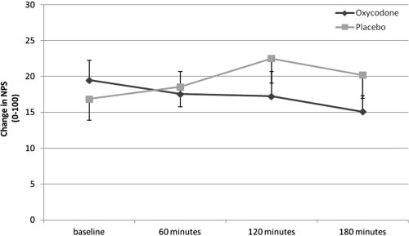
Effects of Oxycodon on Conditioned Pain Modulation
Temporal Summation
Conditioned Pain Modulation
Suzan et al. 2013
Notes:
A: Average temporal summation magnitudes before and at 60, 120, and 180 minutes after oxycodone (0.3 mg/kg)/placebo administration. *P < .025 in the comparison between baseline and the other measurements. NPS, numeric pain scale
B: Conditioned pain modulation magnitudes before and at 60, 120, and 180 minutes after oxycodone (0.3 mg/kg)/placebo administration. NPS, numeric pain scale.

Slide 32
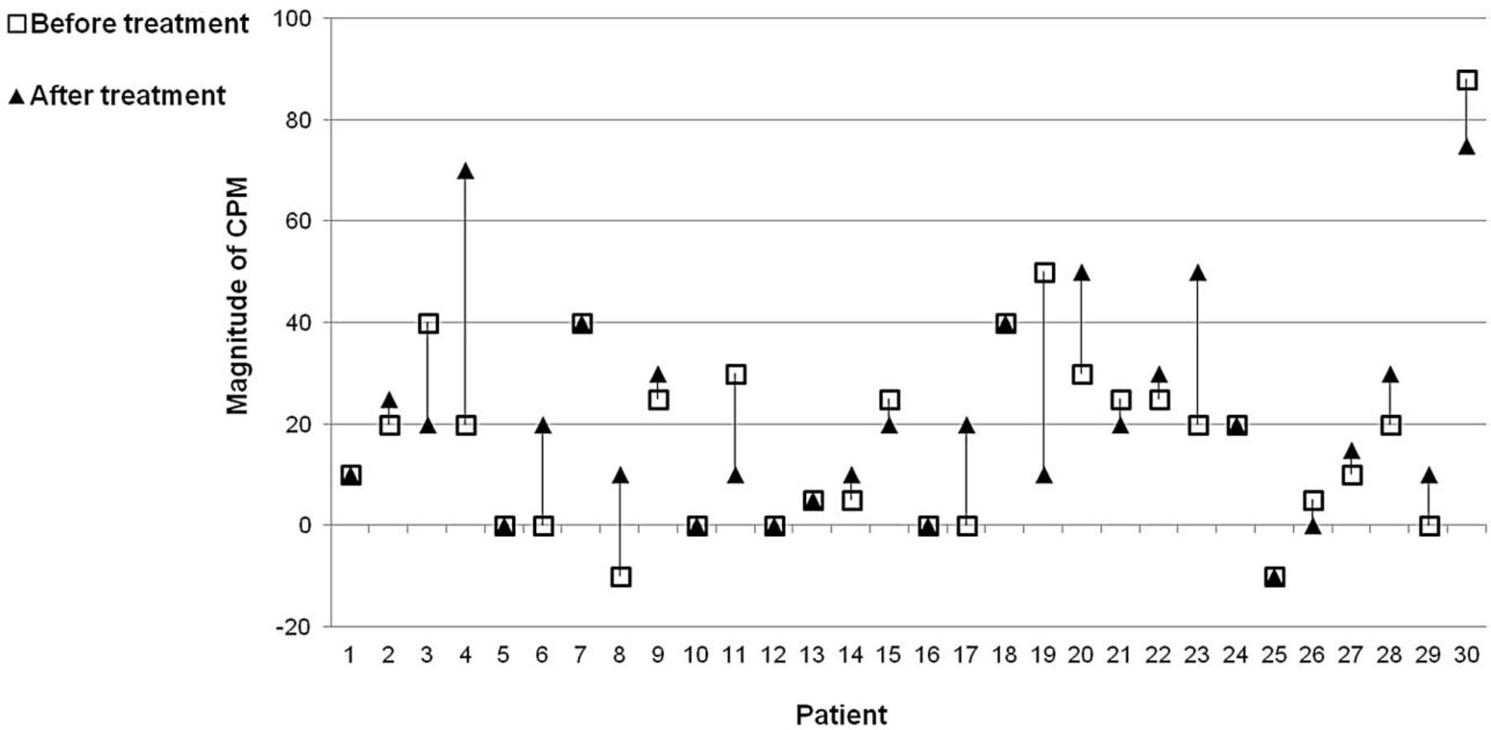
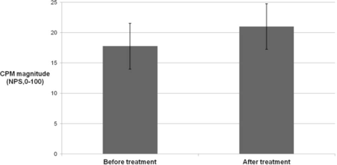
Effects of Hydromorphone on CPM
Suzan et al. 2015
Notes:
The effect of hydromorphone treatment on CPM magnitude (mean ± standard error of the mean; N = 30).
In the comparison of the average magnitude of CPM for the entire group between both sessions (before vs after treatment), Wilcoxon signed rank test revealed no statistically significant difference (P = 0.22; Figure ⇑). Additionally, McNemar test showed that the percentage of patients who exhibited a change in the direction of their CPM was not statistically significant (83.3%; P = 0.37; Figure ⇑).

Slide 33
Naloxone Effects on CPM
Author | n | Pain outcome | Opioid antagonist | Route of administration | Effect on inhibition
Edwards et al. (2004) | 6 | TS, HPT | Naloxone | i.m. (6 mg/kg) | No effect
Peters et al. (1992) | 46^{a,b} | NFR-RIII | Naloxone | i.v. (0.8 mg, 2 mL) | No effect
Pertovaara et al. (1982) | 12 | CT, HT | Naloxone | i.v. (2 mg) | Reduced
Sprenger et al. (2011) | 22ª | HP | Naloxone | i.v. (0.15 mg/kg bolus, 0.2 mg/kg infusion) | No effect
Willer et al. (1990) | 9 | NFR-RIII | Naloxone | i.v. (0.4 mg, 4 mL) | Reduced
Notes:
CT cold thresholds, HT heat thresholds, HPT heat pain threshold, HP 47.5 °C heat pulse, NFR-RIII nociceptive flexion reflex threshold, TS temporal summation of heat pain, i.v. intravenous, i.m. intramuscular
ªMales only
^{b}Chronic pin patients

Slide 34
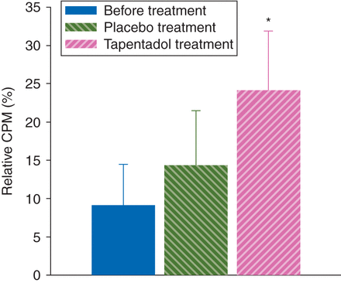
CPM Improved After Tapentadol in Patients with DN
CPM
Niesters et al. 2014
Notes:
Relative CPM responses at baseline (before treatment), in patients receiving a 4-week placebo treatment, and patients receiving a 4-week tapentadol treatment. At baseline, the effect of the CS was not significant (P=0.09). During placebo and tapentadol treatment, the effect of the CS was significant (placebo P=0.04, tapentadol P<0.01). A treatment effect was present with greater increase in CPM responses during tapentadol treatment than during placebo treatment (*P<0.001 vs placebo).
OA responses. (A) An example of a healthy volunteer (female, 60 yr). Data taken from Niesters and colleagues.¹⁹ (B) Absence of tapentadol treatment on OA in painful diabetic neuropathy

Slide 35
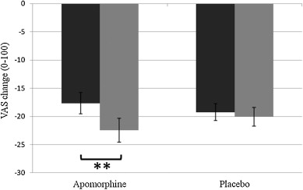
Effects of Apomorphine on CPM
Treister et al. 2015
Notes:
A: Pain intensities (mean ± SEM) in response to the five test heat stimuli at baseline, simultaneously with the conditioning cold stimulus (tests 1 and 2) and following termination of the conditioning stimulus (tests 3 and 4), under the different experimental conditions. Figure shows that under all conditions the maximal drop in heat pain intensities was expressed at test 2.
B: Apomorphine and placebo effects on CPM. Magnitudes of CPM (mean ± SEM) in the two study conditions. Black bars represent baseline values, and gray bars represent CPM following apomorphine/placebo administration. **p = 0.001 in the comparison of CPM between baseline and following apomorphine administration

Slide 36
Reliability of CPM
Excellent Reliability
Poor Reliability
Cathcart et al. 2009
HC
Arendt-Nielsen et al. 2009
HC
Lewis et al. 2012
HC
Manresa et al. 2014
HC
Olesen et al. 2012
Pancreatitis
Wilson et al. 2013
HC
Valencia et al. 2013
Chronic Pain
Martel et al. 2013
Chronic Pain
Oono et al. 2011

Slide 37
Reliability of CPM – Sex Difference
CPM PPThs CP Pain
ICC ISC ICC ISC ICC ISC
Men 0.33 (0.12–0.67) 0.29 0.69** (0.37–0.87) 0.76 0.67** (0.33–0.85) 0.68
Women 0.75** (0.56–0.87) 0.79 0.74** (0.55–0.86) 0.74 0.63** (0.38–0.79) 0.61
Overall 0.59** (0.38–0.74) 0.61 0.72** (0.56–0.83) 0.74 0.61** (0.41–0.75) 0.64
Martel et al. 2013
Notes:
* P < 0.05; ** P < 0.01.
Significant difference between men and women (P < 0.05).
Numbers in parentheses are confidence intervals.
CP pain = cold pressor pain ratings; ICC = intraclass correlation coefficient; ISC = intraindividual stability coefficient.

Slide 38
CPM as Predictor
Risk for the Development of Chronic Post-Operative Pain (Yarnitsky et al., 2008)
Risk for Opioid Induced Hyperalgesia
Cancer (Ram et al., 2008)
Analgesic Response to SNRIs?
Duloxetine (Yarnitsky et al., 2012)

Slide 39
Duloxetine for Pain of Diabetic Neuropathy
N=30
Duloxetine
Placebo
30 mg
60 mg
1 week
1 week
4 weeks
CPM
CPM
Yarnitsky et al. 2012

Slide 40
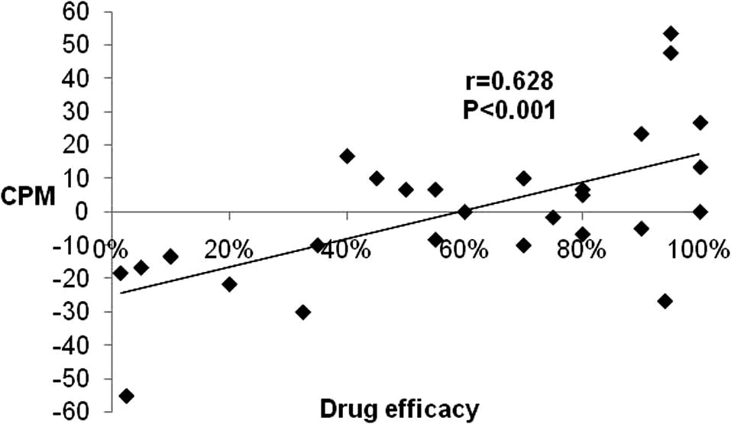
Lack of CPM at Baseline Predicted Duloxetine Efficacy
Yarnitsky et al. 2012
Notes:
Drug efficacy and pretreatment CPM in patients with diabetic neuropathy. Patients with less efficient CPM (positive scores) reported higher drug efficacy and vice versa.

Slide 41
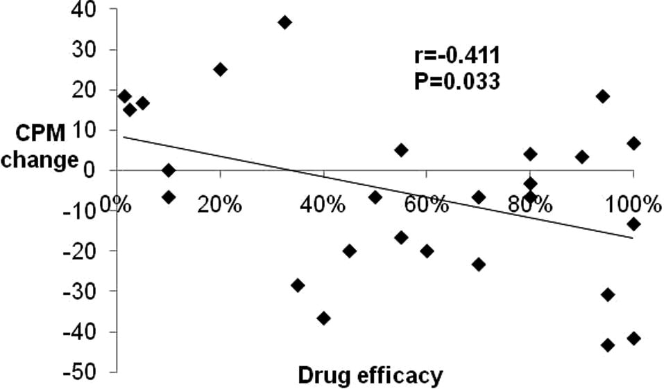
Change of CPM After Duloxetine
Yarnitsky et al. 2012
Notes:
Change in CPM by duloxetine. Higher benefit from the drug is paralleled by improved CPM efficiency (lower scores).

Slide 42
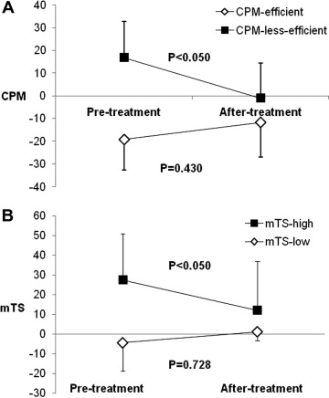
Reversal of Inefficient CPM
Yarnitsky et al. 2012
Notes:
Population-specific reversal of pro-nociception. Based on corresponding median split, only the patients with less efficient CPM (A) and enhanced mTS (B) significantly reversed these pro-nociceptive patterns.

Slide 43
CPM Recommendations (2015)
Sequential Protocol
Conditioning Stimulus (1 min) followed by
Test Stimulus x 2
Test Stimulus
Mechanical Pain 40 VAS (0-100) x 2
Ascending or Fixed Stimulus Intensity
Upper and Lower Extremity
Conditioning Stimulus
Cold Water Immersion over 1 min of the Hand
Yarnitsky et al. 2015

Slide 44
Conclusions
Descending Pain Modulation is Critical for Acute and Chronic Pain Relief
Decreased Endogenous Pain Inhibition has been Reported in Many Chronic Pain Conditions
CPM Can be Used to Determine Endogenous Pain Inhibition in Groups and Possibly in Single Individuals

Slide 45
Conclusions cont.
Usefulness of CPM and Offset Analgesia Testing for Precision Medicine
Standardization of CPM and Offset Analgesia Testing
Prospective Controlled Trials testing CPM or Offset Analgesia Efficacy as Predictor of Treatment Response

