Slide 1

Sodium channels as targets for precision medicine
IMMPACT XIX meeting Washington DC, June 3-4
Disclosure :
Received consultancy or educational grant fees from: Grünenthal, Mundipharma, Orion, Pfizer.
Troels Staehelin Jensen, MD, DMSc
Dept. of Neurology &
Danish Pain Research Center
Aarhus University Hospital, Denmark

Slide 2
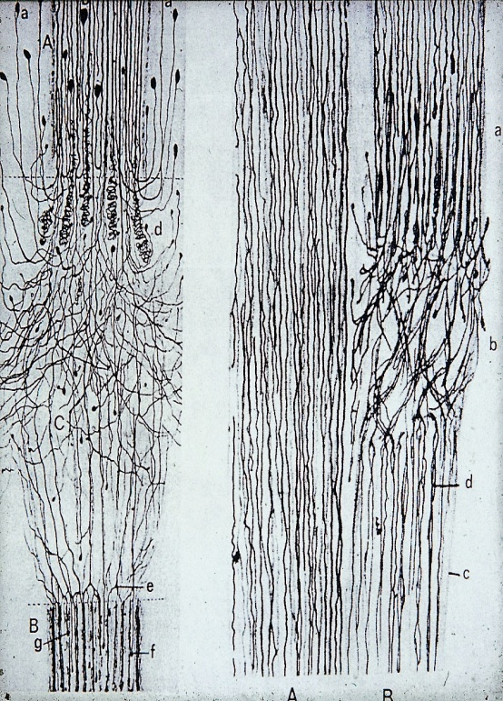
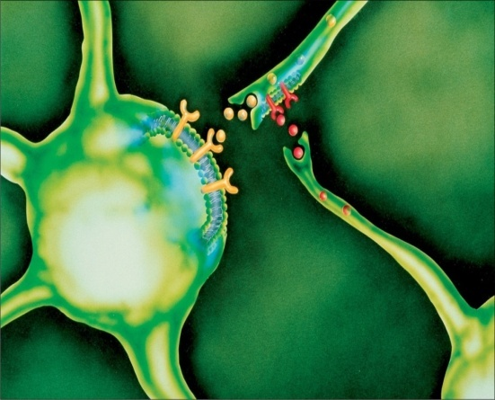
Sodium channels and Neuropathic Pain
Notes:
2

Slide 3
Sodium channels as targets

Slide 4
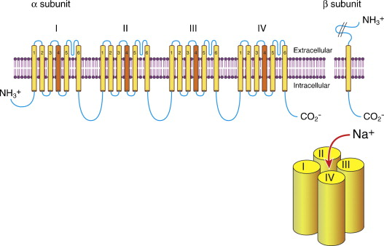
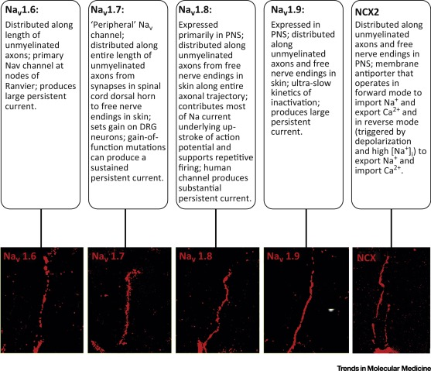
Ion channels and somato-sensory processing
Na⁺ channel with α-subunit and 4 domains each with 6 transmembrane helices, of which one acts as voltage sensor
Krishnan AV et al. Prog Neurobiol 2009;
Na_{V} isoforms | Expressed
Nav 1.1 | Non-noc cells
Nav 1.2 | CNS
Nav 1.3 | Expr in injury
Nav1.4 | Heart
Nav1.5 | Heart
Nav1.6 | Non-noc cells
Nav1.7 | All sens cells
Nav1.8 | A and C cells
Nav1.9 | In noc. C cells
Persson AK et al. Trends Mol Med 2016

Slide 5
Sodium channels and relevance to sensory processing
Channel type | Gene | Distribution | Tetrodotoxin | Function in sensory processing
Na_{v} 1.1 | SCN1A | CNS, PNS | Sensitive | None
Na_{v} 1.2 | SCN2A | CNS | Sensitive | None
Na_{v}1.3 | SCN3A | CNS, PNS | Sensitive | Fast inactivating TTX-S current. Na_{v}1.3 upregulated after axotomy and in neuromas
Na_{v}1.4 | SCN4A | Muscle | Sensitive | None
Na_{v}1.5 | SCN5A | Muscle, Heart | Resistant | None
Na_{v}1.6 | SCN8A | Cerebellum, large DRG | Sensitive | Na_{v}1.6 major ion channel in large fibers; accumulated in nodal egion. Produces large persistent currents.
Na_{v}1.7 | SCN9A | Small and large DRG | Sensitive | Na_{v}1.7produces a rapid current and sets the gain of nociceptive neurons. Mutations may give rise to both: pain /no pain
Na_{v}1.8 | SCN10A | Small DRG | Resistant | Responsible for Na current causing upstroke of action potential and support repetitive firing.
Na_{v}1.9 | SCN11A | Small DRG | Resistant | Produces lareg persistent current and Increases generally neuronal excitability

Slide 6
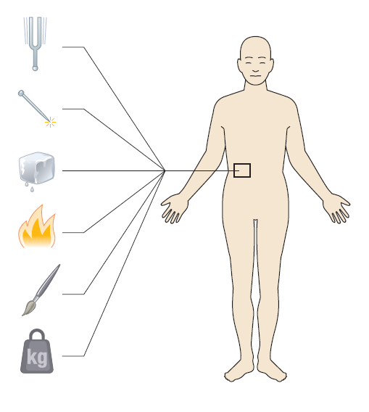
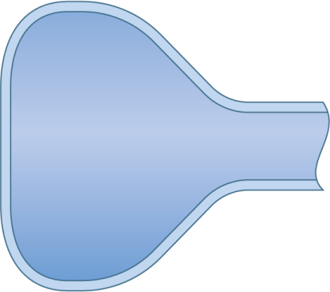

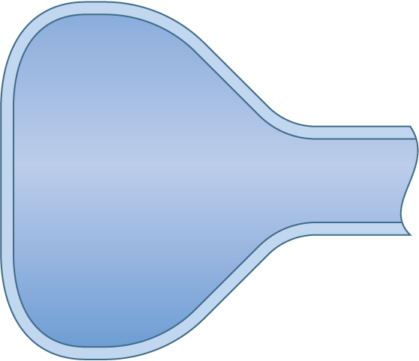








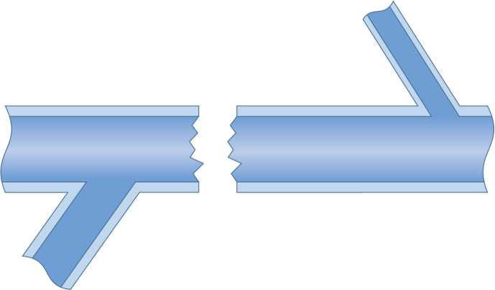




Ion channels involved in the processing of nociceptive information
TRPV1
Glut
Na_{V}
TrkB
Na_{V}1.7
AMPA
Na_{V}1.8
NMDA
Ca_{V}
NK1
Subst P
K_{V}
Na_{V}1.7
K_{V}
Na_{V}1.8
Non-selective
Ion channel
Ca_{V} Channel
Na_{V} channel
Different K⁺ channel

Slide 7




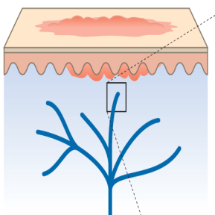
Node of
Ranvier
Juxtaparanode
region
In myelinated axons the distribution of voltage gated ion channels at the node of Ranvier changes with reduced expression of K_{v} at the juxtaparanode leading to hyperexcitability. Upregulation of Na_{v} channels
K_{v}
Na_{v}
Myelinating Schwann cells
Na_{V} 1.7
ASIC
Na_{V} 1.8
K_{V}
At the cell body expression and trafficking Na_{v}1.8. Inheriting rare variants of Na_{v}1.7

Slide 8
A note on precision medicine

Slide 9
What is precision medicine
Pain
Presentation
Eitiology
Genotype
Exogenic
Clinical phenotype
Diagnostic measures
Patho-physiology
Rational treatment

Slide 10
Precision medicine for sodium channels
Pain
Presentation
Eitiology
Specific Na_{v} gene variant
Exogenic ?
Irritable nociceptor
Clinical, QST, IENFD
Patho-physiology
Rational treatment
Phenytoin, Carbamazepine
Oxcarbazepine
Lidocaine
Specific Na_{v} blockers

Slide 11
Sodium channels in neuropathic pain
Why may precision medicine be difficult to apply ?
No gold standard for NP neither based on history or examination
Low specificity of symptoms and signs
No specific sensory profile for Sodium channels ( e.g. ”irritable nociceptor”)
Existing sodium channel nociceptors are unspecific
The neuropathic pain disorder caused by a sodium channel abnormality may drive other pain mechanisms/comorbidities that are unrelated to sodium channels

Slide 12
Clinical approaches targeting sodium channels
Identify potential responders (”irritable nociceptor”)
Change target by altering administration

Slide 13










Neuropathic pain control: Drug action at the spinal level
Descending control
Central projection
Descending Control
TCA, SNRI, SSRI, PGP, opioids
Afferent input
NK1
Monoamine rec.
Na⁺
Primary afferents
  TCA, PGB, GBP, carbamazepine
  Oxcarbazepine Phenytoine
  Lamotrigine
  Lacosamide
  Topiramate
  Levetiracetam
α₂δ
NMDA
Opioid
Postsynaptic
TCA, opioids, NMDA antagonists
Ca⁺⁺
Segmental
Opioids

Slide 14

Lidocaine patch and pain in nerve injury
Central sensitization following abnormal peripheral input
Normalisation af central processes after topical lidocaine block ?
Lidocaine Patch

Slide 15
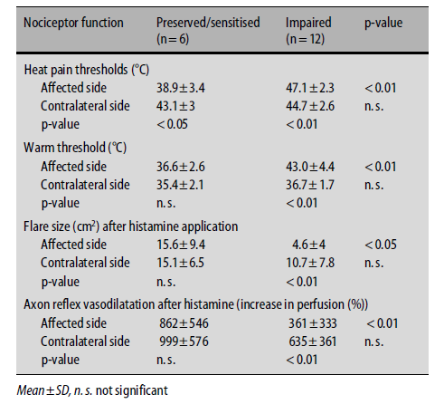
Lidocaine patches in PHN
Randomized double-blind placebo-controlled cross-over study of two 1 week treatments with Lidocaine 5% vs. placebo
Patients divided into
sensitized nociceptor
nociceptor impaired
QST (Warm threshold and heat pain)
Histamine flare size
Axon reflex vasodilatation after histamine
Wasner et al. 2005

Slide 16
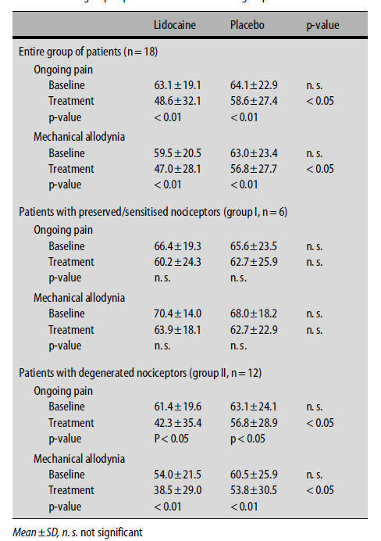
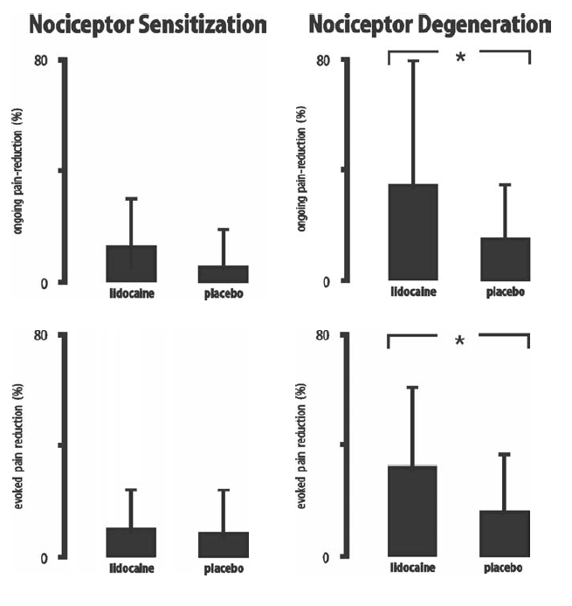
Conclusion: Lidocaine effective in patients with impaired nociceptors, but not in patients with sensitized nociceptors
Wasner et al. 2005

Slide 17
Attempt to determine underlying meachanism:
Irritable vs. non-irritable nociceptor
Z-Score
4
3
Gain of
function
2
Irritable nociceptor phenotype:
1. Normal cold and warmth detection threshold
2. Dynamic mechanical allodynia, or increased mechanical pain sensitivity, or reduced cold or heat pain threshold
1
0
-1
Loss of
function
-2
-3
-4
CDT
HDT
TSL
CPT
HPT
PPT
MPS
WUR
MDT
VDT
QST parameter
Z-Score
4
3
Gain of
function
2
1
Non Irritable nociceptor phenotype:
1. Normal thermal or mechanical detection threshold
2. No thermal or mechanical hypersensitivity
0
-1
Loss of
function
-2
-3
-4
CDT
HDT
CPT
HPT
PPT
WUR
MDT
TSL
MPS
VDT
QST parametr

Slide 18
Peripheral neuropathic study:
Nerve injury, PHN
Z-Score
4
Sensitized nociceptor pain
Hypothesis:
A peripheral Lidocaine patch will block spontaneous pain
hypersensitivity
3
Gain of
function
2
1
0
Randomized double-blind placebo-controlled cross-over study of two 4 week treatments with Lidocaine 5% vs. placebo
-1
Loss of
function
-2
-3
-4
CDT
HDT
TSL
CPT
HPT
PPT
MPS
WUR
MDT
VDT
QST parameter
 | N | Age | F/M
Irritable nociceptor | 15 | 57 | 9/6
Non-irritable nociceptor | 25 | 61 | 14/11
Z-Score
4
Deafferentation pain
3
2
Gain of
function
1
0
-1
Loss of
function
-2
-3
-4
CDT
HDT
TSL
CPT
HPT
PPT
MPS
WUR
MDT
VDT
QST parameter
Demant et al. Pain 2015
Concept from the German Pain Network

Slide 19
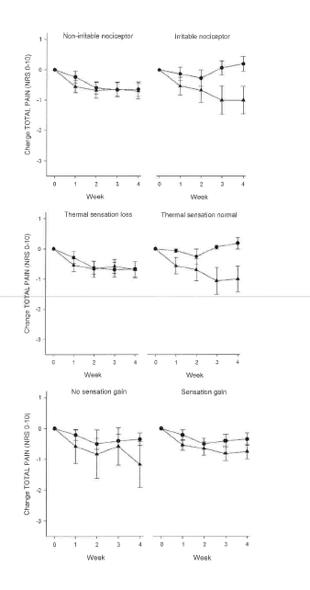
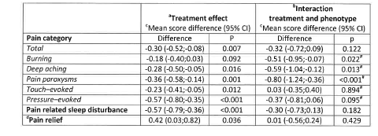
Lidocaine patch in NP ± irritable nociceptor
Pain reduced slightly by lidocaine
Lidocaine reduced pain in patients with IN:
  deep pain
  paroxyms
Conclusion on lidocaine patches in NP:
Weak effect; only active on certain types of NP
More efficacious in patients with the IN phenotype
Demant et al. Pain 2015

Slide 20
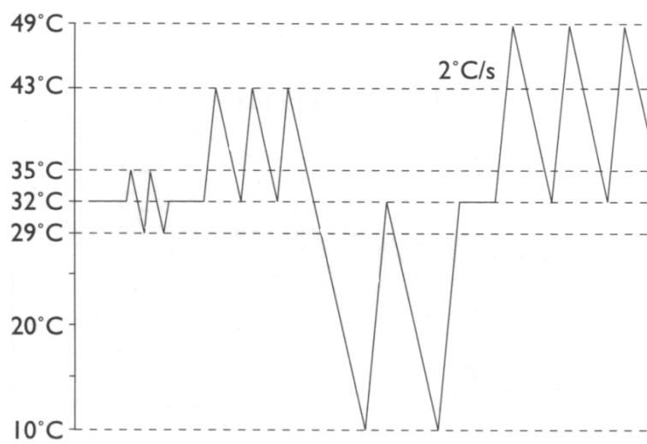
Thermal QST:
Z-Score
4
Sensitized nociceptor pain
3
Gain of
function
2
1
0
-1
Loss of
function
-2
-3
Normal Thermal QST
-4
CDT
HDT
TSL
CPT
HPT
PPT
MPS
WUR
MDT
VDT
QST parameter
50
C⁰
Z-Score
4
HPT
Deafferentation pain
HDT
HPT
3
40
HDT
2
Gain of
function
30
1
CDT
0
20
-1
CDT
Loss of
function
-2
10
CPT
CPT
-3
Feet
Thigh
-4
77 year old man with small fiber neuropathy
CDT
HDT
TSL
CPT
HPT
PPT
MPS
WUR
MDT
VDT
QST parameter
Concept from the German Pain Network

Slide 21

Oxcarbazepine in Peripheral Neuropathic Pain Depends on Pain Phenotype
1
Non-irritable nociceptor (n=52)
Irritable nociceptor (n=31)
0
-1
Change TOTAL PAIN (NRS 0-10)
-2
NNT 13
NNT 3.9
-3
Non-irritable nociceptor (deafferentation or degenerative type): dominated by sensory loss
-4
Irritable nociceptor: preserved small fiber function (cold, warm, pinprick) , hyperalgesia
0
1
2
3
4
5
6
0
1
2
3
4
5
6
Week
Week
Oxcarb: Oxcarbazepine 1800-2400 mg/day.
Cross-over study with 2 x 6-week treatment periods and 1-week washout, 1-week baseline for each treatment period
Demant DT et al. Pain. 2014;155(11):2263-73

Slide 22
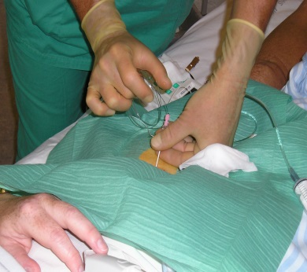
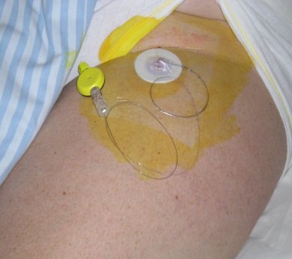
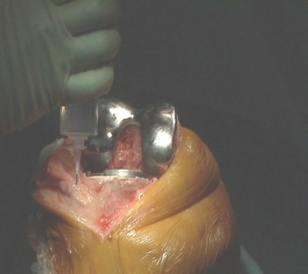
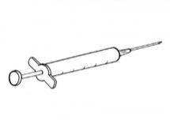
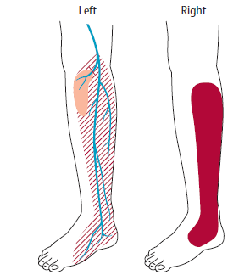
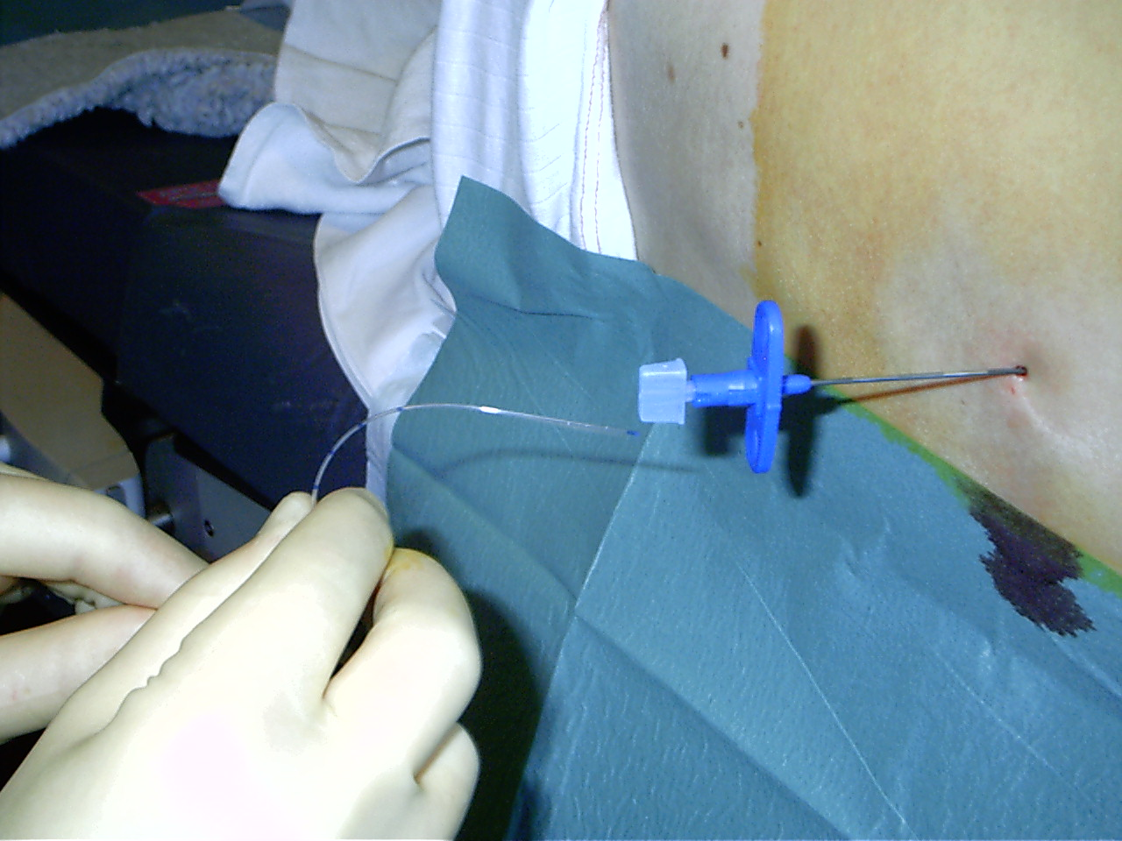
Peripheral block: Does it remove spontaneous pain and allodynia?
Nerve conduction Block + Local Infiltration Analgesia
Jensen & Finnerup, Lancet Neurol, 2014

Slide 23
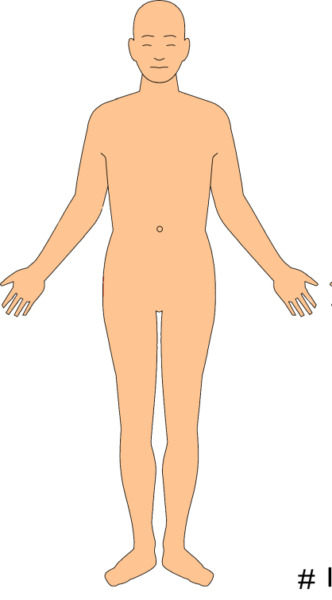

Peripheral nerve injury study
Hypothesis:
Blocking input from the periphery (lidocaine) abolishes spontaneous pain and central sensitization ?
Haroutunian et al. Pain 2014

Slide 24
Nerve block and hyperalgesia
67 yr old M, surgical injury of L tibial neve
Pain in left foot and ankle. NRS: 7
Peripheral lidocaine block
Central lidocaine block
Haroutounian et al. Pain 2014

Slide 25
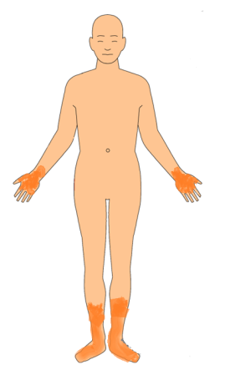
Intensity (0-10
Polyneuropathy and lidocaine block
Male with DPN
Intensity (0-10

Slide 26
Intensity (0-10
Polyneuropathy and lidocaine block
Intensity (0-10

Slide 27
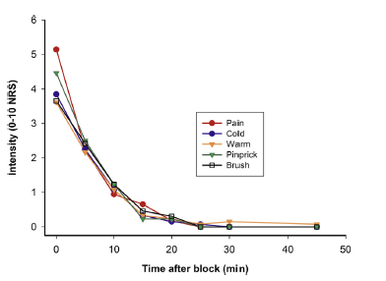
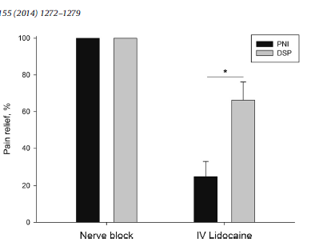
Peripheral and central lidocaine block:
Peripheral nerve injury
Polyneuropathy
Additional effect in polyneuropathy ?
Haroutunian et al. 2014,

Slide 28
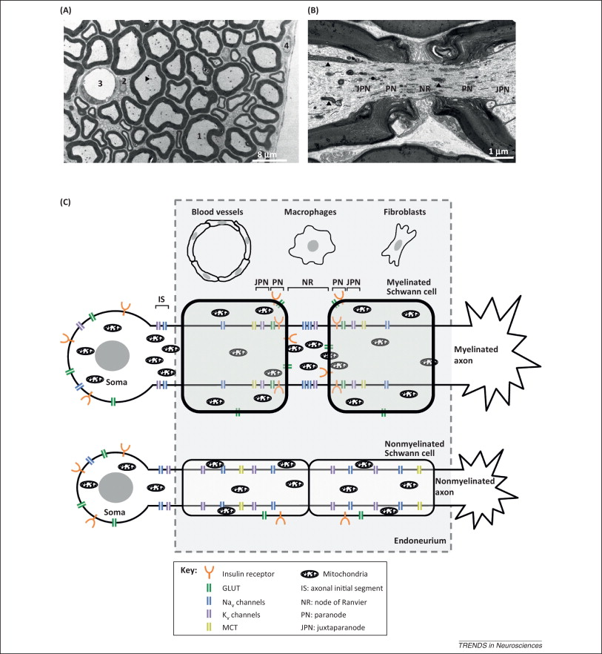
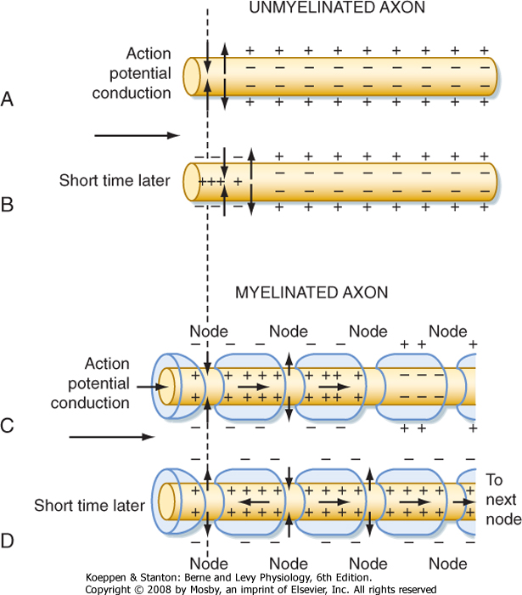
Myelinated and unmyelinated axons in peripheral nerves: Accumulation of ion channels, glucose transporters in nodal and paranodal regions
Na_{V}1.6 mainly at Ranvier Nodes
Na_{V}1.7 along unmyelinated fibers
Na_{V}1.8 postranslational modification
Zenker et al. TINS, 2013

Slide 29
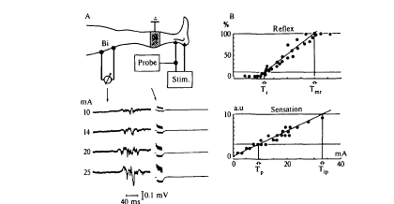
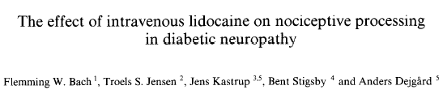
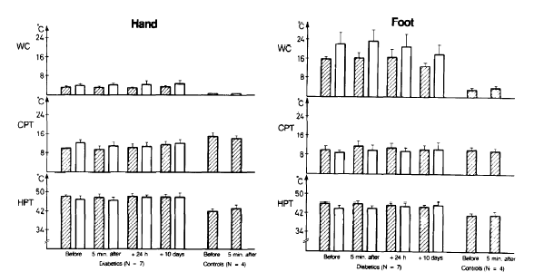
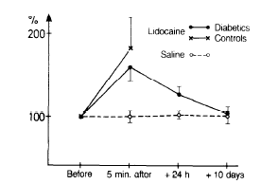
Nociceptive flexor reflex and i.v. lidocaine
Willer & Le Bars 1984
Lidocaine inhibition of NFR
Lidocaine no effect on thermal processing
Bach et al. Pain1990;40:29-34

Slide 30
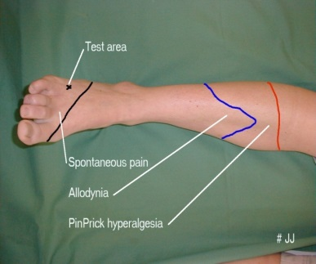
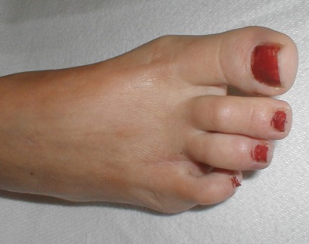
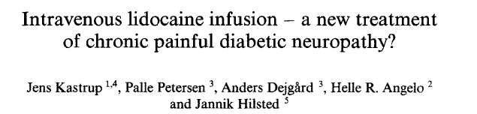
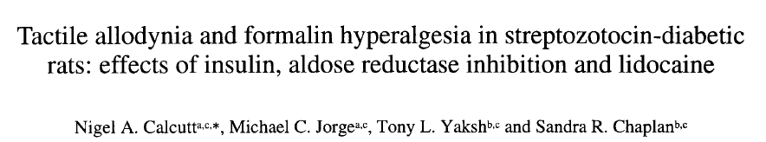
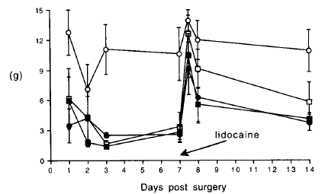
Nerve injury pain:
i.v. Lidocaine/saline
Systemic lidocaine : Possible central effects
scar
Pain1987;28:69-75, BMJ 1986
100
80
60
40
Before
During
After
VAS
NaCl
20
0
0
1
2
Min.
3
v. Frey 2Hz
100
80
VAS
60
40
20
Lidocaine (5mg/kg in 30 min)
0
0
1
2
Min.
3
Brennum et al. 1992; Koppert et al, 1998; Attal et al , 2000, 2004; Finnerup et al., 2005; Gottrup et al. ,2000; 2006; Gormsen et al., 2009 ; Haroutunian et al ., 2014
Pain1996;68:293-99

Slide 31
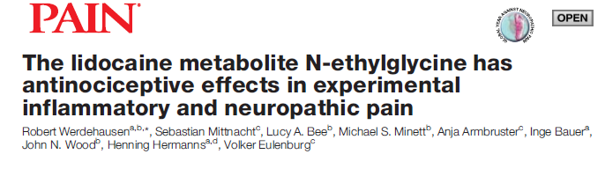
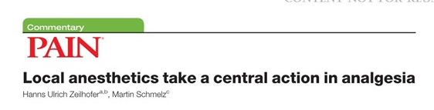
Central action of lidocaine revisited
”Systemically applied lidocaine exerts antihyperalgesic effects through its metabolite N-ethylglycine in vivo, by enhancing spinal inhibition of pain processing through Glycine transporter 1 modulation and subsequent increase of glycine concentrations at glycinergic inhibitory synapses.”
”N-ethylglycine is a substrate of the glycine reuptake transporter GlyT1, thereby competing with endogenous and synaptically released glycine for reuptake and leading to increased extracellular glycine levels”.
Pain 2015

Slide 32
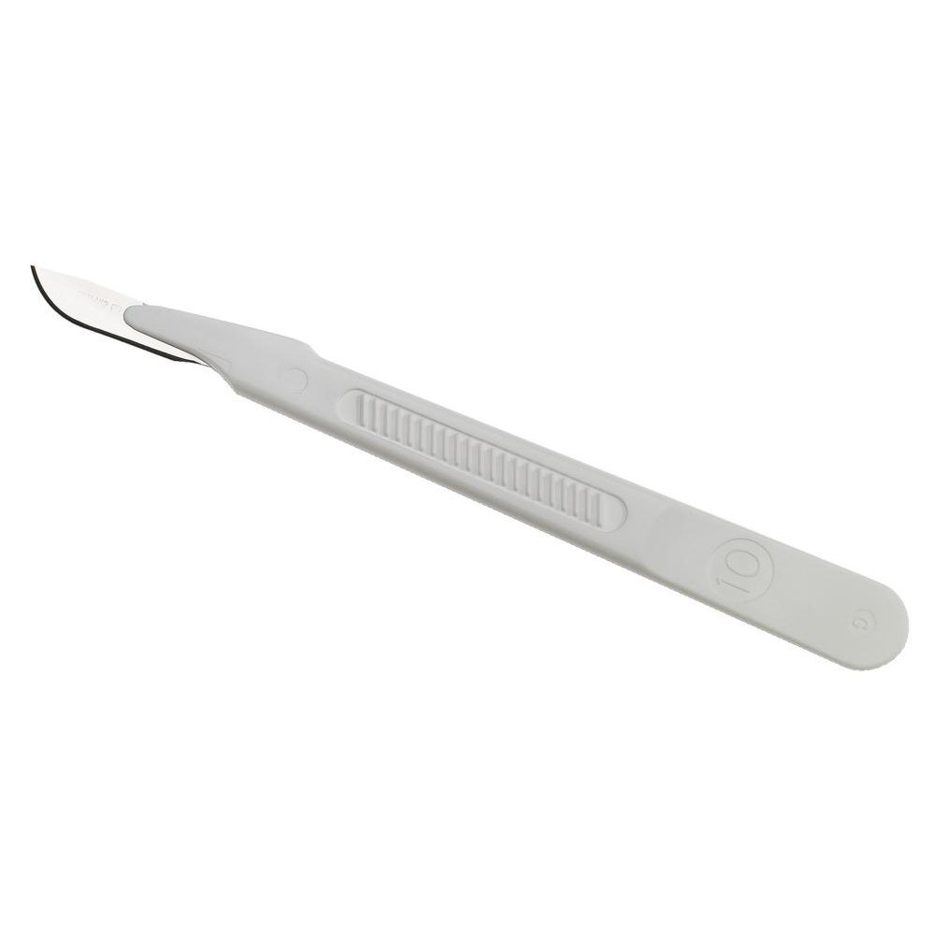
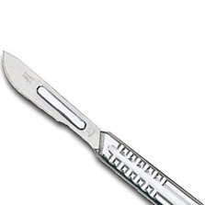
Etiology of nerve injury may influence response to sodium channels
Selective injury
Aβ or Aδ, C fibres
Structural and functional changes
Irritable nociceptors
Degeneration/Regeneration
variable input from adjacent intact/partly damaged fibers
Variable central sensitization
injury of
Aβ and Aδ and C fibres
Nerve cut
Nerve crush

Slide 33
Clinical approaches targeting sodium channels
Can structural changes be used to identify responders to sodium channel blockers ?

Slide 34
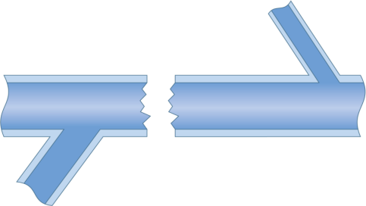
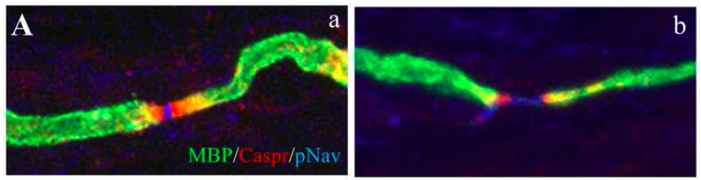
Nerve injury and Na⁺-channels:
Na_{v} | Expression
Na_{v}1.1 | Adult DRG cells
Na_{v}1.2 | Adult DRG cells
Na_{v}1.3 | Injured DRG cells
Na_{v}1.4 | Heart
Na_{v}1.5 | Heart
Na_{v}1.6 | Large DRG cell
Na_{v}1.7 | All DRG cells
Na_{v}1.8 | Small DRG cells
Na_{v}1.9 | Small DRG cells
Triple stained nerve fiber green: myelin basic protein (MBP), red: Caspr, blue: pNav. in entrapment neuropathy
Elongated node with separation of contactin-associated protein (Caspr) staining and dispersion of VGSC channels within the node of Ranvier.
From Schmidt et al,. Brain 2014

Slide 35
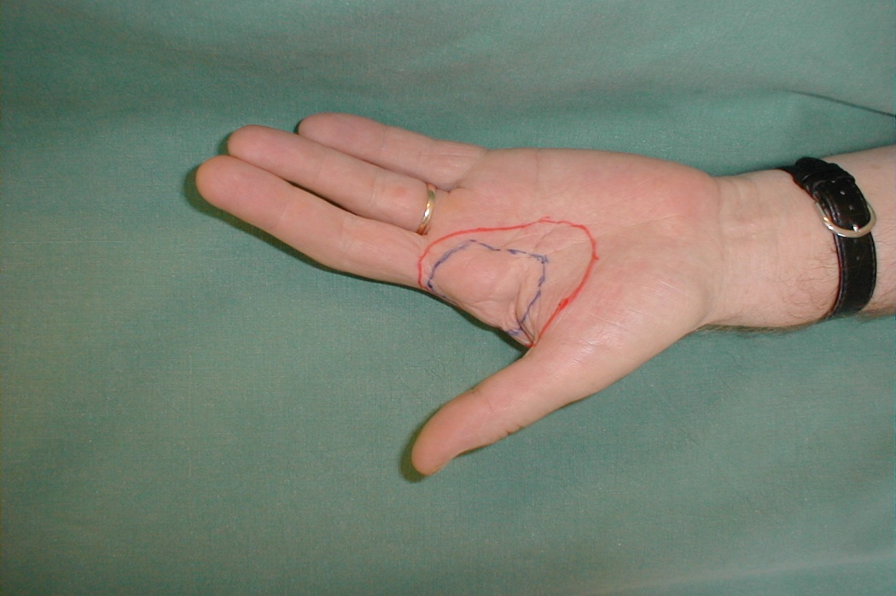
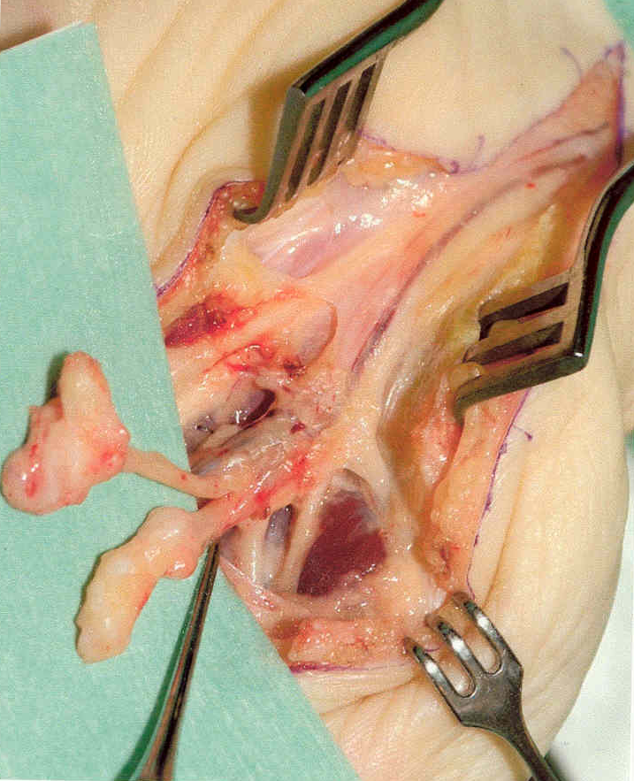
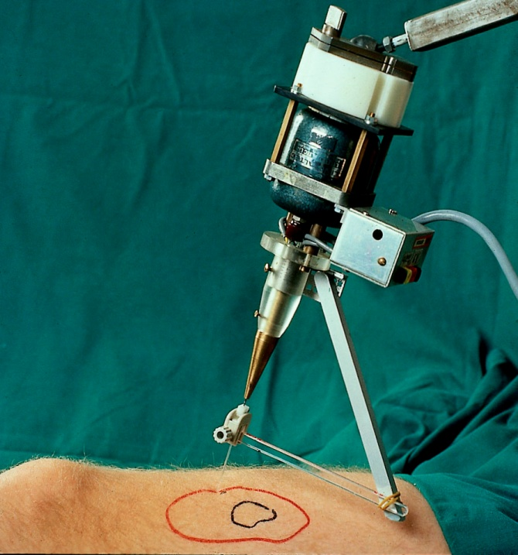
Postamputation Pain
Blockade of upregulated ion channels in painful neuromas
does that produce pain relief ?
Vas rep. v. Frey 2Hz 1 min.
100
Lidocaine/Placebo
90
80
70
60
During
50
Before
VAS
40
30
After
20
10
v.Frey stim.
# KFT
0
0
1
2
3
Min.
Spontaneous pain

Slide 36
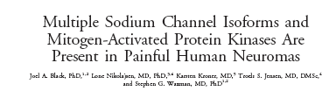
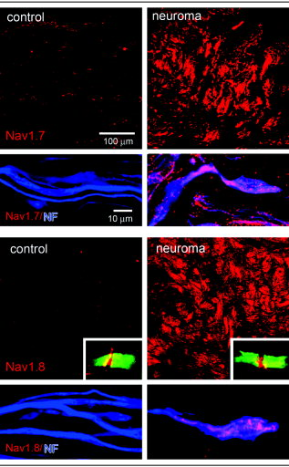
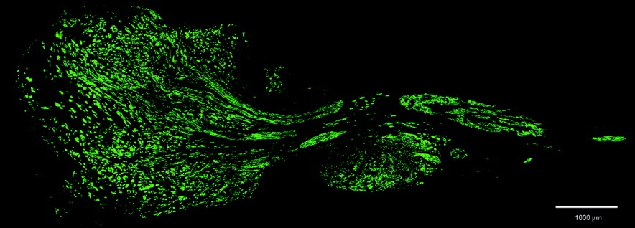
Neuromas and Nav1.7 and 1.8
Nav1.7 and Nav1.8 accumulate in human painful neuromas. Control human tissue low levels of Nav1.7 and Nav1.8
Black et al. Ann Neurol 2008

Slide 37
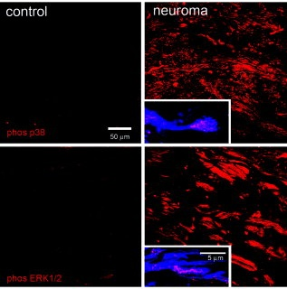
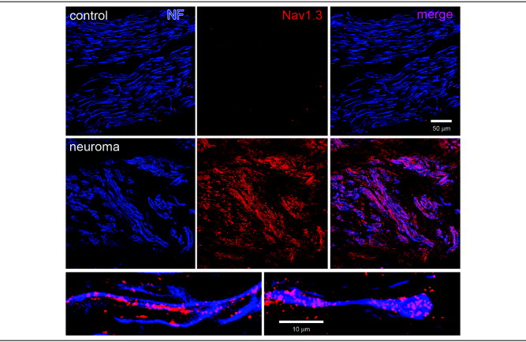
Neuromas and MAP kinases
Neuromas and Nav1.3
Painful neuromas increased immunolabeling of MAP kinases p38 and ERK1/2 compared with control tissue (insets)
Sodium channel Nav1.3 accumulates in painful neuromas. Control human tissue low levels of Nav1.3 immunolabeling Reactivity(red) compared with control tissue.
Black et al. Ann Neurol 2008

Slide 38



Heterogenous response to
systemic lidocaine
Pain before and after neuroma removal
wind-up pain after lidocaine or placebo
B
F
A
Pain (NRS, 0-10)
E
C
% changeof pain
D
A B C D F
Nikolajsen et al. 2010

Slide 39
Caveats in targeting sodium channels
Actions at other sites than the periphery
Narrow therapeutic window

Slide 40
Asessment of efficacy and safety
Number Needed to Treat: NNT
Number Needed to Harm: NNH
1
NNT =
(NPT_{act}/TOT_{act}) - (NPT_{plac}/TOT_{plac})
NNH: number of patients needed to treat with drug before one safety event occurs:
1. drop out due to side effect
2. specific events
3. any event
80
NNT
20
60
Active
15
40
NNT
10
Patients achieving endpoint (%)
Placebo
20
5
0
0
0
20
40
60
80
100
Endpoint (Pain relief %)

Slide 41
Painful polyneuropathy: NNT and NNH
NNT/NNH ratio
TCA
Oxycodone
Tramadol
Pregabalin
SNRI
Oxcarbazep
Memantine
SSRI
Topiramate
Dextrometh
0
2
4
6
8
10
12
NNT
TCA
Oxycodone
Tramadol
NNT/NNH
Drug Preference
Z > Ref = Y < X
Pregabalin
1.0
SNRI
Oxcarbacepine
0.5
Memantine
SSRI
0
Topiramate
Drug X
Drug Y
Drug Z
Ref
0
5
10
15
20
25
30
35
Finnerup et al. 2010 and unpubl obs
NNH

Slide 42
How should we move forward ?

Slide 43
Hierarchical examination for DN
MNSI
BPI
DN4
DN+screen
No DN
DN±Pain
DN±NP
Pain
State
N=7000
DN verified
No DN
DN ± Pain
DN ± NP
Level 1:
MNSI score, BPNS, ENG, TNS, Clin exam.,BAI
Mechanism
N=700
Examinations of diabetic patients :
MNSI= Michigan Neuropathy Screening Instrument; BPI= Brief Pain Inventory;
BAI = Brachial -Ankle index
BPNS= Brief Peripheral Neuropathy Screen;
DN4 = Neuropathic pain screen;
ENG= Electro-neurography;
LFN= Large Fiber Neuropathy,
SFN= Small Fiber Neuropathy;
VDT= vibration detection threshold;
PPD= pinprick detection;
CCM= Cornea Confocal Microscopy,
TT= Threshold Tracking;
CDM = Capillary Dysfunction Measure;
NFD= Nerve Fiber Density
Level 2:
LFN (VDT)
SFN (Cold/heat/PPD
QST, CCM)
DN ± LFN
DN ± SFN
DN ± Pain
DN ± NP
Target
DN ± NP ±
Physiol,
molecular
structural
Level 3:
NFD, CDM,
Metabolomics, TT MRI, Muscle etc.
N=70
Rx
Rx
Vardeh et al. 2016

Slide 44











Classification of Diabetic neuropathy:
Demographics, Duration of neuropathy/pain
Body maps
Utah Neuropathy Early Assessment scale
BPI, DN4, NPSI
Z-Score
4
3
Gain of
function
2
ENG peroneal, tibial, ulnar , median
1
0
-1
-2
Loss of
function
-3
QST parameter
QST, Skin Punch Biopsy
-4
TSL
MP
CDT
HDT
CPT
HPT
PPT
WUR
MDT
VDT
LAB test, DNA
Brachial-Ankle Index
Baroreflex events
Threshold tracking, Autonomic measures
Δmean RR
ΔSBP

Slide 45






Acknowledgement

