Slide 1
Evaluating and Enhancing Adherence to Medications
Bernard Vrijens, PhD
Chief Science Officer, MWV Healthcare
Associate Professor of Biostatistics
University of Liège, Belgium

Slide 2
Adherence is key to therapeutic success
Adherence to Medications
Effective
Disease
Management
Effective
Therapies
“Drugs don’t work in patients
who do not take them.”
– C. Everett Koop, former US Surgeon General
2

Slide 3
Medication adherence
The process by which patients take their medications as prescribed
❶ Initiate
❷ Implement
❸ Persist
time
Patient does
not initiate treament
Binary (yes/no)
Patient delays, omits or takes extra doses
Dosing history
Patient discontinues treatment
Time to event
EU Commission-sponsored research
Vrijens et al. Br J Clin Pharmacol 2012;73:691-705.
3

Slide 4

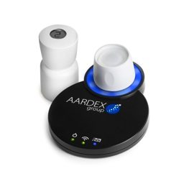
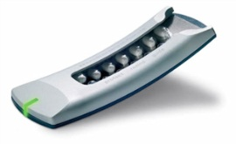

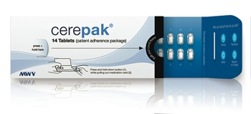

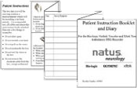
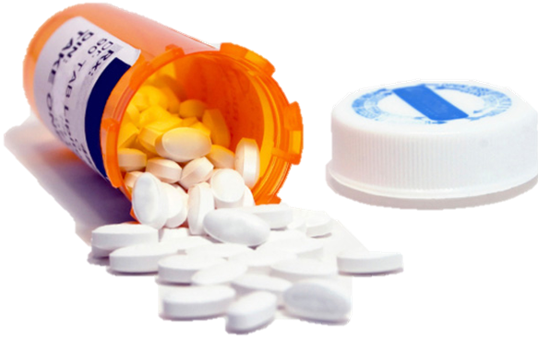



Adherence Measurement Methods
Reliable Method
Therapeutic
drug monitoring
Pharmacy refill data
Automatic compilation of dosing history data
Sparse Sampling
Rich Sampling
Retrospective
questionnaire
Pill Counts
Patient diary
Biased Method
Modified from Vrijens & Urquhart, 2005 Journal of Antimicrobial Chemotherapy.

Slide 5
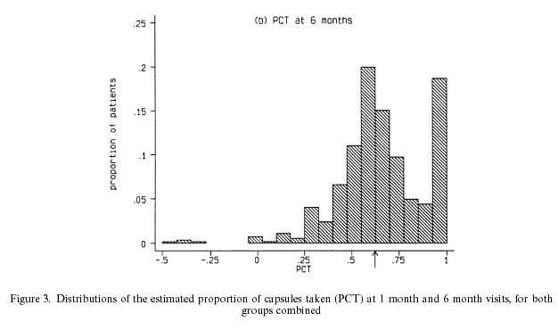
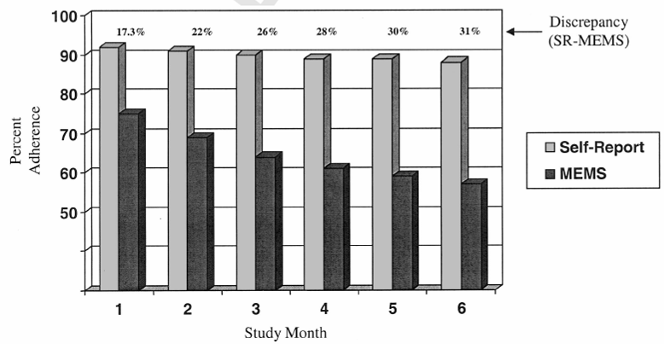
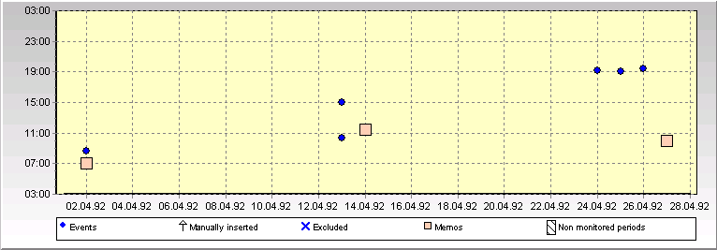
Pre-electronic methods are unreliable
Pill Counts Overestimate Adherence⁽¹⁾
Self Reports Overestimate Adherence⁽³⁾
EM-measured adherence correlates best with clinical outcomes (viral load)
Patients were given 160% drug supply
‘White Coat Compliance’ Limits the Reliability of Therapeutic Drug Monitoring in HIV-1 Infected Patients⁽²⁾
Diagnosing Potential Noncompliance. Physicians’ ability in a Behavioral Dimension of Medical Care⁽⁴⁾
Predict only 35% of the nonadherers
Half of their predictions of nonadherence were incorrect
Bias in 31% of the samples clustered in 66% of the subjects
No better than a coin toss!
(1) Pocock & Abdalla, Stat in Med, 1998.
(2) Podsadecki et al, HIV Clin Trials 2008;9(4):238-246.
(3) Levine et al; 2006; Health Psychology.
(4) Mushlin, Arch Intern Med. 1977;137(3):318-321.
5

Slide 6
Ideal Adherence: The Goal But Rarely the Reality
Patients who adhere to dosing regimens are optimally
exposed to the drug
v
~12 hours interdose interval
Electronically Compiled Dosing History Data
Vrijens,, Urquhart, White, 2014, Expert Rev Clin Pharmacol; 7(5):633-44
Notes:
6
Getting patients to comply with their dosing regimen means they will be optimally exposed to the trial drug, giving you insight into the drug’s full efficacy. However, patients like these are the ideal – they do not represent typical subject behaviour.

Slide 7
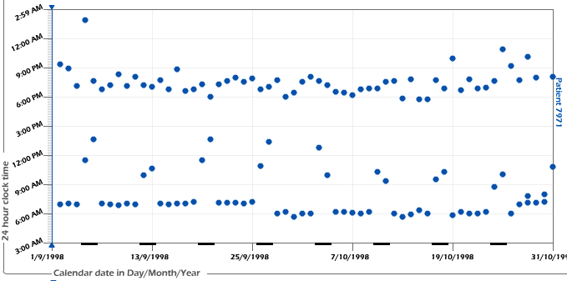
A Patient with Delayed Morning
Intake During Weekends
Vrijens,, Urquhart, White, 2014, Expert Rev Clin Pharmacol; 7(5):633-44
7

Slide 8
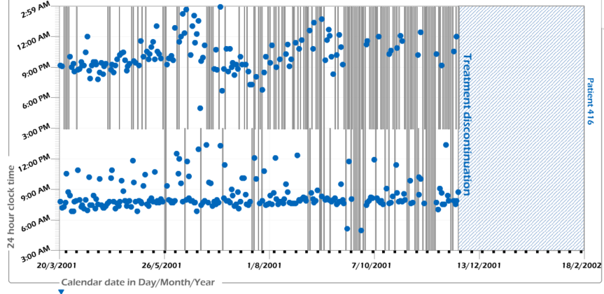
Worsening Regimen Execution,
Then Complete Discontinuation
MWV adherence knowledge centre, HIV patients, BID dosing regimen.
8
Notes:
8

Slide 9
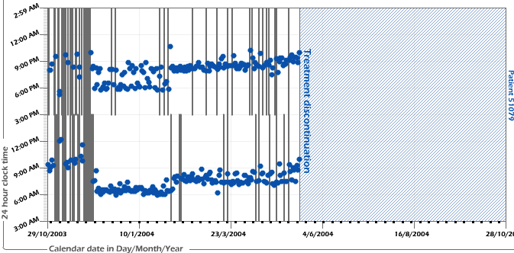
Short Persistence (5 Months)
MWV adherence knowledge centre, HIV patients, BID dosing regimen.
9

Slide 10
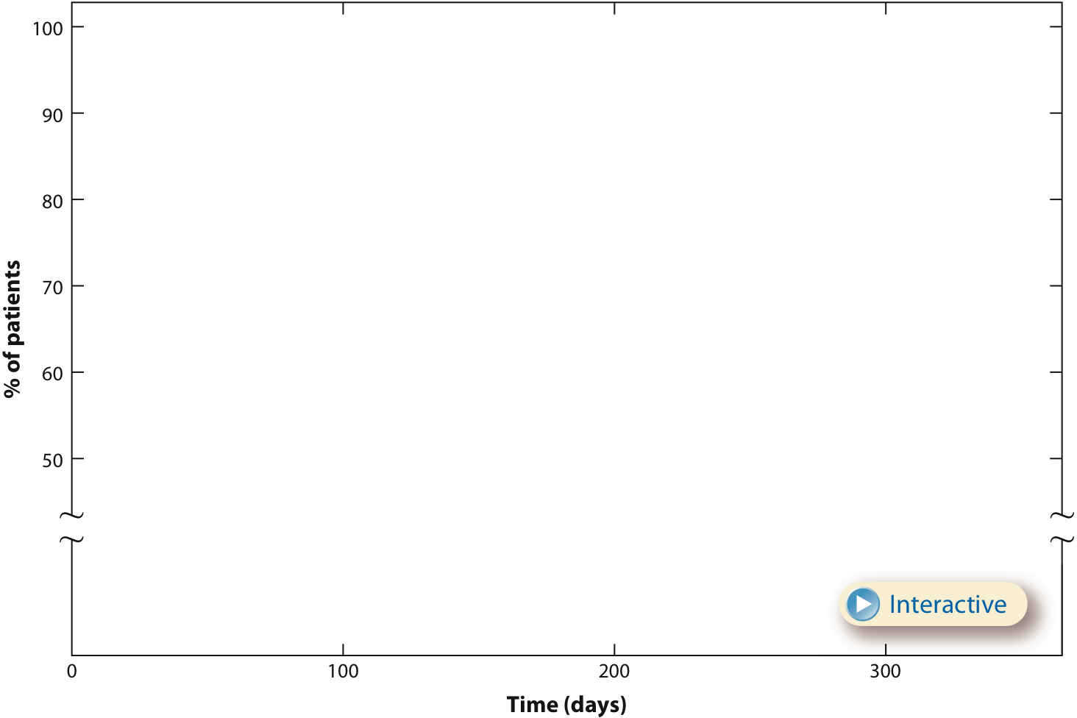
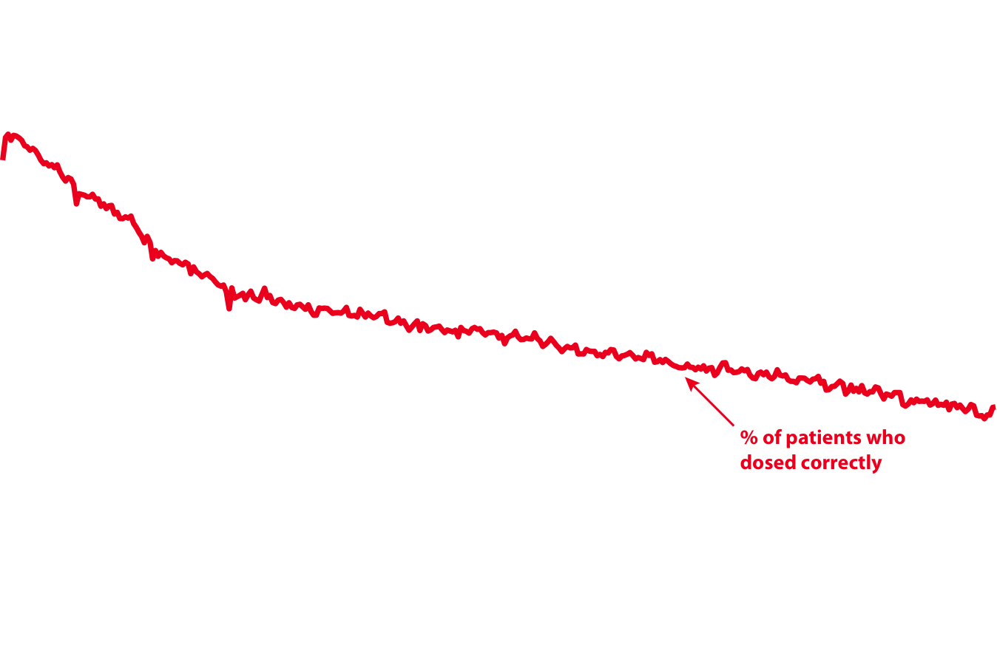
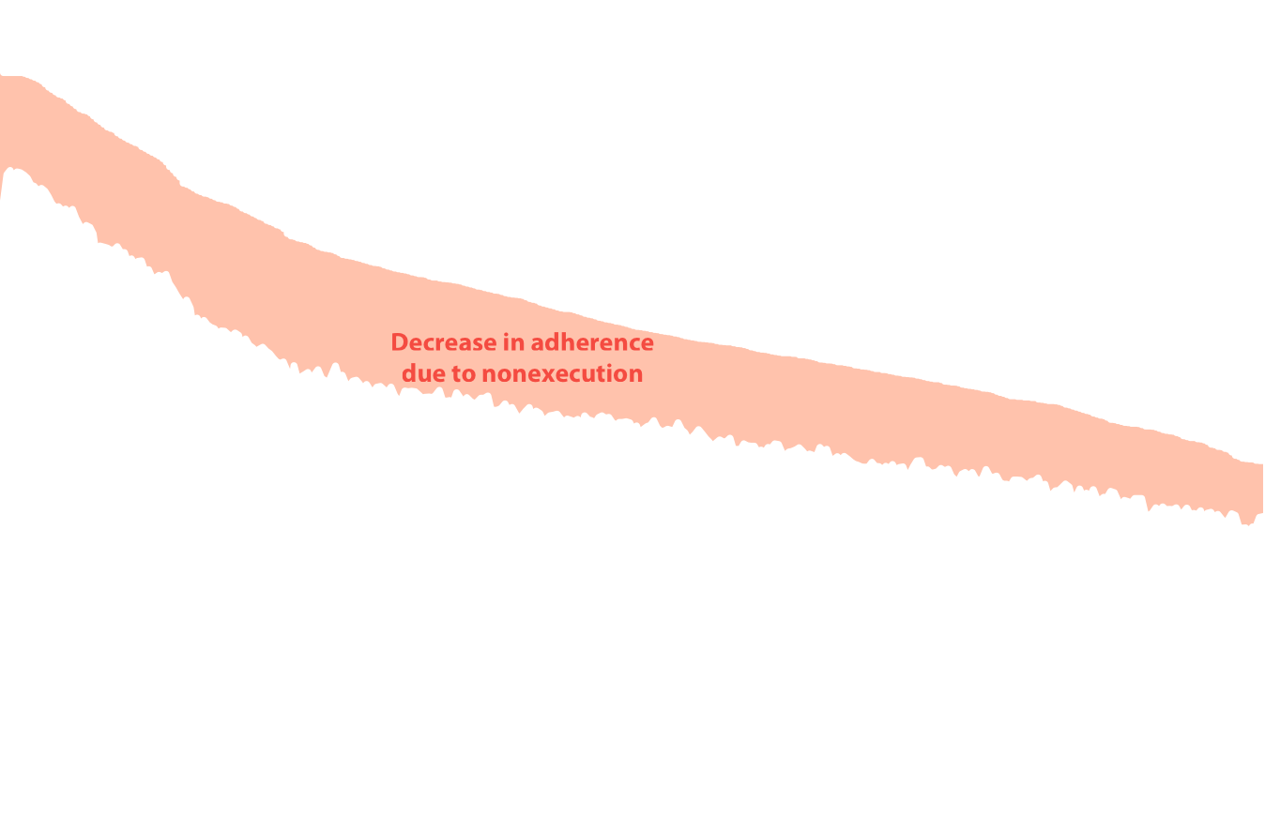
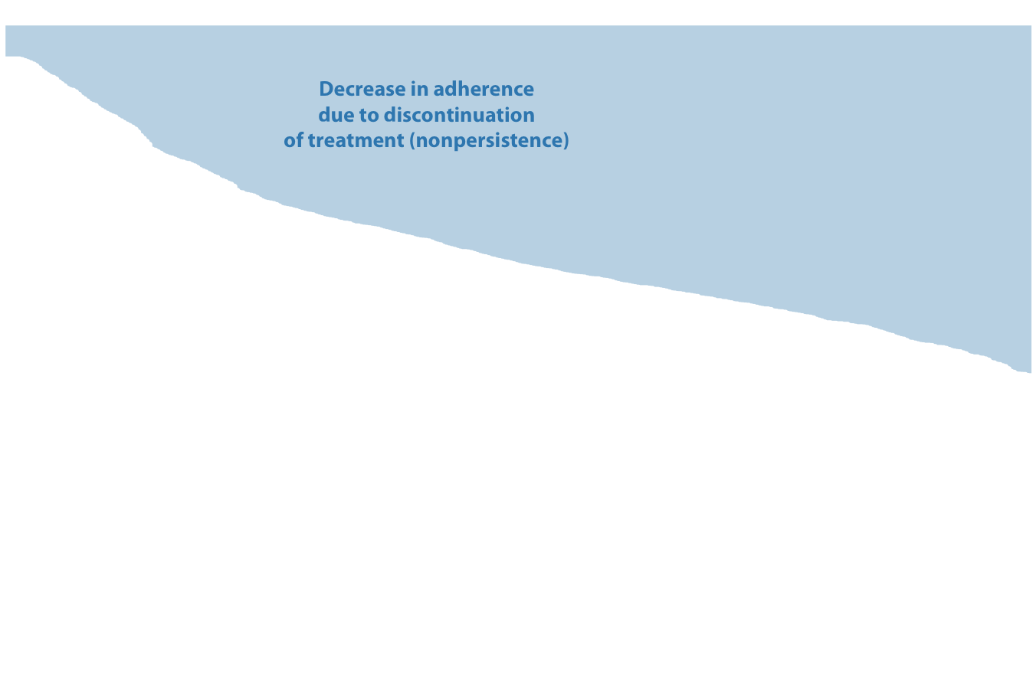
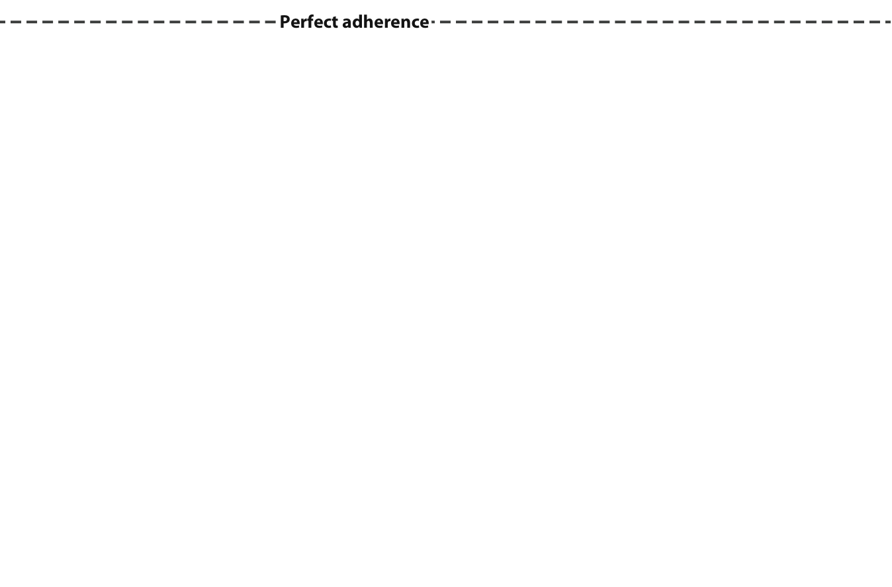
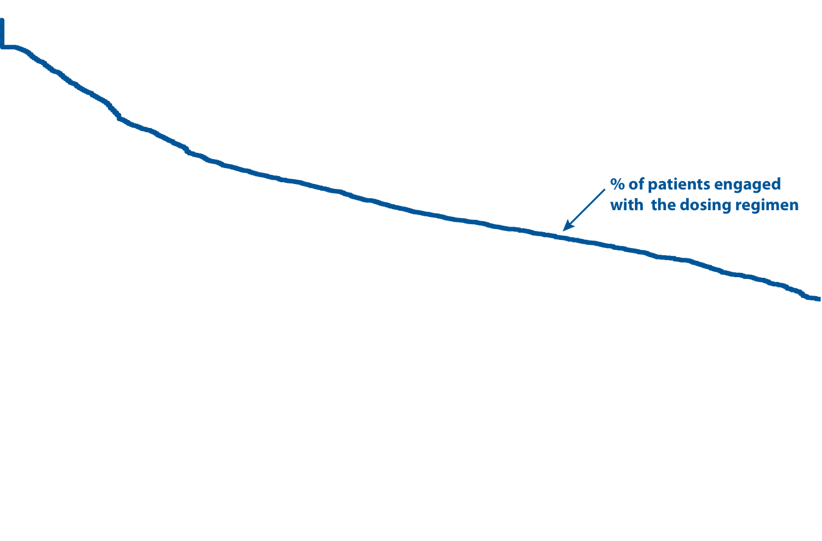
Extent of Non-Adherence in Clinical Trials
16,907 participants from 95 clinical studies
Persistence
Adherence
Blaschke, Osterberg, Vrijens, Urquhart, Annual Review, 2012.
10

Slide 11
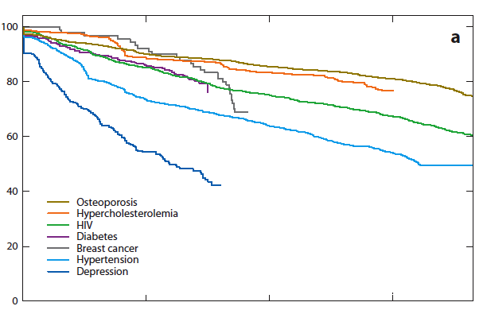

Persistence:
Time to Treatment Discontinuation
Overall, 40%
of patients
will have
discontinued
the prescribed
drug after
12 months
Blaschke, Osterberg, Vrijens, Urquhart, Annual Review, 2012.
11

Slide 12

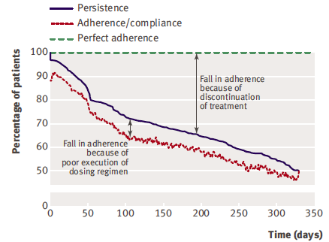
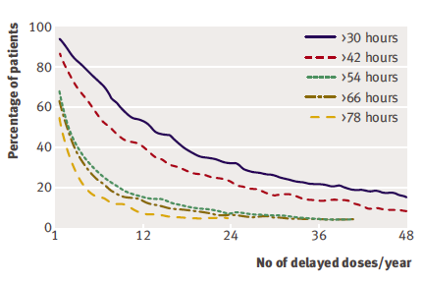
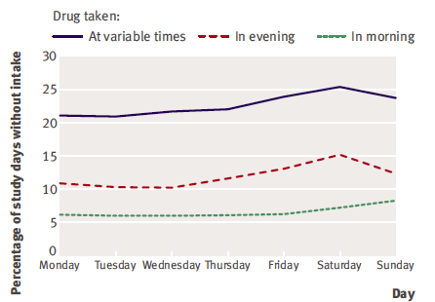
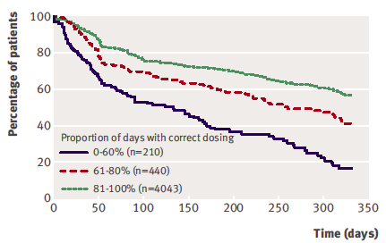
Hypertension
Adherence to prescribed antihypertensive drug treatments: longitudinal study of electronically compiled dosing histories
N=4783 patients from 21 clinical studies
Vrijens et al., BMJ. 2008 May 17;336(7653):1114-7.
12
Vrijens et al., BMJ. 2008 May 17;336(7653):1114-7.

Slide 13
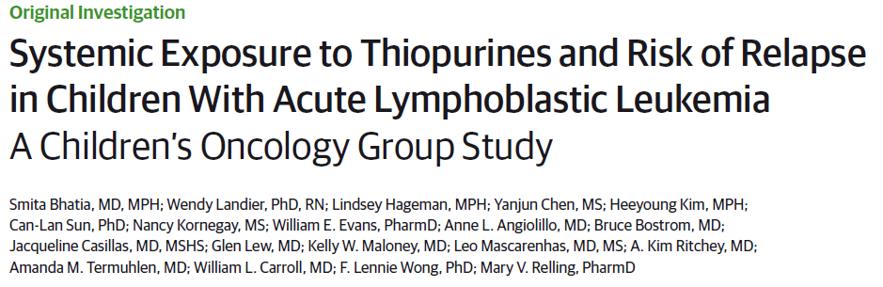
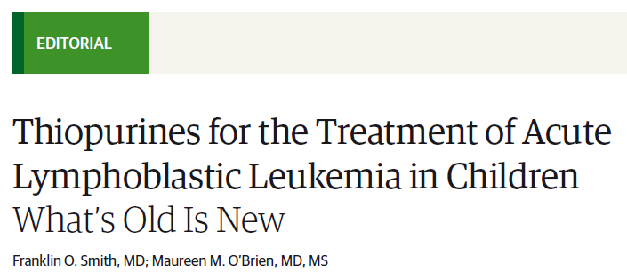
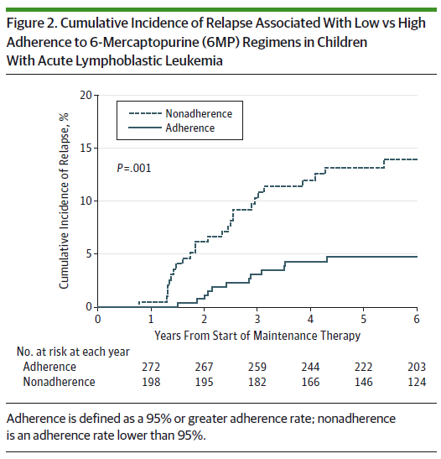
Does Adherence Really Matter –
Even in Serious Conditions?
One of the most striking findings of this study is that among
children who were adherent to the 6MP regimen, those with
high intra-individual variability in TGN levels had a significant
risk of relapse (hazard ratio, 4.4; P = .02).
…. this study raises the provocative question of
whether frequent dose adjustments during maintenance
therapy, with resultant variable TGN levels, may be counterproductive in adherent patients.
This study clearly demonstrates that even after 63 years of use and study on numerous prospective clinical trials, there is still an opportunity to improve how we use this old but highly effective and important drug.
…. we must not lose sight of the fact that precision medicine
also applies to optimizing known effective therapy.

Slide 14
The Adherence Gap
Method effectiveness (efficacy)
Potential consequences
of this gap:
  Risk of failure related
  to lack of effectiveness
  Poor estimation of toxicity
  Inappropriate dosing
  regimen
  Lost revenue/share
Suboptimal adherence
Outcomes
Patient selection
Patient follow-up
Use
effectiveness
Phase I
Phase II
Phase III
Market
Drug development
Adherence Becoming a Regulatory Priority
Draft guidance from the US FDA explicitly addresses adherence strategies
http://www.fda.gov/Drugs/GuidanceComplianceRegulatoryInformation/Guidances/default.htm. Dec 2012
Blaschke, Osterberg, Vrijens, Urquhart. Annual Review, 2012.
14

Slide 15
Variable adherence is a major source of variance in drug response
Manufacturing and distribution
Prescribing
Dispensing
Adherence
PK
PD
Drug response
Harter JJ & Peck CC. Ann N Y Acad Sci 1991;618:563–71.
15

Slide 16
Consequences of medication non-adherence
❶ Initiate
❷ Implement
❸ Persist
time
Drugs don’t work in patients who do not initiate them
Drugs work partially or may create harm in patients who implement a dosing regimen sporadically
Drugs stop working in patients who discontinue them
Drug Forgiveness
16

Slide 17
The Concept of Drug Forgiveness
Or How Much Implementation is Enough?
Increased risk of toxicity
Concentration
24h
Periodic loss of effectiveness
0
1
2
3
4
5
6
7
8
9
10
11
12
13
14
15
Dosing time (Day)

Slide 18
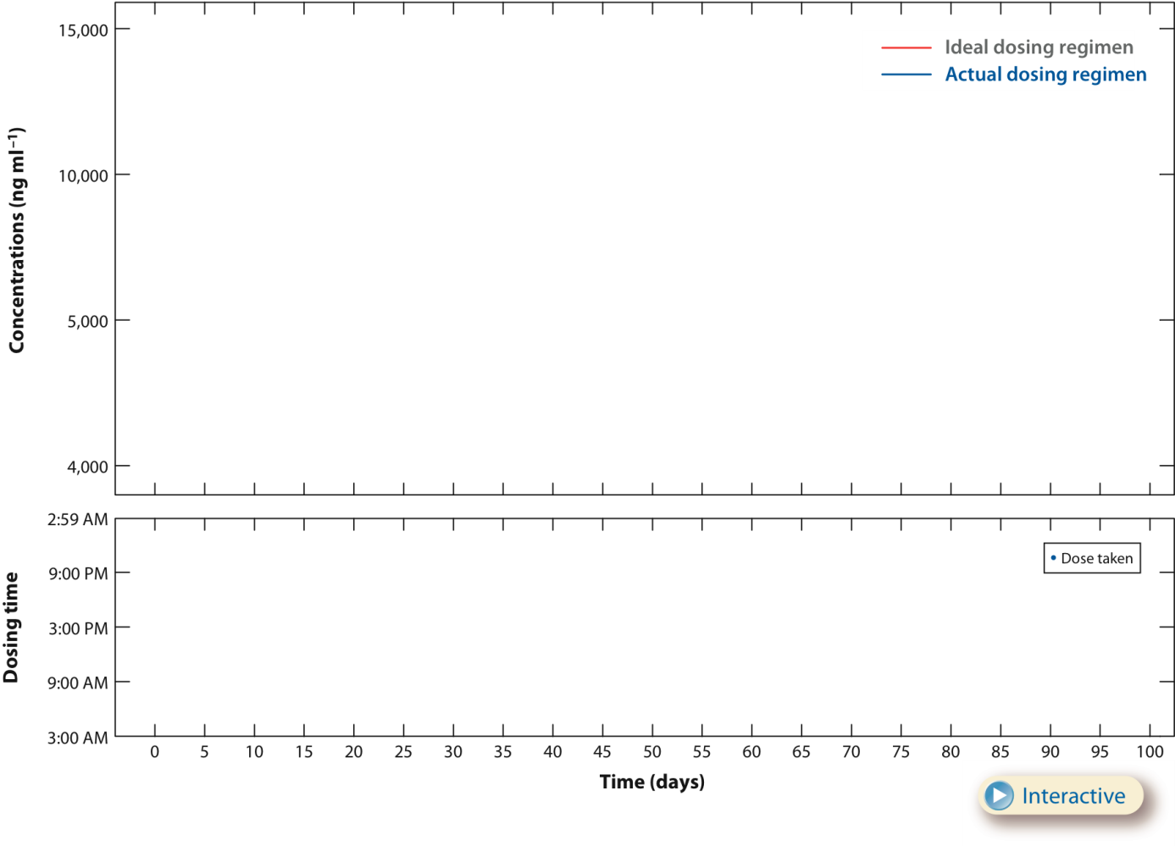
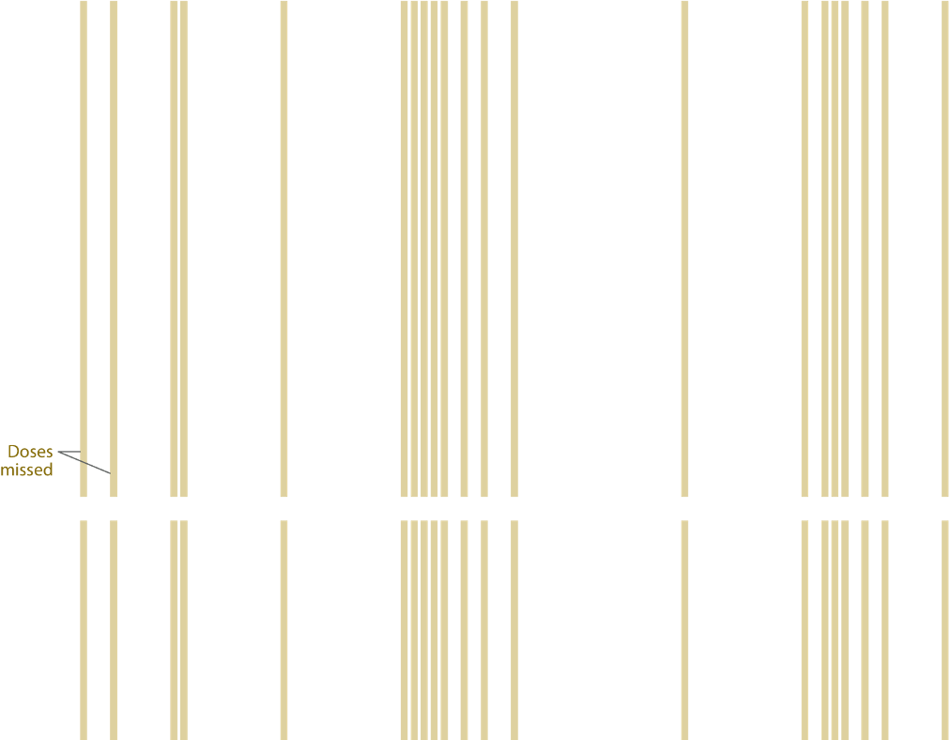
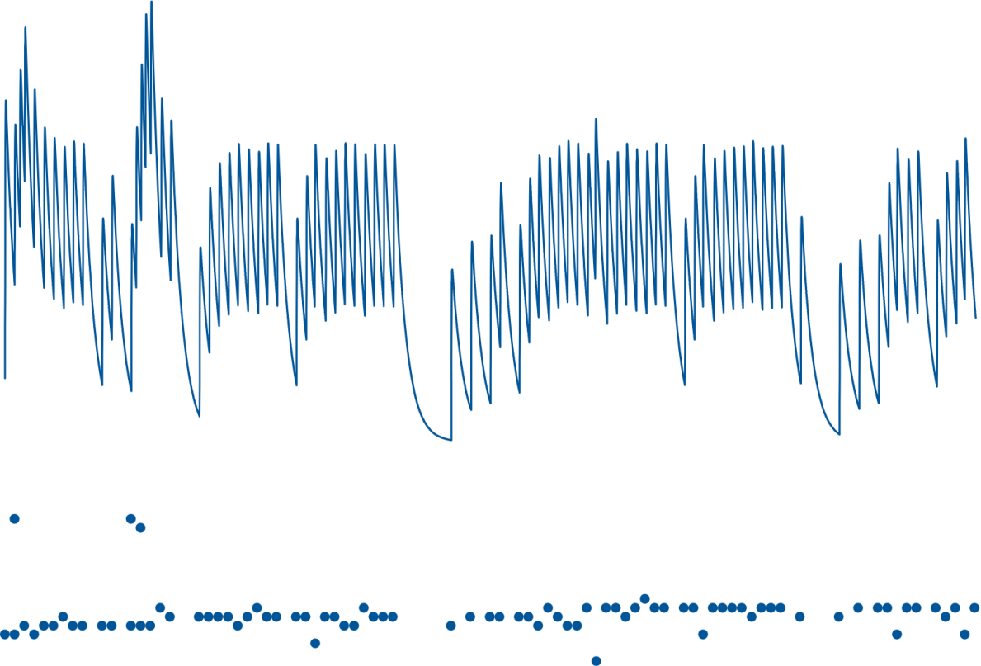

Variable Implementation Creates Drug-Specific Issues of Efficacy and Safety
Occasional toxicity
Periodic loss of effectiveness
Blaschke, Osterberg, Vrijens, Urquhart, 2012, Ann Rev Pharmacol Toxicol, 52:275-301

Slide 19
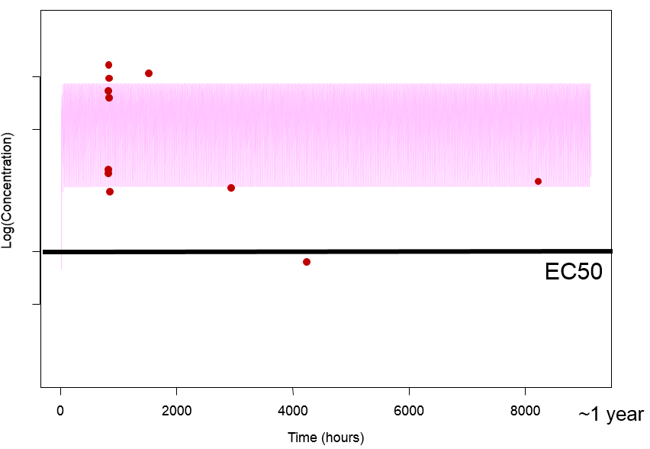
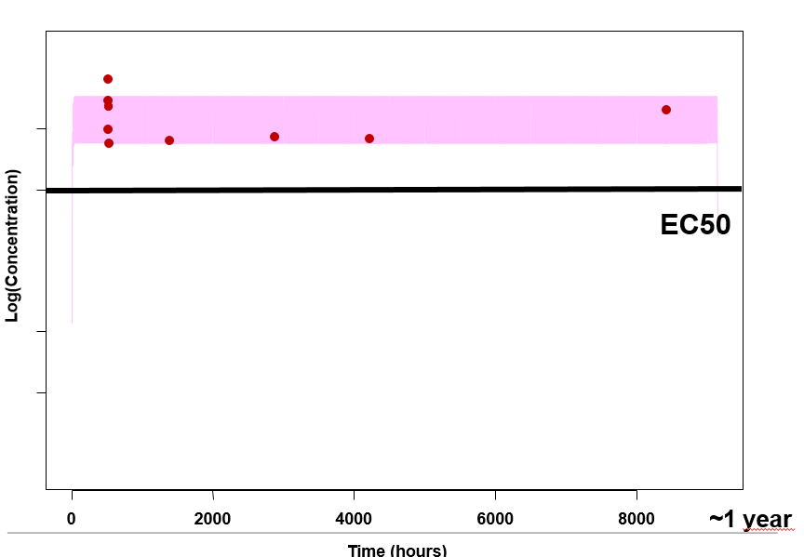
Two examples of long term PK projection based on electronic monitoring & the importance of rich sampling
<3% Discrepancies Between Projected and Observed Concentrations
Measured trough concentrations
Vrijens et al., J of Clinical Pharmacol, 2005, 45: 461-467
Vrijens & Urquhart, CPT, 2014
19

Slide 20
Insufficient Understanding of the Dose-Response Relationship
Placebo
Placebo
5 MG
7.5 MG
Twice daily
Cardiovascular example
Cumulative dosing

Slide 21
Adherence-Uninformed Clinical Development
Efficacy
Safety
Best Dosing Regimen?
Drug development
Market
Phase I
Phase II
Phase III
Compensate
for diluted
efficacy Unexpected ADR’s!
Formulation
Adherence?
PK/PD
Higest Safe Dose*
« Variability makes prediction unreliable »
Peck et al., JAMA, 1993

Slide 22

The Struthian Approach is
No Longer An Option!
Efficacy / Safety
Optimal dose
Forgiveness
Concentration of Drugs

Slide 23
Management of adherence:
A systems approach
Healthcare/Prescribing Policy
Community & Institutions
Providers &
Prescribers
Definition
“the process of monitoring and supporting patients’ adherence to medications by
healthcare systems, providers, patients and their social networks”
Objective
“to achieve the best use, by patients,
of appropriately prescribed medicines
in order to maximize the potential for benefit and minimize the risk of harm”
Family &
Carers
Patient
EU Commission-sponsored research
Vrijens et al. Br J Clin Pharmacol 2012;73:691-705.
23

Slide 24
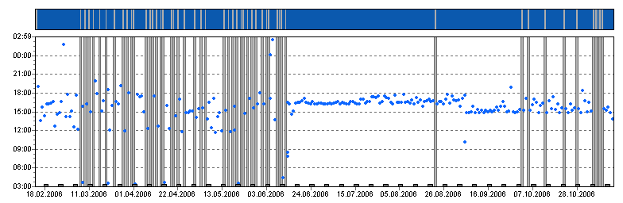
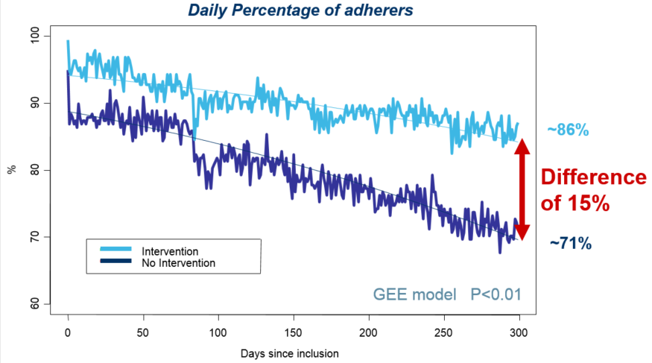
“What can be measured can be managed”
‒Deming, WE
Improved medication adherence
Example of a successful intervention
Focused discussion between healthcare provider and patient based on reliable and detailed adherence data
N=392 patients
Vrijens, et al., Pharmacoepidemiology and Drug Safety, 2006.
.
24

Slide 25
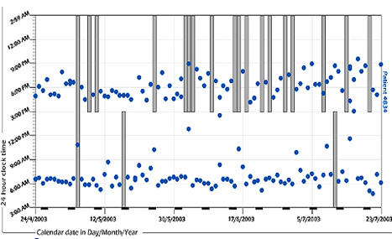
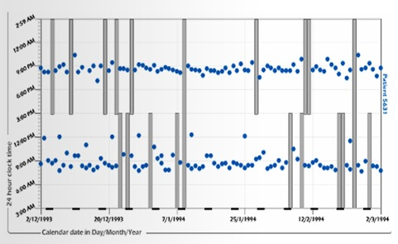
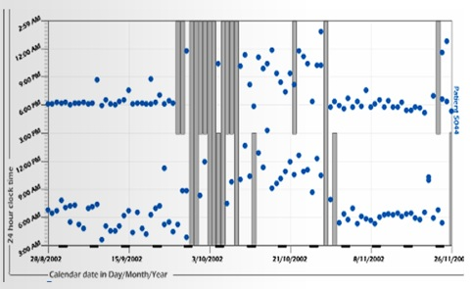
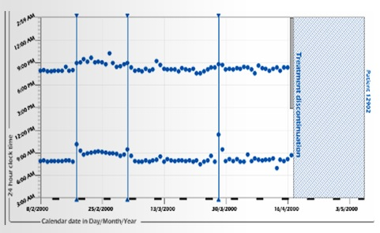
“What can be measured can be managed”
‒Deming, WE
Each of the 4 patients took 75% of prescribed doses
during a 3-month period
Problem with
evening dose
Sporadic
dosing
Drug
holiday
Early
discontinuation
Vrijens,, Urquhart, White, 2014, Expert Rev Clin Pharmacol; 7(5):633-44.
.
25

Slide 26
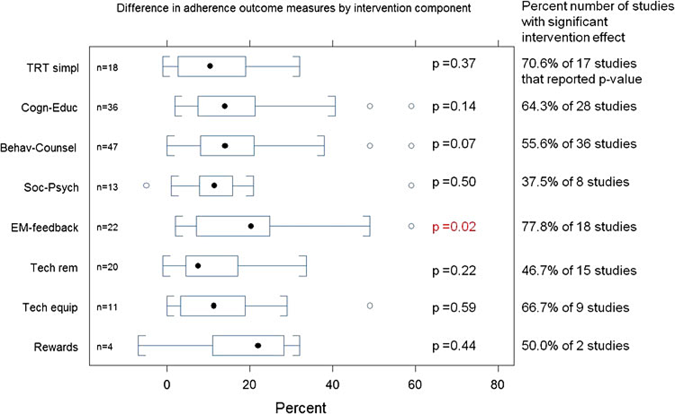
Patients’ awareness of their adherence patterns changes behavior
EU Commission-sponsored study shows this
is the biggest factor influencing adherence
Showing patients their own dosing errors is the most effective means to improve adherence
20%
EU Commission-sponsored research
Demonceau et al, Drugs; April 2013.
26

Slide 27
Elements to change patients’ behavior
Training
EDUCATION
knowledge
MOTIVATION
self-efficacy
MANAGEMENT
OF
ADHERENCE
Package
Goals
MEASUREMENT
awareness
Vrijens,, Urquhart, White, 2014, Expert Rev Clin Pharmacol; 7(5):633-44.
27

Slide 28
Overview of assessment methods of adherence in ambulatory patients
❶ Initiate
❷ Implement
❸ Persist
time
Direct methods (PK/PD)
Requires sampling after prescription
Sampling is too sparse
Subject to white coat adherence
Desirability bias
Recall bias
Desirability bias
Self-report
Easily censored by patient
Only aggregate summary
Easily censored by patient
Pill counts
Prescription & refill databases
Gold standard if both databases combined
Only aggregate summary
Gold standard but retrospective
Gold standard in CT; needs activation
Gold standard
Gold standard in CT; needs patient engagement
Electronic monitoring
Vrijens & Heidbuchel, Europace 2015.
28

Slide 29
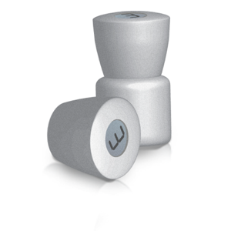
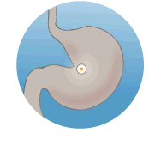
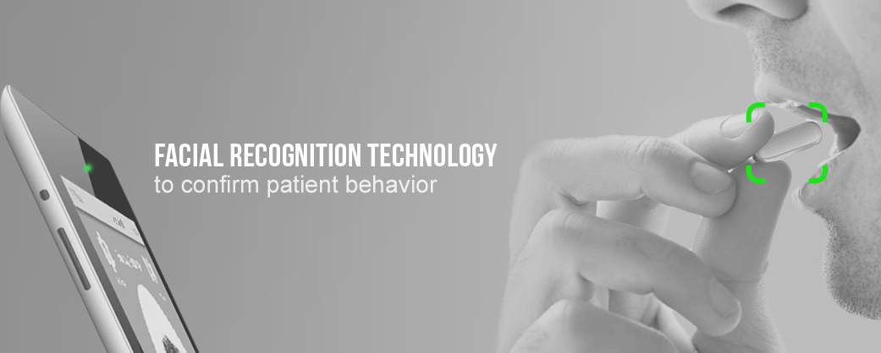

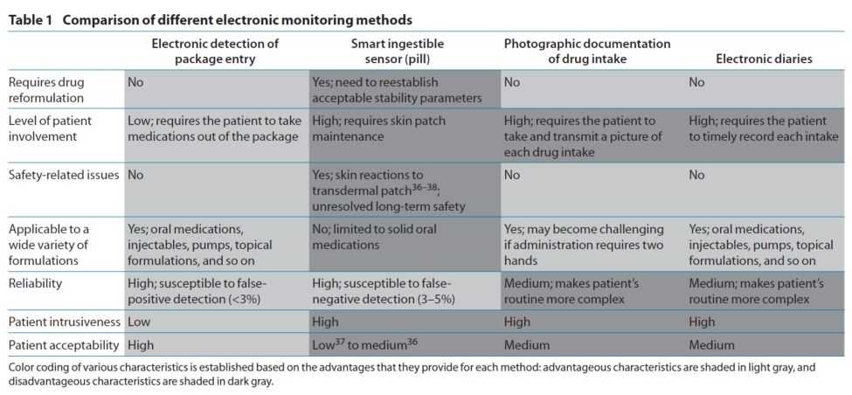
Comparison of Different Electronic Methods
« Smart Package »
« Pills in Hand »
Vrijens & Urquhart, 2014, CPT

Slide 30
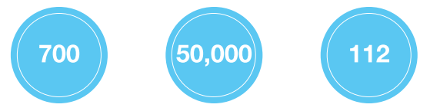
Bibliometry of Medication Event Monitoring System
As of the end of 2014:
676 papers published in peer-reviewed journals
Those papers have been cited > 47000 times
1 in 7 have been cited over 100 times
The most-cited of these papers has 2799 citations
h-index of 108
MEMS BIBIOMETRY
June 2015, Google Scholar
peer-reviewed publications
journal citations
h-index

Slide 31
Opportunities of adherence-informed clinical trials
Time Savings
  Better informed benefit/risk & developmental decisions
  Shorter time to set the optimal regimen
Cost Savings
  Greater efficacy & lower variability (increase power/decrease sample size)
  Fewer post-approval dose reductions
Improved Therapies
  More informative safety
  More effective dosing regimens

Slide 32

Thank You for Your Attention
Questions?
19th ESPACOMP meeting will be held In Prague, Czech Republic, on the 13th and 14th November 2015
www.ESPACOMP.eu

