Slide 1
Data quality issues in the design and analysis of clinical trials: an FDA perspective
Paul Schuette, PhD
Scientific Computing Coordinator
Office of Biostatistics
FDA/CDER/OTS

Slide 2
Disclaimer
This presentation reflects the views of the author and should not be construed to represent FDA’s views or policies.

Slide 3
Outline
Quality for data and analysis
Reviewer Experiences
Monitoring and data anomaly detection
Conclusions

Slide 4
Data Quality
We cannot inspect our way to data quality.
According to William Edwards Deming:
“Eliminate the need for inspection on a mass basis by building quality into the product in the first place.”
“Monitoring, or oversight, alone cannot ensure quality. Rather, quality is an overarching objective that must be built into the clinical trial enterprise. FDA recommends a quality risk management approach to clinical trials…”
(Oversight of Clinical Investigations — A Risk-Based Approach to Monitoring, 2013, page 2)

Slide 5
Building Quality into Clinical Trials
FDA has embraced the Quality by Design (QbD) paradigm.
FDA Guidance Q8(R2) Pharmaceutical Development
Good x Practice (GxP): GCP, GMP, GPvP, GLP
CDISC Data Standards (SDTM, ADaM, SEND)
CDISC Therapeutic Area Standard for Pain (version 1, SDTM)
Prespecified Statistical Analysis Plan

Slide 6
Statistical Quality Concerns
Missing Data. (NAS report, EMA report, FDA guidance in development) Do the study design and study conduct minimize missing data? How do the protocol and SAP propose dealing with the analysis of missing data?
Patient Reported Outcomes (PROs).
  2009 Guidance
  Choice of Instrument, version number, scoring algorithm, etc.
  Verification, Validation and Uncertainty Quantification (VVUQ)

Slide 7
Data Quality and the FDA Submission Process
In CDER, sponsors submit an application to EDR (Electronic Documents Room) staff.
Review teams must determine whether the submission is fileable (Day 30, priority or Day 45, regular) (rudimentary checks)
Reviewers can request Jumpstart service for CDISC (SDTM) data compliance checks
Office of Scientific Investigation inspections (small proportion of sites)
Data quality issues can emerge throughout the review process

Slide 8
Reviewer Experiences
A reviewer reported an incident in which several members of the same family were all enrolled in a pain medication trial on a Friday evening. A number of other questionable practices were found to have occurred at this site, which was the largest site in the trial.
Result: OSI was concerned with validity of data from the site. FDA excluded the entire trial from analyses. Sponsor must submit new studies for approval.

Slide 9
More Reviewer Experiences
Another reviewer reported that a sponsor misclassified rescue medications as concomitant medication, affecting both CM and DS domains. This misclassification significantly changed the efficacy evaluation of the product.
Observation: standards need to be employed correctly to be effective.

Slide 10
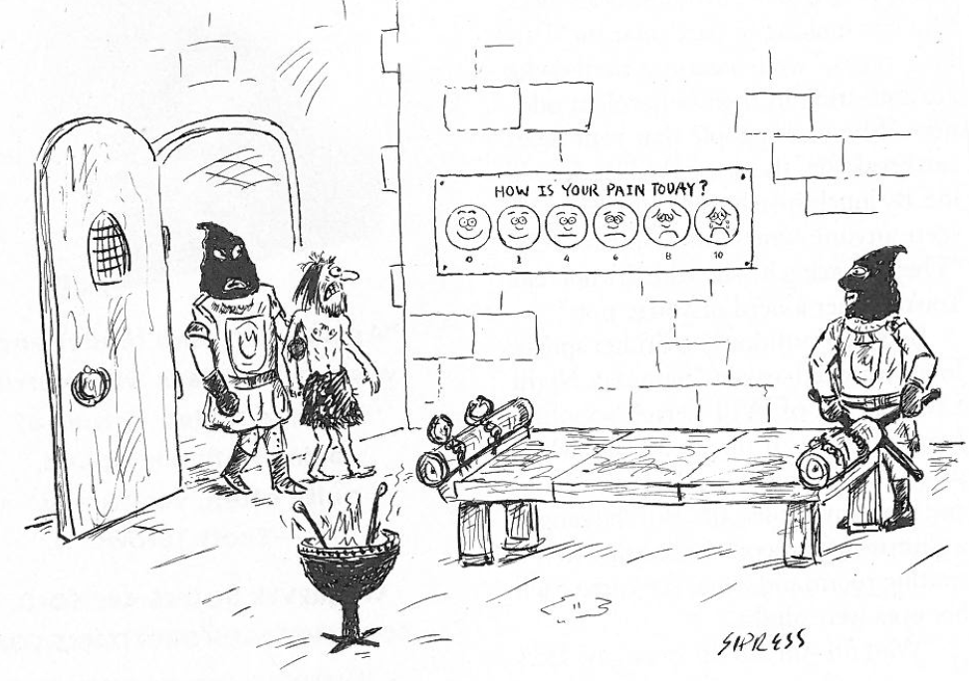
PRO Challenges

Slide 11
PRO Challenges
Instrument validation
Pediatric versus adult scales
Observer reported outcomes
Variability of individual outcomes over time (Subject Training, Instrument Reliability)
Missing values

Slide 12
Rescue Medication
The use of rescue medications for breakthrough pain in both acute and chronic pain trials poses a challenge for efficacy analyses.
Opioids misclassified as concomitant medications, rather than as rescue medications.
Issues with integrating results across trials.

Slide 13
Other issues
Incorrectly coded AEs.
Correctly ascertaining and recording reason for withdrawal.
Lab values (investigator “error”)
Missing Values
Need for better tools to discover misconduct and errors.

Slide 14
Monitoring
Two Basic Types:
On-site Monitoring (traditional approach)
Centralized Monitoring (remote evaluation)
FDA 2013 Guidance: Oversight of Clinical Investigations- A Risk-Based Approach to Monitoring
Recognition that on-site monitoring is time consuming, expensive, and not always necessary

Slide 15
Centralized Monitoring
“FDA encourages greater use of centralized monitoring practices, where appropriate, than has been the case historically, with correspondingly less emphasis on on-site monitoring.” page 7, 2013 FDA Guidance
Centralized Monitoring can be an important component of a risk based monitoring plan.

Slide 16
Risk Based Monitoring
See Guidance for detail.
Identify Critical Data and Processes
Risk Assessment
Consider Risk Factors
Develop Plan (still need some on site monitoring)

Slide 17
Statistics and Central Monitoring
Statistical methods can be an important component of central monitoring.
Distribution of data, too much variation, too little variation, outlier, inlier detection
Results “too good to be true.”
Calendar dates
Examine differences between and within sites
Data anomaly detection
Integrate results for users.

Slide 18
FDA Initiatives
Working with companies to bring commercial software into FDA for evaluation, research and development of “data anomaly” detection.
  High Performance Computing
  Improved statistical methods
Improve existing OSI site selection tool
Potential for Janus Clinical Trials Repository (CTR)

Slide 19
Conclusions
Making progress, but there is room for improvement.
Can we better articulate “Good Clinical Trial Practices?” “Good Data Practices?”
On site and centralized monitoring are complementary (not mutually exclusive) approaches.
Need to develop and implement better tools for data anomaly detection.
Notes:
Design, Planning (including training), Implementation, Data Collection, Data Coding, and Data analysis.

Slide 20
References and Thanks
FDA Guidances:
Analgesic Indications: Developing Drug and Biological Products (2014)
Oversight of Clinical Investigations — A Risk-Based Approach to Monitoring (2013)
Q8(R2) Pharmaceutical Development (2009)
Patient-Reported Outcome Measures: Use in Medical Product Development to Support Labeling Claims (2009)
The Prevention and Treatment of Missing Data in Clinical Trials, National Academy of Sciences, 2010
Thanks to the DBII Analgesics Review Team:
Freda Cooner, Feng Li, Kate Meaker, James Travis, Yan Zhou and also to Scott Komo (PROs).

