Slide 1
Clinical Trial Quality
Nathaniel Katz, MD, MS
Analgesic Solutions, Natick, MA
Tufts University School of Medicine, Boston, MA
IMMPACT-XVIII Washington, dc June 4-5, 2015
Notes:
Good morning everyone.
In this presentation I will attempt to present an overall approach to conceptualizing what clinical trial quality is, and how it can be achieved.
My hope is that this overview provides a scaffolding on which can rest the specific topics that will be addressed by subsequent speakers.

Slide 2
Regulatory vs. Scientific Quality
Principles of experimentation
Definitions
Science of clinical study conduct
Manufacturing quality
Quality
Regulatory
Quality
Scientific
Quality
Notes:
My first proposition to you is that quality, which should in principle have something to do with whether a clinical trial can produce what it is intended to produce, has become fractionated into two different components. CLICK
The first component is REGULATORY QUALITY, which basically means “are you following the rules.”
By rules I’m referring to GCP, ICH, and all the other sets of standards one has to follow to stay out of trouble. CLICK
The second component is SCIENTIFIC QUALITY, which basically means “is the trial set up in a way that it can achieve its scientific goals.”
The irony here is that one would think that the rules of regulatory quality would be designed to achieve scientific quality, and maybe they would be the same, but they aren’t. More on that in a minute. CLICK
During this morning’s presentation I will try to bring in insights from fundamental principles of experimentation, a few definitions, some output from the emerging science of clinical study conduct that a number of us have been laboring in, and manufacturing quality control, to point the way to a concept of scientific clinical trial quality.

Slide 3
A Recent Quality Audit
Rating | Finding
Critical | Inadequate security system in facility
Critical | SOPs 2 days out of date Handwritten notes found on some SOPs
Critical | No independent Quality Assurance department Missing independent vendor audits
Critical | Certain protocol versions in TMF lacking signatures One version of the ICF missing from TMF CRF approval form missing a signature
Critical | Section 10.4 of TMF referred to section 10.4 instead of 10.3 A CV was 2 weeks beyond update window
Critical | Inconsistency between Site Submission Form and Delegation of Authority Log
Notes:
First, let’s dive into a real-life example of a recent so-called “quality audit.”
We audit a lot of vendors now, and we ourselves are frequently audited, so I have access to these types of documents these days. I won’t say who did the audit or who was audited.
On this slide I have listed all the audit findings marked “critical” by the auditor.
The first critical finding was the facility had an inadequate security system in place. We would all agree that’s a problem. However, let’s ask ourselves a question: how closely related is the facility’s security system to the ability of the study to accurately measure the effect of treatment? I think we would all agree that at best the relationship is very weak.
The second “critical finding” is that the organization’s SOPs were 2 days out of date. Again, we would all agree that SOPs are important and should have been renewed before they expired, which basically means getting a bunch of signatures. Again, how closely related is that to the ability of the trial to measure the effect of treatment? Not very close.
Going through the rest of the list one gets the distinct impression that this auditor – who I assure you represents an army of similar auditors out there mobilized on a mass scale, are checking important things, but not things that have a very close relationship to the ability of a study to measure the effect of treatment.

Slide 4
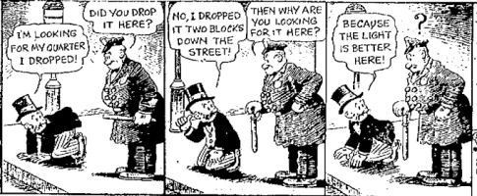
Current quality approaches measure what’s easy, not what’s most relevant, to clinical trial quality
Bud Fisher, Mutt and Jeff comic strip, June 3, 1942
Notes:
This state of affairs compels to mind the parable of the drunk looking for his keys under the street lamp, rather than where he dropped it, because the light is better. (READ CARTOON) It may interest you that the first popular rendition of this story is in this Mutt and Jeff cartoon from 1942, although you can find earlier versions also.
Clinical trial quality, the way we do it now, is basically a regulatory exercise that checks what is easy to check, although it doesn’t have much to do with whether a trial can accomplish its intended purpose.

Slide 5
What is quality?
Notes:
You may have noticed that I have been dancing around definitions of quality without attempting to precisely define it, so now may be a good time to attempt to introduce a definition.

Slide 6
Notes:
One of the better definitions I have come across is from this presentation by Leslie Ball, former director of the Office of Scientific Investigation at FDA, to the CTTI, in 2010. I highly recommend reviewing her whole presentation, which is available on the web.

Slide 7
Notes:
She defined quality as “the ability [of a clinical trial] to effectively and efficiently answer the intended question about the benefits and risks of a medical product” and of course we have the required proviso about protecting human subjects. So it’s about answering the scientific question. It’s interesting to note that she includes efficiency in her definition, and I strongly agree with that, but won’t speak to it further this morning.

Slide 8
What is the intended question of a clinical trial?
What is the magnitude of effect of treatment compared to placebo.
This is a measurement task.
A clinical trial can be considered a measurement system, designed to measure the magnitude of efficacy of a treatment.
Quality means minimizing sources of error that compromise the accuracy of measurement of treatment effect.
Notes:
So if quality is the ability of a trial to answer its intended question, what is its intended question?
Certainly clinical trials can be designed to answer lots of different questions. CLICK
For our intent today I will simplify things and indicate that the main question trials are intended to answer is what is the magnitude of effect of treatment compared to placebo – if the effect is significant enough, we say the treatment works and it gets approved and used. CLICK
What that means is that the fundamental purpose of a clinical trial is to generate an output in the form of a measurement of treatment effect. CLICK. A trial can therefore be viewed as a measurement system, like a pH meter or a spectrophotometer. CLICK
Quality, then, if we follow Leslie Ball’s definition, and recognize that the purpose of clinical trials is to measure treatment effects, can be defined as the minimization of sources of error that compromise the accuracy of measurement of treatment effect.

Slide 9
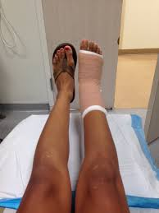
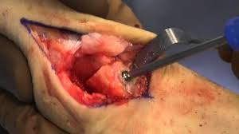
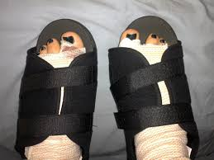
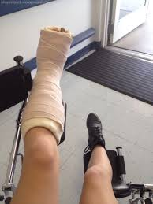
Bunionectomy
Sources of experimental error:
Type of surgery
Timing of assessments
Training of coordinator
Dressings
Timing of PT
Rescue medication
Perspective courtesy of Paul Desjardins
Notes:
I’m going to stop there with the concepts and give you an example that may already be familiar to you, of what kind of sources of measurement error creep into clinical trials, which I derived mostly from comments by Paul Desjardins, who many of you may know, and who was one of the developers of the bunionectomy model. According to Paul, and I’ll take the blame for any details I get wrong, the first few clinical trials of analgesics for bunionectomy failed to show separation from placebo. It was obvious that the medications relieved pain, so the problem must have been in how the studies were done. They followed patients around the ward, and noticed that some patients got one type of surgery, and some got another. Some had their feet elevated, and some had their legs hanging down, which is more painful. Some had tight dressings, and some had loose dressings. Some were assessed after they had rested all night, and some right after they got back from physical therapy. In other words, there was way too much variability in factors that impacted the variable being measured, namely pain intensity, creating a blizzard of experimental noise. Once all these factors were ruthlessly standardized, all of a sudden analgesic beat placebo. The drugs didn’t suddenly get more effective – it was that the instrument being used to measure the effect of treatment, namely the entire clinical trial and all its component parts, was brought under control. Poor quality was turned into good quality, with no change in the regulatory quality standards that by routine were in place all along. Or to put it another way, regulatory quality was clearly necessary, but contributed nothing to scientific quality.

Slide 10
First principle of experimental medicine
Hold everything else constant!
Input
Output

Slide 11
What are the sources of measurement error in clinical experiments?
Fraud & data fabrication
Study design errors
Errors in pain measurement
  Unreliable/invalid pain endpoint
  Poor pain reporting
Study conduct errors
  Protocol violations
  Compromised randomization or blinding
  Poor medication compliance
  Variable patient expectation
  Non-study treatments
Covariates
  Activity
  Sleep
  Assistive devices
  Additional treatments
Data storage and management
  Data entry or transformation errors
Data analysis
  Faulty statistical analysis plan or execution
Notes:
Can we make a more general statement about sources of measurement error in clinical trials? Basically anything that impacts the patient’s pain score other than the intervention can be a source of measurement error. It would be an important exercise, beyond the scope of this presentation, to create a taxonomy of types of measurement error, so we can start to identify and control them.

Slide 12
How can we systematically determine the causes of measurement error (i.e. loss of assay sensitivity) in pain studies?
Notes:
It is probably obvious by now that you could propose some causes of measurement error that are valid, in that they really do compromise the accuracy of measurement of treatment effects, and you could propose some that actually don’t matter. In order to keep our eye on the ball, we need a method for determining what the actual sources of measurement error are, like what was done so successfully by the developers of the bunionectomy model, and other acute pain models, although to date not so successfully in chronic pain.

Slide 13
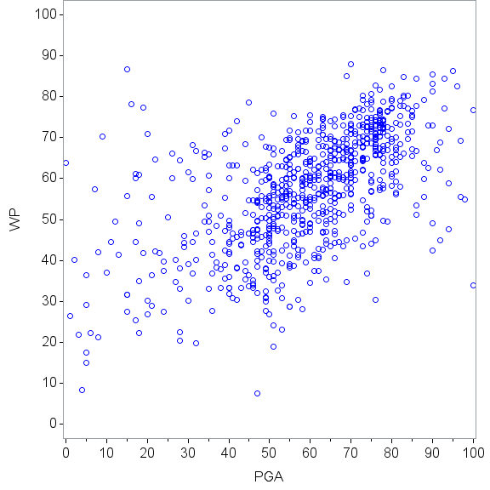
Candidate variable approach
Variables that reflect study quality
Baseline pain variability¹
Subject enrollment rate²
Placebo response rate³
E-diary compliance⁴
Medication adherence⁴
Correlation between two different pain measures⁴
Subject ability to report pain accurately⁵
1. Farrar J, Pain, 2014; 2. Singla N, J Pain Res, 2014; 3. Katz J, Neurology, 2008; 4. Katz N, American Pain Society, May 2015; 5. Trudeau J, IASP, 2012
Notes:
There are two ways to go about this that I can think of. I’ve illustrated one here, which we can call the candidate variable approach, somewhat analogous to the candidate gene approach in genetics. You hypothesize that some variable, let’s say variability of pain scores, is related to ability to measure treatment effect, which in the world of IMMPACT we call assay sensitivity. You do a retrospective or prospective study to see to what extent your candidate variable actually is related to assay sensitivity, usually taken as the standardized effect size of drug vs. placebo. If it is you throw it on this list and start thinking of ways you can control it to improve measurement accuracy. This has been done with a number of such variables and here is a partial list. In the figure to the right we have an illustration of one approach we took with data from an osteoarthritis clinical trial, where we hypothesized that patients whose WOMAC pain scores don’t correlate with their Patient Global Assessment scores aren’t using the scales accurately to report their pain, and therefore won’t demonstrate the difference between drug and placebo – this turned out to be true.

Slide 14
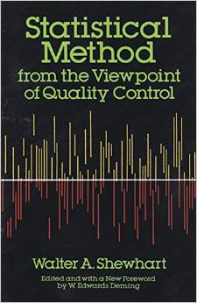
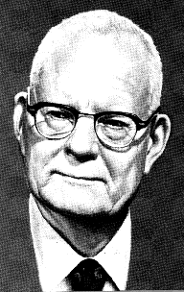
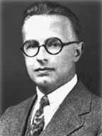
Statistical Process Control Methods in Manufacturing
Walter A. Shewhart
1891-1967
W. Edwards Deming
1900-1993
Notes:
We clinical trials people are not the first to grapple with defining and improving quality; in fact, we are very late in the game. There have been intensive efforts in manufacturing and other areas of engineering to develop a mathematical foundation for the study and control of quality that began in the 1920s. The pioneer of these efforts was Walter Shewhart, on the left, and his main disciple was Edwards Deming, on the right, who virtually on their own completely transformed how quality is approached in industry. Strangely, Deming studied with RA Fisher and Jerzy Neumann, two of the founders of biostatics, but the learning seemed to go one way, and there has been virtually no appreciation in the world of biostatistics of the developments in statistical quality control.

Slide 15
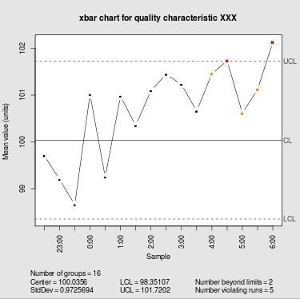
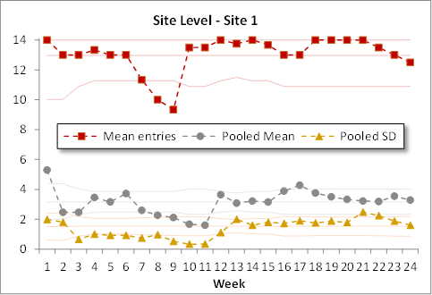
Principles of manufacturing quality control
Process: a unique combination of tools, materials, methods, and people engaged in producing a measurable output; for example a manufacturing line for machine parts
Control chart (or process behavior chart): a graphical display illustrating variation over time in the output of a process, usually showing boundaries of statistical control limits
Notes:
I’m far from an expert in this area, but I’d like to present two central elements of statistical quality control as it is used in manufacturing. One is the concept of a “process,” which is READ DEFINITION.
You can guess what I’m thinking is the relevance of this to our meeting today: a clinical trial can be conceived of as a process, with the components being the patients, the outcomes instruments, the sites, etc., and the measurable output of this process is…..guess what….the measurement of treatment effect.
The second major element is the control chart, which is a display of READ DEFINITION.
On the upper right is a standard illustration of a control chart of some industrial process that I pulled from Wikipedia. It shows some variation in the output of this process, until the output finally exceeds that which would be expected by natural variation, say 3 standard errors.
On the bottom right we have another such chart, aptly called a Shewhart chart, except here you are seeing data from a single site in a clinical trial monitored over time. The top variable is e-diary compliance, which we can see dipped below the control limit at around 7 weeks, followed by mean pain intensity scores, and then standard deviation of pain intensity scores, all at that one site. We don’t know why, but in the language of statistical quality control, the process at this site went out of control from about week 7 to 11, then reverted back into control. If this were an assembly line in a manufacturing plant, the line would have been stopped until people figured out what the problem was.

Slide 16
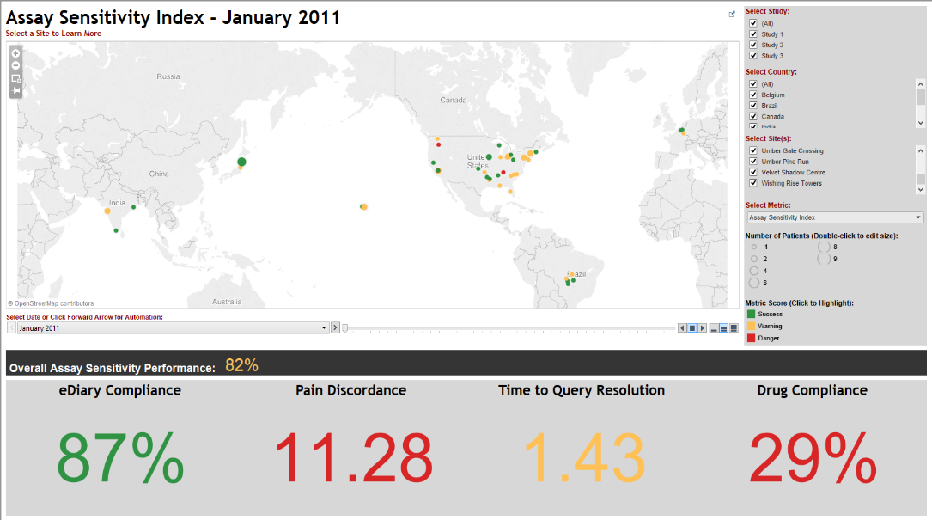
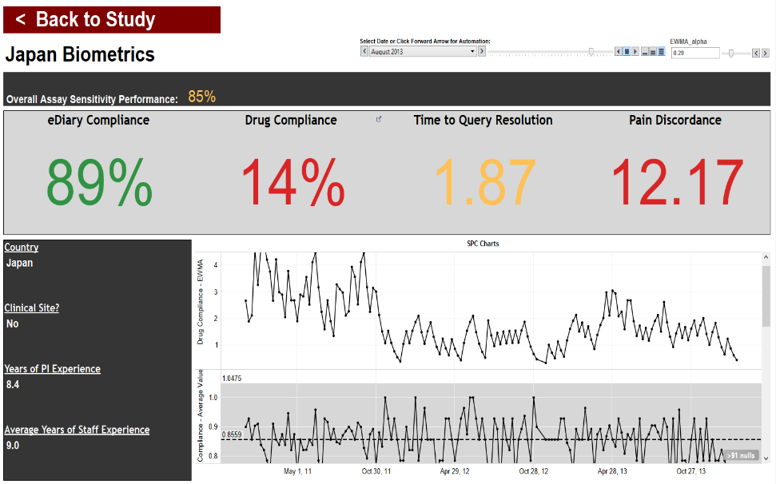
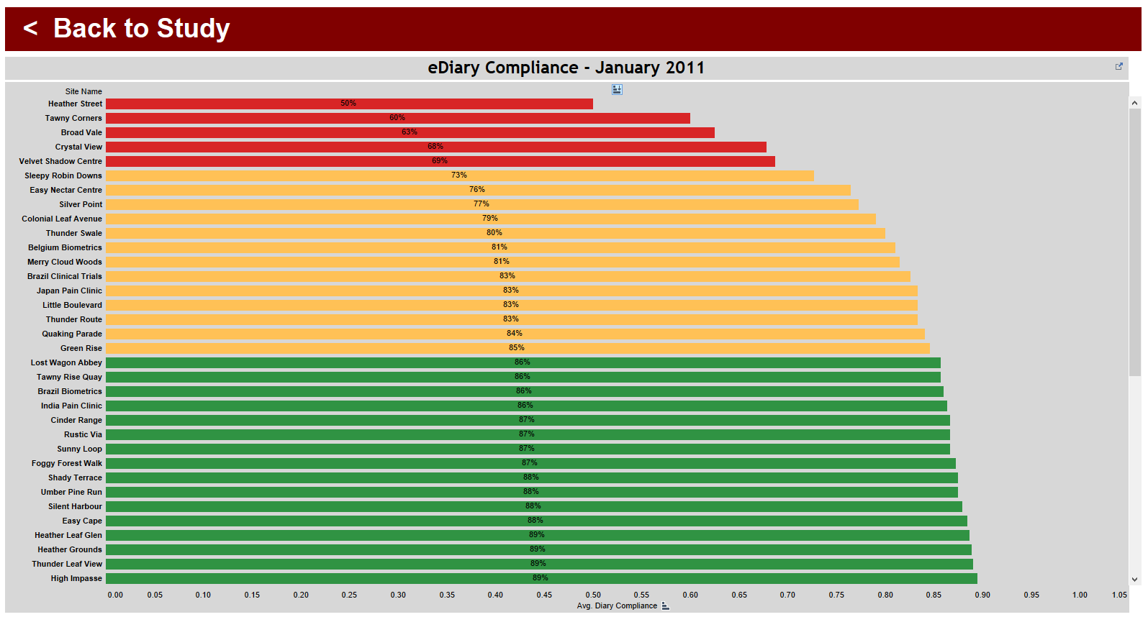
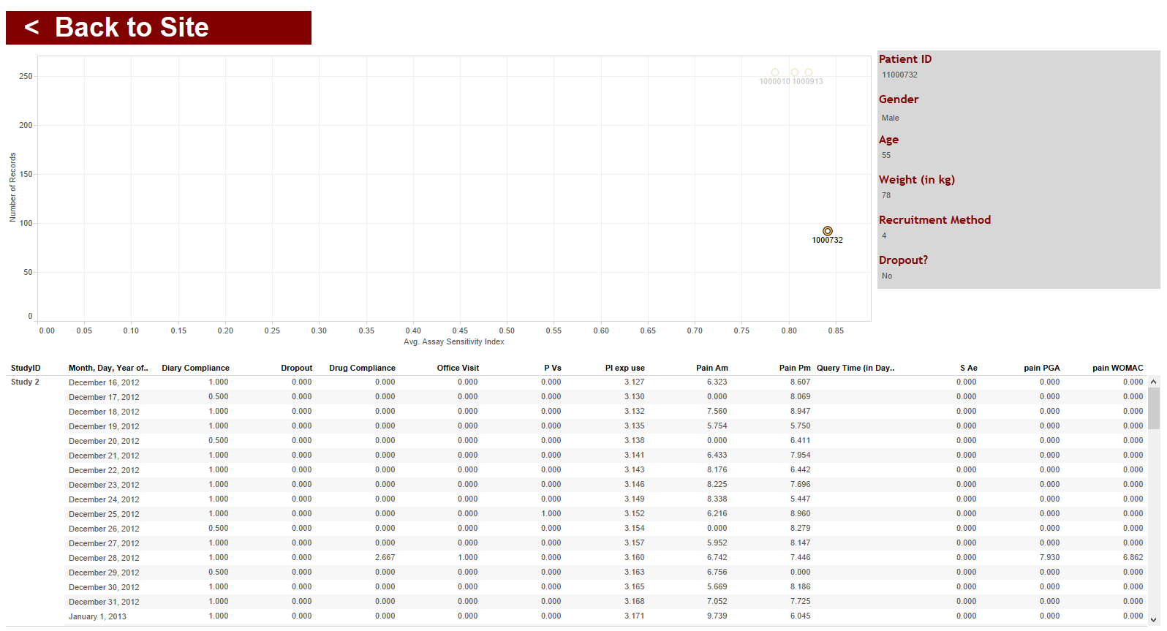
QDSS System
Study View
Site View
Metric View
Subject View
Notes:
In our group we have decided to try to import the learnings from industrial quality control into clinical trials, and have hired a software engineer from the automotive industry to build us a system for real-time monitoring of indicators of scientific quality in clinical trials. The system is currently being implemented in a global program of four clinical trials, and the idea is it will act as an early warning system to identify and correct problems in scientific quality before it’s too late.
The data visualization interface first presents you with a map of all your clinical sites. Any site that is red is out of statistical control in one way or another, yellow is caution, and green is OK. The key performance indicators are displayed at the bottom, with the same color coding on those variables. You can click on any site to see what’s going on in site view, where all the variables are displayed but just for that site. If you are concerned about a specific variable you can click and see a display of each subject at that site, to see exactly which subject is throwing the site out of control. You can also see all the sites in the study compared against each other with respect to any variable, in what’s called a Pareto chart. Depending on the nature of the problem you can implement a corrective intervention.

Slide 17
Summary
Quality in clinical trials is the identification and minimization of sources of error that compromise accuracy of measurement of treatment effect
Quality control rests on evidence that specific variables, amenable to surveillance, are relevant to study output
  Variables that appear to influence study output include pain variability, accuracy of pain reporting, medication compliance, and diary compliance
From a statistical quality control perspective, a clinical trial can be conceived as a process (with many components), yielding a measurable output (a measurement of magnitude of treatment effect)
Further research is needed to further define relevant quality variables and the best method for surveillance and correction
Notes:
So where does all that bring us?
First, we have a definition of quality that is more relevant to our fundamental purpose, which is the identification and minimization of sources of error that compromise accuracy of measurement of treatment effect, which is the output of the clinical trial.
Second, we have a recognition that this enterprise rests on developing evidence for what factors actually do compromise measurement accuracy, so we aren’t attempting to control the wrong things.
Third, we have a new awareness that people have been working towards quality control in industry for a century. I think the main reason we haven’t seen more incorporation of statistical process control methods in clinical research is that the light bulb hasn’t gone off yet that a clinical trial can be viewed as analogous to a manufacturing process, with the output of the system being a precise measure of treatment effect. Once that has been realized, all the accomplishments in that world suddenly seem very relevant.
Finally, we are just at the beginning of figuring out what factors most impact scientific quality and how to control them – a lot more work needs to be done. Hopefully the subsequent talks at this meeting will offer some ways to control some of the more obvious factors that influence clinical trial quality.

