Slide 1
Social Participation
Outcomes Measures
David A. Williams, Ph.D.
Professor of Anesthesiology, Medicine (Rheumatology), Psychiatry and Psychology
Associate Director, Chronic Pain and Fatigue Research Center
University of Michigan Medical Center
Ann Arbor, Michigan
INITIATIVE ON METHODS, MEASUREMENT, AND PAIN ASSESSMENT IN CLINICAL TRIALS
IMMPACT-XVII: RECOMMENDATIONS FOR THE ASSESSMENT OF
PHYSICAL FUNCTION IN ANALGESIC CLINICAL TRIALS
APRIL 17-18, 2013
WESTIN GEORGETOWN
WASHINGTON, DC

Slide 2
Social Outcomes and Health
Individuals are 2-4 times more likely to die of any form of illness if they have low social support
  These odds are greater than the odds for dying from cigarette smoking
  Social participation was more important to the QOL of persons with disabilities than were ADLS, or impairment
Rowe & Kahn (1987), Science, (237):143-149; Dijkers, M et al. (1997). Spinal Cord, 35:829-840

Slide 3
A Family of Social Outcome Constructs
Social Network
Number of Connections
Size of Social Structure
Social Support
Instrumental assistance
Emotional assistance
Social Participation
Social Engagement, participation
Valuation of Social Activities

Slide 4

Social Network

Slide 5
Social Network
What…
  Proxy for social integration
  Number of social ties
Common metric…
  Quantitative Summary Index of social tie counts
    Spouse, close friends, relatives, church, groups etc.
Relevance…
  Social integration is globally related to reduced mortality risks
  Social integration is globally related to better mental health
  Data is mixed regarding outcomes for specific diseases
  The quality (not just quantity) of the ties appears important and could be both protective or damaging
Seeman, T. (1996). AEP, 6 (5):442-451

Slide 6

Social Support

Slide 7
Social Support
What…
  Attempt to identify the benefit of being around others or receiving help from others
Common metric…
  Subjective rating scales
Relevance…
  Social support can have beneficial impact on pain and functional disability ^{1,2}
  Emotional social support tends to improve physical functioning but Instrumental (e.g., doing for others) promotes learned helplessness ³
  Both network and quality of social support at diagnosis predict pain and functional status 3-5 years later⁴
¹Keefe et al. (2002). JCCP, 70: 640-655; ²Uchino et al. (1996). Psych Bull, 119:488-531;
³Avorn et al, (1982) J. AM Geriatric Soc, 30(6):397-400.; ⁴Evers et al. (2003). Beh Res & Ther, 41:1295-1310.

Slide 8

Social Participation

Slide 9
A Bit of History…
1980’s: Health Care was focused on the disease
  International Classification of Disease (ICD: WHO)
Health Care needed a way of assessing diseases/disorders that did not have a cure but from which you did not die
  International Classification of Impairments, Disabilities, and Handicaps (ICIDH: WHO) – (1980)
WHO. ICD10 (2010). Geneva: WHO; WHO. ICIDH. (1980). Geneva: WHO

Slide 10
Medical Model Vs. ICIDH Model
Medical Model
Etiology
Pathology
Manifestation
ICIDH Model
Disease/disorder
Impairment
Disability
Handicap
WHO-ICF, Geneva: WHO:2001; 1980. Gray et al, (2000). Arch Phys Med Rehabil, 81:S10-S14

Slide 11
ICIDH Concept of “Handicap” had Limitations
Handicap
  Emphasized disadvantage in a limited number of specific normative activities and specific normative life roles
  Did not account for mediating and moderating influences of environmental factors
  Little emphasis on subjective patient valuation of social relationships
WHO-ICF, Geneva: WHO:2001

Slide 12

ICIDH Replaced by ICF
Activity: execution of a task or action by an individual
  Includes either capacity to carry out task or actual performance
Participation: Involvement in an uncontrolled life situation
Participation Restriction: problems experienced while involved in uncontrolled life situations.
ICF
WHO-ICF, Geneva: WHO:2001

Slide 13
ICF (2001)
Disease or Disorder
Body
Functions/Structures
(Impairments)
Activities
Participation
Environmental Factors
Personal Factors
¹WHO-ICF, Geneva: WHO:2001; Gray et al, (2000). Arch Phys Med Rehabil, 81:S10-S14

Slide 14
ICF (2001)
Disease or Disorder
Body
Functions/Structures
(Impairments)
Activities
Participation
Environmental Factors
Personal Factors
¹WHO-ICF, Geneva: WHO:2001; Gray et al, (2000). Arch Phys Med Rehabil, 81:S10-S14

Slide 15
ICF
Activities and Participation Domains
Learning and Applying Knowledge
General Tasks and Demands
Communication
Mobility
Self Care
Domestic Life
Interpersonal Interactions and Relationships
Major Life Areas
Community, Social, and Civic Life
¹WHO-ICF, Geneva: WHO:2001

Slide 16
ICF (2001)
Disease or Disorder
Body
Functions/Structures
(Impairments)
Activities
Participation
Environmental Factors
Personal Factors
¹WHO-ICF, Geneva: WHO:2001; Gray et al, (2000). Arch Phys Med Rehabil, 81:S10-S14

Slide 17
ICF (2001)
Disease or Disorder
Body
Functions/Structures
(Impairments)
Activities
Participation
Environmental Factors
Personal Factors
¹WHO-ICF, Geneva: WHO:2001; Gray et al, (2000). Arch Phys Med Rehabil, 81:S10-S14

Slide 18
ICF (2001)
Disease or Disorder
Body
Functions/Structures
(Impairments)
Activities
Participation
Social
Environmental Factors
Personal Factors
¹WHO-ICF, Geneva: WHO:2001; Gray et al, (2000). Arch Phys Med Rehabil, 81:S10-S14

Slide 19
Assessment of Social Participation Domains

Slide 20
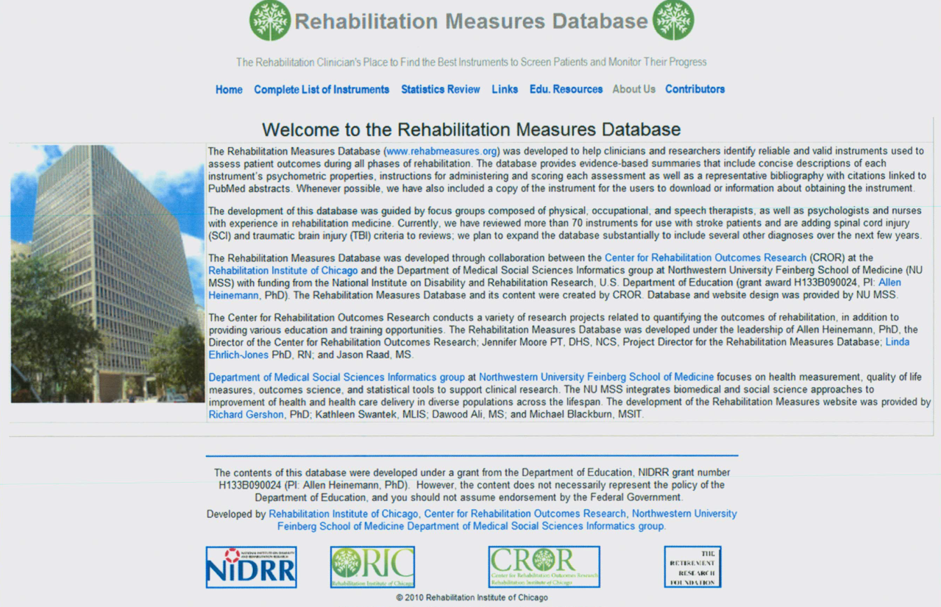
Approach
Topical Reviews
Rehabilitation Measures Database
  Social Participation
  Life Participation
  Social integration
  Social relationships
37 Potential Measures
  17 Relevant
Perenboom & Chorus (2003), Disability and Rehabilitation, 25, 577-587; Dijkers et al (2000), Arch Phys Med Rehabil, 81, S63-S80; http://www.rehabmeasures.org/rehabweb/allmeasures.aspx

Slide 21
Early Measures that included a Social Participation Construct

Slide 22
Early Measures that included a Social Participation Construct
Sickness Impact Profile (SIP: 1975)
  Assesses level of dysfunction
    Measures “objective” ability not “subjective” perceptions
  68 items (136 long): domains: Physical, Psychological, Social
    Social (mobility, social behavior)
    Scores: Total, Domain, Subscale
  Populations: Arthritis, TBI, SCI, Stroke, Parkinson’s, MS
Sample Domains | Sample Items
Social Interactions | I make many demands (e.g., insist that people do things for me, or tell them how to do things)
Leisure | I am going out for entertainment less often
Interactions - family | I isolate myself as much as I can from the rest of the family
  Gilson BS et al. (1975), 65(12):1304-10

Slide 23
Early Measures that included a Social Participation Construct
Nottingham Health Profile (NHP: 1980)
  Assesses perceived health impact on personal and social life engagement
  45 items: 7 Domains: Sleep, Mobility, Energy, Pain, Emotions, Social Isolation, Impact to Participation in Life Areas
    Impact to Participation in Life areas: work, house work, social life, home life, sex life, hobbies, vacations
  Populations: Pregnancy, Chronically Ill, Limb Fractures, Stroke, OA, Soft Tissue Injury, Headache, COPD
Hunt et al, (1980). J Epidem and Community Health, 34:281-286.

Slide 24
Early Measures that included a Social Participation Construct
Reintegration to Normal Living Index (RNLI: 1988)
  Assesses the degree to which individuals achieve reintegration into normal social activities
  11 items: 7 domains: Indoor, Mobility, Self-care, Daily Activity, Recreation & Social Activities, Family Roles, Personal Relationships, Presentation of Self to Others
  Populations: Stroke, TBI, SCI, Cancer, Heart Disease
  Wood et al. (1988). Arch Phys Med Rehabil, 69:583-590

Slide 25
Early Measure that included a Social Participation Construct
Emphasis on comparing patient to normative behavior
Performance based rather than values based
  Do you engage?, Can you do it?
  How much help to you need?
  Are you social? (yes/no)
Early measures lacked a specific frame work
Are notable for even including assessments of social factors in the context of illness

Slide 26
Measures Consistent with the
ICIDH Framework
ICIDH Model
Disease/disorder
Impairment
Disability
Handicap

Slide 27
Measures Consistent with the
ICIDH Framework
Craig Handicap Scale & Reporting Techniques (CHART: 1992)
  Assesses amount of time spent in various activities
  32 items: 6 domains: Physical Independence, Cognitive Independence, Mobility, Occupation, Economic Self-sufficiency, Social Integration
  Populations: SCI, Stroke, TBI, MS, Burn, Amputee
  Has a 19-item short form
  Can obtain a single Social Integration score
Whiteneck et al. (1992). Arch Phys Med Rehabil, 73:519-526

Slide 28
Measures Consistent with the
ICIDH Framework
Perceived Handicap Questionnaire (PHQ: 1994)
  Assesses perceived integration to “normal” life activities
    Compares self to normal and self to other disabled individuals
  10 items: 5 domains: Physical Independence, Mobility, Occupation, Economic Self-sufficiency, Social Integration
  Populations: SCI
Tate et al (1994). Am J Phys Med Rehabil, 73:175-183.

Slide 29
Measures Consistent with the
ICIDH Framework
London Handicap Scale (LHS:1994)
  Attempts to quantify “handicap”
  6 items: 6 domains: Physical Independence, Mobility, Occupation, Orientation, Economic Self-sufficiency, Social Integration
  Populations: Stroke, THA, TKA, MS
Harwood et al (1994). Qual Health Care, 3: 11-16

Slide 30
Measures Consistent with the
ICIDH Framework
Community Integration Questionnaire (CIQ: 1993)
  Assesses social role limitations and community integration of people with acquired brain injury
  15 item: 3 domains: Home integration, Productive activity, Social Integration
    Social Integration (shopping, visiting friends, leisure)
  Populations: TBI, Acquired brain injury, SCI, Brain tumor, Stroke
mostly alone (0)
mostly with friends who have
head injuries (1)
mostly with family members (1)
mostly with friends who do not
have head injuries (2)
with a combination of family
and friends (2)
When you participate in leisure activities
do you usually do this alone or with
others?
Willer, B., Rosenthal, M., et al. (1993). "Assessment of community integration following rehabilitation for traumatic brain injury." The Journal of head trauma rehabilitation 8(2): 75.

Slide 31
Measures Consistent with the
ICIDH Framework
Measurement limited to ICIDH construct of “Social Integration”
Social Integration operationalized as
  Time spent in social activities
  Comparing self to “normals” or other disabled persons
  Lack of integration into “normal” social activities = handicap
ICIDH framework now outdated
Little emphasis on the environment and individual strengths
Little emphasis on personal social interests or values

Slide 32
Measures Consistent with the
ICF Framework
Body
Functions/Structures
(Impairments)
Activities
Participation
Environmental Factors
Personal Factors

Slide 33
Measures Consistent with the
ICF Framework
Assessment of Life Habits (LIFE-H: 2002)
  Assesses 77 life habits with regard to perception of difficulty and assistance required
  77 items (short form) in two domains: Activities & Social Roles
    Social Roles Domain: Responsibility, Interpersonal relationships, Community life, Education, Work, Recreation
  Populations: Geriatrics, CP, MS, SCI, Stroke, TBI
Noreau et al. (2002). Technology and Disability, 14:113-118

Slide 34
Measures Consistent with the ICF Framework
Participation Objective, Participation Subjective (POPS: 2004)
  Assesses objective and subjective participation and “outsider” valuation
  26 items stem items each has 3 parts (1 objective – 2 subjective)
    5 ICF domains: Domestic life, major life activities, Transportation, Interpersonal interactions and relationships, Community, Recreational, and Civic Life
  Populations: TBI
“How often in a typical month do you go to the movies?"
"How important is this to your well-being?”
“Are you satisfied with your current level of participation, or would you like to be doing more or be doing less?"
Brown, Dijkers, et al (2004). J Head Trauma Rehabil, 19:459-481.

Slide 35
Measures Consistent with the
ICF Framework
Participation Survey/Mobility (PARTS/M: 2006)
  Assesses participation in major life activities
  135 items: 6 ICF domains: Self-care, Mobility, Domestic life, Interpersonal interactions and relationships, Major life areas, Community, Social and Civic life (sub-scale scores)
  Populations: Stroke, CP, MS, SCI
Sample Items
How frequently do you socialize with others?
Is your participation in social activities limited by illness, pain, fatigue etc…
How important is it for you to participate in social activities?
How satisfied are you with your participation in socializing?
Gray et al (2006). Arch Phys Med Rehabil, 87:189-197.

Slide 36
Measures Consistent with the
ICF Framework
Participation Measure for Post Acute Care (PM-PAC: 2007)
  Assesses participation in outpatient or homecare
  51 items, 7 ICF domains: Mobility, Community social and civic life, Role functioning, Self-care/domestic life, Home management and finances, Social relationships, Communication
  Populations: SCI, TBI, Musculoskeletal
  CAT version
Sample items
How many times in the past week have you done things socially with other people?
How satisfied are you with the general quality of your relationships with family and friends?
How many close friends to do you have?
Gandek et al (2007). Amer J Phys Med Rehabil, 86:57-71

Slide 37
Measures Consistent with the
ICF Framework
Vestibular Activities and Participation (VAP: 2012)
  Assesses activity and participation limitations created by vestibular disorders
  34 items: Aligned with the ICF framework
  Population: Vestibular disorders
Alghwiri et al, (2012). Arch Phys Med Rehabil, 93: 1822-1831

Slide 38
Measures Consistent with the
ICF Framework
WHO Disability Assessment Schedule 2 (WHODAS 2.0: 2012)
  Assesses Health status, Disability, Functioning
  36 items (12 item screener): 7 domains: Understanding and communicating, Getting around, Self-care, Getting along with people, Life activities (Household, school/work), Participation in society
  Population: compatible with IFC classification for multiple populations
World Health Organization, 2012. Measuring health and disability: manual for WHO Disability Assessment Schedule (WHODAS 2.0), World Health Organization, 2010, Geneva.

Slide 39
Measures Consistent with the
ICF Framework
Tend to offer more complete psychometric information
Use of IRT and CATs
Tend to be lengthy and complex
Comprehensive nature limits ability to assess nuanced features specific to social participation
No consistency in how social participation is defined

Slide 40
Measuring Specific Aspects of
Social Participation

Slide 41
Measuring Specific Aspects of
Social Participation
Life Satisfaction Questionnaire-9 (LSQ: 1991)
  Assesses “life satisfaction” across multiple domains
  9 items: Life as a whole, Self-care, Vocational, Financial, Leisure situations, Contacts with friends, Family life, Partner relationships, Sex life
  Populations: Stroke, TBI, MS, SCI, Trauma, Chronic Pain
Fugl-Meyer A, Bränholm I-B, Fugl-Meyer K. Happiness and Domain-Specific Life Satisfaction in Adult Northern Swedes. Clin Rehabil 1991;5:25-33.

Slide 42
Measuring Specific Aspects of
Social Participation
Impact on Participation and Autonomy Questionnaire (IPA:1999)
  Assesses “perceived” participation and “perceived” problems
  39 items (31 perceived participation, 8 perceived problems)
  5 domains: Autonomy outdoors, Autonomy indoors, Paid work and education, Social relationships, Family roles
  Populations: Stroke, Neuromuscular disease, SCI, RA, FM
Cardol et al. (1999). Clin Rehabil, 13:411-419

Slide 43
Measuring Specific Aspects of
Social Participation
Measurement of Quality of the Environment (MQE: 1999)
  Assesses the role of the environment in one’s ability to maintain life habits in relationship to one’s limitations and capacities
  109 items: 17 domains: (Social Networks, Attitudes, Social Rules)
  Populations: Movement disorders
Fougeyrollas et al (1999). MQE, v2.0 INDCP-C.P. 225, lac-St. Charles, Quebec, G3G3C1, CANADA

Slide 44
Measuring Specific Aspects of
Social Participation
Participation Enfranchisement (2011)
  Assesses extent to which people feel they participate in the community in a manner that is personally valuable as opposed to assessing actual performance of community-based activities
  19 items: 3 domains: Choice and Control, Contributing to One’s Community, Valued by Others
Heinemann et al, (2011). Arch Phys Med Rehabil, 92:564-571.

Slide 45
Measuring Specific Aspects of Social Participation
Ability to capture social participation concepts outside the ICF framework
Acknowledges that someone could be very active with many people within a community but the community could be hostile or unwelcoming thus diminishing the potential health benefit or value of social participation

Slide 46
Social Domains with the
PROMIS Framework

Slide 47
Social Domains with the PROMIS Framework
Ability to Participate in Roles and Activities
  Assesses: Perceived ability to perform usual social roles and activities
  35 items: 4,6,8 item short forms
Satisfaction with Social Roles and Activities
  Assesses: Perceived satisfaction performing one’s usual social roles and activities
  44 items: 4,6,8 item short forms
Companionship
  Assesses: perceived ability of someone to share enjoyable social activities
  6 items, 4 item short form
http://www.nihpromis.org/measures/domainframework3

Slide 48
Social Domains with the PROMIS Framework
Emotional Support
  Assesses: Perceived feelings of being cared for and valued as person, having confidant relationships
  16 items: 4, 6, 8 item short forms
Informational Support
  Assesses: Perceived availability of helpful information or advice
  10 items: 4, 6, 8 item short forms
Instrumental Support
  Assesses: Perceived availability of assistance with material, cognitive, or task performance
  11 items: 4, 6, 8 item short forms
Social Isolation
  Assesses: Perceptions of being avoided, excluded, detached, disconnected from, or unknown by others
  14 items: 4, 6, 8 item short forms
http://www.nihpromis.org/measures/domainframework3

Slide 49
Conclusions
The construct of “Social Participation” has its roots within the rehabilitation literature
Assessment of social participation has largely evolved out of the ICF framework
Social Participation as a construct is not consensually defined
  Often confounded by General participation, activities, support, QOL, social structure, roles, normative behavior
Many instruments with varying degrees of psychometric rigor
No instrument specifically assesses “Social Participation”
None of the instruments reviewed was designed specifically for pain

