Slide 1
Performance-based measures of physical function
Kristine Phillips, MD, PhD
Disclosures: None

Slide 2
What are performance-based tests?
In performance-based tests, an individual has to execute one or more specific activities that are evaluated in a standardized manner
Usually measured as time to complete the activity or observer report of completion of task

Slide 3
Why measure performance?
Self-report may be subject to under or over estimation in musculoskeletal disease
Only moderate relations between both measures, particularly in the elderly
Time-based performance and self-reported (PRO) measures likely assess different aspects of the physical function domain
J Clin Epidemiol 1998, 51:1243–1252
J Am Geriatric Society 1992, 40:457–462
J Clin Epidemiol 1996, 49:1103–1110

Slide 4
Why measure performance?
Evidence for discrepancies between perceptions of the individual assessed using a self-reported measure and their true ability (underestimation or overestimation, personality traits, language, depression)
Discordance between observed and perceived physical function measured with a self-reported questionnaires has been reported in patients with ankylosing spondylitis, rheumatoid arthritis and fibromyalgia
Br J Rheumatol 1995, 34:951–955
J Rheumatol 1994, 21:818–823

Slide 5
Goals
To describe performance-based physical function assessment as outcome measures for chronic musculoskeletal pain RCTs
Overview
Global or localized / segmental
Complexities
Measurement properties

Slide 6
Conceptual framework for impact of chronic musculoskeletal pain
Disability
Musculoskeletal pain
Functional
Limitations
Activity
restrictions
Difficulty standing, walking, bending, or with grip…
Difficulty with
personal care, social participation, work...
Core Areas of Measurement

Slide 7
Developing a Core Outcome Measurement Set
Core Domains
Literature Review
Applicability:
Truthful Discriminative
Feasible
Preliminary Core Outcome Measurement Set
Each Domain with at least one instrument?
No
1. Develop new instruments
2. Validation studies
Yes

Slide 8
Core Domain: Physical Function
Performance measure: Individual Contextual factors
Effort
Exertion
Comorbidities (PAH)

Slide 9
Why evaluate rheumatologic studies?
Peformance-based physical function outcome measures form a core set of endpoints for clinical trails in:
Osteoarthritis
Rheumatoid arthritis
Ankylosing spondylitis
Fibromyalgia
Low back pain
Joint specific musculoskeletal pain

Slide 10
Example: OA systematic review
Measurement properties of performance-based measures to assess physical function in hip and knee osteoarthritis: a systematic review.
Dobson F1, Hinman RS, Hall M, Terwee CB, Roos EM, Bennell KL.

Slide 11
Example: OA Literature Review Methods
Keywords used
Exclusion criteria
Online databases used
CINAHL, etc
Cochrane
Embase
Medline / PubMed
PsychINFO
References of all articles
OMERACT-OARSI initiative

Slide 12
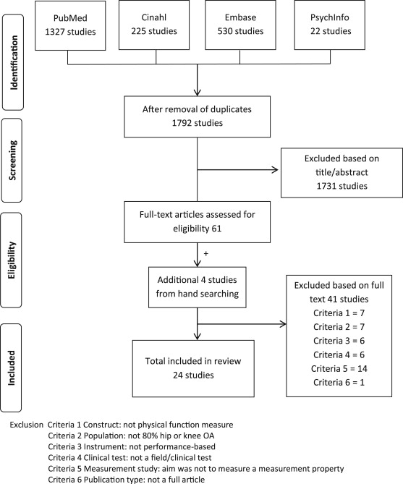
Fig. 1 Flowchart of the selection and inclusion of studies.
F. Dobson , R.S. Hinman , M. Hall , C.B. Terwee , E.M. Roos , K.L. Bennell
Measurement properties of performance-based measures to assess physical function in hip and knee osteoarthritis: a systematic review
Osteoarthritis and Cartilage, Volume 20, Issue 12, 2012, 1548 - 1562

Slide 13
Quality criteria for rating the results of the measurement properties
Reliability
Internal consistency
Measurement error
Responsiveness
Validity
Content
Structural
Construct (Hypothesis testing)
Cross-cultural
Criterion
Terwee et al J Clin Epidemiol 2007;60(1):34-42

Slide 14
Levels of evidence for the quality of the measurement property
Level Rating∗ Criteria
Strong +++ or −−− Consistent findings in multiple studies of good methodological quality OR in one study of excellent methodological quality
Moderate ++ or −− Consistent findings in multiple studies of fair methodological quality OR in one study of good
methodological quality
Limited + or − One study of fair methodological quality
Conflicting ± Conflicting findings
Unknown ? Only studies of poor methodological quality
Adapted from Terwee et al. J Clin Epidemiol 2007;60(1):34–42.

Slide 15
Example study
Internal consistency N/A
Reliability 0
Measurement error ?
Validity 0
Responsiveness 0
Interpretability 0
Intra +
Inter +
Retest 0
50ft fast-pace

Slide 16
Are there performance-based physical function measures that are used across multiple musculoskeletal diseases?
How do they compare?

Slide 17
Timed Up and Go (TUG) Test
Incorporates walking 3 m, turning and returning to sit down
Assessment of both walking and turning
Another variation: Get up and go test, which incorporates walking 20 m with no return

Slide 18
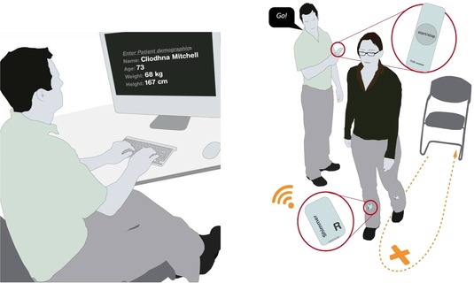
Timed Up and Go (TUG) Test
Scanaill et al, Ageing International, 36:2, 2011

Slide 19
OA Systematic Review Results
Six different sit to stand tests with variations in (1) method of measurement (count over 30 s, time for five repetitions, total time and quality grading) and (2) height of chair (standard and high) and (3) incorporated walking and/or turning components
Sit to stand tests were included in three multi-activity measures

Slide 20
TUG test: Rheumatoid Arthritis
RA patients randomized to 4 weeks of rehabilitation in Norway or in a Mediterranean climate
Comparable improvements in TUG tests. No differences seen in TUG test between groups.
ACR20: (20% improvement in tender and swollen joint counts and 20% improvement in 3 of the 5 ACR-core set measures: patient and physician global assessments, pain, disability, and an acutephase reactant)
25% achieved ACR20 in the Mediterranean climate and 15% achieved ACR20 in the Norwegian climate
Scand J Rheumatol. 2009 Jan-Feb;38(1):28-37

Slide 21
One of the potential pitfalls of performance measures: not always associated with disease activity (RA, AS)

Slide 22
Six minute walk test

Slide 23
Six minute walk test
Considerable normative data from the cardiology and pulmonary literature. Guidelines on administration from American Thoracic Society
Documentation should include the speed tested if fastest speed is not used (preferred vs. fast)
Assistive devices can be used but kept consistent from test to test
Length of track taken into consideration (40 feet versus 50 feet)

Slide 24
OA Systematic Review Results
Two main types of walk tests: short distances (<100 m) and long distances (>100 m)
9 different short-distance walk tests with variations in (1) set pace (self-paced, fast-paced); (2) distance walked (range 2.4–80 m); (3) functional measure (time, speed, distance, quality grading); and (4) incorporated turns (range 0–7)
Short-distance walk tests were included in six multi-activity measures
The 6-min walk test was the only long-distance walk test and was investigated in four studies and included in two multi-activity measures.

Slide 25
Six minute walk: Fibromyalgia
Lean patients with fibromyalgia walked shorter distances during a six minute walk test compared with healthy controls
Arch Phys Med Rehabil 87: 259–264
Arthritis Care Res 12: 193–199

Slide 26
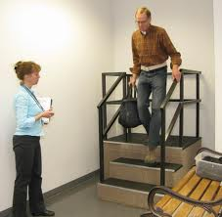
Stair negotiation
12 stair up/down
9 stair up/down
4 stair up/down

Slide 27
OA Systematic Review Results
Seven different stair negotiation tests with variations in (1) number of stairs (range 4–12); (2) ascend only, descend only or both; (3) hand-rail support and (4) leading limb step pattern
Stair negotiation tests were included in five/six multi-activity measures

Slide 28
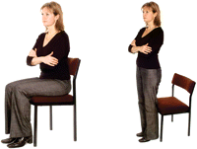
Other Physical Function Measures
Balance
One leg hop
Standing stork
Chair stand test
X 5
30 second

Slide 29
Fullerton Advanced Balance (FAB) Scale
1. Stand with feet together and eyes closed
( ) 0 Unable to obtain the correct standing position independently
( ) 1 Able to obtain the correct standing position independently but unable to maintain the position or keep the eyes closed for more than 10 seconds
( ) 2 Able to maintain the correct standing position with eyes closed for more than 10 seconds but less than 30 seconds
( ) 3 Able to maintain the correct standing position with eyes closed for 30 seconds but requires close supervision
( ) 4 Able to maintain the correct standing position safely with eyes closed for 30 seconds
10 measures total

Slide 30
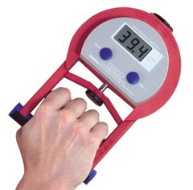
Site specific physical function
Loaded forward-reach test (LBP)
Shoulder Range of motion
Knee range of motion
Knee quadriceps strength
Hand grip strength test
Single leg hop test

Slide 31
Multi activity tests of physical function
Continuous Scale – Physical Function Performance Test (CS-PFP)
Physical performance battery, based on three timed tests: 4-m walking speed test, the balance test and the chair stand test
Physical Performance Test (PPT)
Physical Activity Restrictions (PAR)
Aggregated Locomotor Function (ALF)
Functional Assessment System (FAS)
Lin battery
Steultjens battery
Stratford battery

Slide 32
Comparison of specific functions
Performance-based tests and BASFI-questionnaire measure different aspects of physical function in ankylosing spondylitis
Tests: 1) climbing stairs, 2) bending, 3) reaching up, 4) putting on socks, 5) reclining and declining from a chair, 6) getting up from the floor, 7) looking over the shoulder, 8) physically demanding activity.
BASFI, Bath Ankylosing Spondylitis Functional Index
Moderate association: R-square of 0.31 and Beta of 0.56 (p < 0.05)
Salima et al Arth Res Ther 2012

Slide 33
Adaptation in physical function:
Creating a new normal
Performance is better but capability is still limited
(Dr. Beaton’s patient with ankle pain)

Slide 34
Adaptation: Creating a new normal
Patients may underestimate levels of physical function due to disease duration
Patients with longer disease duration may tolerate greater limitations in function
Each year is a little worse in overall function and the decline is faster than expected/perceived
Sowers et al Am J Epidemiology 2006

Slide 35
Other considerations
Objectivity: Are performance based physical function measures truly more ‘objective’ than other (PRO) physical function measures?

Slide 36
Time versus observer report
Swimming
Ice Dancing

Slide 37
Other considerations of physical function tests: sensitivity to activity (SPA)
Recent findings suggest that certain individuals with musculoskeletal pain conditions have increased sensitivity to physical activity (SPA) and respond to activities of stable intensity with increasingly severe pain.

Slide 38
Other considerations of physical function tests: sensitivity to activity (SPA)
Importance of activity-related pain among individuals with musculoskeletal conditions such as OA, low back pain, and fibromyalgia
In OA patients, SPA was significantly correlated to 6MWT performance such that higher levels of SPA were associated with reduced distance traveled

Slide 39
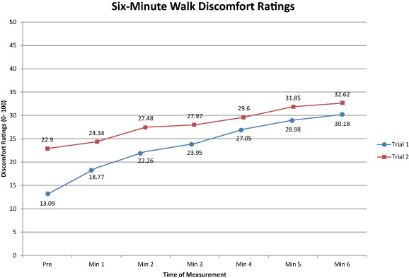
Fig. 1 Six-minute walk discomfort ratings.
Timothy H. Wideman , Patrick H. Finan , Robert R. Edwards , Phillip J. Quartana , Luis F. Buenaver , Jennifer A. H...
Increased sensitivity to physical activity among individuals with knee osteoarthritis: Relation to pain outcomes, psychological factors, and responses to quantitative sensory testing
PAIN®, Volume 155, Issue 4, 2014, 703 - 711
http://dx.doi.org/10.1016/j.pain.2013.12.028

Slide 40
What would an ideal physical function performance measure look like?
Related to patient symptoms
Measures only one domain
Sensitive to change
Accurate (free from error)
Easy to perform

Slide 41
Impressions
Performance items may not all belong to the same domain, especially with multi-activity measures
Limited reliability and validity data: few widely used tests
Future studies should include measurement properties for performance tests
Can we develop performance tests that can discriminate between therapeutic and nontherapeutic effects on physical function in patients with chronic pain?

Slide 42
References
World Health Organization. International Classification of Functioning, Disability, and Health. Geneva, Switzerland: ICF; 2001.
Wright AA, et al. Physiother Theor Pract 2011; 27:253-62
Mizner RL et al. J Arthroplasty 2011; 26:728-37
Stratford PW, Kennedy DM. J Clin Epidemiol 2006; 59:160-7
Terwee C, et al. Qual Life Res 2012; 21:651-7
Piva SR, et al. Arch Phys Med Rehabil 2004:85:284-9
Oberg U, et al. Phys Ther 1994;74:861-71
McCarthy CJ, Oldam JA. Rheumatology 2004;43:514-7
Steultjens, et al. Arthritis Care Res 1999; 12:19-25
Almeida GJ et al. Arch Phys Med Rehabil 2010;91:932-8
Crosbie J et al. Physiother Res Int 2010;15:35-41
Onder G et al. Pain 2006;121:53-9
Carbonell-Baeza A et al. Pain Manag Nurs 2013;14:193-9
Kingsley JD et al. Arch Phys Med Rehabil 2005; 86:1713-21
Desmeules F et al. Physiother Can 2013; 65:116-24
Patel KV, et al Pain 2013; 154:2649-57
Chaparro LE et al. Spine 2014
Dansie EJ et al. J Pain 2014

