Slide 1
Actigraphy
Kushang V. Patel, PhD, MPH
University of Washington, Seattle
IMMPACT XVII
April 17, 2014
Notes:
SO I am going talk about actigraphy or accelerometry as an objective method for measuring PA, a behavior that is difficult to measure as it is not stable
and is prone to daily, weekly and seasonal variation

Slide 2
Objective
To provide an overview of accelerometry as an objective measure of physical activity for use in analgesic clinical trials in chronic musculoskeletal pain populations

Slide 3
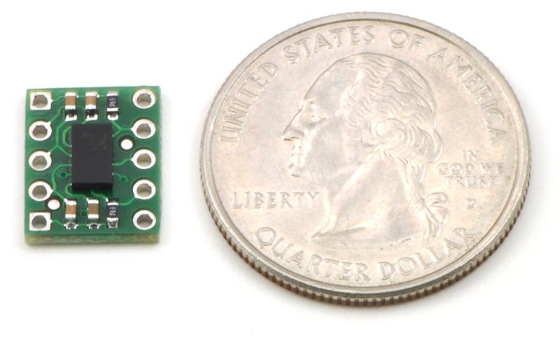
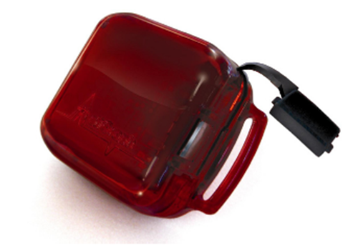
Accelerometers
Small, lightweight, portable, noninvasive, and nonintrusive devices that record motion in 1, 2, or 3 planes
Measures frequency, duration, and intensity of physical activity

Slide 4
Compliance with Physical Activity Guidelines among Adults in the US, NHANES 2005-06
Tucker JM, et al. Am J Prev Med 2011
Notes:
The DHHS recommended guidelines: at least 150 minutes/week of moderate-intensity physical activity or 75 minutes/week of vigorous-intensity
physical activity, or a combination of moderate and vigorous physical activity.
Based on self-reported physical activity that use

Slide 5
Compliance with Physical Activity Guidelines among Adults in the US, NHANES 2005-06
Tucker JM, et al. Am J Prev Med 2011
Notes:
The differences in adherence may be attributable to several factors. One possibility is that the accelerometer provides an estimate close to truth, and that respondents greatly overestimate their physical activity (9).
The reporting overestimate could result from misclassifying sedentary or light activity as moderate, or from overestimates of activity duration.
Whereas researchers define cutoffs for accelerometers and assume that reported "moderate"-intensity activity is defined as 3.0-6.0 METs, respondents to questions are unlikely to be familiar with the MET metric. Respondents may apply relative intensity definitions in answering questions, despite attempts to
calibrate the responses by providing example activities and physiologic cues. Alternatively, the self-reported activity may be accurate, and the difference is attributable to certain types of activity, such as bicycling or swimming, not being captured by accelerometers. However, according to the reports in NHANES 2003-2004, fewer than 10% of adult respondents reported any bicycling for leisure, and fewer than 5% reported swimming. It should also be noted that the accelerometer is capturing activity in all contexts, including activities that are not covered by the questionnaire, such as occupation.
The overall correlations between self-reported and accelerometry-based estimates of MVPA were fairly low (r= 0.27).

Slide 6
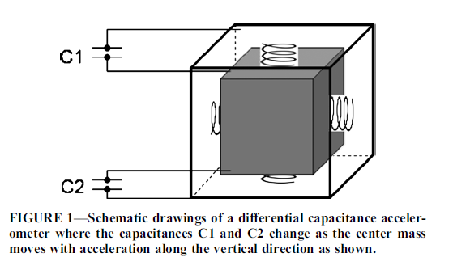
Microelectromechanical System
Chen K, et al. Med Sci Sports Exerc 2012

Slide 7
Accelerometer “Counts”
Dimensionless units that are specific to each make and model of monitor
  Cannot be compared across devices
Measure the frequency and intensity of acceleration in a given plane (eg, vertical displacement)
Time stamped
Accumulated over a discrete, user-defined time-sampling interval (“epochs”; 1, 15, 30 seconds)
Shorter epochs provide greater detail, but consume more memory and reduce battery life

Slide 8
Validity of Accelerometry
Validity studies have yielded moderate-to-strong correlations between accelerometer counts and oxygen consumption (VO_{2max}), PAEE, or MET
  r = 0.45 to 0.93 in adults
  r = 0.53 to 0.92 in children
Wide range in correlation is due, to a large extent, to the type of measurement protocol
  Uniaxial vs triaxial
  Improvements in signal filtration, use of raw data
ICCs>0.95 for inter- and intra-model reliability
Butte NF, et al. Med Sci Sports Exerc 2012

Slide 9
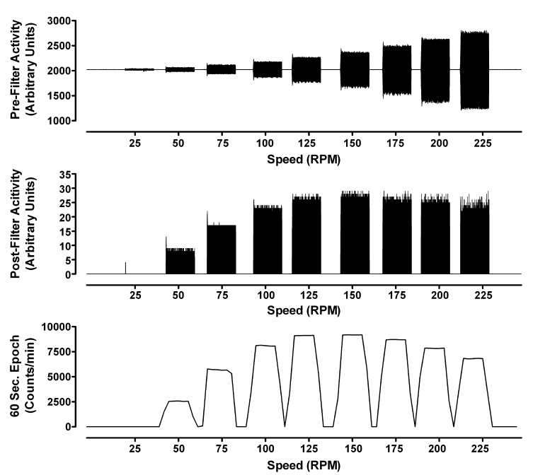
Chen K, et al. Med Sci Sports Exerc 2012
Notes:
Sensor output from three ActiGraph GT3X monitors varies with different input frequency on a benchtop shaker (radius of oscillation =
46.6 mm). All three monitors were using the firmware 1.3 but were programmed in raw prefiltered (30 Hz), raw postfiltered (30 Hz), and 60-s–epoch
modes.

Slide 10
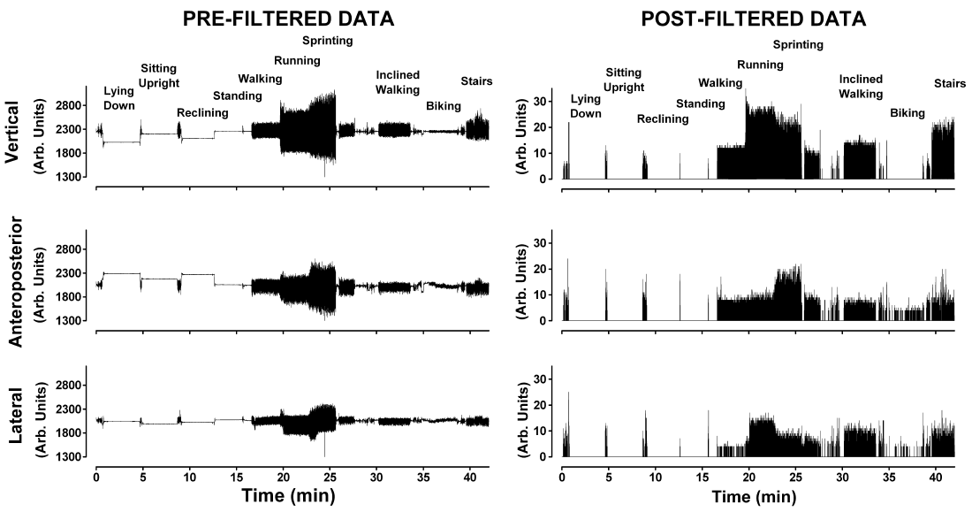
Signal Filtering Effect
Chen K, et al. Med Sci Sports Exerc 2012

Slide 11
Monitoring time
Up to 30 days of monitoring, but memory and wireless capacities are improving
Valid day = at least 10 hours or 60% of waking hours are recommended
Sampling 3 or more days, including weekdays and weekend days are recommended

Slide 12
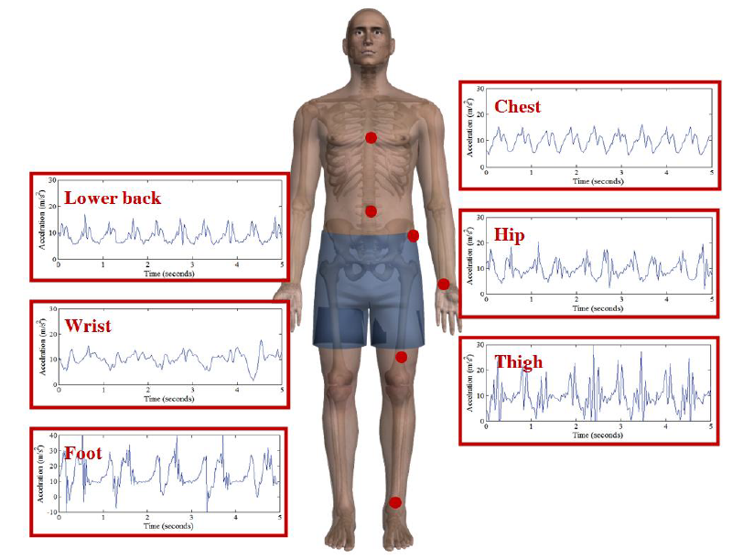
Device Placement
Data from all locations provide similar levels of accuracy, although the hip provides the best single location to record data for activity detection
Activities tested: walking, running on treadmill, sitting, lying, standing and walking up and down stairs
Cleland I, et al. Sensors 2013

Slide 13
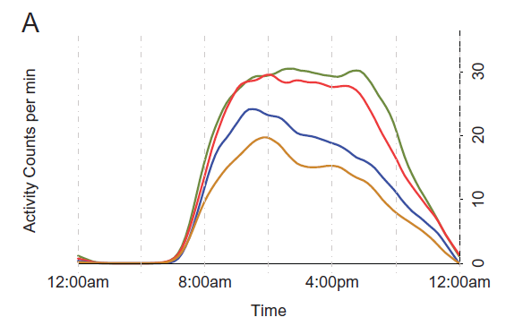
Activity counts by age (N=611)
<60 years
60-67 year
68-74 years
>=75 years
Schrack JA, et al. J Gerontol A Biol Sci Med Sci 2014

Slide 14
Chronic Widespread Pain and Objectively Measured Physical Activity in Adults: NHANES 2003-2004
Dansie EJ, et al. J Pain 2014
Notes:
In terms of physical activity, many studies have shown that self-reported physical activity is decreased in patients with chronic pain. There are some studies suggesting that chronic pain patients misjudge activity levels, so we analyzed data from the National Health and Nutrition Examination Survey in which participants wore accelerometers for 1 week. These plots show the average activity level through the course of a day according to chronic pain status. Green is no chronic pain, gold is chronic regional pain, and red is chronic widespread pain. Those with CWP had significantly decreased activity compared to those without chronic pain. The main differences were in time spent in moderate to vigorous activity (4-7 minutes less per day than ncp). There were no differences in sedentary or light intensity activity. We are currently obtaining accelerometry data in the WHI to characterize activity patterns in older women with pain.

Slide 15
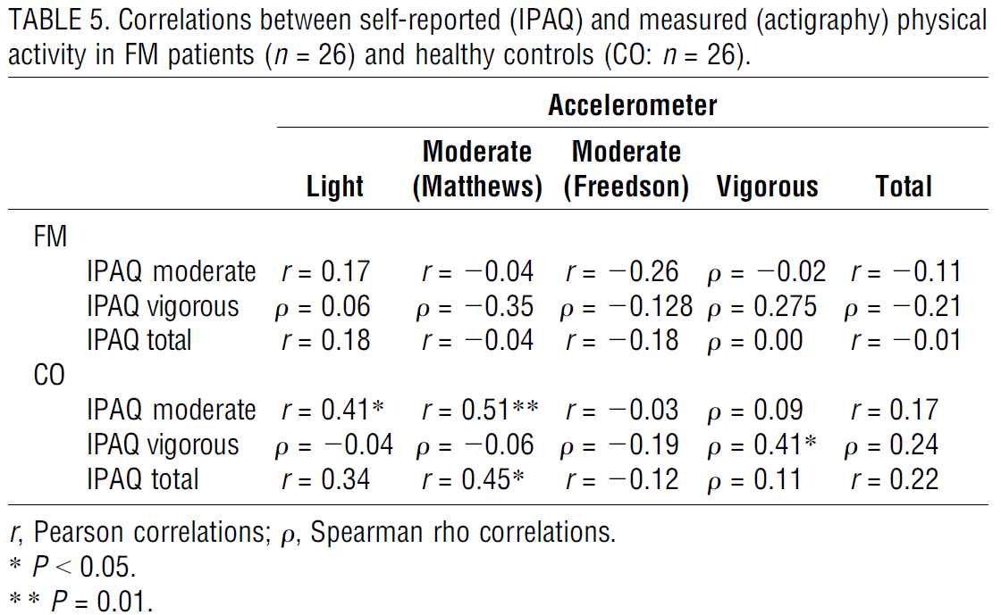
McLoughlin MJ, et al. Med Sci Sports Exerc 2013

Slide 16
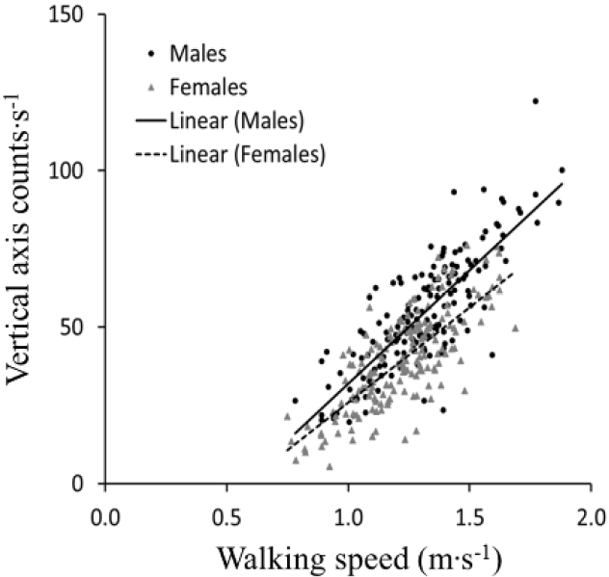
Accelerometer Counts During a 6-minute Walk Test in Older Adults (N=319)
r = 0.80
Van Domelen DR, et al. J Phys Act Health 2014

Slide 17
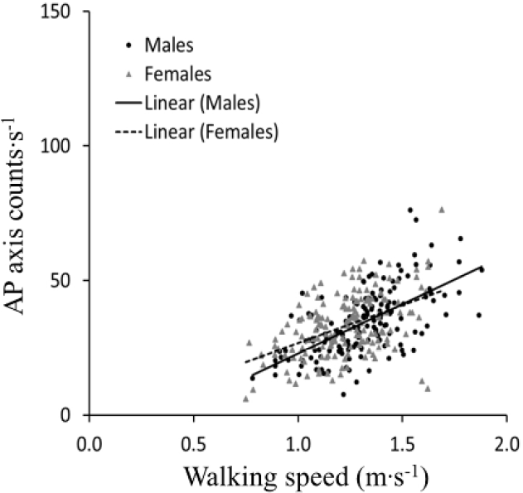
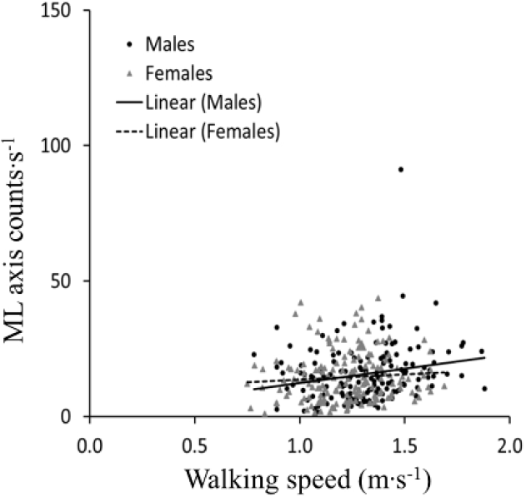
Accelerometer Counts During a 6-minute Walk Test in Older Adults (N=319)
Vertical axis
r = 0.80
AP axis
r = 0.55
ML axis
r = 0.16
Van Domelen DR, et al. J Phys Act Health 2014

Slide 18
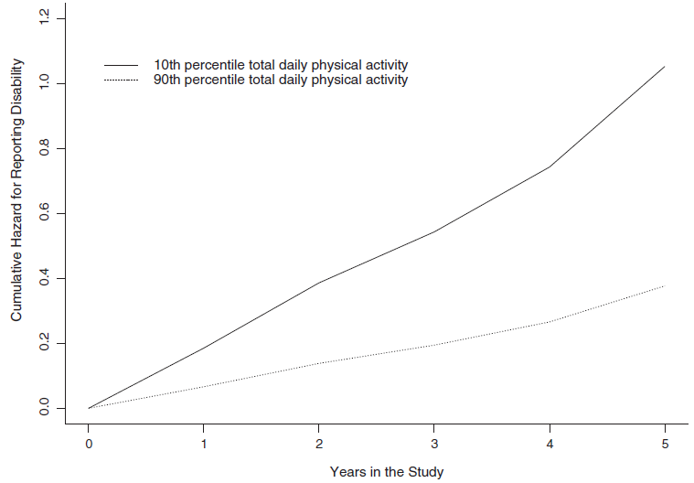
Total Daily Physical Activity and Incident Disability in Basic ADLs (N=718)
Shah RC, et al. BMC Geriatr 2012

Slide 19
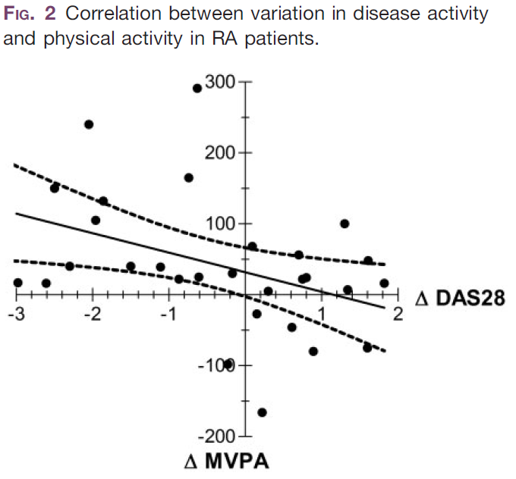
r = -0.46
Hernandez-Hernandez et al. Rheumatol 2014

Slide 20
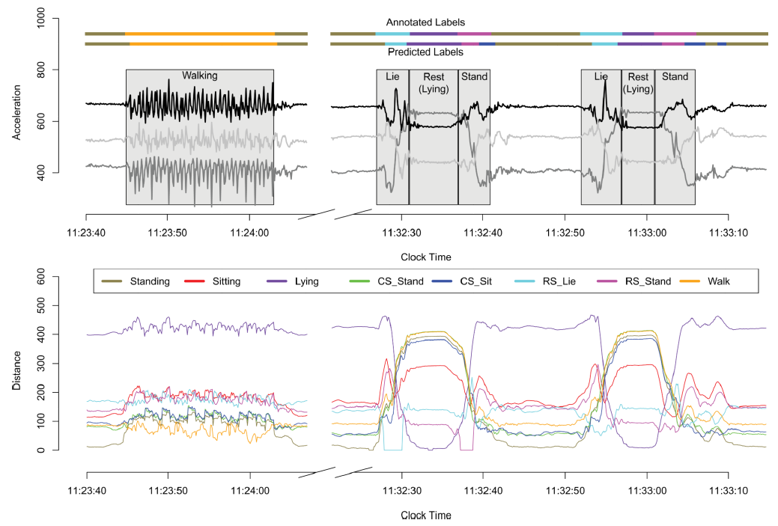
“Movelets”
Bai J, et al. Electron J Stat 2013

Slide 21
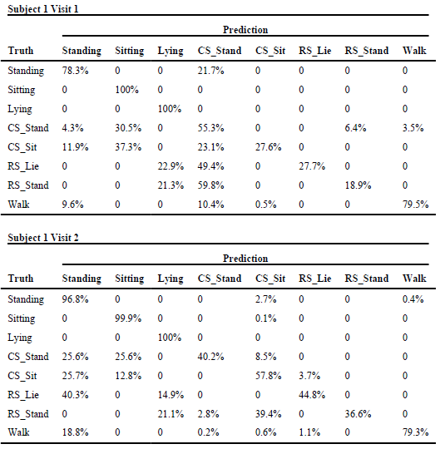

Slide 22
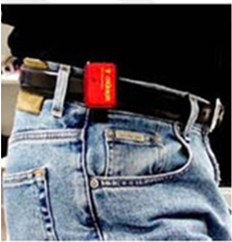
Considerations
Pros
Objective, continuous monitoring
Free-living
High density data, detect lighter intensity activities
Passive
Cons
Costs ($100-$300/device)
Lack context
Underestimates some activities (bicycling, strength training)
Lack of industry standards, device-specific parameters
Data processing & analysis expertise
Notes:
Lack of industry standards for conversion of accelerometer raw data to counts, proprietary algorithms
Higher costs than collecting self-reported data
Need of technical expertise
Information varies per location (hip, lower extremities, upper extremities)
Compliance
Some activities difficult to measure objectively (e.g strength training, bicycling)

