Slide 1










June 14, 2013
IMMPACT-XVI meeting
Washington, DC
Conditioned Pain Modulation (CPM)
Diffuse Noxious Inhibitory Controls (DNIC)
for Phase 2 and 3 Trials
Simon Haroutiunian
B.Sc.Pharm, M.Sc (Clinical Pharmacy), PhD
Danish Pain Research Center
Aarhus University Hospital
Aarhus, Denmark

Slide 2
OUTLINE
Introduction
  Descending pain modulation
  CPM/DNIC testing paradigm and terminology
What does CPM/DNIC measure?
CPM/DNIC testing approaches
CPM/DNIC and chronic pain
CPM/DNIC and response to pharmacotherapy
Discussion: Key methodological issues for inlcuding CPM testing in trials
Notes:
So a brief outline of the talk for the next 30 minutes or so:
I’ll present a short background on descending pain modulation and on of DNIC/CPM testing paradigm and an update on terminology.
I’ll try to raise some of the key questions regarding what is it that we are measuring by this paradigm, which might serve as a basis for the further discussion.
This will be followed by some data on CPM testing approaches, as well as on what happens with CPM in patients with various chronic pain syndromes, and as a consequence of pharmacotherapy.
And finally, I’ll raise some of the methodological issues regarding CPM testing in trials.

Slide 3
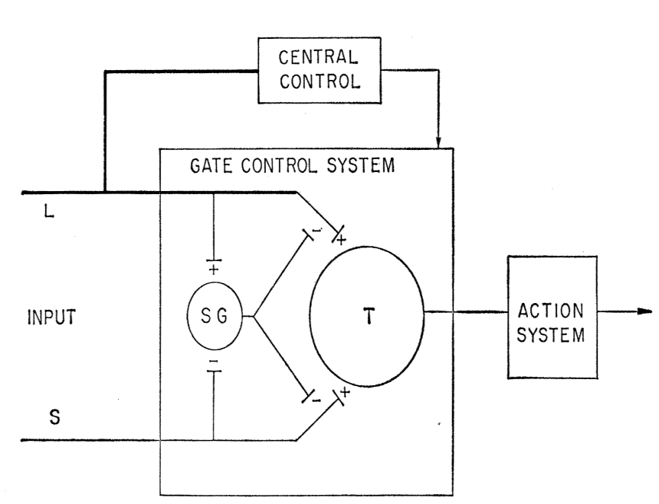
INTRODUCTION
Descending Pain Modulation
Electric shocks, burns and cuts in dogs, followed consistently by presentation of food resulted eventually in dogs responding to these stimuli as signals of food, failing to show “even the tiniest” signs of pain.
Either “the dogs were out to fool Pavlov and refused to reveal they were feeling pain…” or “intense noxious stimulation can be prevented from producing pain…”
Pavlov IP. “Conditioned Reflexes” 1927
Melzack and Wall, Science 1965
Notes:
SG Substancia Gelatinosa
When Pavlov performed his experiments in investigating conditioned reflexes about 100 years ago, he reported that electric shock, burns, cuts and other noxious stimuli in dogs, followed consistently by presentation of food resulted eventually in dogs responding to these stimuli as signals of food, failing to show any signal of pain.
In their seminal 1965 paper on gate control theory Melzack and Wall write: either the dogs were out to fool Pavlov and refused to reveal they were feeling pain…” or “intense noxious stimulation can be prevented from producing pain…”
And this is in fact, one of the earliest experimental evidence that pain experienced by a noxious stimulus, may be modifiable. And this does fit with the gate control theory of spinal cord neurons being regulated by central control.

Slide 4
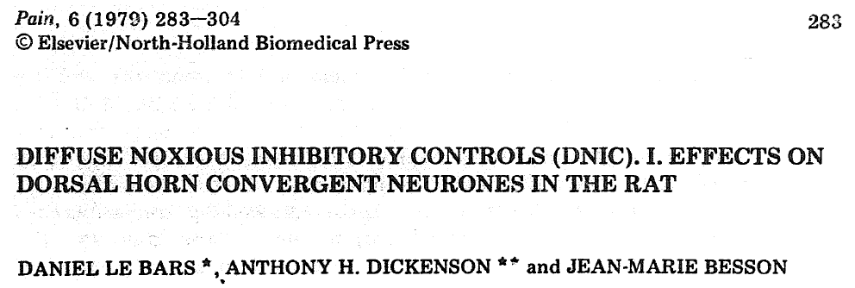
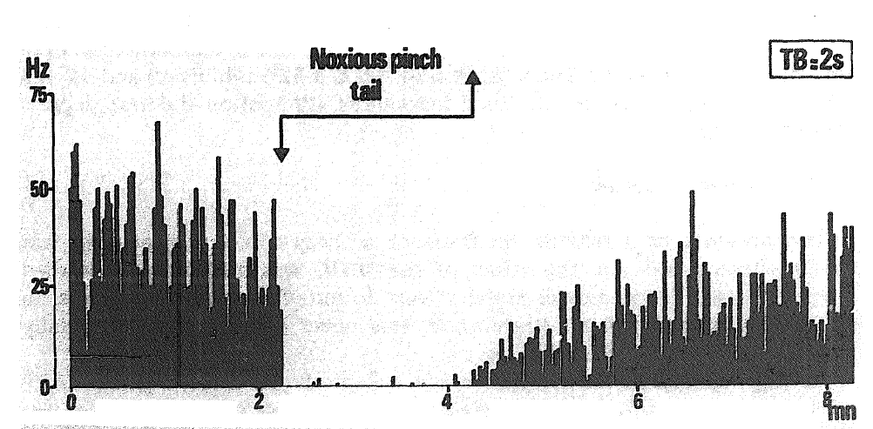
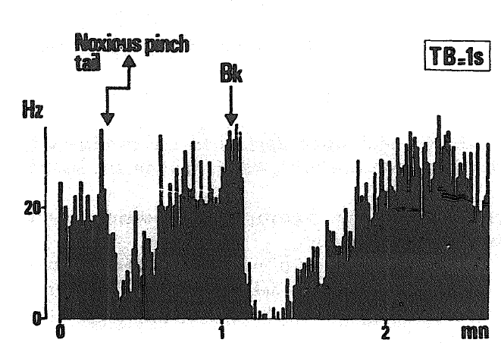
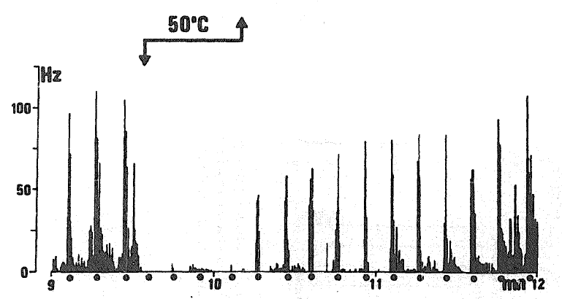
INTRODUCTION
Descending Pain Modulation
Recording from lumbar convergent (Lamina V, WDR) neurons in anesthetized rats
Sustained paw pinch
Tail
Stroking the receptive field
No DNIC effect was observed when recording from non convergent (noxious only, non-noxious and proprioceptive) neurons in the dorsal horn
Le Bars et al, Pain 1979
Notes:
The Term Diffuse Noxious Inhibitory Controls (or DNIC) was coined in this classic 1979 paper, where recording from rat spinal neurons (Lamina V convergent, or Wide dynamic range) showed that the nerve activity following noxious peripheral stimuli can be completely blocked by introducing a different mechanical or thermal stimulus in another part of the body, be it mechanical such as tail pinch, thermal or pharmacologically induced such as IP injection of bradykinin.
And this depression of neuronal activity by peripheral noxious stimulus seems to be specific to convergent neurons and does not silent the activity of other types of dorsal horn neurons.

Slide 5
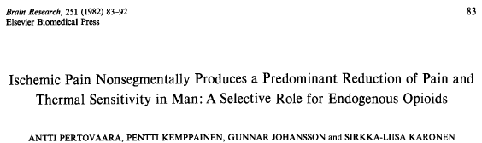
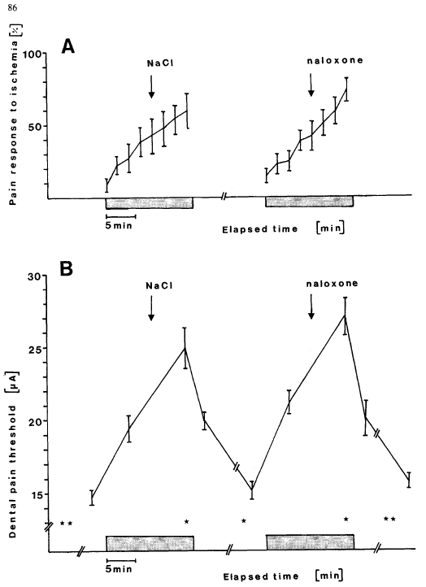
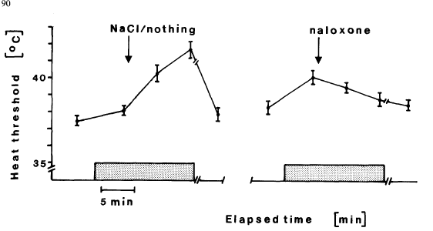
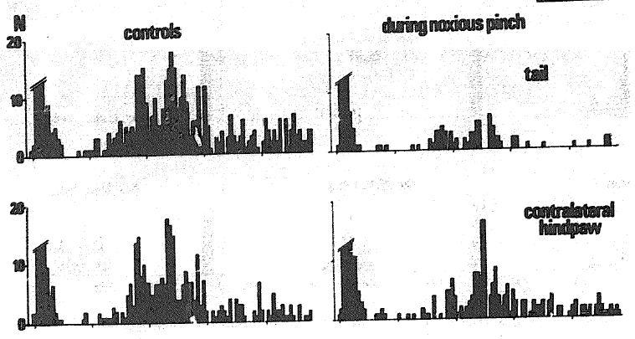
INTRODUCTION
Clinical DNIC/HNCS
No effect of ischemic pain on tactile sensitivity in contralateral arm
Le Bars 1979
Notes:
We hardly can perform similar measurements of live recording from dorsal horn neurons in humans.
Secondly, we don’t know how exactly the activity of the WDR neurons is correlated with clinical or experimental pain
So several approaches have been developed to assess DNIC or DNIC-like response in human subjects, and naturally the terminology different groups have used somewhat varies.
One of the terms frequently used is HNCS, or Heterotopic Noxious Conditioning Stimulation, that refers to the fact that the conditioning stimulus is applied at a remote, extra-segmental, site.
This study from the Finnish group in healthy volunteers showed that applying ischemic conditioning stimulus (tourniquet) on the arm, increased the threshold for pain induced by electrical stimulation around the tooth, and also the heat pain thresholds on the lip, but did not affect mechanical pain threshold on the contralateral arm.
And while heat pain threshold increase was blocked by naloxone, the electrical pain was not, suggesting that endogenous opioid system might selectively be able to block the C fiber mediated thermal pain, but not electrical stimulation pain.
The lack of effect on the contralateral arm is somewhat consistent with animal data, with the same 1979 paper showing that the noxious conditioning of the contralateral paw had less effect on WDR neuronal activity depression, than for example conditioning stimuli applied at the tail, or the muzzle.

Slide 6
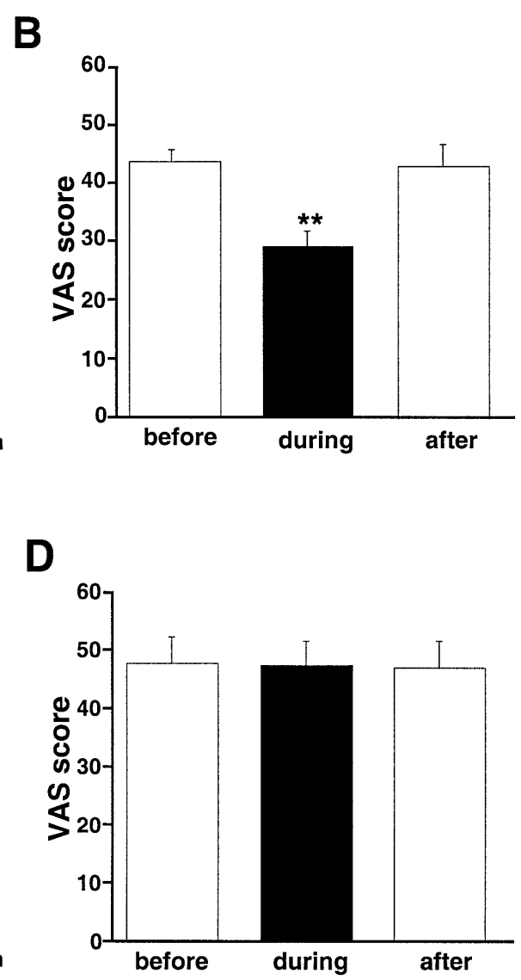
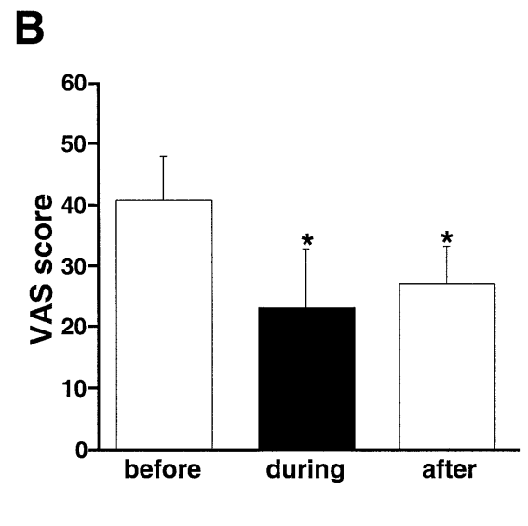
INTRODUCTION
Clinical DNIC/HNCS
Cold pressor test /tourniquet
on normal upper limb
Brushing
Conditioning
Allodynic area
Test
Electrical stimulation of the sural nerve
Contralateral area
Bouhassira et al, Brain 2003
Notes:
HNCS Heterotopic Noxious Conditioning Stimulation
Now let’s take a look at patients with neuropathic pain due to nerve injury:
Brushing the allodynic area as conditioning, and applying electrical stimulation at the sural nerve in the foot as test stimulus, demonstrated that brushing the allodynic area reduced the pain sensation from the stimulation. But brushing the contralateral, nonpainful side did not change the pain rating of the electrical stimulation.
An interesting question would be what will happen to the baseline value if you took the spontaneous pain away and performed the sural nerve stimulation. I’ll try to address in later in the talk.
When the conditioning was changed to applying cold pressor test or tourniquet to normal upper limb, the pain following the nerve stimulation was also reduced.

Slide 7
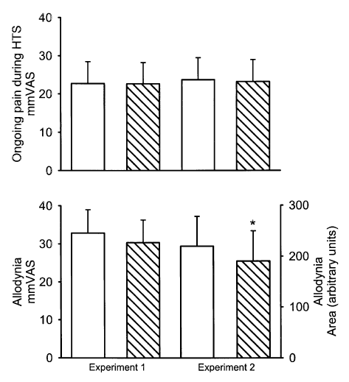
INTRODUCTION
Clinical DNIC/HNCS
Ongoing pain affected by
nonpainful (C/L foot) HTS (17°C, 2 min)
vs
painful HTS (1°C, 2 min)
Brush evoked allodynic pain affected by
nonpainful (C/L foot) HTS (17°C, 2 min)
vs
painful HTS (1°C, 2 min)
Witting et al, Pain 2003

Slide 8
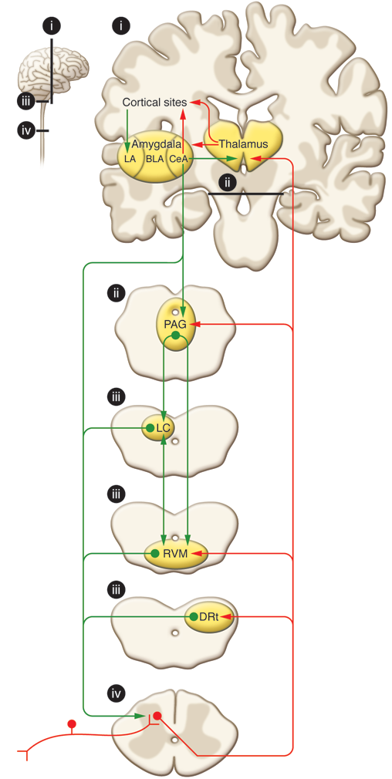
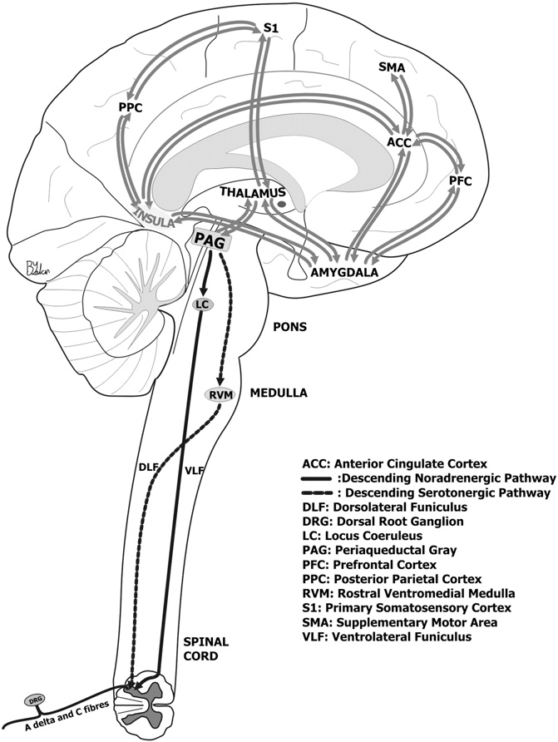
INTRODUCTION
Descending Pain Modulation
Ossipov et al, Journal of Clinical Investigation 2010
Dogrul et al, Progress in Neuro-Psychopharmacology & Biological Psychiatry 2012
Notes:
When we look at the involved somatosensory pathways, nociceptive inputs enter the spinal dorsal horn through primary afferent fibers that synapse onto transmission neurons. The projection fibers ascend to target the thalamus, and collateral projections also target mesencephalic nuclei, including the DRt (Dorsal Reticular Nucleus), the RVM, and the midbrain PAG.
The various sites of the so called pain matrix communicate with each other to integrate the cognitive and conscious perceptions of pain.
And then, the Descending pain modulation is mediated through projections to the PAG, which also communicates with the RVM as well as other medullary nuclei that send descending projections to the spinal dorsal horn.
The locus coeruleus (LC) receives inputs from the PAG, and sends noradrenergic descending inhibitory projections to the spinal cord.
The RVM is responsible for sending the serotonergic descending inhibitory projections to the spinal cord.
Descending projections from the DRt Dorsal Reticular Nucleus are also a critical component of the DNIC pathway.

Slide 9
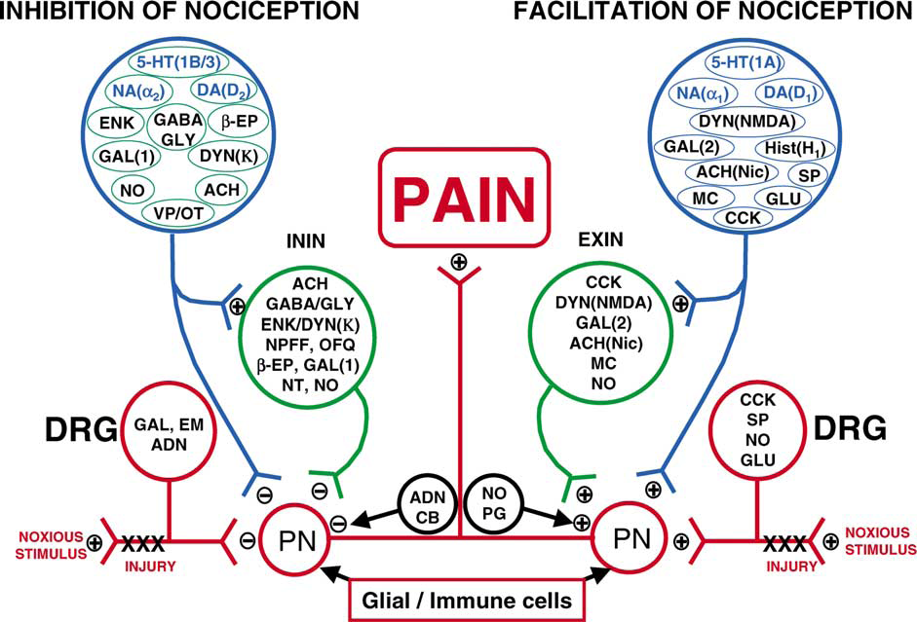
Millan MJ. Progress in Neurobiology 2002
Notes:
A huge number of experiments have been performed with administration of various pharmacological agonists and antagonists to affect the descending inhibition pathways. As this figure illustrates, numerous neurotransmitters are involved in the descending inhibition of nociception directed toward dorsal horn projection neurons, either directly or by a inhibitory interneuron. The process is quite complicated by the fact that some of the same neurotransmitters, by acting at different receptor subtypes, may actually activate descending facilitation of nociception.
Given the amount of involved receptors and neurotransmitters, it’s not a big surprise, that the mechanisms of several of the available analgesic drugs include interfering with descending pain modulation pathways.
But non/drug therapies, such as acupuncture and TENS also work by facilitating descending inhibition, and it was shown that mechanisms of placebo analgesia also involve these processes.
Just note:
Two anatomically-undefined sources are shown: one incorporates the antinociceptive modulators, cannabinoids (CB) and adenosine (ADN)
and the other includes nitric oxide (NO) and prostaglandins (PG). NO can both enhance and suppress nociceptive transmission, while prostaglandins
act pronociceptively. Individual receptor types are indicated only for transmitters which appear at multiple loci and which exert opposite antinociceptive
versus pronociceptive properties. Abbreviations are as follows; PN, projection neurone; DRG, dorsal root ganglion; CCK, cholecystokinin; SP, substance
P; CGRP, calcitonin gene related peptide; GLU, glutamate; DYN, dynorphin; NMDA, N-methyl-d-aspartate; MC, melanocortin; 5-HT, serotonin; NA,
noradrenaline; DA, dopamine; Hist, histamine; GAL, galanin; EM, endomorphin; ACh, acetylcholine; GABA, _-hydroxy-butyric acid; GLY, glycine;
ENK, enkephalin; NPFF, neuropeptideFF; OFQ, orphaninFQ (nociceptin); _-EP, _-endorphin; VP, vasopressin and OT, oxytocin

Slide 10
INTRODUCTION
CPM/DNIC Testing Paradigm
The activity of pain-signaling neurons in the spinal dorsal horn (and in trigeminal nuclei) is attenuated in response to noxious stimuli applied to a remote area of the body
DNIC/CPM/HNCS testing: psychophysical measure to characterize a person’s capability to modulate pain (effect of endogenous analgesia)
Notes:
So the paradigm of DNIC or CPM, if you will, is based on the notion that the activity of pain signaling neurons in the spinal dorsal horn (and in trigeminal nuclei) is attenuated in response to noxious stimuli applied to a remote area of the body.
And in the clinical context, DNIC, CPM or HNCS testing is the psychophysical measure to characterize a person’s capability to modulate pain (which is basically the effect of endogenous analgesia).

Slide 11
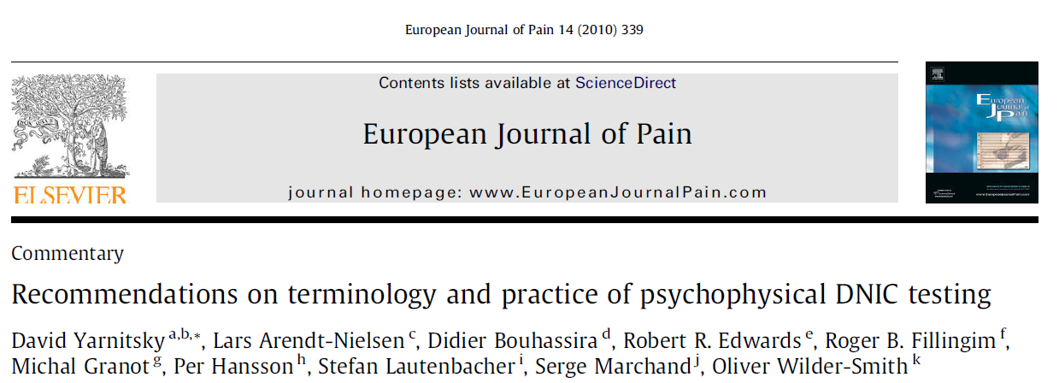
TERMINOLOGY
DNIC / HNCS → Conditioned Pain Modulation (CPM)
Conditioning Stimulus: to induce the change in pain perception
Test Stimulus: the painful stimulus upon which the conditioning effect is tested
CPM: The phenomenon through which the conditioning affects the test
Counterirritation vs. Conditioning
Separating HNCS from DNIC, as these are “overlapping but not homogenous”
Using ”perceptual DNIC-analogous effects” instead of CPM
Michaux et al, Eur J Pain 2010
Notes:
You might have noted I have been using several terms such as DNIC CPM and HNCS. Apparently I am not the only one who was confused by the various term, so to be consistent from now on, I will use the recommendations of the consensus meeting published in European J Pain:
Instead of using DNIC, which is more related to the neurophysiological measuring of the brainstem mediated pain inhibition in animals, and Heterotopic Noxious Conditioning Stimulation, the consensus suggested that the psychophysical human testing to register the net effect of facilitatory and inhibitory mechanisms of pain processing is called Conditioned pain modulation, or CPM.
The stimulus to induce the change in pain perception was agreed to be termed conditioning stimulus, and the painful stimulus upon which the conditioning effect is tested is called Test stimulus. And CPM represents the net phenomenon through which the conditioning stimulus affects the test stimulus.

Slide 12
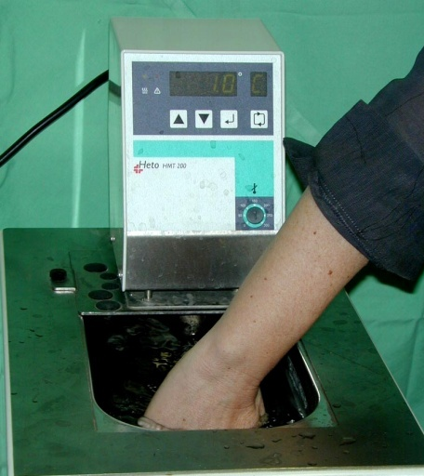
CPM TEST PARADIGM
CPM = ∆ NPS
NPS
Rt
Lt
Rt
Temp
Test-stimulus _{baseline}
Test-stimulus _{conditioned}
Conditioning stimulus
Courtesy: David Yarnitsky
Notes:
So the DNIC paradigm is that there is a test stimulus that gives rise to pain, intensity of which we measure, for example on NRS scale. Sometime after that we apply the conditioning stimulus, during which, or after which, we apply the test stimulus again and measure the intensity of pain it induces. The difference between the two pain ratings is the value of CPM. When the intensity of the second test stimulus is lower, it refers to efficient CPM.

Slide 13
OBJECTIVE
Using CPM testing for patient phenotyping
1. What are we REALLY measuring?
Identifying a neurotransmitter-specific malfunction in a descending pathway?
Combined output of all descending control mechanisms?
Capability of “placebo response”?
2. What factors affect DNIC/CPM?
Age/Gender/Genetics
Psychological variables
Painful conditions (and their duration)
Pharmacological and other treatments
Notes:
Now this is a nice paradigm, but the main question that we should ask is what is really that we are measuring by CPM?
Can we identify neurotransmitter or pathway specific malfunction in the descending somatosensory system?
Is CPM a combined output of all descending control mechanisms? And if yes, how should we apply it then if we are looking for specific mechanisms?
Does CPM give us an indication of placebo response? If yes, it could be a fantastic tool to screen and exclude patients from analgesic clinical trials…
Another important aspect is how we interpret the results of CPM testing?
Are there normative values for healthy volunteers?
Is it affected by gender/age/genetics?
How strongly psychological variables like anxiety, depression or catastrophization are linked to CPM response?
How painful conditions affect CPM? Does CPM become inefficient because of chronic pain, or patients with inefficient CPM are the ones who develop chronic pain?
And some of these questions are yet to be answered.

Slide 14
CPM PROTOCOLS
Examples
Spatial summation procedure (cold conditioning)
Conditioning stimulus
Hot water bath immersion
Cold water bath immersion
Tourniquet: ischemia
Test stimulus
Fixed stimulus
  Contact heat: Fixed intensity of stimulus (e.g. Pain-60)
  Electrical stimulation
  Mechanical stimulation
Threshold measurement
  Thermal or mechanical
Most common conditioning, UE
Notes:
The methodologies have developed over time, and different types of conditioning and test stimuli has been tried.
The typical conditioning stimuli are either thermal, like hot or cold water immersion, or the ischemia model by applying a tourniquet. The most common conditioning method is immersion of the upper extremity in cold water.
The test stimulus can be of fixed intensity, thermal mechanical or electric stimulation, or you can measure the pain threshold by applying thermal or mechanical stimuli of varying intensity.
Another method is the spatial summation procedure, which is a type of cold conditioning, but the conditioning also serves as test stimulus.

Slide 15
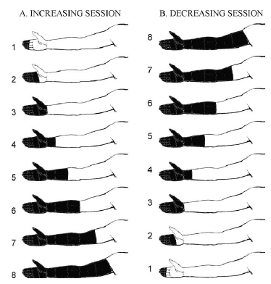
Spatial summation (cold conditioning)
12°C water bath
Julien et al, Pain 2005
Notes:
Gradual immersion of increasing or decreasing area into cold water, with a few min intervals between immersions, typically results in lower pain rating and unpleasantness at the end of each session, as opposed to the opposite order of immersion.

Slide 16
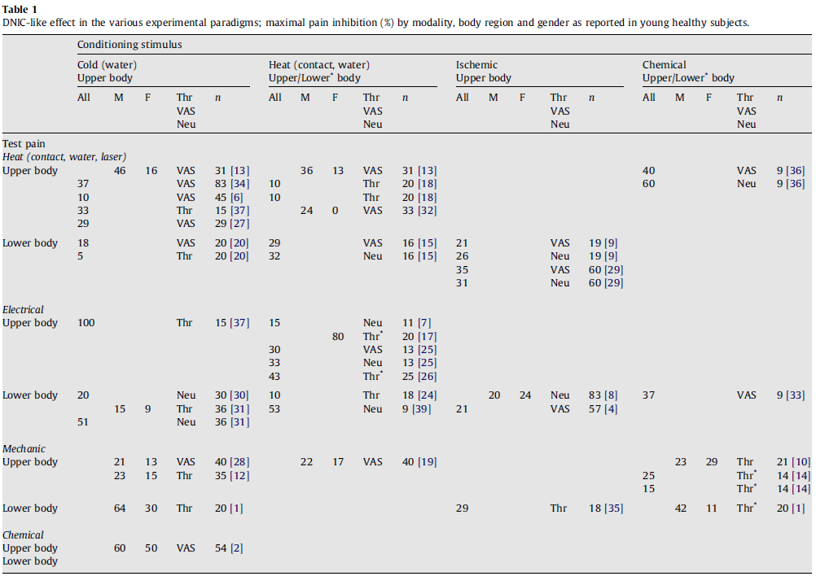
CONDITIONING vs. TEST STIMULI
Variability in protocols
Pud et al, Pain 2009
Notes:
There is a substantial variability among various CPM protocols, and the generalization from one method to another is not straightforward.
In the figure here from Dorit Pud and colleagues you can see the summary of different conditioning and test stimuli employed, and the resulting maximum change in CPM, and this table suggests that you can use different combination of thermal, mechanical, chemical and electrical stimuli, and end up with comparable CPM outcome. This demonstrates that there is probably no one single preferred protocol, or even type of preferred combination between conditioning and test stimuli. But the main question is whether these all measure the same effects, and then it doesn’t really matter which method to implement in a clinical trial.. or each combination might be assessing a different mechanism of descending pain modulation.

Slide 17
CONDITIONING vs. TEST STIMULI
Variability in protocols
Conditioning: Hot bath 46.5°C
Test stimulus: Heat Pain-60
Yarnitsky el al, Pain 2008
Nahman-Averbuch et al,
J Pain Sympt Manage 2011
Yarnitsky et al, Pain 2012
DNIC>0: efficient pain modulation
CPM<0: efficient pain modulation
CPM<0: efficient pain modulation
Test stimulus application: Dominant / Right / Dominant arm
Notes:
And even within the same group, using the same paradigm, methods evolve over time, which is quite natural, and these three studies, within the range of 4 years, all from the same group, using the same conditioning and test stimulus, have slight modifications, as for the assessment of conditioning stimulus intensity, the times of pain assessment, definitions, and testing site (e.g. dominant arm vs. right arm). And even these small differences may obviously influence the testing outcome.

Slide 18
FACTORS AFFECTING CPM
Variables that may affect the extent of the CPM response:
Gender
Age
Testing site
Surface area
Duration
Intensity of conditioning and test stimuli
Parallel vs. sequential stimulation
ISI
Genetic variability
Notes:
Several factors has been identified, that may affect the extent of CPM response.
Differences in any of the following has the ability to affect the CPM. So future studies should aim to control as many of these factors as possible.
Baad-Hansen Pain 2005. no sex differences in intraoral capsaicin induced pain and DNIC.

Slide 19
FACTORS AFFECTING CPM
The relationship between conditioning stimulus intensity vs. CPM response magnitude is unclear
Positive correlation: Le Bars 1995; Villanueva and Le Bars 1995; Fujii 2006
No correlation: Pud 2005; Baad-Hansen 2005
Does conditioning stimulus need to be painful to induce endogenous analgesia?
Yes: Le Bars 2002
No: Lautenbacher and Rollman 1997, Lautenbacher et al. 2002
Pain intensity of conditioning stimuli: 12°C VAS 20-25
46.5°C VAS 40-50
Granot et al, Pain 2008
Notes:
And it is not simple, as the data until now have been confusing. For example some studies have shown a positive correlation between stimulus intensity and CPM response, but other did not found such correlation.
The same goes with the question whether the conditioning stimulus should necessarily be painful? And here again, the data are contradictory.
On the other hand, in some studies different conditioning stimuli, causing different magnitudes of pain, have shown comparable effect on CPM response.

Slide 20
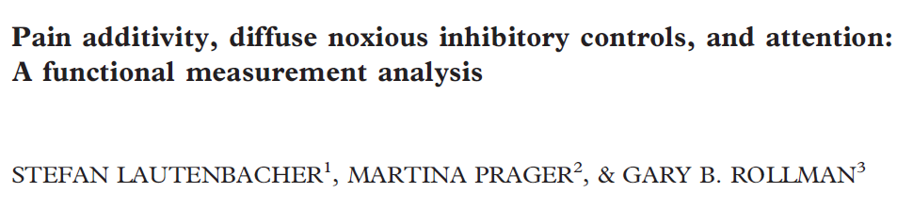
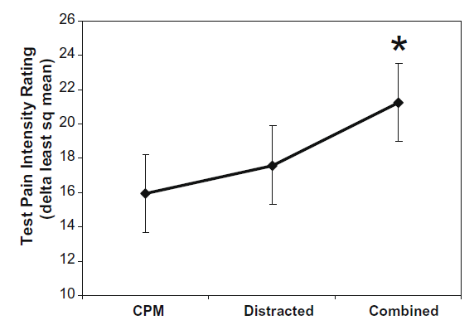
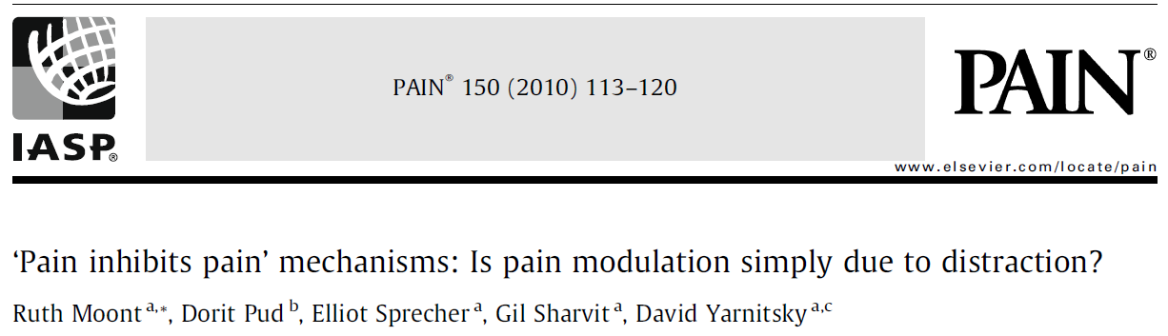
FACTORS AFFECTING CPM
Is CPM merely attributable to distraction?
Two stimuli, whether innocuous or noxious, produce joint effects, which are greater than either presented alone but the combined perceptual effect is far from additive.
“…Distraction had a very small effect, suggesting that the “pain inhibits pain” phenomenon attributable to DNIC is not due to attentional processes”.
Notes:
We know from clinical practice, or just even from daily experiences, that distracting someone who is in pain may shift his attention from pain and thus pain experience becomes less unpleasant, or disturbing.
So is conditioning, or counterirritation simply a type of distraction?
I think it’s a difficult question with no simple answer. Several groups have tried to address this issue, by testing pain modulation just by distraction tasks, by conditioning, or both, and the suggestion until now, is that CPM is not due to just distraction, as combining Conditioning with distraction yields higher pain modulation, and this cannot be accounted for just as “even more distraction”.
We did a study recently where experimental pain intensity was reduced by emotional stimulation in one group of participants but not in another, and when we did the same experiment in FMRI, the group that did’t modulate the pain in a quiet environment, had more pain modulation effect in the noisy stressfull environment of MRI.
So it seems that distraction cannot explain all CPM effect, but it plays some role in it. The difficult task is to differentiate between the contribution of the two components.

Slide 21
CPM & CHRONIC PAIN
Temporomandibular disorders
Maixner et al, Pain 1995
King et al, Pain 2009
Fibromyalgia
Julien et al, Pain 2005
Kosek and Hansson, Pain 1997
Osteoarthritis
Arendt-Nielsen et al, Pain 2010
Kosek etal, Pain 2000
Tension type headache and migraine
Pielsticker et al, Pain 2005
Sandrini et al, Cephalgia 2006
Irritable Bowel Syndrome
Wilder-Smith et al, Gut 2004
Piché et al, Pain 2010
Notes:
Now let’s look at the CPM profile in chronic pain patients.
Many studies have been performed to address the question whether CPM is impaired in chronic pain patients, and indeed, it seems that this is the case, mainly in what is called functional or idiopathic pain syndromes such as fibromyalgia, TMD, and IBS.

Slide 22
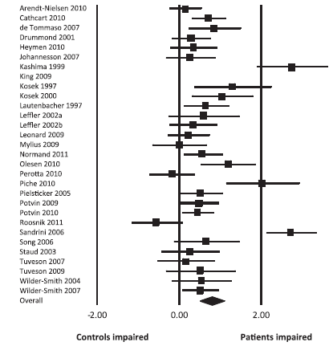
Conditioning
Cold (n=17)
Limb ischemia (n=8)
Heat (n=4)
Capsaicin (n=1)
Test
Mechanical pressure (n=15)
Electrical stimulus (n=9)
Thermal stimulus (n=8)
Lewis et al, J Pain 2012
Notes:
A recent systematic review that included about 30 studies characterizing CPM in chronic pain quite clearly shows that CPM is less efficient in chronic pain population. And this includes studies with different paradigms of CPM testing, various conditioning and test stimuli. And the results seem quite unidirectional.

Slide 23
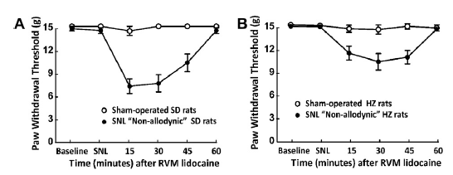
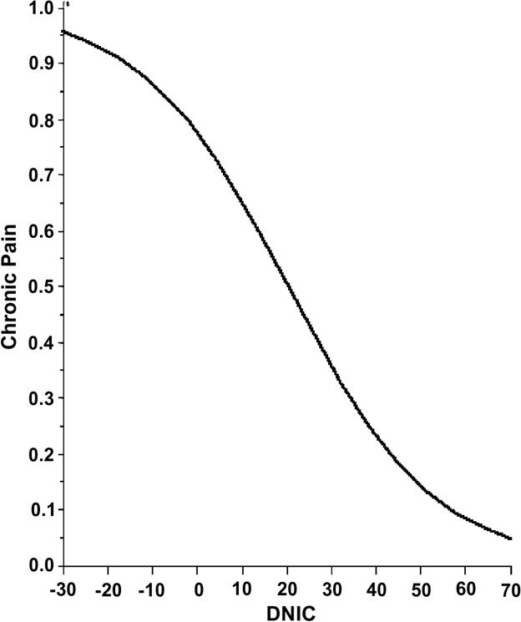
CPM& CHRONIC PAIN
Can CPM protect us against chronic pain?
De Felice et al, Pain 2011
Yarnitsky et al, Pain 2008
Notes:
And the question is of course, again, is it pain due to low CPM, or low CPM is due to chronic pain?
There are some data supporting that efficient CPM may be protective against chronic pain.
In an elegant preclinical study by Franc Porrecas group, rats that after SNL did not develop allodynia, actually did show allodynia when lidocaine was injected into the RVM to block the descending inhibitory control.
In sham operated animals, that of course did not exhibit allodynia, RVM injection of lidocaine did not cause allodynia.
And also clinically, patients that demonstrated more efficient CPM before thoracic surgery, developed less persistent post thoracotomy pain.

Slide 24
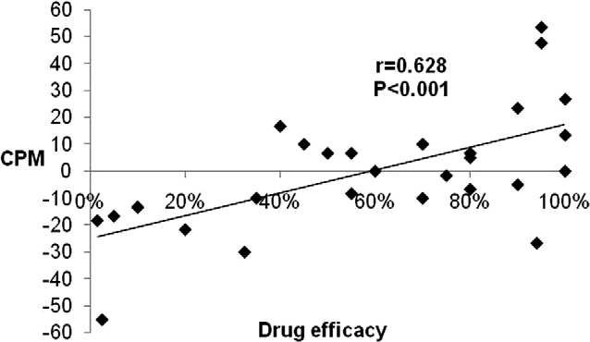
CPM & PHARMACOTHERAPY RESPONSE
Duloxetine for DPN
Yarnitsky et al, Pain 2012
Notes:
So we have data that CPM is less efficient in chronic pain, we have data suggesting that inefficient CPM may increase the chances for chronic pain., and another important question is, especially for clinical trials: can CPM response predict response to specific pharmacological therapy?
The only prospective study I am aware of to test this hypothesis is the study from David Yarnitskis group, that showed, that patients with DPN with low CPM baseline responded better to treatment with Duloxetine, an SNRI that is supposed to enhance descending pain modulation.
But since this is not a placebo controlled trial, a natural question that arises : is this response drug specific or mechanism specific, or these patients would also response to any treatment? Or placebo treatment?
And this should be addressed in modifications in future study design

Slide 25
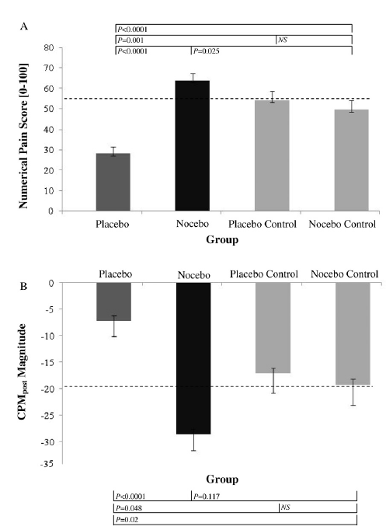
CPM & PLACEBO RESPONSE
Brain and brainstem structures essential for DNIC (e.g. ACC, Thalamus, PAG, RVM) play a key role in placebo analgesia
Eippert et al, Neuron 2009
Nir et al, Pain 2012
Notes:
We know that some of the brain and brainstem structures that are essential for DNIC, also play a key role in placebo analgesia.
In an interesting study by Nir and colleagues, they evaluated whether the CPM effect is a function of the stimulus intensity, or rather the magnitude of perceived pain. And by manipulating pain perception by placebo or nocebo, they concluded that CPM capacity depends on the perceived magnitude of the conditioning pain, rather than only its physical intensity.
The placebo manipulation diminished the perceived Conditioning stimulus painfulness and in turn reduced CPM responses;
The nocebo manipulation augmented the perceived CS painfulness but evoked no significant change in the CPM responses, possibly due to a ceiling effect of descending pain inhibition represented by the CPM response.
This means that the CPM effect is not merely a neurophysiological response to the noxious stimulus, like DNIC, but rather something more complex, with significant cognitive involvement and also probably placebo type response.

Slide 26
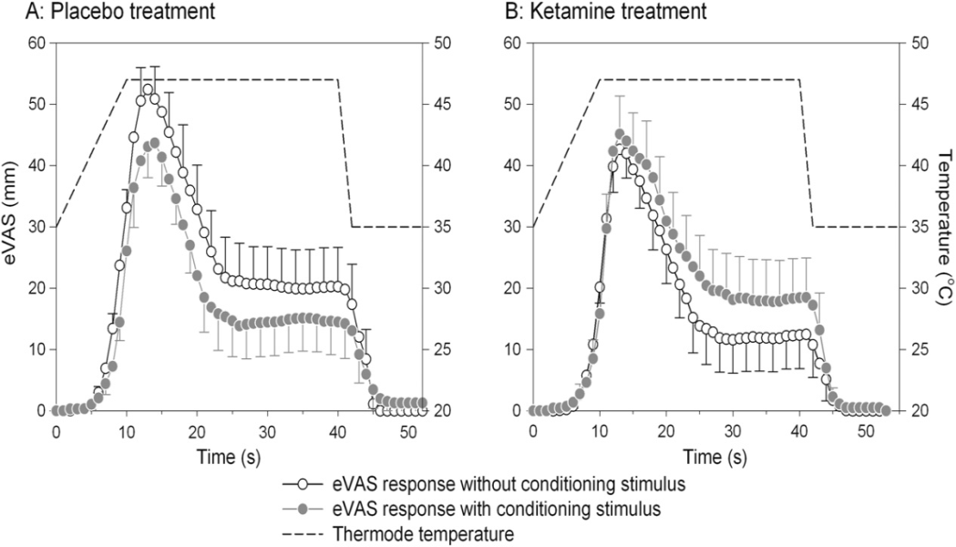
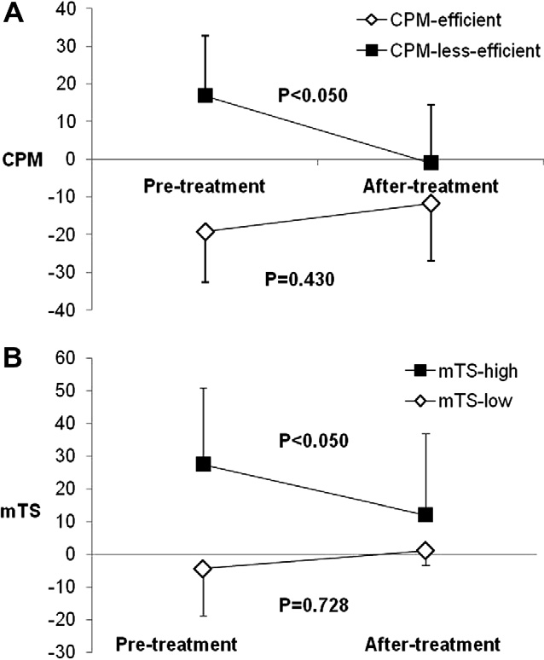
TREATMENT EFFECT on CPM
Pregabalin treatment has only moderate effect on CPM
Bouwense et al, PLoS One 2012
IV Ketamine treatment reduces DNIC towards more pronounced pain facilitation following noxious thermal stimulation in healthy volunteers
Niesters et al, Pain 2011
The effect of Duloxetine on CPM different in patients with efficient vs. inefficient CPM
Yarnitsky et al, Pain 2012
Notes:
Another important question is whether CPM is a given property of an individual, or it is a trait that can change over time, or following a treatment for example.
There is not too much literature on it,
But Pregabalin treatment was shown to have only moderate effect on CPM.
Iv ketamine treatment, for example, worsened CPM, or caused more pain facilitation and not inhibition.
In the previously mentioned duloxetine study, duloxetine improved CPM in patients with malfunctioning CPM, but did not change it much in those who had functional cpm profile.

Slide 27
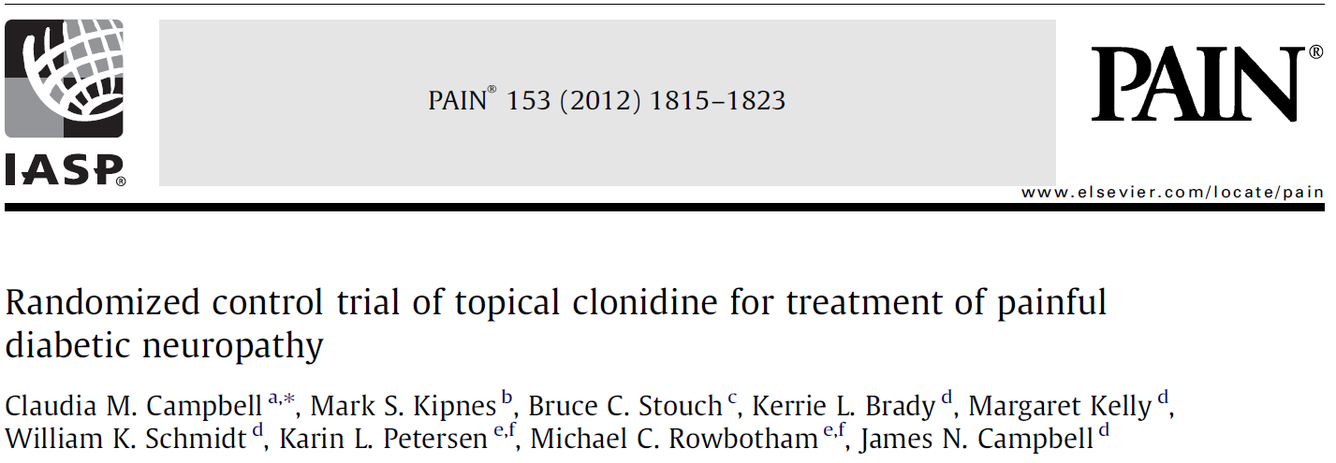
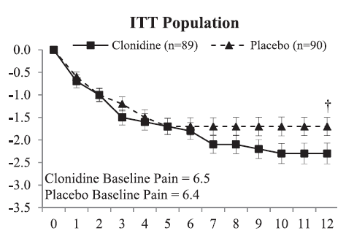
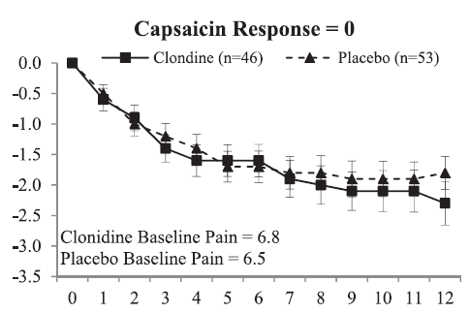
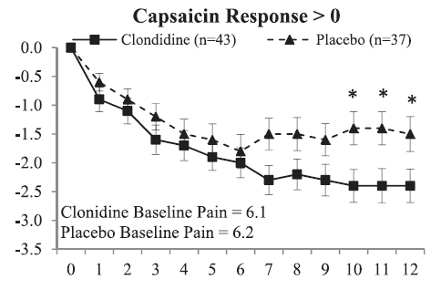
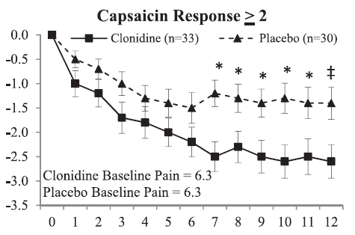
PHARMACOTHERAPY RESPONSE PREDICTORS
May other biomarkers/predictors actually measure CPM response?
P=0.07
P<0.05
P<0.01
Notes:
A question that very much interests me, personally, is whether other predictors or biomarkers we are using, may be actually measuring CPM response.
In an interesting recent study on topical clonidine in DPN, the authors showed that in overall, topical clonidine was not more effective than placebo, but in subgroup of patients with increased baseline pain response to topical capsaicin, the treatment was more effective.
Yes, in these that had any pain following capsaicin application, and especially those with pain more than 2 on 0-10 scale, the separation between clonidine and placebo is indeed better.
But let’s look carefully at the data. Here is the drug response of the whole group… and here are the different subgroups. Is the response really better? I don’t think so..
But now look at the placebo response.. here is the response in overall group, and here is the reponse in capsaicin responders. In my humble opinion, the conclusion of the paper is that in patients with capsaicin response the placebo effect is smaller.
So these patients all had chronic pain… and now we applied capsaicin.. and regardless of their small fiber morphology or function, maybe the ones that had high pain response were merely those who has inefficient CPM, and thus, also less placebo response.

Slide 28
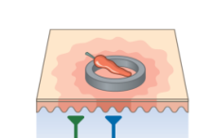
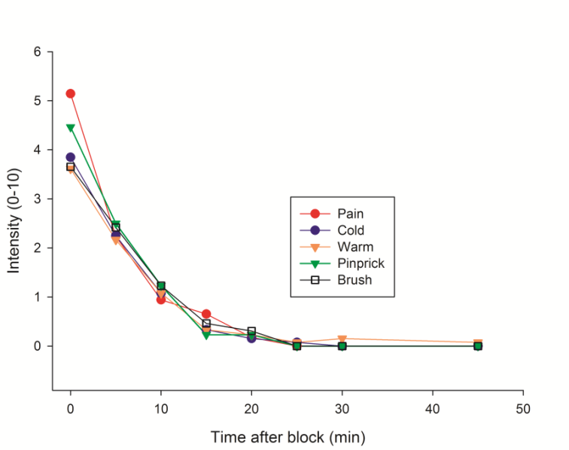
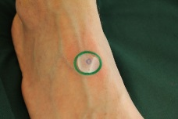
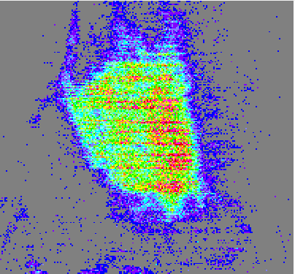
PHARMACOTHERAPY RESPONSE PREDICTORS
May other biomarkers/predictors actually measure CPM response?
Unilateral PNI in foot.
Baseline topical capsaicin testing (10% cream for 30 min) (pain, flare response by laser Doppler)
US-guided peripheral nerve block with 2% Lidocaine (innervation of painful area)
Topical capsaicin testing on C/L foot 90 min after block (with complete pain relief)
 | Baseline (ongoing pain) | With nerve block
Flare response | 248.7 | 232.2
Pain | 24.2 | 38.3
Notes:
In this regard I looked at some of our data, from a study we just completed with a completely different objective, but the data was there, so consider it just a stimulating exercise. This is complete post hoc analysis.
We had 7 patients with one sided peripheral nerve injury and NEUP.
WE PERFORMED baseline topical capsaicin testing on the contralateral foot.
On a diffetent day, they underwent a pnb that completely abolished their ongoing pain. And now when they don’t have pain, we did the topical capsaicin test again on the CL foot. We measured the local flare response with laser doppler, which is completely local response that do not involve CNS, and also the pain response.
Correlations
Individual pain change
No change in flare, but about 50% INCREASE in pain intensity
Again, I cannot claim anything since this is not prospectively tested hypothesis, but it may be possible that assessing topical capsaicin induced pain in healthy volunteers and patients with ongoing pain measures different things, and maybe the ones with less pain have just more effective CPM, and therefore better placebo response.

Slide 29
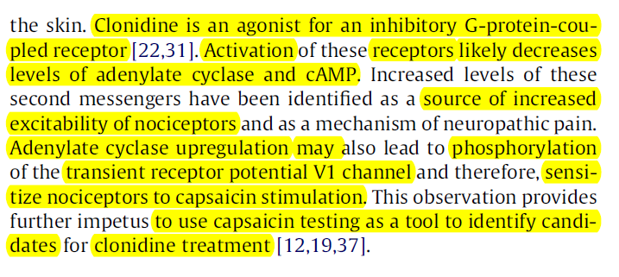
PHARMACOTHERAPY RESPONSE PREDICTORS
May other biomarkers/predictors actually measure CPM response?
Notes:
The discussion in the papers was that clonidine, by acting at GPCRs decrease adenylate cyclase levels, that might have caused TRPV1 sensitization to capsaicin.
Now this might be true. But my point is that while it is important to do explorative analyses to formulate questions for further research, we should be careful in drawing conclusions on mechanism-specific interventions, based on this type of findings, where our primary hypothesis was not generated to answer this specific question: Do patients with increased response to capsaicin respond better to topical clonidine tx? If this was the hypothesis, the study would be probably designed differently

Slide 30
DISCUSSION
Is CPM mechanism-specific, or may be useful for predicting any (placebo?) treatment response?
Study design optimization for prospective testing in Phase 2 and Phase 3 studies
Optimal / standardized CPM protocols
Notes:
And this brings me to the last slide, where I would like to raise the key issues that I believe are still unclear, and warrant an appropriate discussion.
Is CPM mechanism specific? Or it can be used as a tool to predict any treatment response, or maybe placebo response?
How should we design future studies to address this questions properly, and find drug specific or mechanism specific effects?
How can we optimize, or least try to standardize the various CPM protocols so we can compare findings from different studies?

Slide 31
THANK YOU

Slide 32
INTRODUCTION
Descending Pain Modulation
Treatments involved in facilitating descending pain modulation:
Antidepressants
Opioids
Cannabinoids
NSAIDs
Nicotinic Acetylcholine agonists
Placebo
Electrical stimulation (e.g. TENS)
Acupuncture
Bitner et al, J Neurosci 1998
Meng et al, J Neurophysiol 1998
Ossipov et al, J Clin Invest 2010
Notes:
Thus, descending pathways appear to be very important therapeutic target for the treatment of pain.

