Slide 1




Recommendations for Patient Phenotyping in Phase 2 and 3 Analgesic Clinical Trials: Response to Pharmacologic Challenge
Stanford University School of Medicine
Department of Anesthesia
Martin S. Angst
M.D., DEAA
Professor of Anesthesia
email: ang@stanford.edu
Notes:
Good morning – it is a pleasure to have the opportunity to speak to you about the clinical features and implications of opioid-induced hyperalgesia, a topic that has stirred my interest during the last decade.

Slide 2

Pharmacological phenotyping
Notes:
The assumption underlying the concept of pharmacologically phenotyping of patients is that the pharmacological response to an intervention is diverse. Most of us would expect that patients’ response to a pharmacological intervention is highly variable. As such, we would accept the notion that putting all patients through the same test procedure or phase II or III analgesic clinical trial does not do justice to patients. Some patients may do well, some may do okay, and some may miserably fail. Averaging test performances or trial results across all patients likely produces ambiguous results ranging from no to moderate efficacy. As importantly, subgroup of patients who may respond well to the intervention may readily be missed. So, an ability to a priori identify and characterize the subgroup of patients that is likely responsive to a pharmacological intervention is highly desirable and is the goal of pharmacological phenotyping.

Slide 3
Pharmacological diversity: Some evidence
Angst et al., Pain 2012
Notes:
Pharmacological diversity can be shown quite readily under experimental conditions, i.e., conditions that eliminate many confounders that complicate the clinical setting including disease heterogeneity, co-morbidites, and drug-drug interactions. If pharmacological diversity exists in the laboratory, we would only expect it to be even greater in a clinical setting.
The graphs depict data collected in 228 MZ and DZ twins exposed to the same target concentration of the opioid alfentanil during a computer controlled intravenous infusion. Analgesic effects were assessed by determining the pain threshold to cold pressor pain before and during the infusion of alfentanil. The cold pressor pain threshold is determined by asking a subject to immerse the hand and part of the forearm into a 12-liter tank filled with ice water and measuring the time to the onset of pain.
Exposure to alfentanil produced significant analgesia as indicated by an increase of time from 8.1 to 15.2s. The box indicate the IQ-range, the bars indicate the 10th and 90th percentile and the small lines indicate outliners.
The plot in the middle ranks analgesic effects for all twins from smallest to largest. The median, interquartile range and 10th and 90th percentile are indicated by the straight line, the dashed lines and the dotted and dashed lines. There was a 5x variation in analgesic effect size within the IQ range and a 40x variation in-between the 10th and 90th percentile. Heritability or genetic effects accounted for 60% of the observed response variance.
We also measured respiratory depressant opioid effects as indicated by an increase in transcutaneous carbon dioxide. The magnitude of respiratory depression is plotted against the magnitude of analgesia to cold pressor pain. There was no significant correlation indicating that subjects can be subdivided into four quarters: subjects with small analgesic and respiratory depressant effects, subjects with large analgesic and respiratory depressant effects, subjects with small analgesic but large respiratory depressant effects and subjects with large analgesic and small respiratory depressant effects – the group I wanted to belong to. These data suggest dose escalation in the absence of a desired analgesic effect may be possible in some but not all patients due to dose limiting toxicity.
Twin study: Large variability in cold-pressor pain threshold; heritability accounted for 60% of the variance. No significant correlation between analgesic and respiratory depressant effects. Respiratory depressant effects not significant for heritability but significantly aggregated in families (30%).

Slide 4
Enriched enrollment randomized withdrawal design
Aim: Account for pharmacological response diversity (patient characteristics, disease heterogeneity) → avoid disappointing average results and maximize benefits for subgroups
Exclude patients from efficacy studies who are unresponsive to drug or suffer from unacceptable side effects
Most commonly used form of pharmacological phenotyping
Short history of use with a few dozen trials to date
Accepted for phase II and III analgesic drug studies
Implemented in approval process of Ultram ER® (tramadol), Opana ER® (oxymorphone), Embeda® (morphine/naltrexone), and Lyrica®
Notes:
Pharmacological phenotyping has formally been implemented in analgesic trials with the use of the enriched enrollment randomized withdrawal design
During the last decade the use of EERW has received significant attention and has been endorsed by regulator agencies
Indications for listed medications: Ultram-ER for moderate to moderately severe chronic pain; Opana-ER for moderate and severe acute/chronic pain; Embeda for moderate and severe pain; Lyrica for PHN, PDN, FM

Slide 5
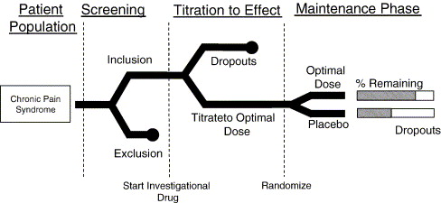
Enriched enrollment randomized withdrawal design
Lemmens et al., Contemp Clin Trials 2006
Notes:
The essential differences between a classical analgesic RCT and the EERW design is the shift in the point of randomization. In the classical RCT the patient is randomized before receiving trial therapy, while the patient is openly titrated with active treatment under study and is only randomized when satisfactory efficacy at worst tolerable adverse affects are established.
Study drug is titrated to effect in all patients meeting inclusion criteria during the enrichment phase to identify responders. This first phase of the EERW closely mimics clinical practice. Patients unresponsive to the drug or experiencing unacceptable side effects are discontinued.
The second phase then uses the conventional randomization to active treatment and placebo allowing for a conventional test of efficacy in a population more likely to respond to the drug of investigation. Most common efficacy measures are differences in pain scores or loss of treatment effect in groups randomized to active treatment or placebo.

Slide 6
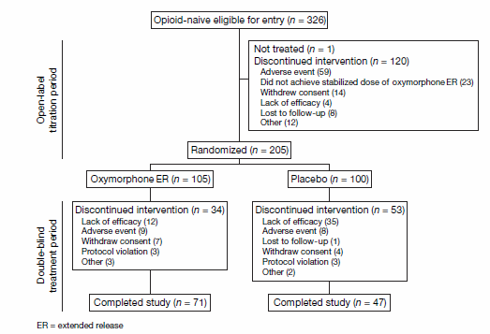
Enriched enrollment randomized withdrawal design
Katz et al., Curr Med Res Opin. 2007
Notes:
The essential differences between a classical analgesic RCT and the EERW design is the shift in the point of randomization. In the classical RCT the patient is randomized before receiving trial therapy, while the patient is openly titrated with active treatment under study and is only randomized when satisfactory efficacy at worst tolerable adverse affects are established.
Study drug is titrated to effect in all patients meeting inclusion criteria during the enrichment phase to identify responders. This first phase of the EERW closely mimics clinical practice. Patients unresponsive to the drug or experiencing unacceptable side effects are discontinued.
The second phase then uses the conventional randomization to active treatment and placebo allowing for a conventional test of efficacy in a population more likely to respond to the drug of investigation. Most common efficacy measures are differences in pain scores or loss of treatment effect in groups randomized to active treatment or placebo.

Slide 7
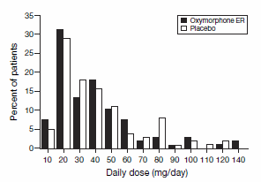
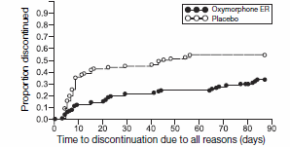
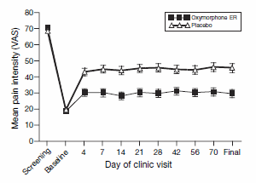
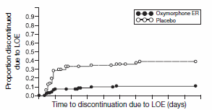
Enriched enrollment randomized withdrawal design
Katz et al., Curr Med Res Opin. 2007
Notes:
The essential differences between a classical analgesic RCT and the EERW design is the shift in the point of randomization. In the classical RCT the patient is randomized before receiving trial therapy, while the patient is openly titrated with active treatment under study and is only randomized when satisfactory efficacy at worst tolerable adverse affects are established.
Study drug is titrated to effect in all patients meeting inclusion criteria during the enrichment phase to identify responders. This first phase of the EERW closely mimics clinical practice. Patients unresponsive to the drug or experiencing unacceptable side effects are discontinued.
The second phase then uses the conventional randomization to active treatment and placebo allowing for a conventional test of efficacy in a population more likely to respond to the drug of investigation. Most common efficacy measures are differences in pain scores or loss of treatment effect in groups randomized to active treatment or placebo.

Slide 8
Enriched enrollment randomized withdrawal design
Strength:
Characterize drug response in clinically relevant way
Increased assay sensitivity
Limited exposure to placebo
Criticism:
Generalizability
Carry-over effects
Unblinding
Notes:
The major advantages of the withdrawal approach appear to be the ethical imperative of minimizing patient exposure to placebo, greater likelihood of demonstrating differences between drug and placebo (decreased false-negative trial rate), and decreased non protocol drop-outs, resulting in greater internal validity of the trial. The major caveats that have been expressed²⁰ include lack of ability to compare patients with regard to a clinically understandable outcome measure (e.g., average pain intensity), questions about generalizability of the results and, for some critics, an unsettling circularity, in which the benefit of treatment is shown in patients in whom benefit has already been demonstrated. (Katz Neurology)

Slide 9
Ideal proof of concept study
High assay sensitivity
Rapid enrollment
Short duration of patient participation
Limit exposure to ineffective therapy
Notes:
Accepting that patients vary widely in response to an analgesic intervention proposing pharmacological profiling as an integral part of phase II and III trials seems to be a reasonable proposition.

Slide 10
Problems of EERW
Un-blinding due to prior exposure to active treatment during EE-phase
Carry-over effects due to withdrawal during RW-phase
Extrapolation to the population at large (regulatory problem; overestimation of treatment effect if incl. in meta-analysis)
Greater sensitivity requires fewer patent in randomization phase. However, this ignores sample size requirement for enrichment phase. Unclear whether EEWR is more efficient than traditional design regarding sample size, time to study completion, financial resources.
Lack of AE-events estimates in general population as AE during EE-phase result in non-inclusion in RW-phase
Notes:
Generalizability concerns may be more relevant for phase III than phase II proof-of-concept studies.
Adding a small placebo group in EE-phase may allow accurately estimating drug-related incidences of AE

Slide 11
Methodical issues of EERW
Types of binding during EE-phase
Duration of EE and RW-phase (onset and max analgesic benefit as a function of time; loss of therapeutic effect as a function of PK or PD)
Rate of titration during EE-phase
Definition of positive drug response (recruitment efficiency versus power
Primary outcome: composite index versus pain inetnsity
Notes:
Development of detectable versus full analgesic effect may be of different importance for phase II (detectable) and III (full) trials.

Slide 12
EERW – points of discussion
Recommendations for EEWR versus RCT
Recommendations as to when and how to implement EERW?
Formal assessment of placebo effects
Effectiveness? Cost, duration, recruitment, etc
Notes:
Measuring placebo effect:
Asses per patient the expected benefit, beliefs about study drug, level od desire for pain reduction and posthoc assessment of guessed group assignment

Slide 13
Pharmacological profiling
Implicit:
Explicit:
Inclusion/exclusion criteria
Characteristics of patient population
Enriched enrollment design
Single occasion drug exposure
Single ⇒ combined therapy (Rehm 2010)
Notes:
This slide provides a summary of the most important findings of studies examining pain sensitivity in former addicts on methadone maintenance therapy. These patients are more sensitive to CPP but not other tested pain modalities. Findings are contrasting with data reported in animals. It is unclear whether an increased sensitivity to CCP is a trait predisposing to drug abuse or alternatively, a consequence of opioid therapy. As such data remain inclonclusive and do not firmly establish that former addicts on methadone maintenance suffer from OIH.

Slide 14
Implicit or partial enrichment
Examples:
Sponsored studies on gabapentin and pregabalin used prior responsiveness of the neuropathic pain symptoms to gabapentin as a disclosed inclusion criteria (McQuay, Pain 2008)
Gabapentin extended release tablets for post-herpetic neuralgia excluding patients previously failing gabapentin therapy (Wallace, Clin Drug Investig 2010)
Fentanyl nasal spray for cancer breakthrough pain in patients responsive to chronic opioid therapy (Portenoy, Pain 2010)
Buprenorphine transdermal patch for LBP excluding patients “refractory” to opioid therapy or with “anticipated high dose requirements (Gordon, Pain Res Manage 2010)
Notes:
Other sources:
Quessy Pain 2010: Pre-approval trials of rofecoxib and celecoxib in OA and RA enriched for patients with Hx of NSAID benefit and flare response during NSAID washout in a run-in phase. Similar approaches for opioid trials by including patients profiting from chronic opioid therapy and flare response.

Slide 15
Implicit or partial enrichment
Impact of partial enrichment on assay sensitivity is unclear (e.g. Straube et al., Br J Clin Pharmacol 2008)
Detailed reporting of enrichment process and extent of enrichment is required
Considering comprehensive characterization of patients with respect to their previous medication history

Slide 16
EEWR design: Assay sensitivity
FDA perspective on trials for acute depression: Classical RCTs ~50% failure rate, even with drugs known to be effective, while EERW were almost invariably successful [Temple, Clin Pharmacol Ther 2010]
Pain
NNT for 50 % relief of neuropathic pain with pregabalin 5.4 → 4.2 [Finnerup, Pain 2005]
Average effect size (11-point NPRS) for trials using opioids for chronic pain 1.1 (range 0.7-2.0) → 1.7 (range 1.3-2.3) [Katz, Clin J Pain 2009]
However, no difference in average effect size (Cohen) for RCT and EEWR trials using opioids for non-malignant chronic pain: 0.56 (0.38-0.73; 95%-CI) versus 0.60 (0.49-0.72; 95%-CI) [Furlan, Pain Res Manage 2011]
Notes:
Finnerup: Enrichment by excluding patients who previously failed to respond to gabapentin
Katz: Analysis of 17 parallel RCT and 5 EERW
Furlan: Meta-analysis of 50randomized trials (11 EERW)

Slide 17
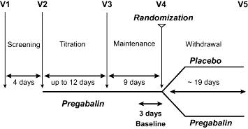
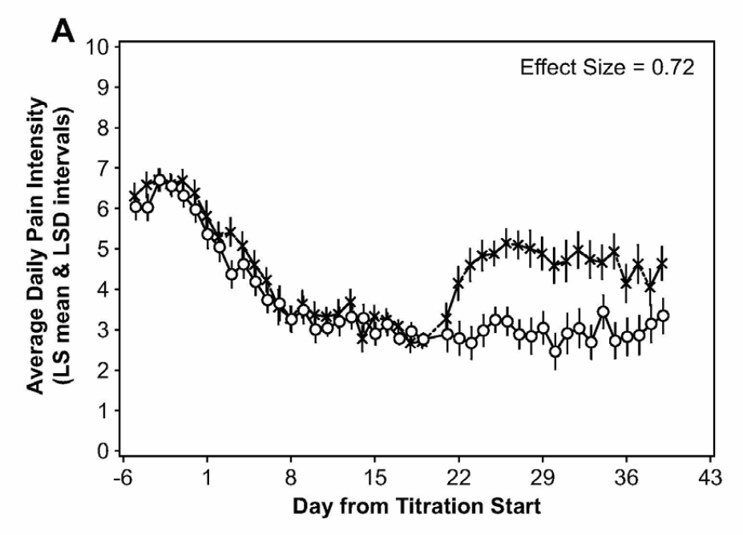
EEWR design: Assay sensitivity
Hewitt et al., Pain 2011
Notes:
Impact of responder definition on the enriched enrollment randomized withdrawal trial design for establishing proof of concept in neuropathic pain
First trial including all patients in RW-phase regardless of response during EE-phase and stratifying them in outcome analysis based on responder characteristics.
Trial characteristics: Different neuropathic pain conditions (preponderance of PDN but also PHN, small-fiber neuropathy and idiopathic sensory neuropathy); Current analgesic therapy continued (stable); rescue medication (acetaminophen) allowed during titration phase
Screening: Including patients with average daily pain score equal or greater 5/10
EE-phase: 50mg pregabalin tid to max of 200 mg tid (or max tolerable side effects) with dose increase by 50 mg q 3 days
Primary endpoint: Mean average pain intensity during last 3 days of RW-phase compared to 3 last days of EE-phase
Secondary endpoint: Time to efficacy failure as defined by a pain score equal or greater 4/10 and an increase of pain by at least 30% compared to pain at the beginning of the RW phase on any of 3 consecutive days. Efficacy failure was reached by >50% in placebo group within 6 days of RW-phase, while less than 30% in the pregabalin group reached it at the end of the RW-phase.
Drop out rate during EE-phase of about 30% suggests that increased power (1.7-2.0-fold) would allow decreasing the total number of subjects enrolled for the trial.

Slide 18
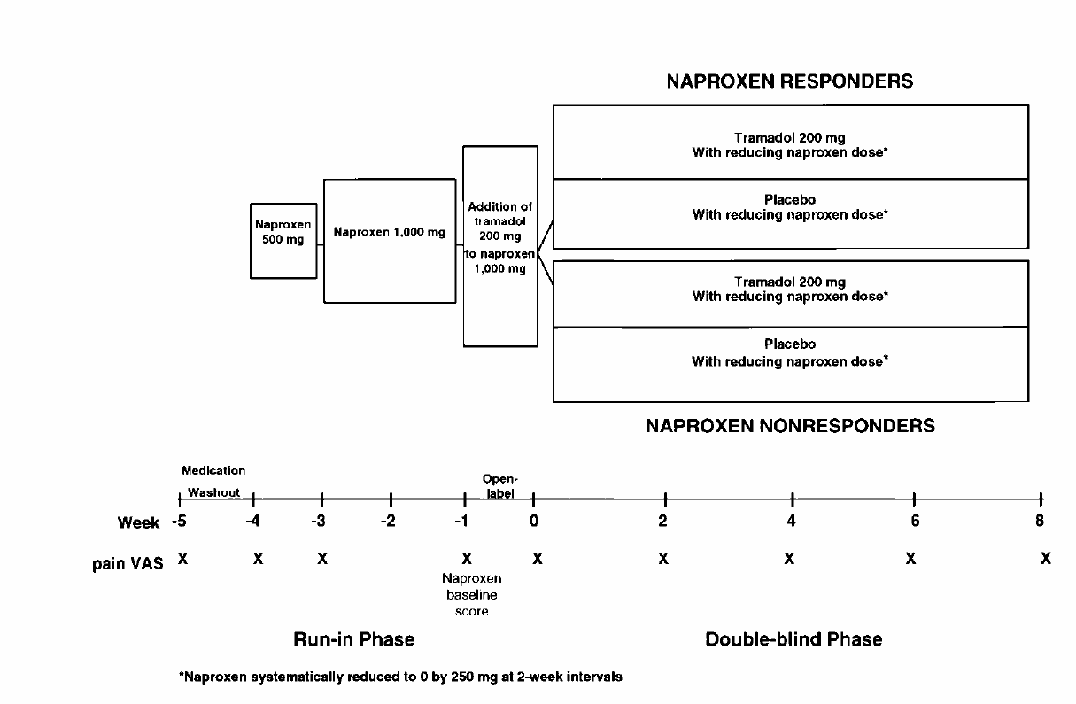
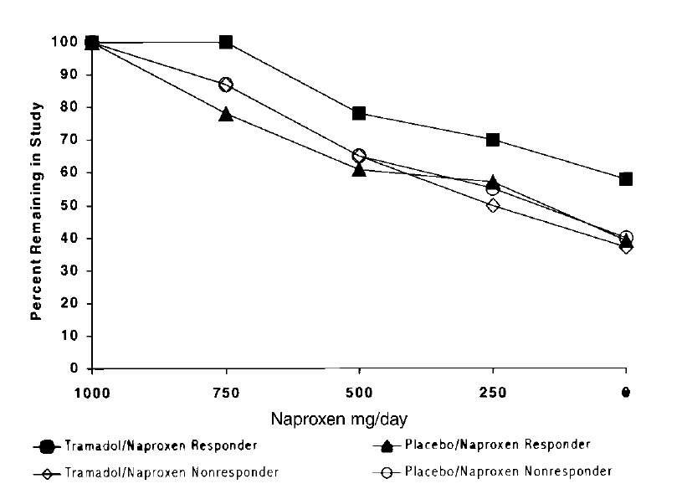
EEWR design: Assay sensitivity
Schnitzer et al., Arthritis & Rheumatism 1999
Notes:
Aim: Test whether addition of tramadol allows reduction of naproxen dose among patients with naproxen-responsive OA of the knee
Patients: Painful OA of knee and on stable dose of any NSAID
Washout: Continued if pain >40/100 and >20 than before washout (pain in OA knee during the last 48h)
Naproxen 500 mg: Continued if pain >20/100
Naproxen 1000 mg: 2 weeks of naproxen and then 1 week of naproxen plus 200 mg tramadol.
Responder definition: Assessed 2 weeks after exposure to naproxen 1000 mg and defined as pain <40/100 and at least 20/100 lower than at end of washout.
Naproxen withdrawal phase: reduction by 250mg/day every 2 weeks.
Outcome: Minimal effective naproxen dose; adequate defined as pain <40/100 and increase < 20 compared to pain at entry into naproxen dose reduction phase (or inadequate pain relief at any time)
PROBLEM: PAIN AT EENTRY INTO NAPROXEN DOSE REDUCTION PHASE N WAS ABOUT 20/100 IN NAPROXEN RESPONDERS BUT ABOUT 45/100 IN NAPROXEN NON-RESPONDERS.
Trial condition: No other pain medications allowed.

Slide 19
Pharmacological phenotyping: Intravenous infusion techniques
IV adenosine → IV adenosine for various NP
IV lidocaine → oral mexiletine for various NP
IV ketamine → oral dextromethorphan for fibromyalgia, NP, and nociceptive pain
IV phentolamine → regional sympatholysis with guanethidine for CRPS

Slide 20

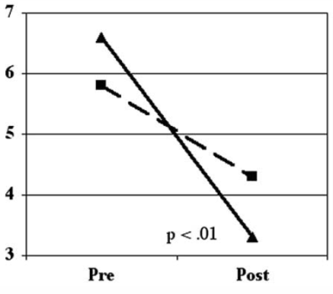
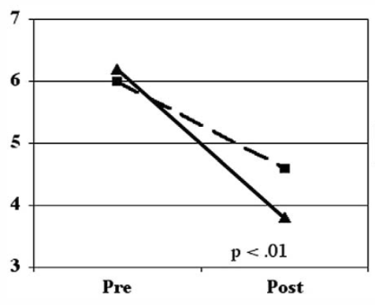
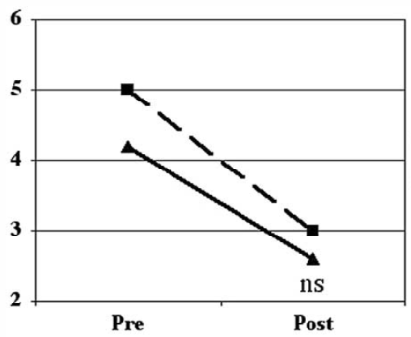
Phenotyping: IV adenosine – IV adenosine
EERW design in patients with various NP
EE-phase: open label 60-min infusion of 50ug/ml adenosine in 66 patients
41 patients with positive response (>30% pain relief)
23 patients randomized to dbl cross-over including placebo
Assessment of spontaneous pain, pin-prick hyperalgesia, and brush allodynia after infusion
Assessment of spontaneous pain at day 1, 7, and 14
Significant drug effect on spontaneous pain and pinprick hyperalgesia; effect sustained over 2 week period.
Spontaneous pain
Pinprick hyperalgesia
Brush allodynia
Lynch et al., Pain 2003
Notes:
Approaches other than the described EERW for pharmacological phenotyping have been relatively spares. A single study formally exploited the EEWR design using a single dose administration.
Trial characteristics: patients with PDN, PHN, neuropathic oro-facial pain, posttraumatic/surgical neuropathic pain of > 6 months duration with allodynia, hyperalgesia or both.
Open-label EE-phase with response criteria of >30% pain reduction during adenosine IV infusion over a period of 60min (50ug/kg/min) (62% response rate)
Double-blind cross-over design (2-week interval) in 23 responders assessing spontaneous pain, allodynia and hyperalgesia after infusion, and 1 d, 1 w and 2 w after infusion.
Adenosine modestly but significantly reduce spontaneous pain and pinprick hyperalgesia but not brush evoked allodynia. Effects were maintained for 2 weeks.

Slide 21
Phenotyping: IV ketamine – oral dextromethorphan
Low-dose IV ketamine infusion (0.1 mg/kg) in a) 34 patients with fibromyalgia and b) 56 patients with worsening nociceptive or neuropathic pain and on a stable opioid dose
Oral dextromethorphan titrated up to 1 mg/kg tid 1-2 weeks later during a 2-week period
Pain scores recorded before and after ketamine infusion and before and after dextromethorphan titration
Positive responses: 67% decrease of pain during ketamine infusion and 50% decrease in pain in response to dextromethorphan
Cohen et al., J Pain 2006 & J Pain Symptom Manage 2009

Slide 22
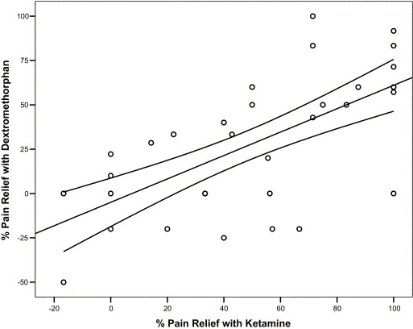
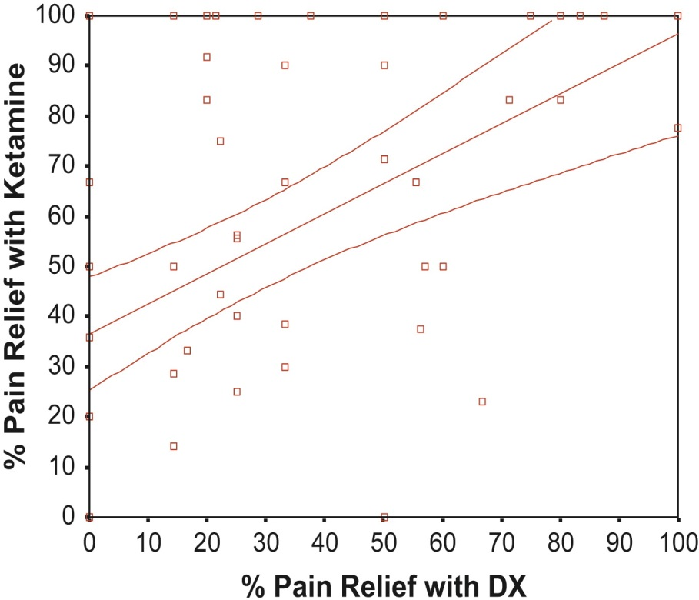
Phenotyping: IV ketamine – oral dextromethorphan
R=0.66
R=0.54
Cohen et al., J Pain 2006 & J Pain Symptom Manage 2009

Slide 23
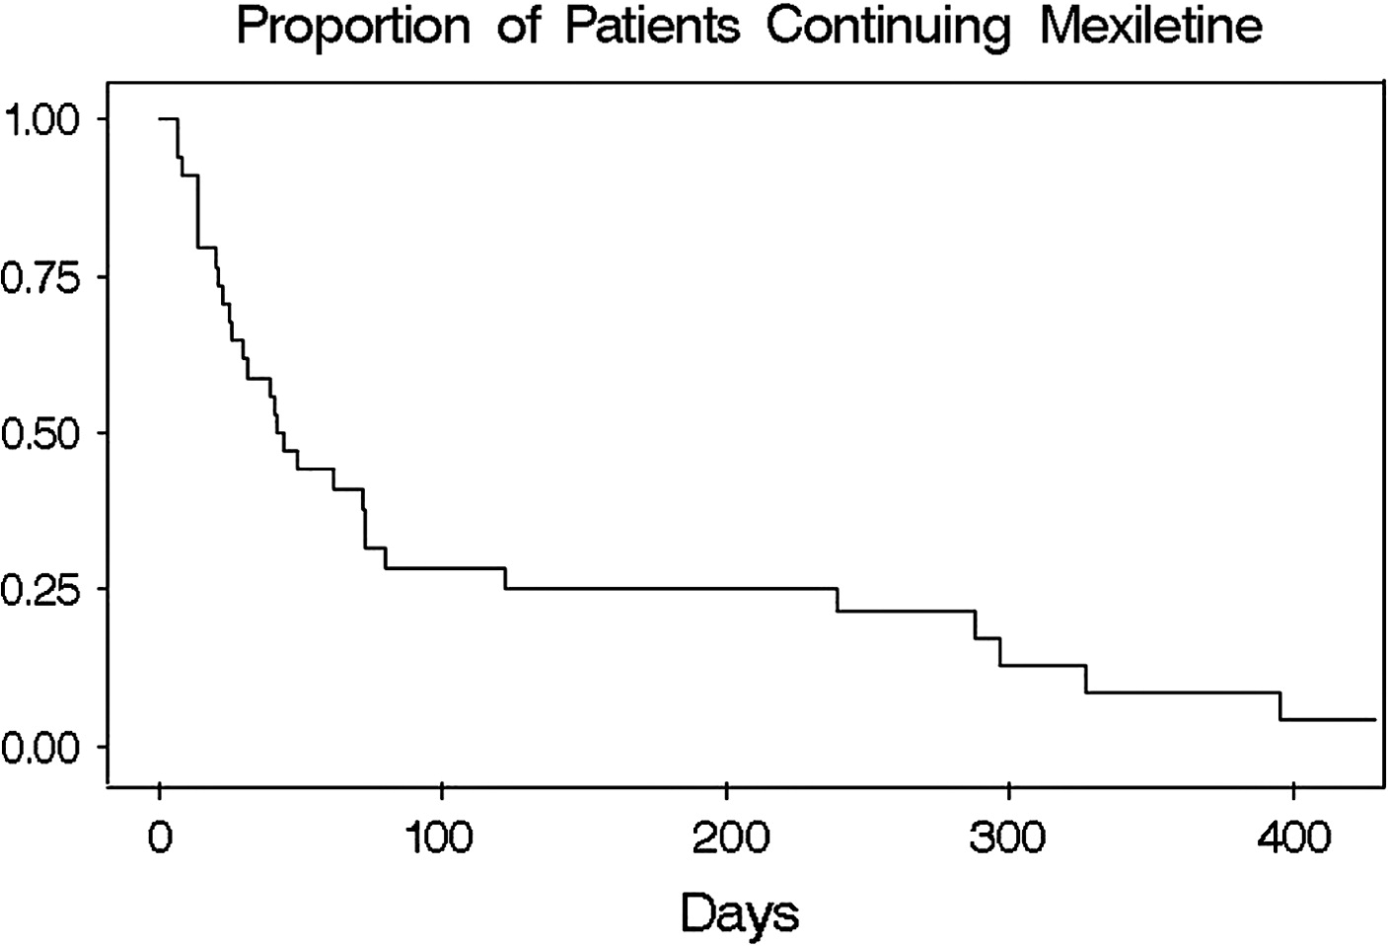
Phenotyping: IV lidocaine – oral mexiletine
Two separate IV lidocaine infusions (2 and 5 mg/kg 1-w apart in 9 patients with NP
1 week following 2nd infusion oral mexiletine titration up to 1200 mg/day over 4-w period
Pain relief reported during lidocaine and mexiletine treatment correlated significantly (R=0.58).
Separate study: Magnitude of analgesic response to IV lidocaine in 37 patients with NP predicted time to discontinuation of mexiletine
Each 20% decrease in analgesic response increased rate of discontinuation by 30%
Galer et al., J Pain Symptom Manage 1996 ; Carroll et al., J Pain Symptom Manage 2008

Slide 24
Pharmacological phenotyping: Topical techniques
Lidocaine → capsaicin for PHN
Capsaicin → clonidine for PDN

Slide 25
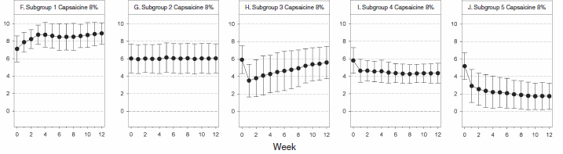
Phenotyping: Lidocaine → capsaicin for PHN
Analysis of response patterns to administration of topical capsaicin 8% in 722 patients with PHN to determine presence of significant predictors
5 distinct patterns detected (non-responders [2], partial responders [1], responders [2])
Lidocaine pretreatment efficacy predicted efficacy of capsaicin 8%: Complete relief → 70% and 15% probability to be responder/non-responder Elevated pain → 25% and 51% probability to be responder/non-responder
Martini et al., Eur J Pain 2013
Notes:
Approaches other than the described EERW for pharmacological phenotyping have been relatively spares. A single study formally exploited the EEWR design using a single dose administration.
Trial characteristics: patients with PDN, PHN, neuropathic oro-facial pain, posttraumatic/surgical neuropathic pain of > 6 months duration with allodynia, hyperalgesia or both.
Open-label EE-phase with response criteria of >30% pain reduction during adenosine IV infusion over a period of 60min (50ug/kg/min) (62% response rate)
Double-blind cross-over design (2-week interval) in 23 responders assessing spontaneous pain, allodynia and hyperalgesia after infusion, and 1 d, 1 w and 2 w after infusion.
Adenosine modestly but significantly reduce spontaneous pain and pinprick hyperalgesia but not brush evoked allodynia. Effects were maintained for 2 weeks.

Slide 26
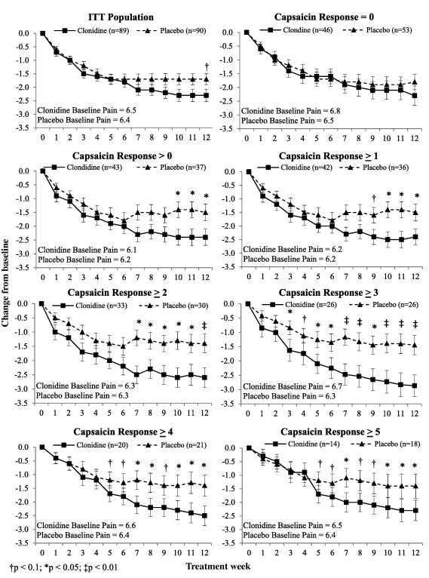
Phenotyping: Capsaicin → clonidine for PDN
179 patients with PDN randomized to 12-w therapy with 0.1% topical clonidine or placebo gel
Nociception function assessed by response to topical capsaicin 0.1% during screening
Primary outcome: Difference in foot pain at 12-w in relation to baseline
In subjects who felt any level of pain to capsaicin clonidine was superior to placebo, while the effect was not significant in the study population at large
Campbell et al., Pain 2012

Slide 27
Accelerated EEWR

Slide 28

Thank you
Stanford University

Slide 29
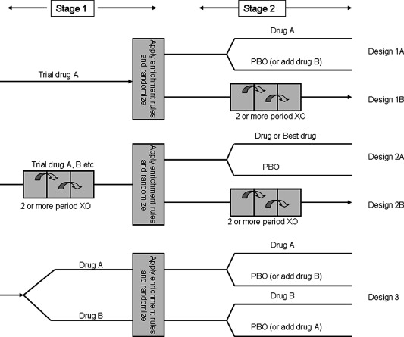
Enriched enrollment randomized withdrawal design
Quessy, Pain 2010
Notes:
While almost half of the trials follow the basic design, more complex designs have been introduced including
Multiple randomized cross-over periods during stage two (cancer break through pain)
Placebo-controlled cross-over during stage one and possibly stage 2
Randomization to two different active treatments during stage 1

Slide 30
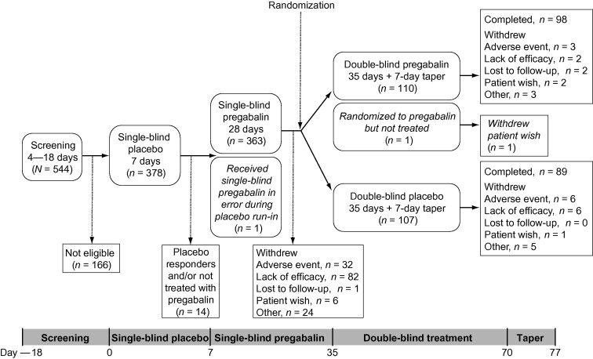
Enriched enrolment design: Pregabalin in radicular NP pain
Baron et al., Pain 2010

Slide 31
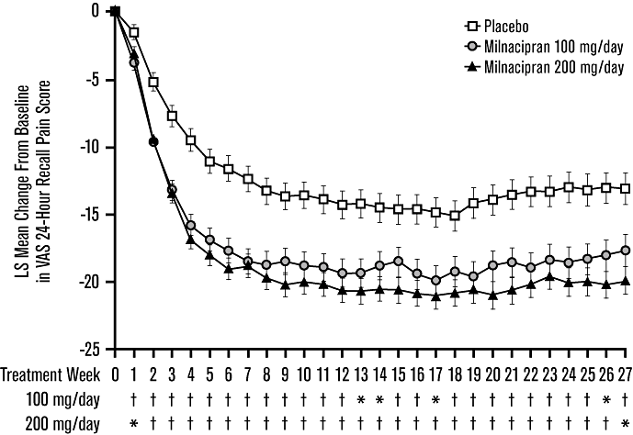
Onset of treatment effect: Milnacipran in fibromyalgia
Geisser et al., Pain Practice 2010

