Slide 1
General Considerations for Analgesic Risk-Benefit Analyses
Nathaniel Katz, MD, MS
Analgesic Solutions, Natick, MA
Tufts University School of Medicine, Boston, MA

Slide 2
Potential benefits of quantitative risk-benefit integration
Communicating the probability of a good overall response
Patients and clinicians choice of best overall drug
Regulatory decisions: do the benefits of this drug outweigh the risks?
Market access and reimbursement: which drug should be first tier? How much is this drug worth?

Slide 3
Risk-Benefit Integration
BENEFIT
RISK-BENEFIT
RISK

Slide 4
The ingredients: efficacy
Pain intensity reduction
Pain relief
Physical function
Sleep
Psychosocial function
Attention and cognition
Vitality

Slide 5
Pain-Activity Composites in OA Celecoxib vs. Placebo
P=.115
N=43
Pain alone: >20% improved from baseline; liberal: pain improved >20% OR activity improved >10%; conservative: pain pain improved >20% OR activity improved >10% WITHOUT deterioration in the other measure.

Slide 6
Ingredients: safety
Common burdensome side effects
Nausea, vomiting, dizziness, dyspepsia, sexual dysfunction
Uncommon severe side effects
Short-term: anaphylaxis, Stevens-Johnson syndrome
Long-term: NSAID-induced GI bleeding, addiction/overdose

Slide 7
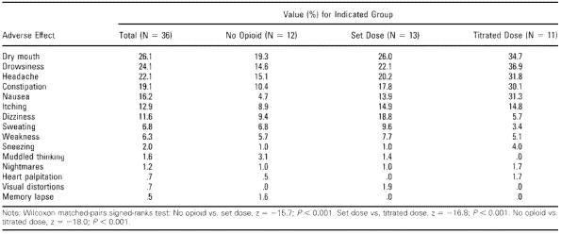
Opioid side effects are not just events
Jamison RN, Spine, 1998

Slide 8
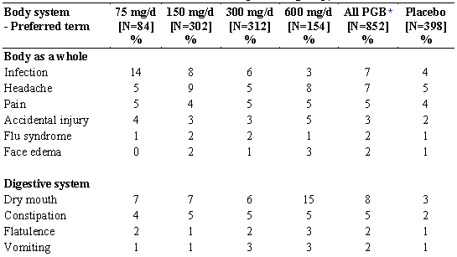
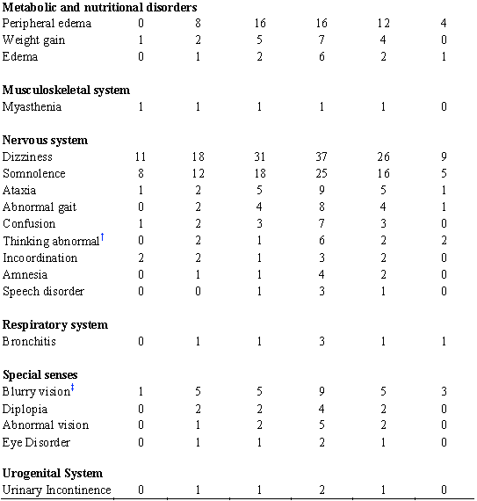
Pregabalin Safety Information
“A majority of … patients had adverse reactions with a maximum intensity of “mild” or “moderate.”
“14% of patients treated with Lyrica withdrew prematurely due to adverse events”

Slide 9
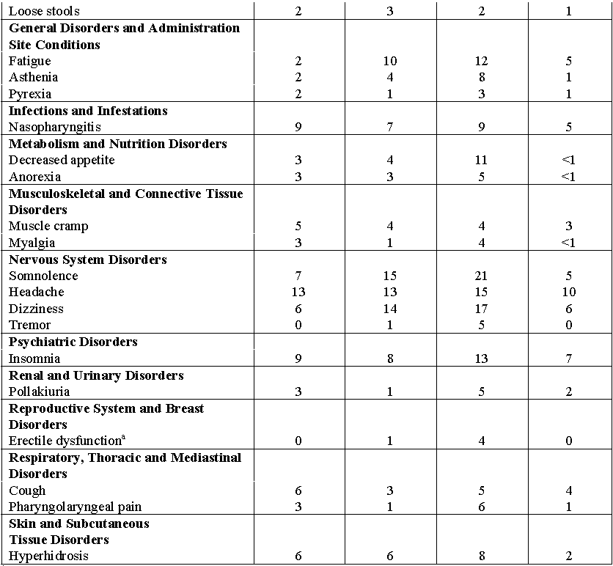
Duloxetine Safety Information
Treatment-Emergent Adverse Reactions Incidence of 2% or More in DPNP Placebo-Controlled Trials
No mention of adverse event intensity
14.3% of the patients who received duloxetine in placebo-controlled trials for DPNP discontinued treatment due to an adverse reaction

Slide 10
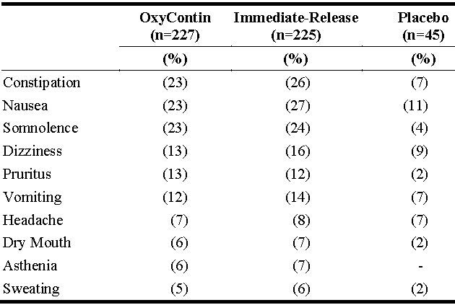
Oxycontin Safety Information
Adverse events reported in >5% of patients (unclear which trials, what duration)
No mention of adverse event intensity
<1%: Reproductive system and breast disorders: amenorrhea, decreased libido, impotence
No mention of dropouts due to AEs
Overdose, addiction mentioned, no rates

Slide 11
Safety Information
What we usually get
What we may not get
% of pts with >1 AE
% of pts with >1 SAE
% of patients with individual AEs
% of patients who drop out due to AE
% of pts with drug-related AEs
Consistency
AEs by intensity
Uncommon severe AEs
% of pts with ongoing side effect burden
Important symptoms that may be underreported

Slide 12
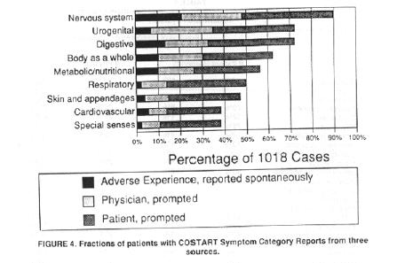
AEs Miss Important Side Effects
Anderson, Drug Inf J, 1994

Slide 13
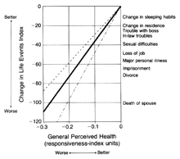
Symptom Distress Correlates to Moderate Stressful Life Events
Captopril vs. enalapril for HTN, n=379
Testa, NEJM, 1993

Slide 14
Approaches to Integration
Patient-level risk-benefit responder criteria
Integration of efficacy and tolerability as continuous variables
Co-primary endpoints on safety and tolerability

Slide 15
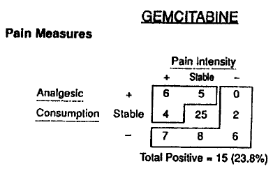
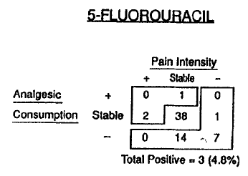
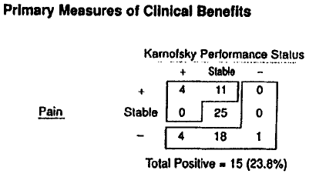
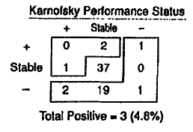
Gemcitabine vs. 5-FU for pancreatic cancer
Burris HA, J Clin Oncol, 1997

Slide 16
Within-patient composite benefit-risk response
Pros
Cons
Clinically intuitive
Face valid
Statistically simple
Regulatory precedents
Need to agree on appropriate safety response criterion
Dichotomania
Loss of statistical power

Slide 17
Bivariate Analyses
Better
Side effects
Better
Pain

Slide 18
Bivariate Analyses
Pros:
Intuitive
Statistically tractable
Challenges:
Need valid continuous measure of symptoms
What about different patterns of symptoms?
Is10-point shift in pain equivalent to10-point shift in symptoms?
Statistical tests may ignore direction of differences
Better
Side effects
Better
Pain

Slide 19
AEs >5% Oxycodone vs. Acurox in Bunionectomy
AE | Oxycodone 5mg (%) N=22 | Oxycodone 5 mg / Niacin 30 mg (%) N=22
Nausea | 36 | 18
Dizziness | 23 | 14
Flushing | 14 | 32
Pruritus | 27 | 23
Headache | 32 | 27
Paresthesia | 5 | 27
Sedation | 18 | 41
Fatigue | 5 | 32
And how do we measure up these against uncommon severe side effects?
FDA Briefing Package, April, 2010

Slide 20
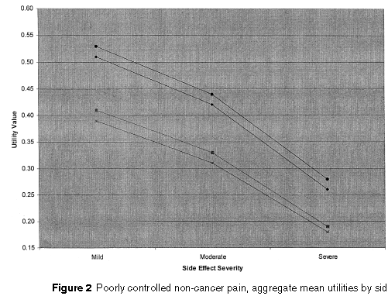
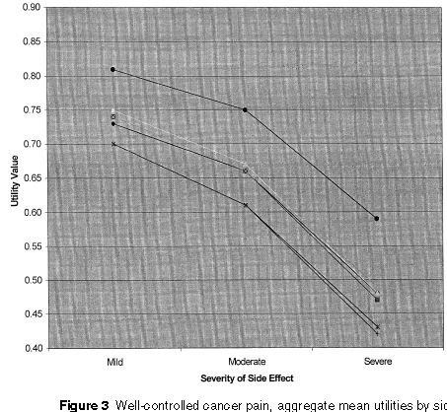
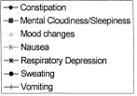
Utilities in chronic pain patients for pain relief and side effects
Schmeier JK, Pain Med, 2002

Slide 21
Conclusions
Integrated risk-benefit metrics could:
Help patients and clinicians understand likelihood of overall treatment benefit
Help compare treatments with diverse patterns of benefit, tolerability, and safety
Help regulators and payers make decisions
Methodological challenges include:
Identifying appropriate measures of benefit and risk
Weighting benefits, tolerability burdens, and severe adverse events in a common framework
Presenting the results in a clear and persuasive manner

